Slide 1

Twitter Sentiment Analysis Covid 19
Team DevDas

Slide 2



TWEETS
Collection and preprocessing of tweets along with integration of front end with backend
Workflow of Twitter Sentiment Analysis Dashboard
TRAINING OF MODEL
Classification and training of model.
FRONT END
Convert the UI design to functional webpages.
Twitter sentiment analysis of covid 19 Team DevDas

Slide 3
TWITTER SENTIMENT ANALYSIS OF
COVID 19
TEAM DEVDAS
Explanation Of Workflow (Process and Technology stack)

Slide 4
GEOGRAPHICAL LOCATION BASED SENTIMENT ANALYSIS
The emotions of a particular city or state is shown based on the graphs and which emotion dominates (i.e higher in percentage)
Ideation
CUSTOMISABLE WORD CLOUD
A word cloud will be formed based on the input word given and sentiments associated with it will be shown.
SOLUTION FOR TWITTER SENTIMENT ANALYSIS
ANALYSIS OF TWEETS IN ENGLISH AND DEVNAGRI SCRIPT, GOVERNMENT
ANNOUNCEMENTS
Team DevDas

Slide 5
CUSTOMERS
Target Audience
Team DevDas

Slide 6


COMPANIES
The government can understand and make obligatory changes or give assurance with their proposed solutions for quandaries concerning people.
REGIME ORGANISATIONS
The companies can draw a conclusion to strategise how to sell their products based on the sentiments analysed on the past data and understand the trend. The companies can even analyse their competitors

Slide 7


FINANCIAL MARKETS AND PUBLIC
In the field of medical with the help of word clouds and area based sentiments professionals can understand the gravity of the situation .
MEDICAL FIELD
The investors can also search for a brand and see how people are generally reacting to their products and what are the sentiments associated with it.

Slide 8
Future Scope
INCLUDE MORE
LANGUAGES AND
SCRAPPING OF DATA FROM NEWS
The government announcements can be scrapped directly from news websites and inclusion of more native languages
FINANCIAL MARKETS
The stock companies can ask to be notified about certain companies they select and emotions of people associated with those brands.
AI BASED
RECOMMENDATIONS
suggest what should a company do in the future based on past emotion analysis
Team DevDas

Slide 9
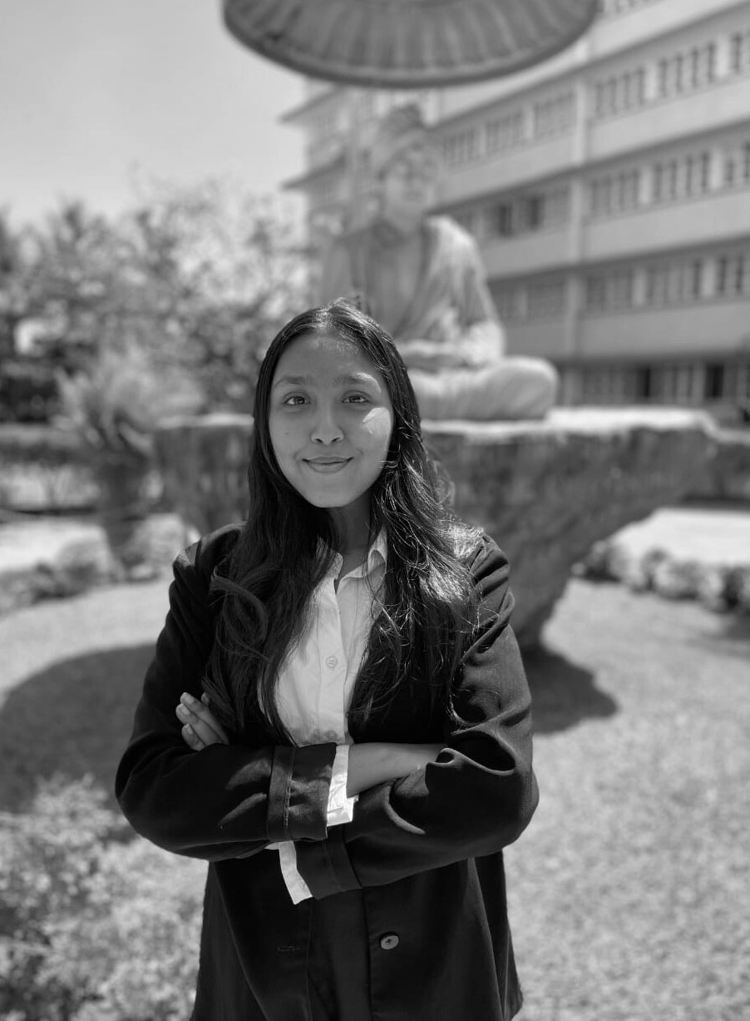
The Presenters
BHUVANA RAISINGHANI
UI DESIGNING AND DATA ANNOTATIONS (TEAM LEADER)
TEAM DEVDAS

Slide 10

The Presenters
Comstech • Oct. 15, 2020
DISHANK PODDAR
BACKEND AND FRONT END DEVELOPER
TEAM DEVDAS

Slide 11

The Presenters
Comstech • Oct. 15, 2020
SAURABH SATAVALEKAR
BACKEND AND FRONT END DEVELOPER
FROM GROUP 5

Slide 12
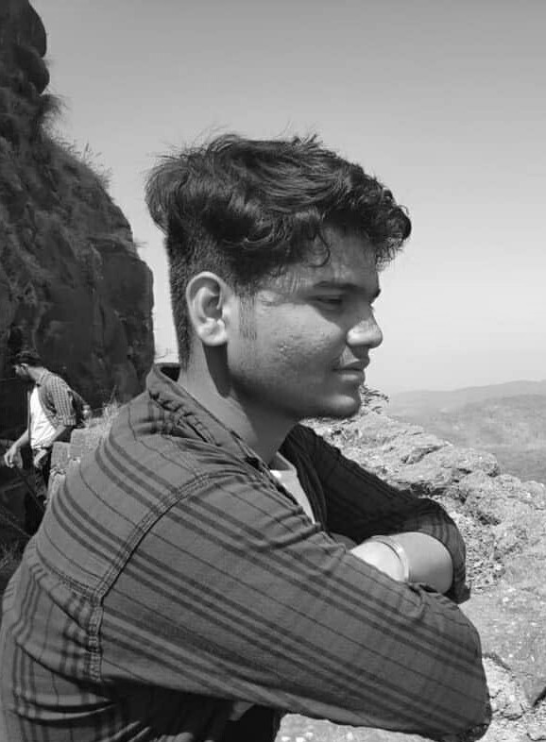
The Presenters
Comstech • Oct. 15, 2020
JAYESH WAGHMARE
FRONT END DEVELOPER
FROM GROUP 5

