Slide 1

Bot with Dots

Slide 2
Details of the Batch
We are 4 members in total
G Sumanth Naga Deepak --> my self
K Nikhil
Ch Akhil
A Keerthi
Project ID:SPS_PRO_616
Coming to Our Project , We did the project by taking the problem statements

Slide 3
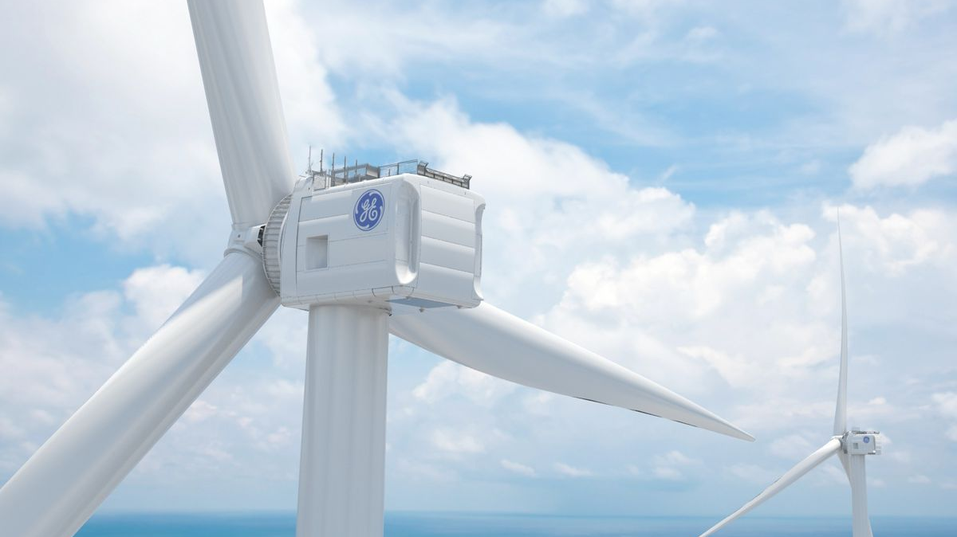
Predicting the Energy output of Wind Turbine based on Weather Conditions

Slide 4
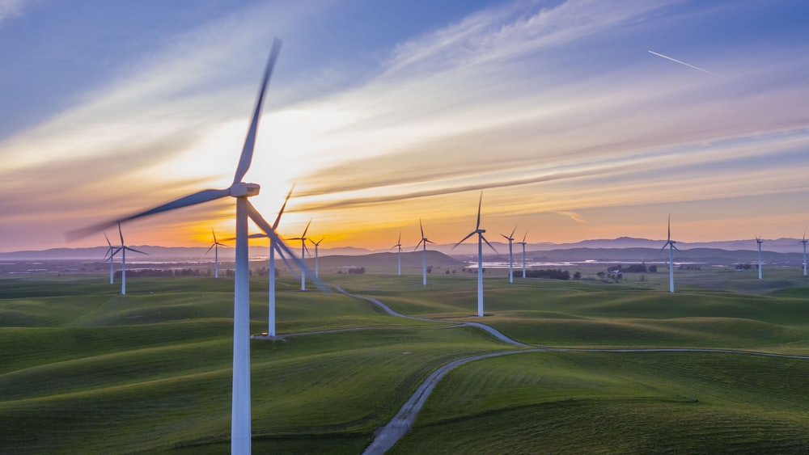
Scope of the project
This project comes under the business sector and Government Sector in other way.
This project can reduce the loss in the producing electricity from wind turbine before they build the turbines .
However they build a sample model before the construction so if they provided to our project it will predict where the construction is viable or not in that particular place .

Slide 5
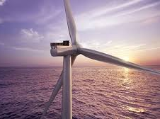
Project Details
Our 1st step in our project is data set which plays a key role in the whole project the will able to train and test the model
That important component is made by Akhil and Keerthi as .csv file .
It is purely prepared by them . Not downloaded anywhere from the google .
They did by gathering formulas and relations from the research papers.

Slide 6
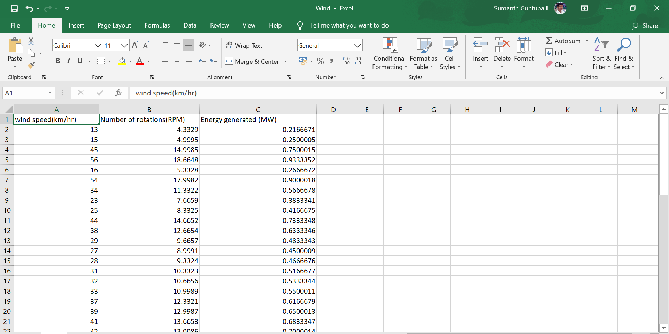
Data Set

Slide 7

Algorithm
We have consider the all algorithm’s present in Artificial Intelligence and finalized ANN is suitable for this project .
Because we can train as much we want by increasing the epochs and batch size to get good accuracy.
In the Artificial Neural Networks (ANN) we tried with activation functions like relu , softmax , sigmoid and tanh functions.
In those activation functions we got good accuracy with tanh function.
We have used keras to bulid the network .

Slide 8
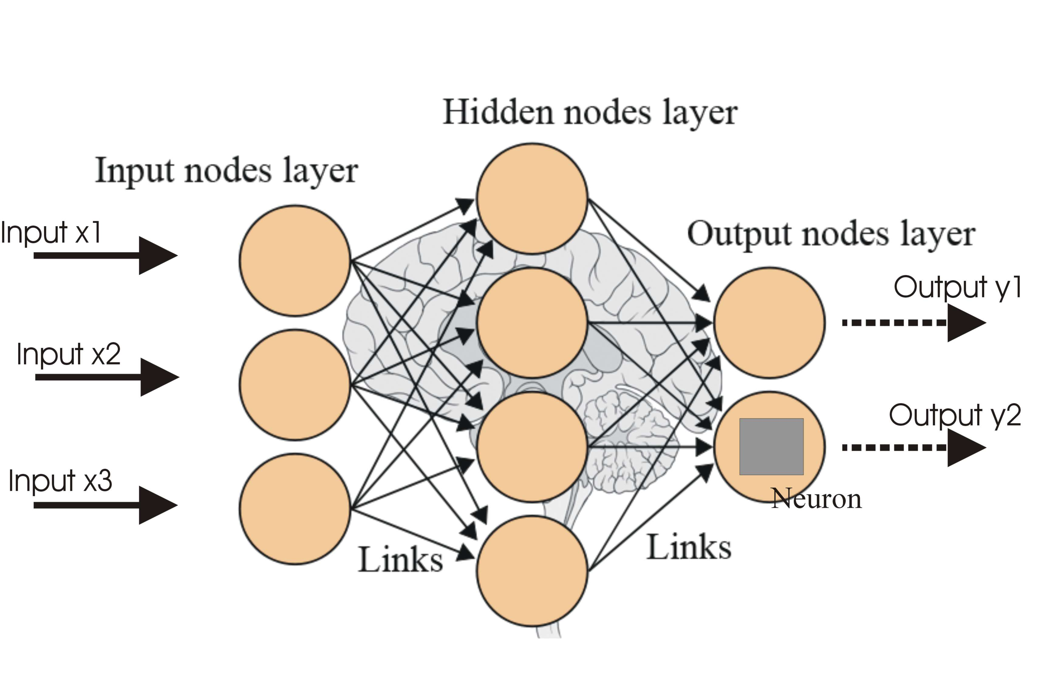
ANN

Slide 9


Chat bot
As the team name says “Bot with dots” we did a chat bot with the help of IBM cloud services
It is a static bot and we developed deployed in Node red .
Functionalities of the bot are as follows:
Welcome image
Greetings
Predictions

Slide 10
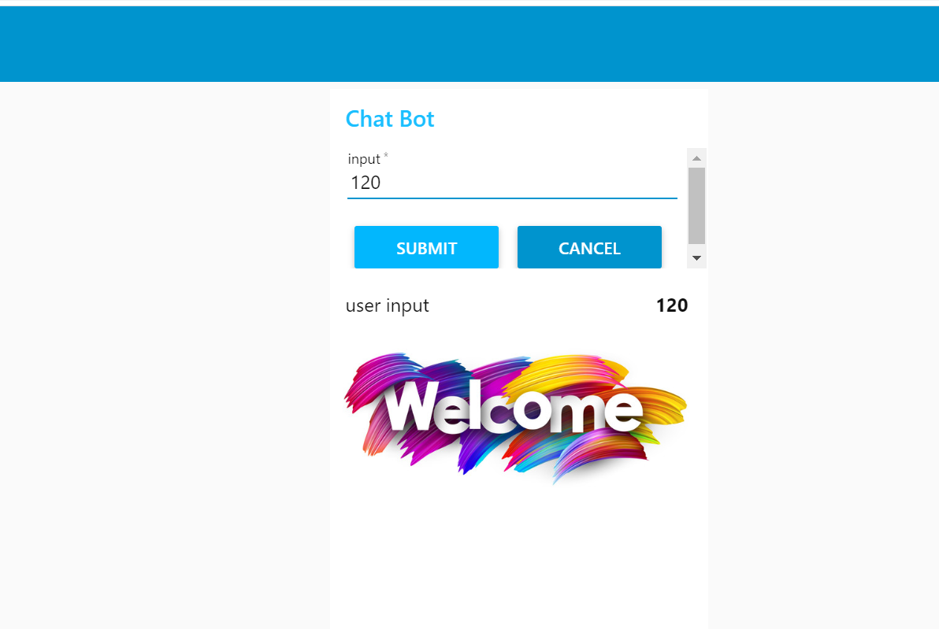
Chatbot

Slide 11
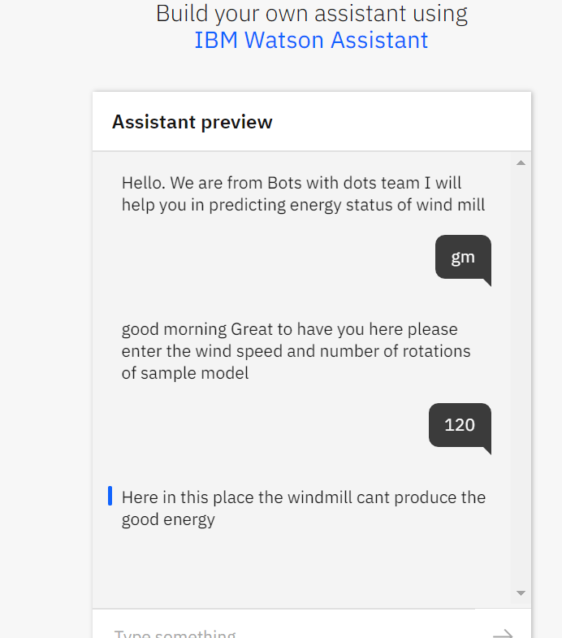
Chatbot

Slide 12
Watson Output:

Slide 13

Thank you

