Slide 1
RISK – FREE
TRANSIT SYSTEM
PRESENTED BY
M.VARSHAA
G.K.SHREE
G.KARISHMA

Slide 2
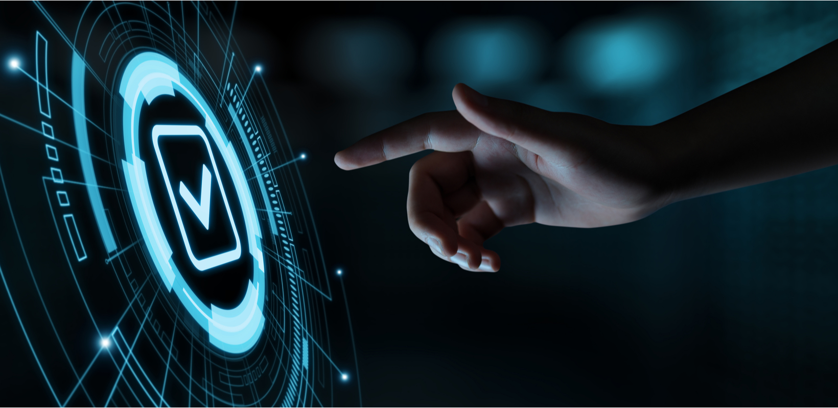
1
2
3
4
General
Description
Uniqueness
Social Impact
Scope of work
Temperature detector
Seat booking
Time scheduling
Post lockdown transit app
Effective way of
maintaining social
distancing
User Interface Design & Workings

Slide 3
Problem Statement :
Intelligent Post-Lock Down Public
Transportation Management System
Proper utilization of public transportation while efficiently maintaining social distancing, by following certain guidelines, is very crucial at this hour, to stay protected.
As the old normalcy is not attainable anytime soon, we have devised a logical approach to new normalcy involving integration of various independent services, to make way for safe transportation.
This approach involves creation of a platform / Solution for the bus operators to facilitate temperature check for the onboarding passengers, seat booking and time scheduling.

Slide 4
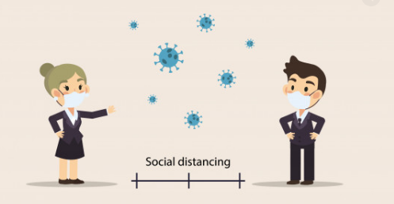
Covid-19 pandemic has toppled the world, impacting lives of millions and brought in unforeseen challenges. As part of the preventive measures, unprecedented changes to the global transportation system have been introduced
. Amidst the uncertainty, social distancing is believed to be the key to flatten the curve of this deadly pandemic. In times of the chaos, with the perspective of social distancing in mind, we propose a practical solution to enable a risk free transit system.

Slide 5

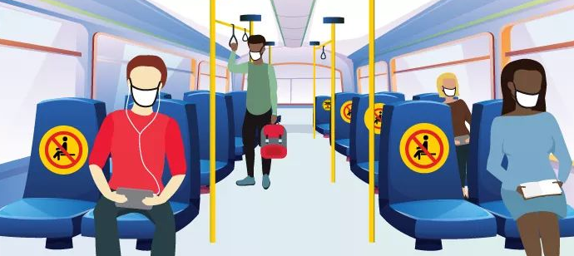
Uniqueness:
Temperature Detector
Seat Booking
Time scheduling
UPI Payment

Slide 6

Temperature Detector:
This app will detect the temperature from the IOT sensor & display it in the screen. If the temperature is higher than the normal body temperature (i.e.,>37°C), warning message will be displayed. This clearly gives a signal to differentiate between safe and unsafe passengers. Hence, only the safe passengers will be allowed to use the transport

Slide 7
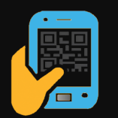
SEAT BOOKING:
Here the conductor will lock the seat for the passengers. Ticket Booking Page lets the ticket collector to book the tickets for people and also UPI payment gateway is added to further ensure the social contact.

Slide 8
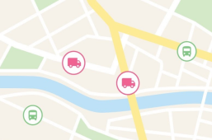
Time Schedule:
In this current situation, with people allowance limited to 60 % , Transport authorities will find it difficult to pickup all the people from a certain Point 1 To Point 5.
Time Scheduling ensures the Transport Authorities to pickup all the people from Point 1 To Point 5 by increasing the frequency of the bus between different points.
In Normal Situation, If 5 Buses operates between a certain point, New system ensures that 10 bus will operate to ensure all the people picked up with Social distance maintained.

Slide 9
UPI PAYMENT :
Payment for the booked seats can be received using online payment gateway also, through the app, by scanning the QR code. Bus operators will block the seat for the respective passengers, once the payment is made.
UPI Payment gateway are provided through App, So that passengers can easily avoid social contact and travel in a safe way.

Slide 10
Social Impact
Temperature detector:
This is an Automated Temperature Monitoring System. Where a system is installed in the entrance of the bus to monitor the people , which enables to filter out the higher temperature persons and ensures the people safety
UPI Payment Gateway:
UPI Payment gateway are provided through App, So that passengers can easily avoid social contact and travel in a safe way

Slide 11
SCOPE OF WORK:
RFTS
App
Login page
Home Page
Temperature detector
Seat Booking
Time Scheduling
QR Code

Slide 12
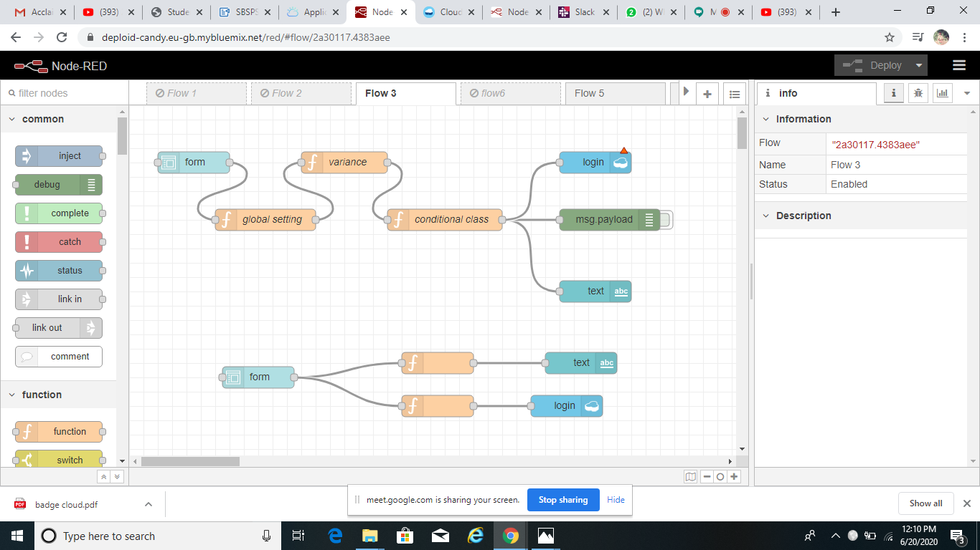
Node-red Flow For Login Page

Slide 13
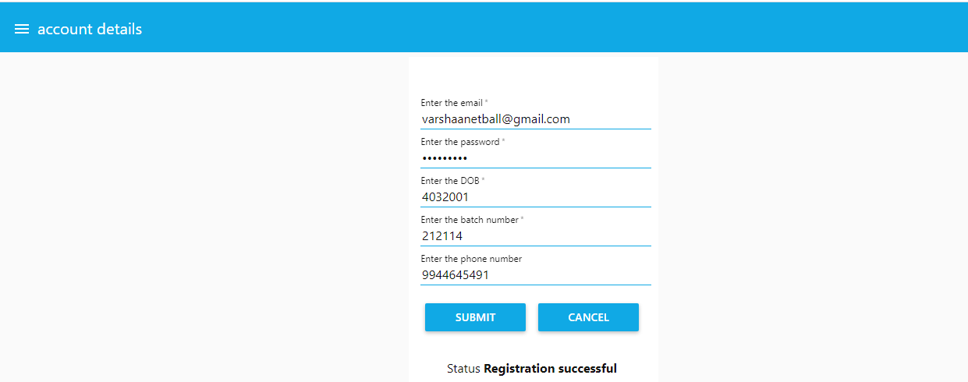
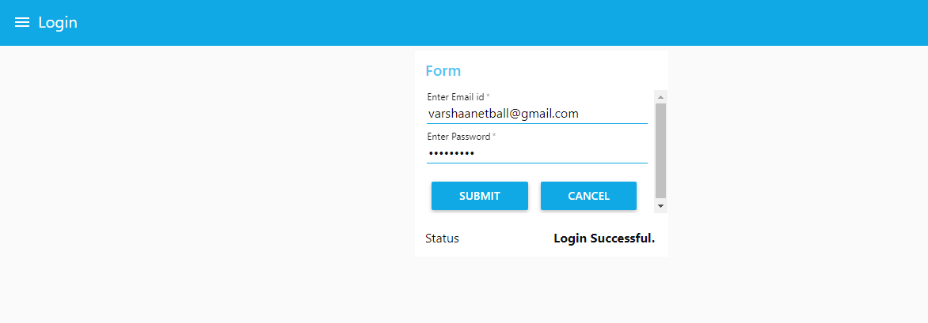

Slide 14
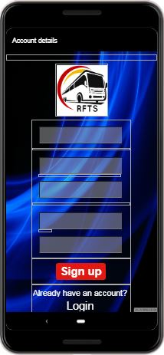
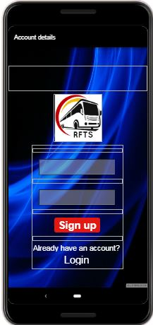
Login Page

Slide 15
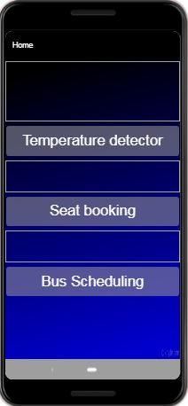
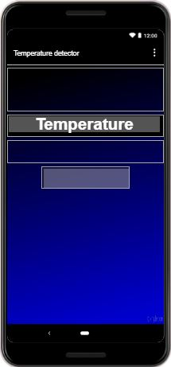
Home Page
Temperature Detector

Slide 16
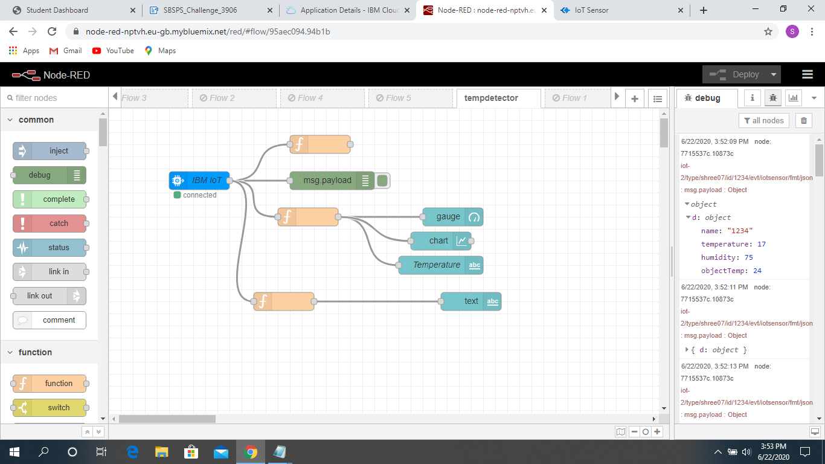
Node-red Flow For Temperature Detector

Slide 17
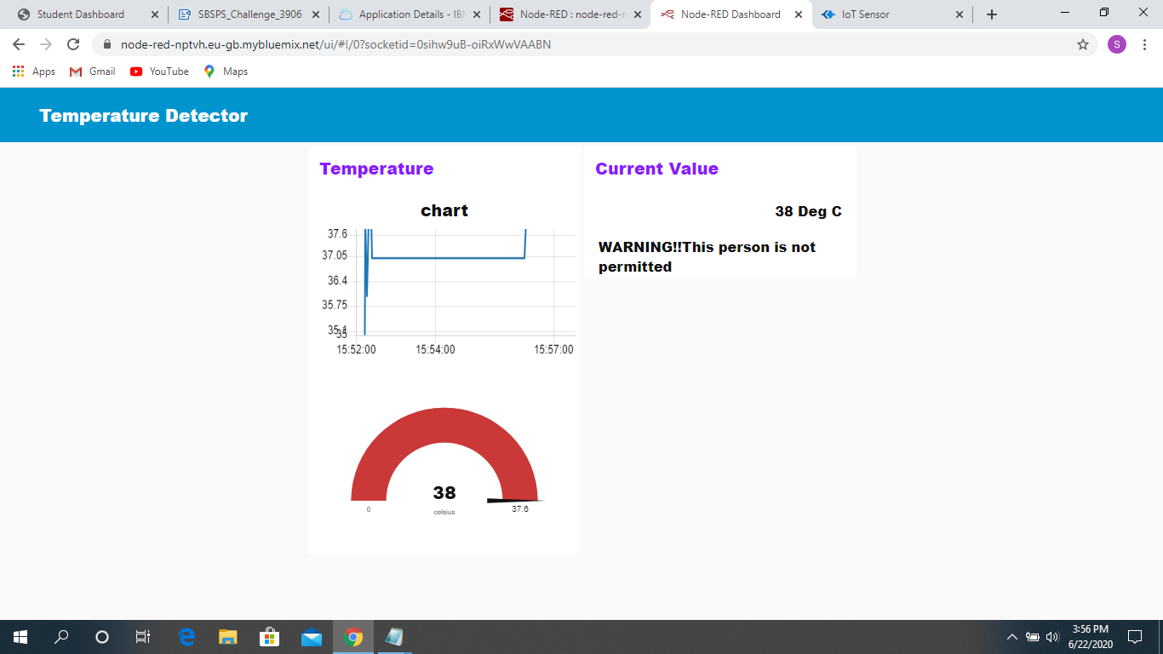
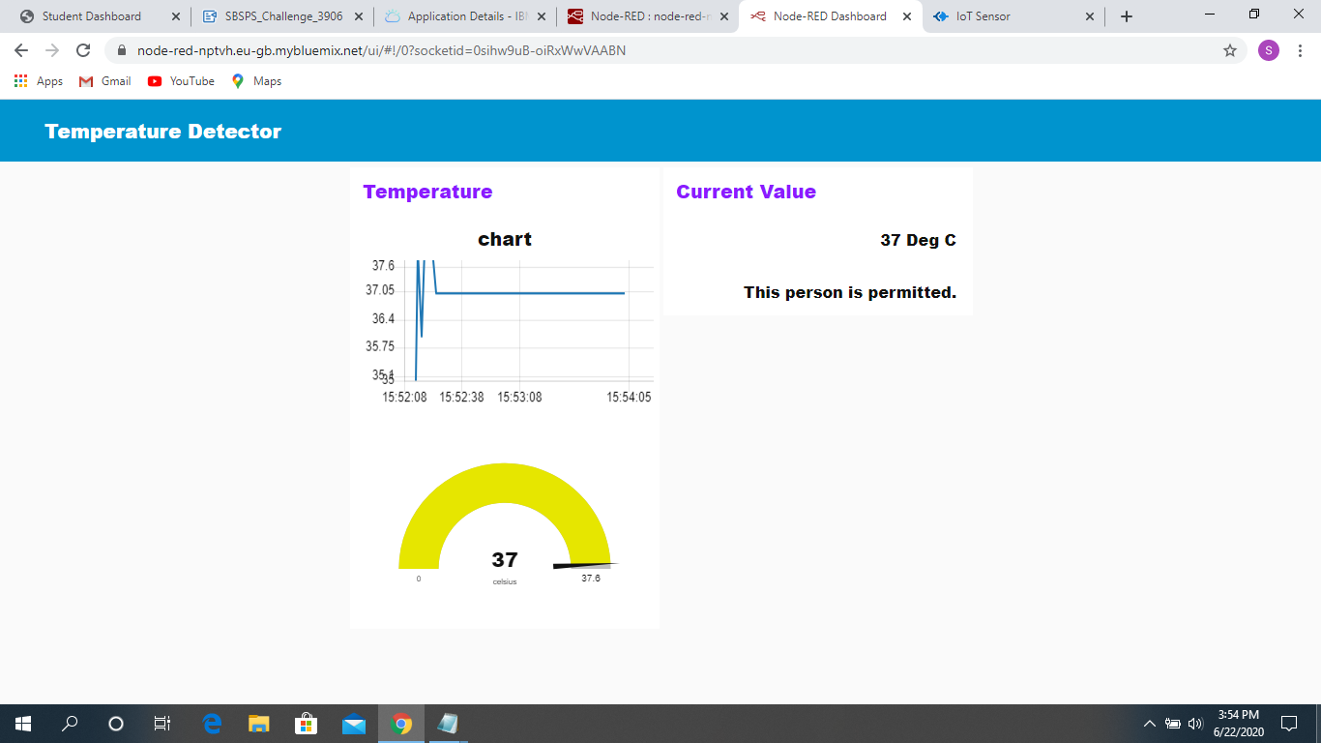

Slide 18
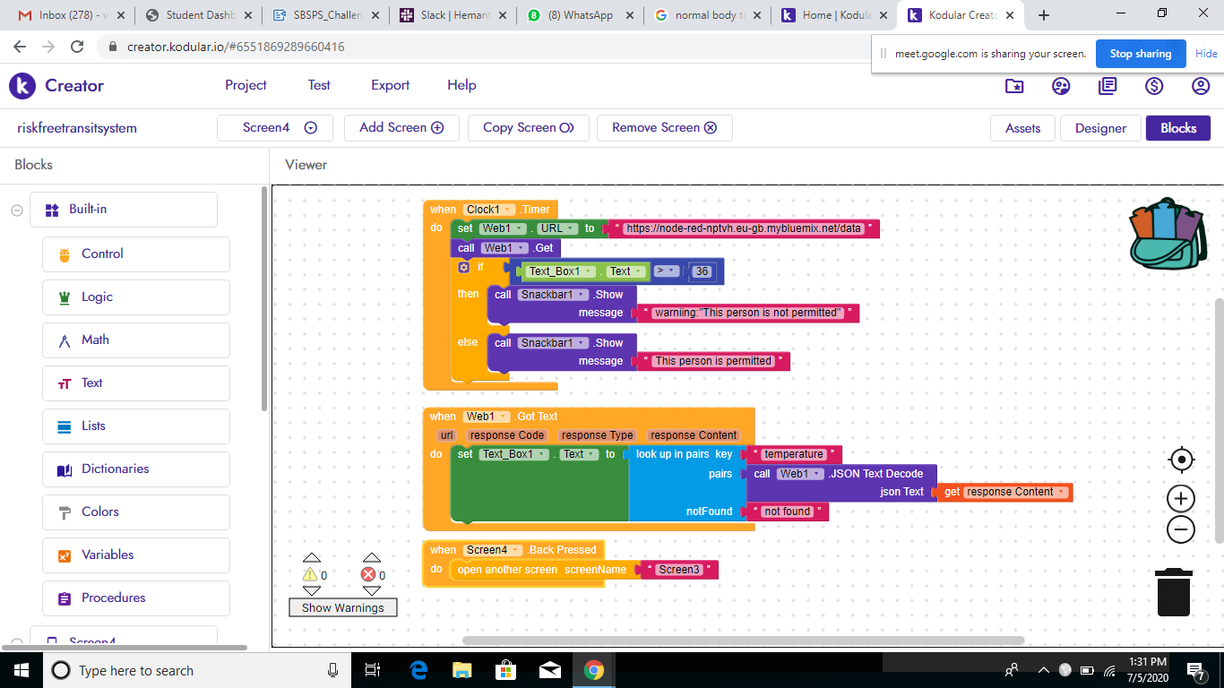
Kodular Backend For Temperature Detector

Slide 19
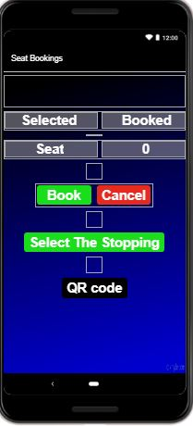
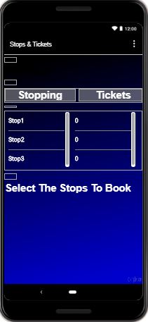
Seat Booking

Slide 20
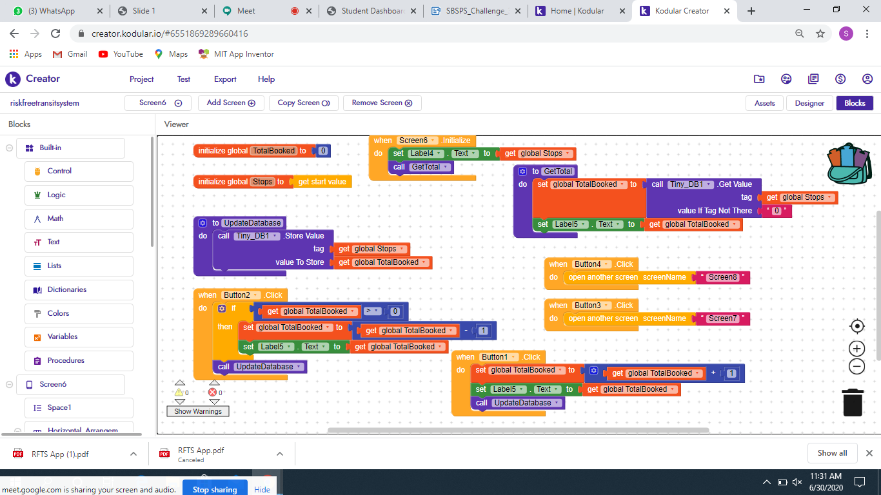
Kodular Backend For Seat Booking

Slide 21
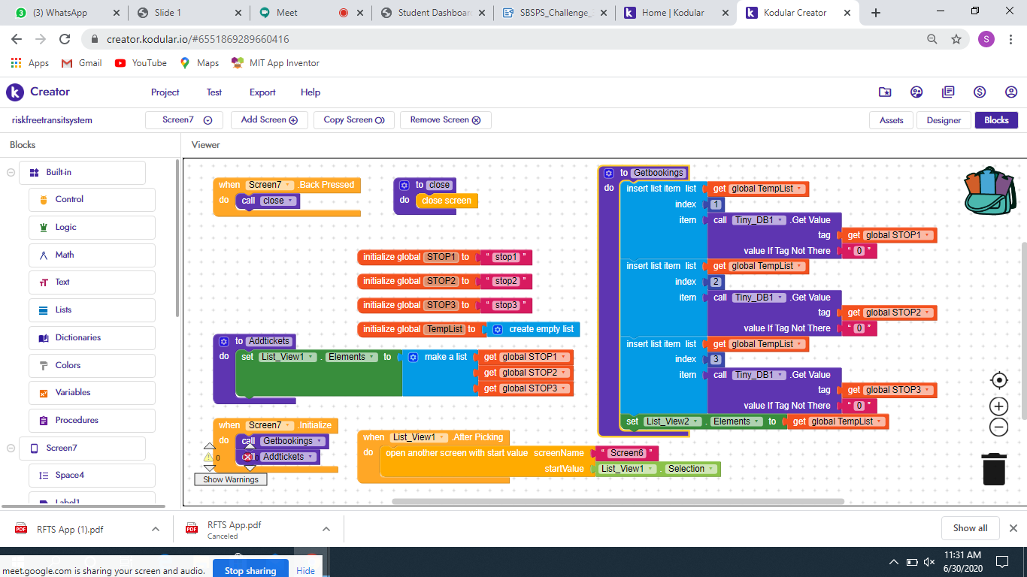

Slide 22
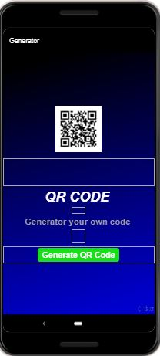
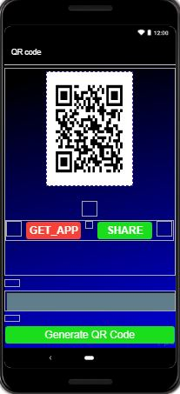
UPI Payment Gateway

Slide 23
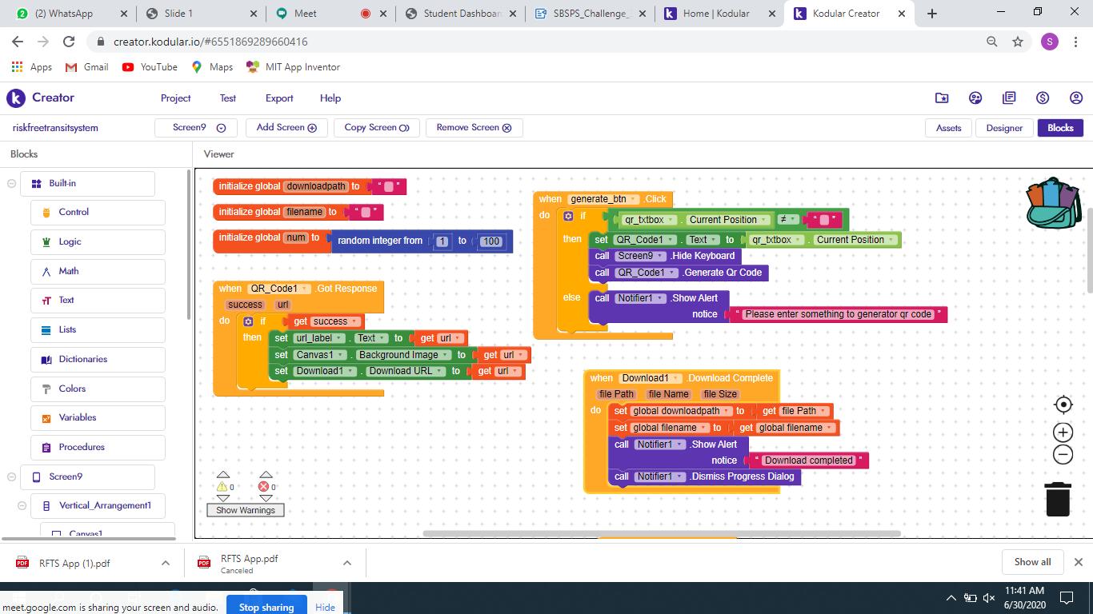
Kodular backend for UPI payment gateway

Slide 24
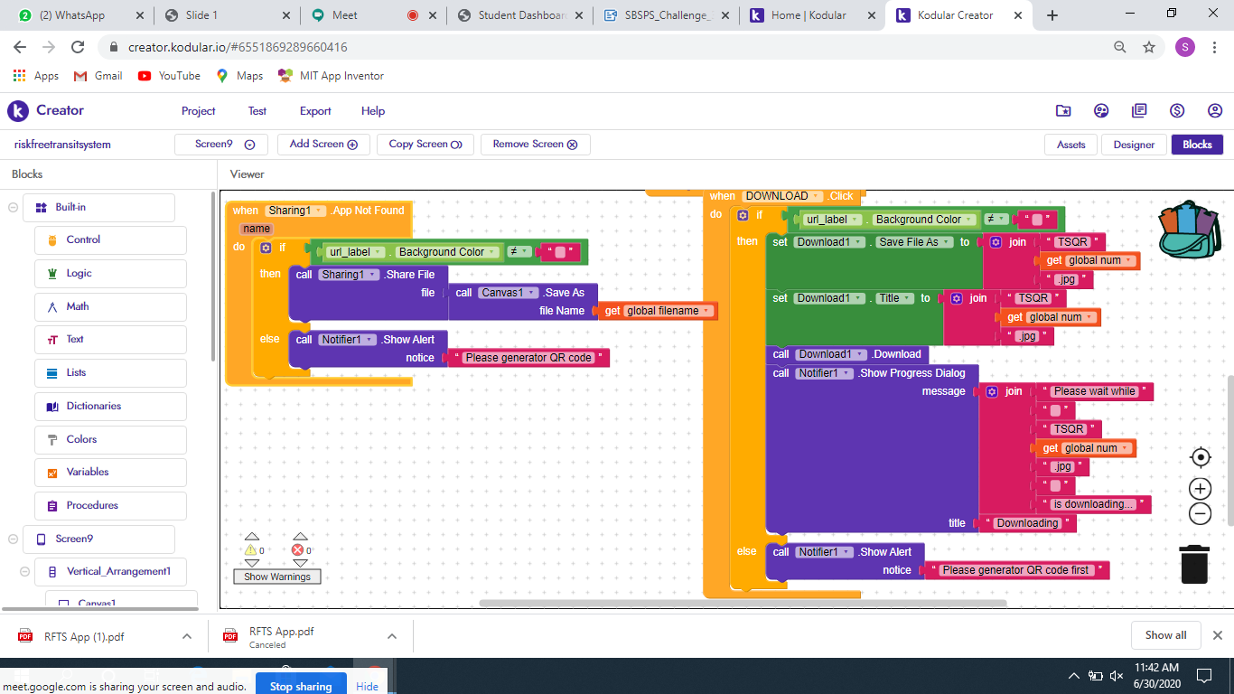

Slide 26
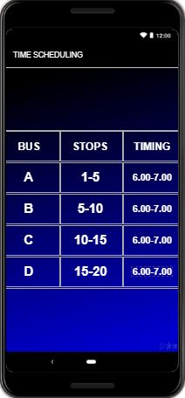
Time Schedule

Slide 27


