Slide 1


IBM Hack challenge 2020
Idea Title: Sentiment Analysis of COVID-19 Tweets – Visualization Dashboard
Team Member: Mr.Amir Abbas
Ms.Pragati Chauhan
Team Name : IoCraZon

Slide 2

Sentiment Analysis of COVID-19 Tweets – Visualization Dashboard

Slide 3

Aim of the Project
To create an ineractive web based COVID-19 Sentiment Analyser
Get to know people’s sentiment towards the epidemic
Understand the sentiments of people on govt. decision to extend the lockdown

Slide 4

Idea General Description
Live dashboard of streamed twitter tweets, filtered by your own key words with applying sentiment analysis of tweets.
Classifying on positive and negative tweets
Store them in local database, and then creates a dashboard with live charts

Slide 5
Technology Stack
Frontend
A simple user friendly webpage created using dash plotly and python for convenience of the user.
Keywords of sentiment analysis are COVID19 , CORONA and LOCKDOWN all are predefined by the backend side
Using herokuapp for the deployment of the script

Slide 6
Backend
Python algorithms fetch tweets related to COVID19 using twitter API configuration
Fetching, Tokenization, filtration/Cleaning, removing stop words and Classification of tweets by python algorithm

Slide 7

Visualization
Pie Chart
Historical scatter moving average chart
Window size generated on the webpage according to the received data

Slide 8
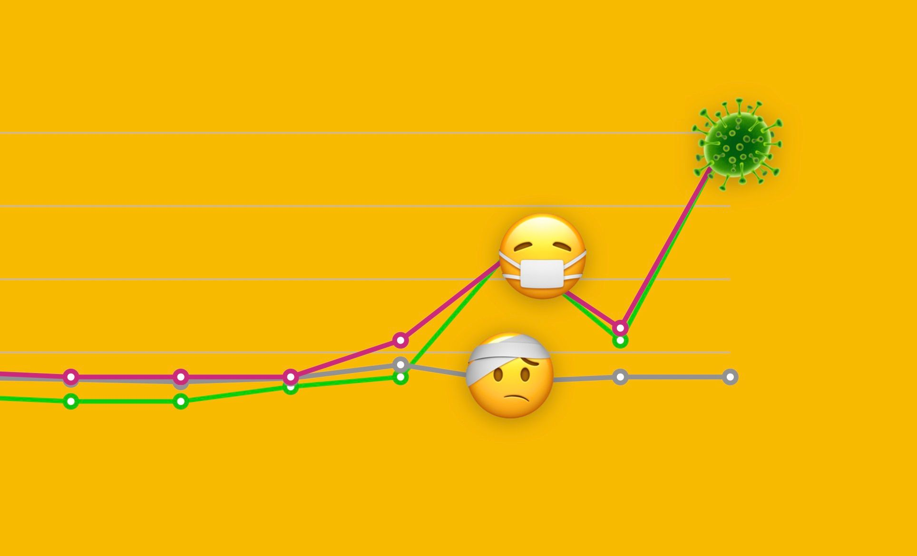
Technologies & Tools
Python 3.6 ,pandas, threading, sqlite3, textblob, tweepy, plotly, dash, dash-html-components, dash-core-components IBM Watson Studio, Herokuapp Deployment, Any Web frameworks

Slide 9
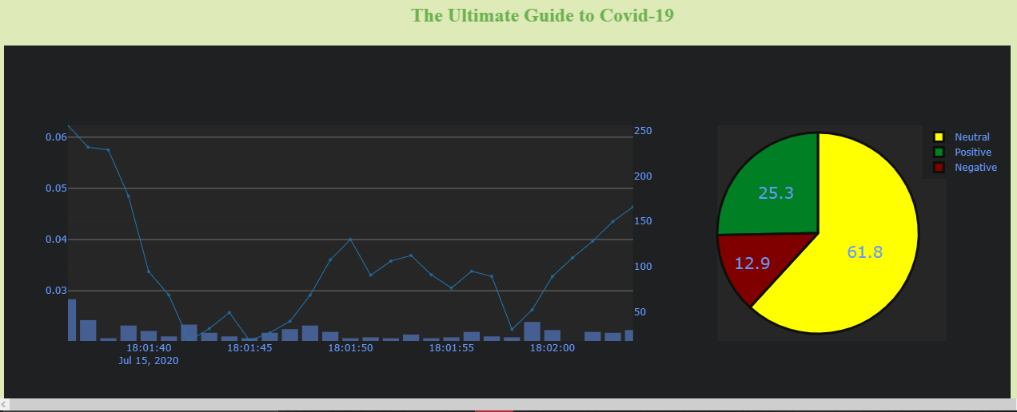
DASHBOARD

Slide 10
Scope of Work
We can add options like to perform sentiment analysis on any other topics just by typing the keyword of it. More effective types of dashboard visualization can be plotted. Also it’s essential to identify fake tweets as well to stop the spreading of false information among people

