Slide 1
IBM HACK CHALLENGE 2020 Sentiment Analysis of COVID 19 Tweets: Visualization Dashboard

Slide 2
Team Info
Team Name : Squadron
Project ID : SPS_PRO_1729
Team Members: Himanshu Tekade
Abhinav Gandhi
Poorvaja Rao
College : International Institute of Information Technology, Pune.
Education : TE E&TC, 2020

Slide 3
Problem Statement
During this pandemic the Corona Virus endangers our physical
health, but alongside, social distancing also poses a threat to our
emotional stability.
Thus, it is crucial to understand public sentiments for COVID
19.
The proposed solution would provide the analysis of tweets and
visualization of the sentiments to tackle the situation.

Slide 4
Why Sentiment analysis
Allows us to gain an overview of the wider public opinion behind certain topics.
Sentiment Analysis Can Boost Business
Sentiment analysis captures insights for the entertainment industry
Sentiment analytics acts as a fundamental tool to understand how individuals feel about the topic

Slide 5
Proposed Solution
The project aims at analyzing the sentiments and emotions of the
people during COVID – 19 pandemic.
To analysis is divided into following :
1 .Collecting tweets from twitter.
2. Filter out the data to remove unwanted words from each post.
3. Sentiment classification and analysis.
4. Creating a word cloud.
5. Displaying data on dashboard.

Slide 6

Implementation Flow

Slide 7

Data Extraction
Reading Data
Data Analysis
Data visualization & word cloud

Slide 8
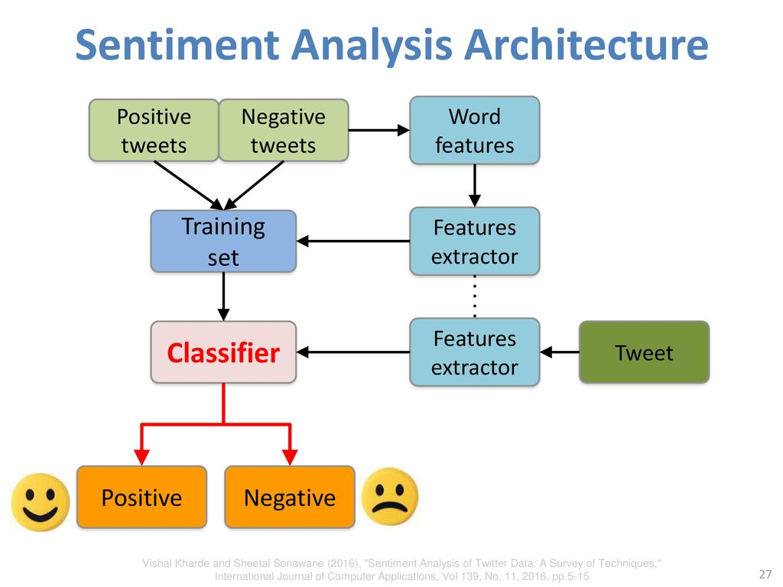
Architecture

Slide 9
Team Contribution
Abhinav & Himanshu
Himanshu
Abhinav
Poorvaja
Data Extraction
Data Analysis
Reading Data
Dashboard, ppt

Slide 10
Difficulties Faced
Using tweepy to extract tweets
Textblob for sentiment ploarity
Using Python tools to build dashboard

Slide 11
CONCLUSION
In this project, we analysed the sentiments of COVID-19-related
tweets in several ways. The overall trend shows that the public
has been more optimistic over time.
To fight the corona virus not only needs the guidance from the
government but also a positive attitude from the public.
Our analysis provides a potential approach to reveal the public’s
sentiment status and help institutions respond timely to it.

Slide 12
References
https://www.tatvaminsights.com/why-sentiment-analysis-is-important/
https://www.tweepy.org/
https://textblob.readthedocs.io/en/dev/
https://matplotlib.org/

Slide 13
THANK YOU! 👍

