Slide 1



IBM Hack Challenge
WareHouse Management System
Team Name: Nexus
College: NIT Rourkela

Slide 2
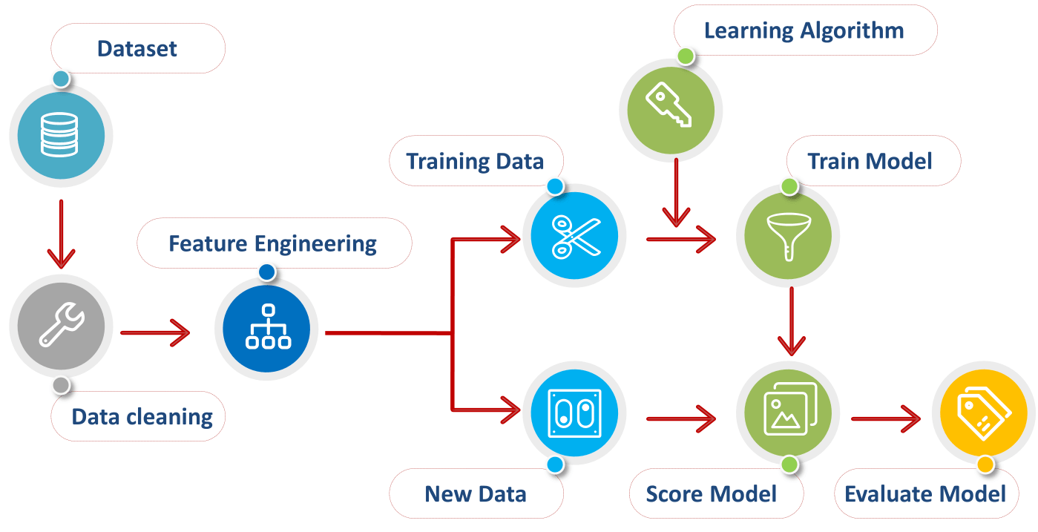
Algorithm

Slide 3
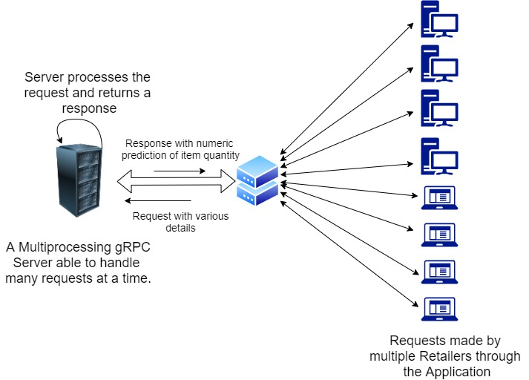
Multiprocessing Server

Slide 4
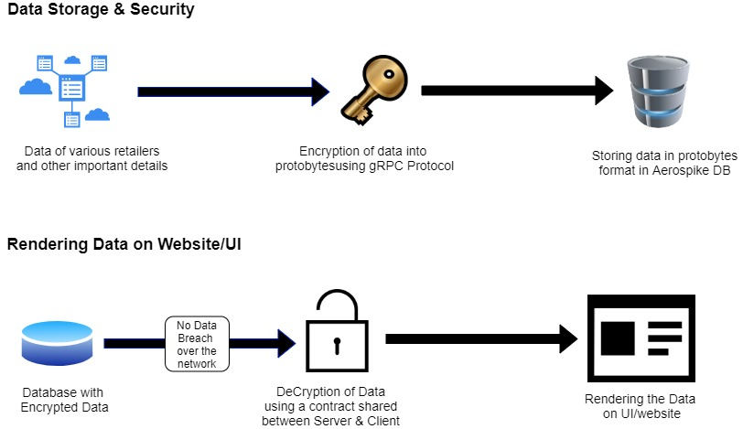
Data Security & Database

Slide 5
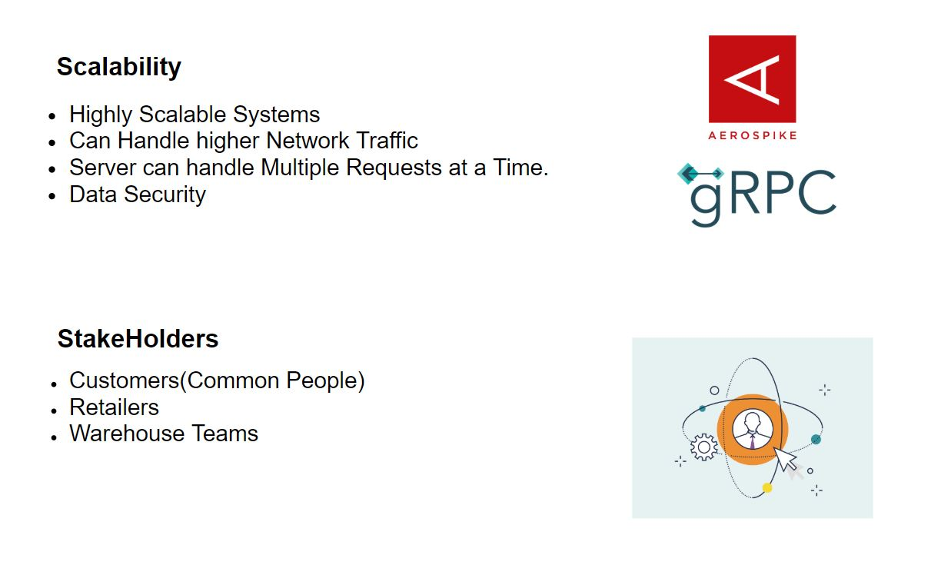
Finally…

Slide 6
Thank You !!!
Any
Questions ?

