Slide 1

Sentiment Analysis Dashboard of COVID19 tweets
Infering people’s daily reactions and with various phases of lockdown
https://github.com/SmartPracticeschool/SBSPS-Challenge-4564-Sentiment-Analysis-Dashboard-of-COVID-19-tweets

Slide 2

SENTIMENT
ANALYSIS
Sentiment Analysis is a subdomain of NLP (Natural Language Processing) in which we infer the sentiment of some text through mathematical models.
In this project, tweets are already analysed and there sentiments are precomputed using textblob, which is a language processing python library.
A sentiment score of greater than zero means positive sentiment, and conversely less than zero means negative sentiment. It is good measure to study people’s reactions on a large scale.

Slide 3
APP WITH DEPENDENCIES AND OUTPUT
Languages used
LIBRARIES USED
Python, html, css, js
Built with
Pandas, dash, plotly
Dash and Plotly
Part of IBM HACK CHALLENGE 2020
Data Source
.
Here
DASHBOARD APP
DAY WISE STATS
PHASE WISE STATS

Slide 4
Project Workflow
Final Project
Building UI
After getting processed, then creating the UI for the app using Dash and Plotly.
2
Data Preprocessing
Collected data is then preprocessed using these scripts for ease in plotting.
1
Collecting Data
Data for the dashboard is collected first from here.
0

Slide 5
Dash App
Day Wise Tab
Phase Wise Tab
Core Structure of App
The dashboard app has two tabs, each concerning with their respective domains. First tab depicts statistics and summary day wise, and similarly second tab depicts statistics and summary phase wise, i.e. with various phases of lockdown.

Slide 6
Core Architecture of first tab of the dashboard app
Day wise data
Day wise stats
Date selector
Selected date summary
Plots of tweet counts per day
Sentiment score plot per day

Slide 7
Core Architecture of second tab of the dashboard app
Phase wise data
Phase wise stats
Phase selector
Selected Phase summary
Plots of tweet counts per phase
Sentiment score and p/n plot per phase

Slide 8
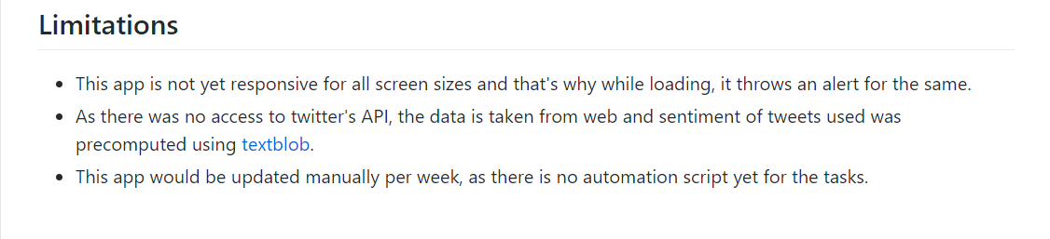
PROJECT INFO AND LIMITATIONS
THIS PROJECT IS HOSTED ON GITHUB AND IT’S SOURCE CODE CAN BE FOUND HERE

Slide 9
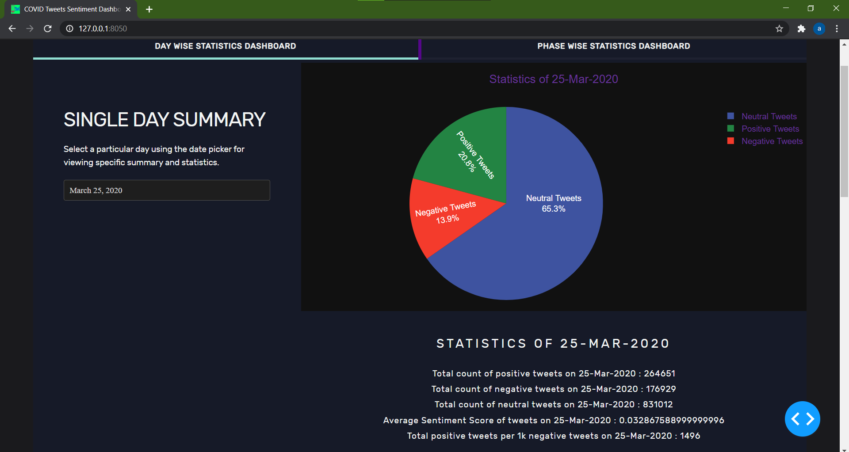

Slide 10
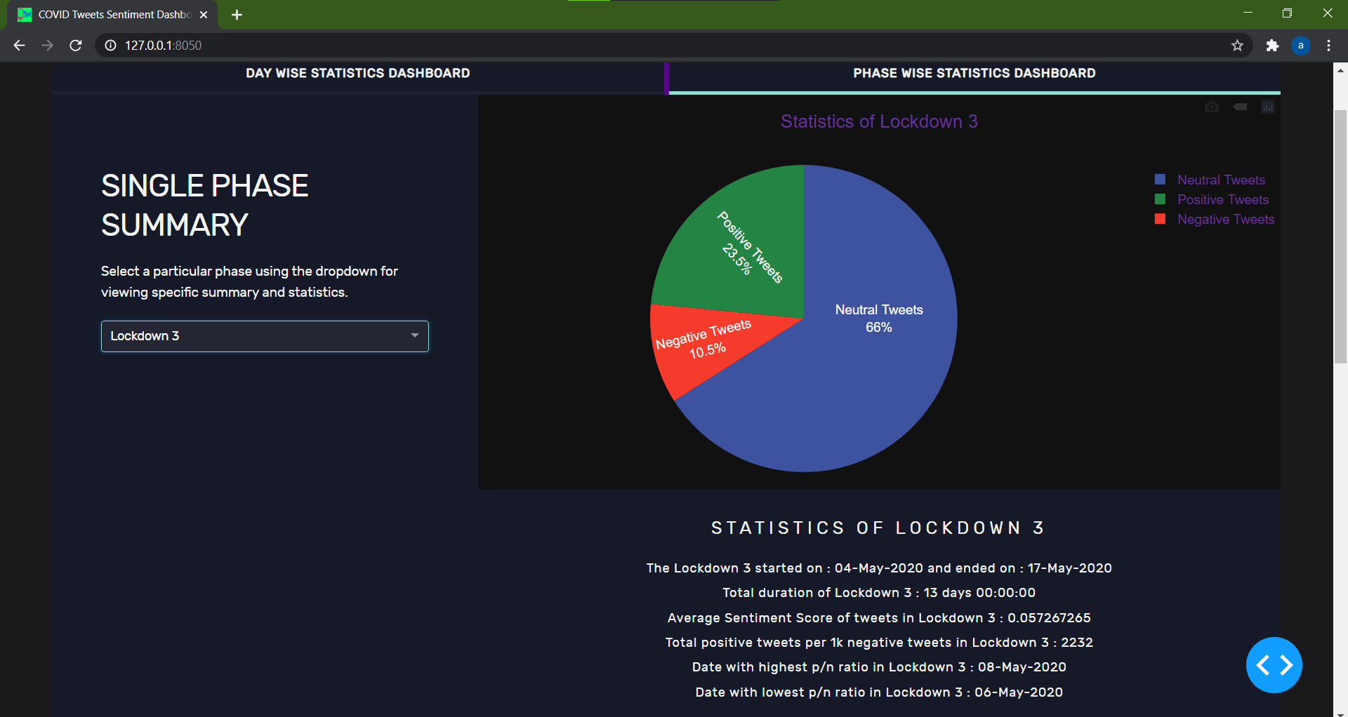

Slide 11
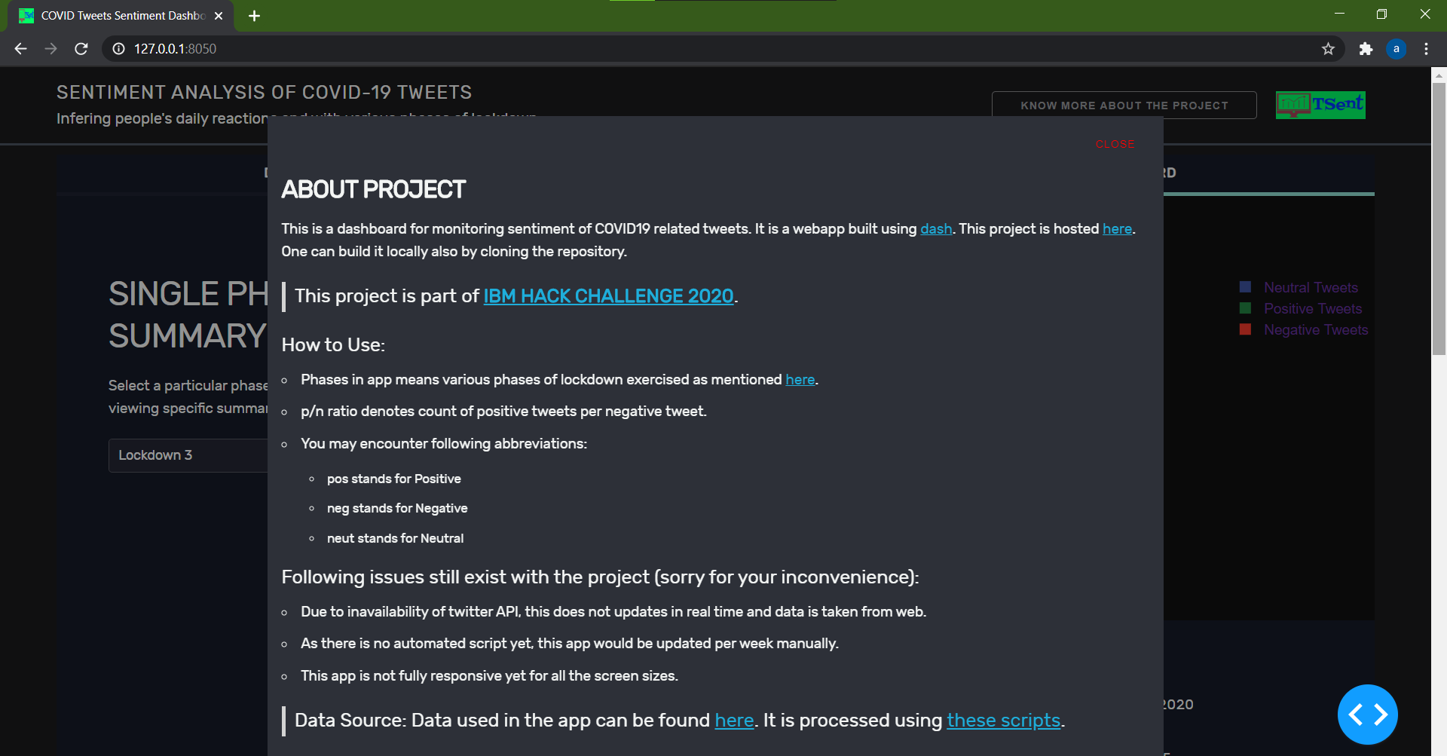

Slide 12
THANKS
FOR A BETTER FUTURE!! HAPPY CODING!!
CREATED AND DEVELOPED BY: ADITYA VATS
CONNECT: GMAIL LINKEDIN GITHUB

