Slide 1

SMART INTERNZ
IBM HACK CHALLENGE
TEAM TWIN
DHRUBAJOYTI CHATTERJEE
SRIJANI BHATTACHARJEE

Slide 2
EXISITING PROBLEM
Impact Of COVID 19 worldwide has seen a drastic effect on mankind especially if it is related to the living.
Under complete lockdown, factories and other production units which are responsible for producing Retail and supply products are all paused for a moment.
The agricultural farm is affected due to lack of manpower hence less effectiveness, causing a hike in an increase of demand but a decrease in the supply chain.

Slide 3
SOLUTION
It is important to keep in mind all the factors related to food security and think of the future to cope up with demands, for this reason visualizing the production and utilization is important.
Using Machine Learning To predict the Supply Demand chain can be a way to understand and analyze the dangerous situation.
To learn about the parameters we are using a Term called FOOD PRICE INDICES which is a[applicable worldwide.

Slide 4
What is FPI?
The Food Price Index (FPI) is a measure of the monthly change in international prices of a basket of food commodities. It consists of the average of five commodity group price indices weighted by the average export shares of each of the groups over a certain period.
Using the price index and getting an average for a period we can predict the price index of a future period and likewise can get prepared for any increase in supply demand gap in the food market

Slide 5
What if FPI decrease or increase?
If Predicted Value>Average Value : Supply Production Needs to be Improved to meet demand.
If Predicted Value=Average Value : Supply Production And Utilization is balanced.
If Predicted Value< Average Value : Supply is enough but utilization needs to increase.
So Observing the FPI predicted and comparing it with our average prediction over the period we can come into certain conclusion.n

Slide 6
TOOLS USED:
IBM Cloud Machine Learning Platform.
Node Red For UI Designing.
IBM Watson Assistant for CHATBOT preparation.
Watson Studio API to deploy the trained model into the IBM directory.
Microsoft Excel to retrieve dataset.
Tableau For Visualization.

Slide 7
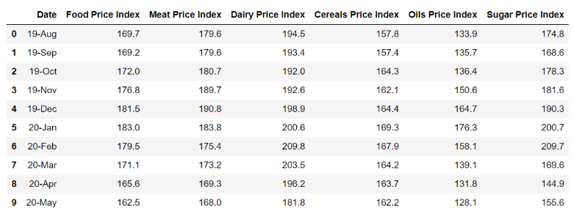
DATA SOURCE
*Note The Dataset is taken from FAO.org and is specified in the bibliography

Slide 8
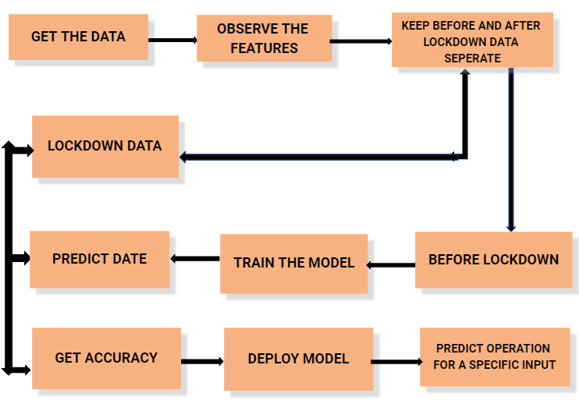
BLOCK DIAGRAM

Slide 9
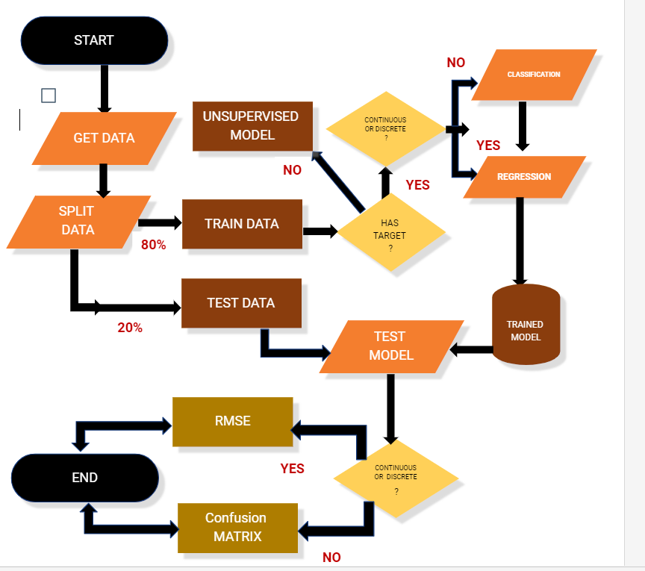
MACHINE LEARNING MODEL FLOW

Slide 10
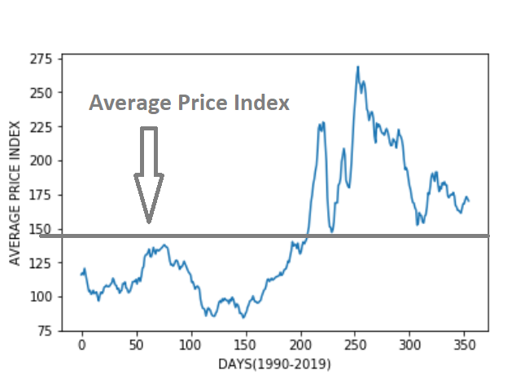
What does the Model Say?
Training the model with the help of Polynomial Regression we came to observe our Average price index Data as Somewhat around 146.
The Data point is not uniform and
during the lockdown period there is
a steep increase in the price index.
Zooming into the specific Lockdown
period Index helps to study farther.

Slide 11
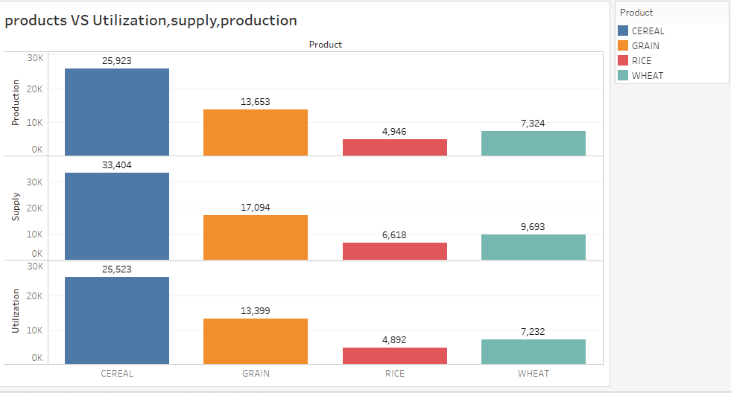
COVID 19 Period Visual
The Supply Prediction And demand of 4 major commodities are observed and are Utilized in the food price index average calculation
The parameters are:
Production
Supply
Utilization
And the major food commodities are:
Cereal
Grain
Rice
Wheat

Slide 12
Result:
It can be seen that the predicted values of the FPI is pretty high as compared to the average model price.
The result depicts that during the lockdown period the Supply Production is much lower than the Utilization.
The Food Market needs to get aware of any such changes and apply for the Increase of food requirements.

Slide 13
BIBLIOGRAPHY
Food Security Model Dataset: http://www.fao.org/home/en/
IBM Cloud : https://www.ibm.com/cloud/get-started
IBM Watson Studio: https://cloud.ibm.com/catalog/services/watson-studio
Watson Assistant: https://www.youtube.com/watch?v=6t8C0YRUGec&t=11218s
Node Red : https://nodered.org/

