Slide 1
AI Recruiter for Shortlisting Candidates
BY
Ignatius Almeida
Andrea Lobo

Slide 2

What is an AI Recruiter ?

Slide 3
To tackle challenges, new technology companies are rapidly emerging in the HR tech ecosystem with robust solutions…
Big Data
Predictive Analytics
AI
Text Analytics
Machine Learning Algorithms

Slide 4
Introduction to Good Genes
In our Project we have made a website (Good Genes) interface where in the Candidate will fill in the details and then be shortlisted according to the skills.
The Chatbot is created using Watson Assistant from Cloud IBM
We also have also used Python in Jupyter Notebook for extracting Keywords from the resume that will be displayed.

Slide 5
Problem Definition
To create a system for recruiting good candidates based on the resume and the personality test based on the chat with the Watson Assistant.
For the Keyword Extraction from the resume , we have used Entity Recognition Algorithm of NLP(Natural Language Processing).
This project is created so as to select the best candidate and avoid human error.

Slide 6
Proposed Solution
Collect data from the Candidate and display on the next web page
Deploy the webpage on Node-red or on any other software
Integrate the webpage with Watson Assistant
Integrate the website and Watson Assistant together with the ipnyb file
Display the data and grade the candidate accordingly

Slide 7
Future Scope of the Project
We can make use of the Watson Studio to gather images of the Candidate and then Classify them.
The Chat bot can be made as available as a video and can have a voice assistant
We could have integrated the python ipnyb with Flask Python Libraries for effective Interactivity

Slide 8
Hardware and Software Requirements
Hardware
Speed:1.1 GHZ
RAM: 4 GB(min)
Hard Disk:40GB
Software
Jupyter Notebook
Cloud IBM
Heroku
Sublime and Xampp

Slide 9
Screenshots

Slide 10
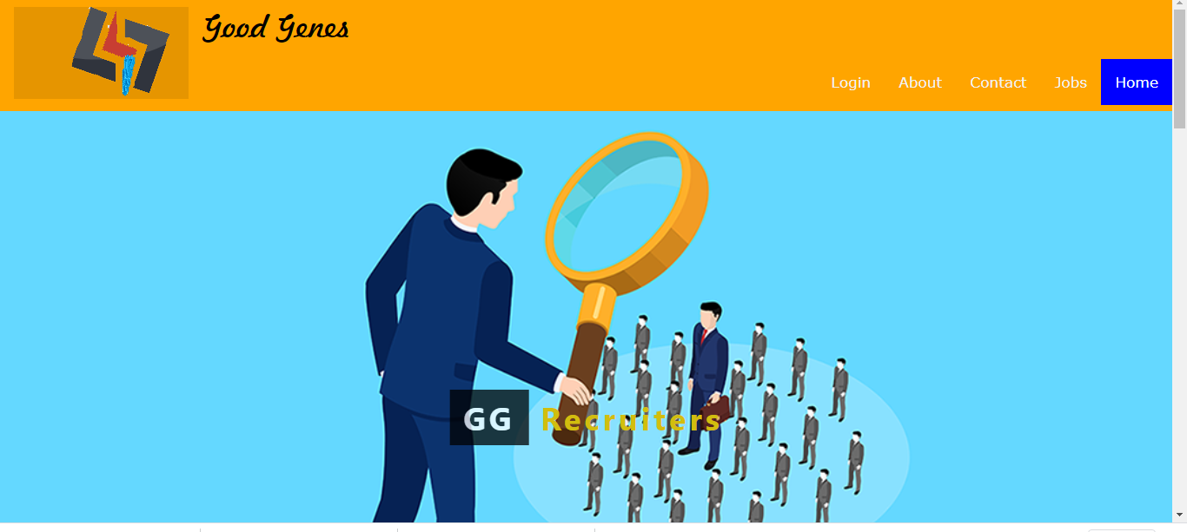
Website Opening

Slide 11
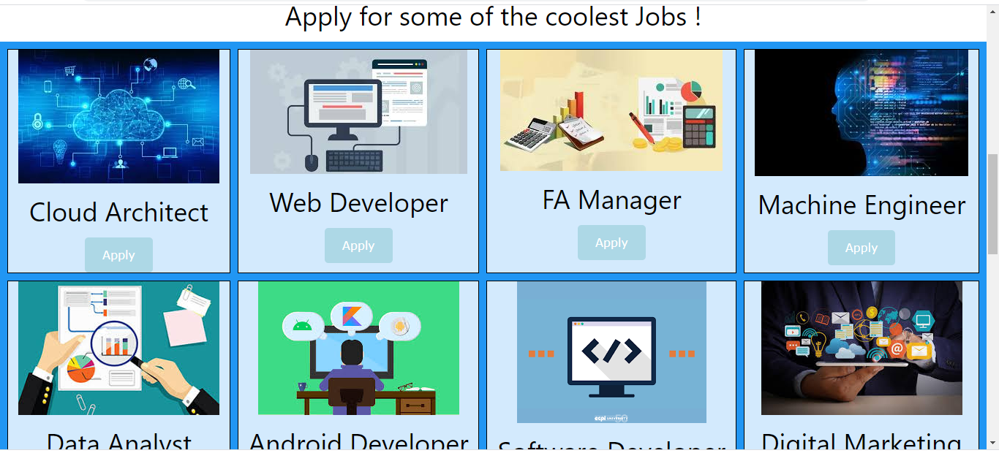
Apply for Job Page

Slide 12
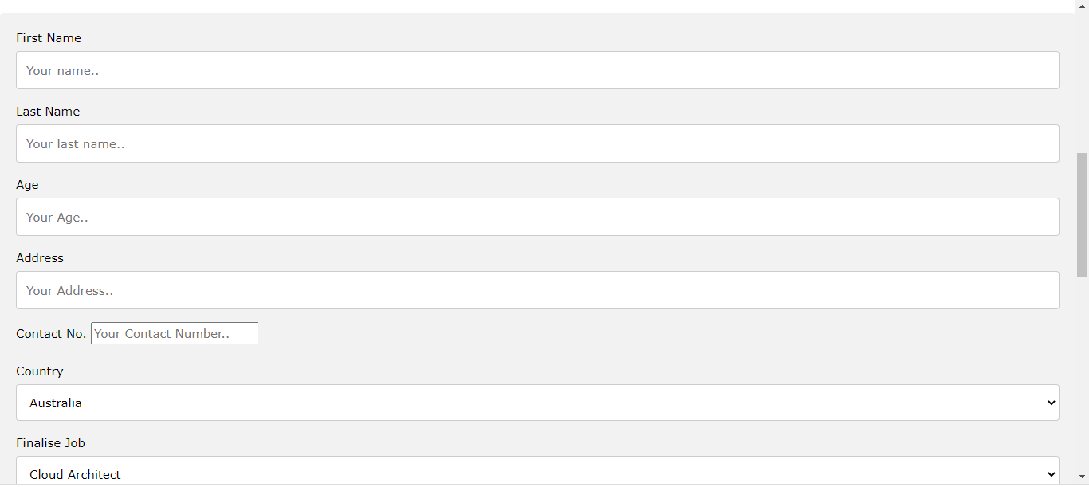
The form page

Slide 13
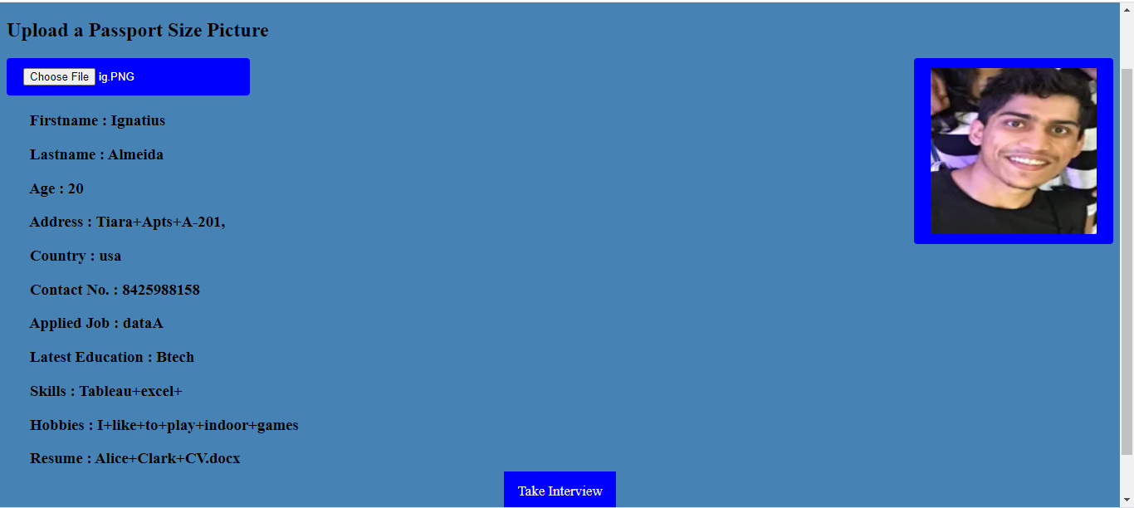
Displayed Data

Slide 14
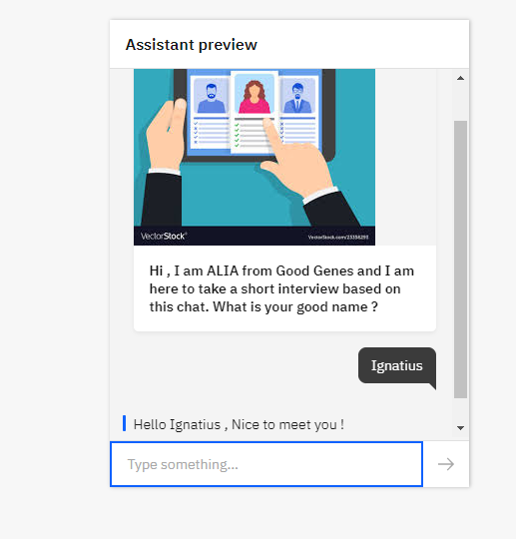
Watson Assistant Chat Bot

Slide 15
Deployment
We deployed our website on Heroku using Git command

Slide 16
What did we Learn ?
We came across Cloud IBM and its services in a vast field and idea
We learned about Node-red and created management site during the Bootcamp
We learned more about Cloud IBM databases , Db2 and Cloudant
We understood Watson Assistant and Build Interactive Chatbots
We learned about Watson Studio and Knowledge Studio

Slide 17
Issues Faced
We wanted to make the HTML website as Flask website using the Python Libraries so that we could integrate the Resume extraction with the Website
We tried to integrate Voice Agent Assistant with Watson Assistant

Slide 18
Experience
It was an amazing Experience with Cloud IBM and Smart Interns Platform.
We have a lot to take from this experience such as amazing Bootcamps and Courses.
The responses on Slack were very speedy and Helpful.
It was altogether an amazing platform to work with.

Slide 19
Conclusion
AI will change the recruiter role through augmented intelligence which will allow recruiters to become more proactive in their hiring, help determine a candidate’s culture fit, and improve their relationships with hiring managers by using data to measure KPIs such as quality of hire.
In this Project , we have applied Cloud IBM services to our HTML website resourcefully and have learned and gained knowledgeable insights on its services

Slide 20
Thank You

