Slide 1
Sentiment Analysis of COVID-19 Tweets - Visualization Dashboard
By:-
Pranav Bhaskar
Team : 0xHEISENBERG

Slide 2
INDEX
INTRODUCTION
PROPOSED SOLUTION
BLOCK DIAGRAM
FLOWCHART
RESULT
ADVANTAGES
DISADVANTAGES
CONCLUSION

Slide 3
INTRODUCTION
Social media has always provided a platform for people to express their opinion and emotions.
COVID-19 also known as the novel coronavirus has had a substantial effect on the routine as well as the mental state of the people.
In this situation people are turning towards social media platforms like twitter to express their sentiments towards the events taking place all across the country.

Slide 4
PROPOSED SOLUTION
Most of the problems faced by us can easily be solved by using IBMCloud to build our project.
Since IBM is providing us 5GB of Cloud Object Storage which can be connected to Watson Studio, where we can spawn notebooks with 8GB RAM which is more than sufficient to bear the load of the data.
This notebook would be responsible for processing the data and storing the results to a Cloudant instance.
We would then be using Node-RED for hosting the UI and retrieving data from the Cloudant instance.

Slide 5
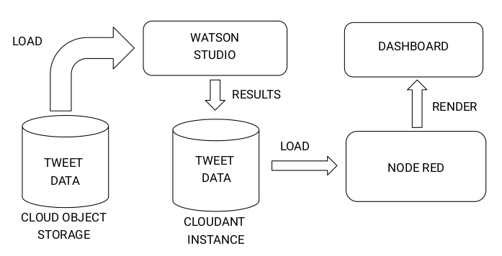
BLOCK DIAGRAM

Slide 6
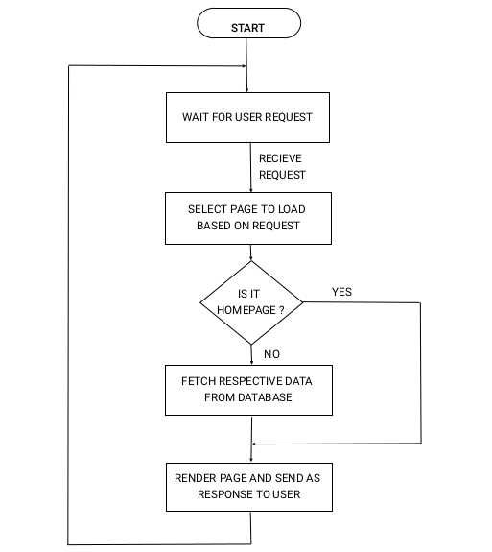
FLOW CHART

Slide 7
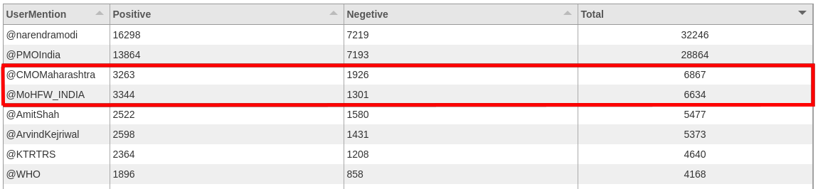
RESULT
@CMOMaharashtra was mentioned more than @MoHFW_INDIA

Slide 8
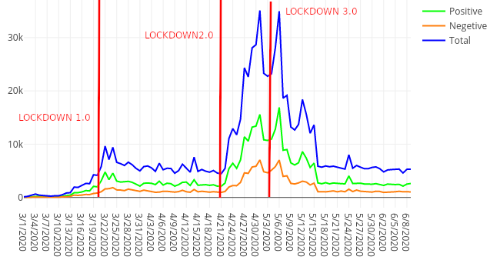
RESULT (CONT.)
Lockdown 2.0 caused an exponential growth in number of tweets

Slide 9
ADVANTAGES
We have an interactive dashboard for visualizing the analysed data.
The same project can be run on a different situation to analyse the sentiments of people with just changing the input dataset.
The result of the project is quite lightweight and the dashboard hardly uses any computation.
The same dashboard can also be used to analyse other trends (hashtags and user mentions) which took place during the COVID-19.

Slide 10
DISADVANTAGE
No real time tweet data is being processed, since I did not have a premium or enterprise plan on twitter API, I could not run it on real time data without exhausting the API limit.

Slide 11
CONCLUSION
We have developed a dashboard for visualizing the twitter data collected during the COVID-19.

Slide 12
THANK YOU

