Slide 1
Apply By AI
An application submitted by
Vidhi Mody (Team Leader)
Vrushti Mody
Soham Parekh
Darshee Machhar

Slide 2
Motivation
Job recruitment is a time-consuming and tedious process, often resulting in frustration for both parties.
Throw in time zone differences and the task becomes a nightmare.
One of the most tedious parts of a hiring process for a company is sifting through the countless applications.
To simplify recruitment, it's necessary to invest in modern technology.
With the right platform and a properly trained recruitment team, your likelihood of successful hires becomes infinitely greater.

Slide 3
Purpose
Automates tasks where they can be automated
Reduces bias in judgments
Helps find the right candidate
Simplifies the recruitment process

Slide 4
Literature Review
Existing problem(s)
Large applicant pool for a given job listing.
Difficulty in validating an applicant’s profile
Economic fluctuations
Bias in judgments
Proposed Solution
Resume Screening
Interview with Chatbot
Online/ Video Interview

Slide 5
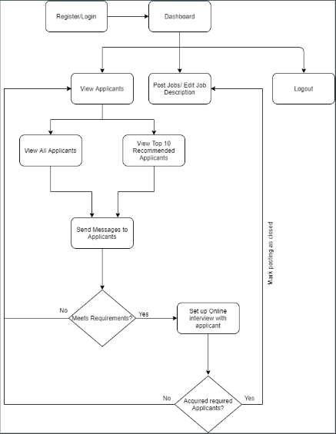
Flow Diagram
Candidate Side

Slide 6
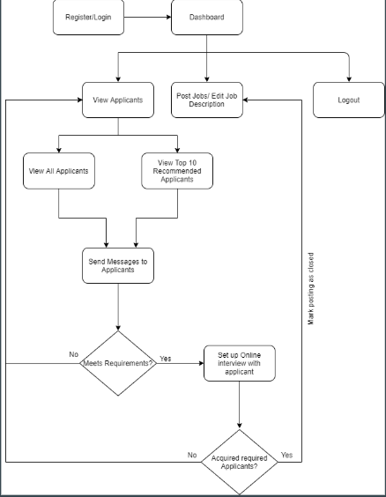
Flow Diagram
Recruiter Side

Slide 7
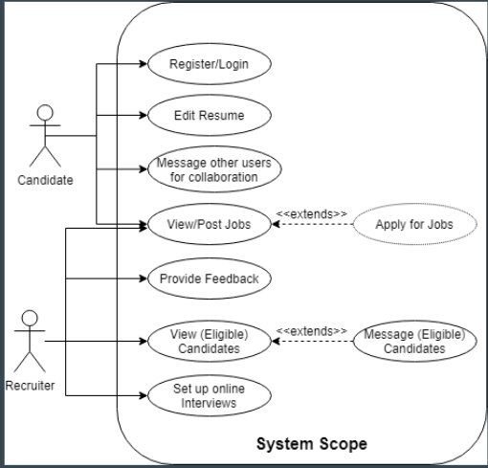
Use Case Diagram

Slide 8
Technology Stack
Front-end
HTML5, CSS3, Bootstrap4
Embedded Javascript (EJS)
Back-end
Node.js, Express.js
Helmet for security
MongoDB as a database, Mongoose as an ORM for MongoDB

Slide 9
Technology Stack
Library & Dependencies
IBM Watson SDK for Node.js
Socket.io for messenger chat
WebRTC for peer-to-peer video conferencing
Tensorflow.js
PassportJS for user authentication

Slide 10
Results
Resume Generator.
Job Recommendation System using hybrid filtering.
Skill-based filtering system.
AI ChatBot for skills and personality analysis.
Messenger for connecting applicants and recruiters.
A secure peer-to-peer video conferencing system for interviews

Slide 11
Conclusion
Our solution is aimed at the problems of recruitment and job seeking. It is a revolutionary change that will help unburden the recruiting firms and also provide an all-encompassing platform to the job seekers to apply to desirable jobs and follow the process without any fear of missing out on crucial communication, as all the activities of selection will occur in one place. Our solution will provide means to create resumes, to carry out virtual interviews- be it by using Interview Bots or video calls, and to stay in touch with fellow candidates or employers. Our system selects candidates on the basis of their qualifications and skills as well as their overall personality in accordance to the job profile. We believe it will make the recruiting game a lot more easier and more inclusive.

Slide 12
Future Scope
Converting the web-application to a native application as well is the future scope of our application. Having said that, our web-application is fully web-responsive and supports all browsers.

Slide 13
Challenges Faced
Designing the flow of the application
Integrating various parts of the application
Lack of prior research regarding recruitment automation
Security Challenges for protecting data

Slide 14
Contribution
User Side - Vidhi Mody
Company Side - Soham Parekh
Chatbot - Darshee Machhar
UI & Database - Vrushti Mody

