Slide 1
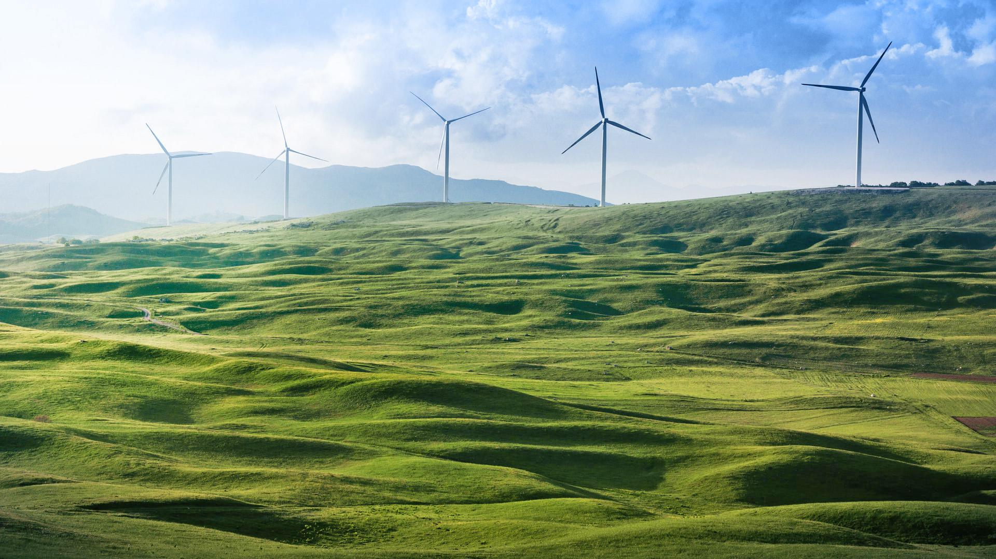
Smart Wind Power

Slide 2
Problem Statement
Predicting Energy output of wind turbine based on weather condition.

Slide 3
Approach
API for fetching weather report up to 5 days.
Sending data into ML model.
Shorting out maximum active power that can be generated.
Preparing Dataset
Normalizing data
Trying Different Algorithms
Training model using Deep Learning
Testing model

Slide 4
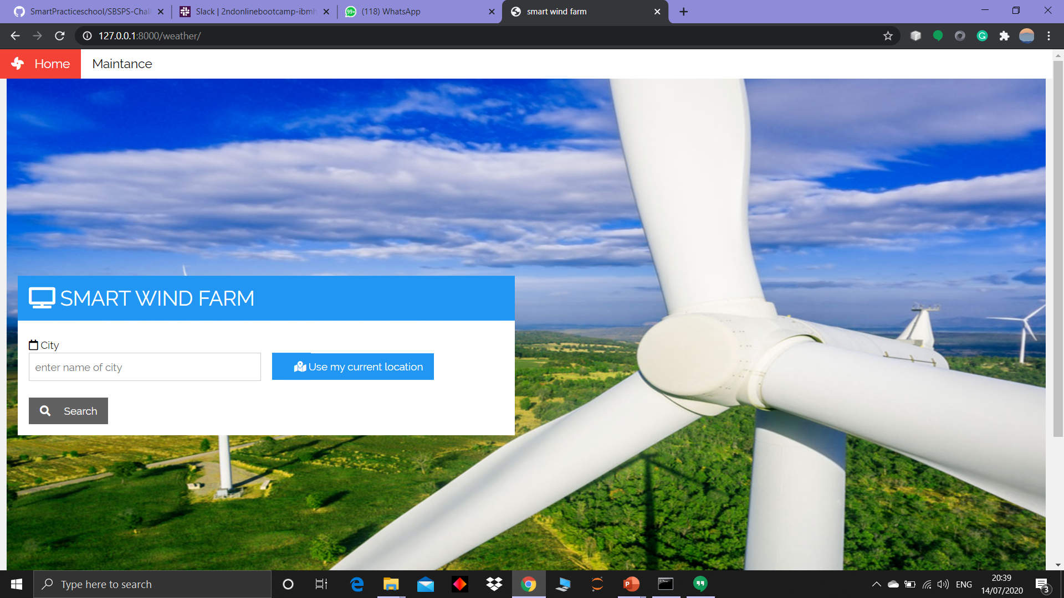
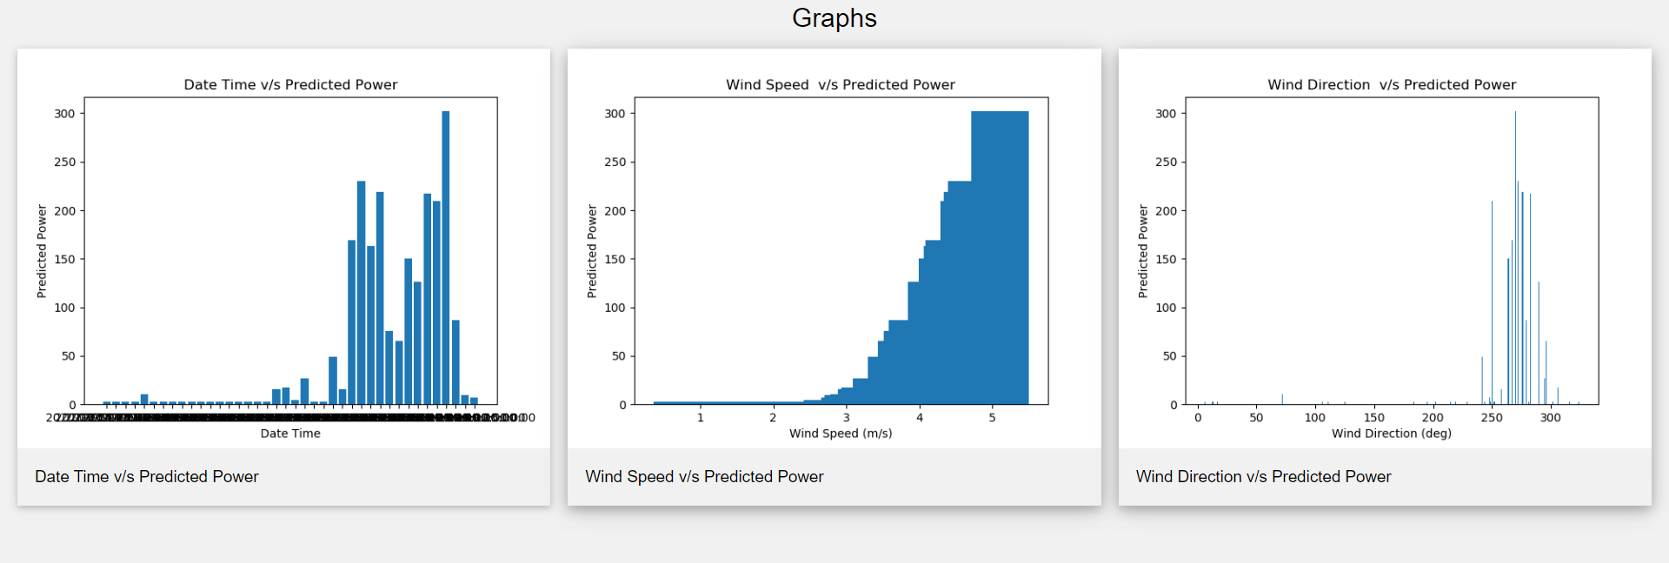
Uniqueness
Location
Current
User Defined
Graphical Representations
Maintenance Measures
Interactive UI

Slide 5
Future Scope
Language Diversity
Map Representation
Real- time Alert
Maintenance records

Slide 6
Thank You

