Slide 1
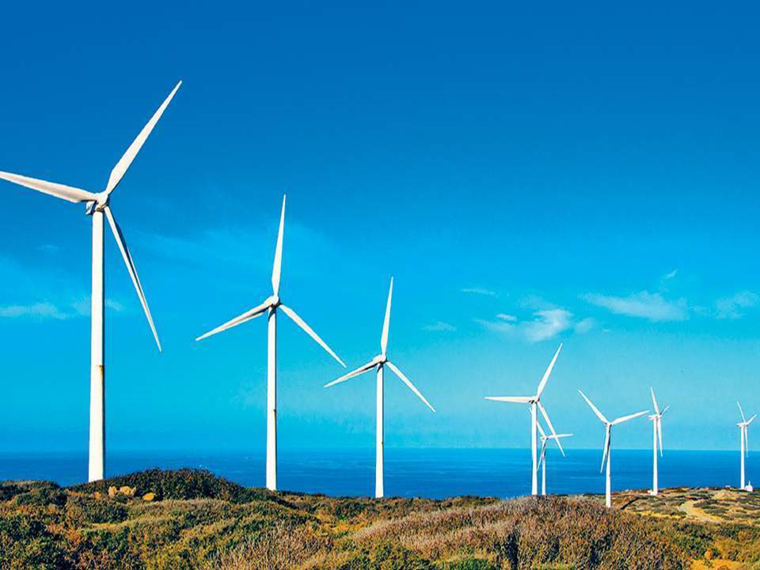
Predicting the Energy Output of wind turbine based on weather conditions

Slide 2
Problem Description/Existing Methods To Solve

Slide 3
PROBLEM DESCRIPTION
Wind farm plays an increasing role in the supply of energy world-wide. The energy output of a wind farm is highly dependent on the wind conditions present at its site. If the output can be predicted more accurately, energy suppliers can coordinate the collaborative production of different energy sources more efficiently to avoid costly overproduction.

Slide 4
EXPECTED SOLUTION
Develop a time series model to Predict the power output of wind farm based on the weather condition in the site (1Hr prediction to 72Hrs. prediction) Build an application to recommend the Power Grid to suggest the best time to utilize the energy from wind farm.

Slide 5
EXISTING SOLUTIONS AVAILABLE
There are several methods which are used for short-term prediction of wind generation at present:
The simplest ones are based on climatology or averages of past production values. One such naive predictor referred to as 'what you see is what you get' states that the future wind generation will be the same as the last measured value. Quiet good for 4-6 hours curve but very naive.
Advanced approaches for short-term wind power forecasting necessitate predictions of meteorological variables as input and make use of power curves. So to predict wind energy output one has to understand the power curve and plot the points in the curve, which is very tedious task.

Slide 6
Proposed Solution

Slide 7
Develop an ML model for prediction of power output from meteorological variables using historical weather data and actual power output results. So the prediction will be more genuine and trustworthy.
We used Boosted Tree Regression model which is one of the types of “Decision Trees” which are very credible for accurate predictions.
Develop an Android App which only takes location geo-coordinates as input and in backend will get weather forecast details and the predictions of power output from forecasted details.
App capable of taking user defined operation time of windmill and providing best time grids for most optimum utilization of resource.

Slide 8
IMPACT OF PROPOSED SOLUTION

Slide 9
FLAW IN EXISTING SOLUTION
Solutions available are very cumbersome and difficult to use
The methods available either do not make use of historical data or use it in very unsmart manner
In advanced methods, we first need the location geo-coordinates and then we need to find meteorological variables and plot it in on power curve which is a very tedious task
May require human capital to carry out the task of plotting and predicting. Also it is a very time consuming plus not very trustworthy process
SOLUTION WE OFFER
A mobile application with easy-to-use and beautiful UI
We developed an ML model using boosted tree regression method and learning from past weather conditions and corresponding power output data
You just need the geo-coordinates of location and the app will give a time series of power output data. Even the names of cities will work if geo-coordinates couldn’t be known or you can use your live location
A simple Android App which uses ML model in backend which has an accuracy of 85% in predicting. Financially feasible and so anyone can use it without the need of additional resources.

Slide 10
CODING PART/TECHNOLOGY STACK USED

Slide 11
TECHNOLOGY STACK USED
Python for Data Analysis and Data Collection
Python for ML Model Development
IBM Watson Studio to develop and visualize the model and reduce error as much as possible
Pickle for storing object of model and integrating it with backend
Flask for backend of app and integrating frontend with pickle object
Flutter for developing UI of app
Heroku for deploying app

Slide 12
Features of app

Slide 13
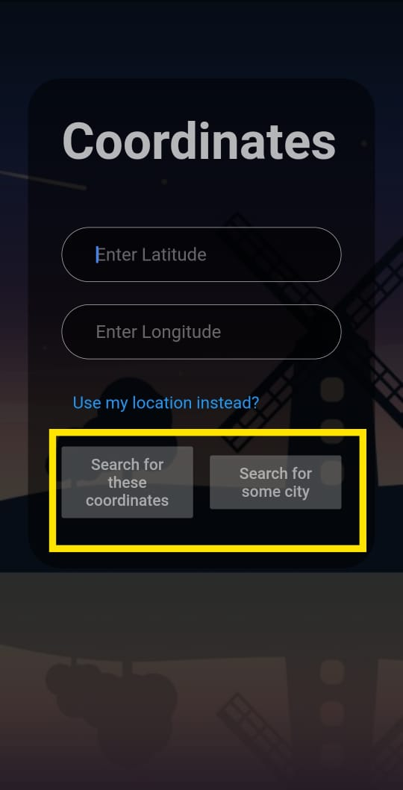
1.provide wind energy output prediction just by knowing the coordinate of location, name of the city or your current location

Slide 14
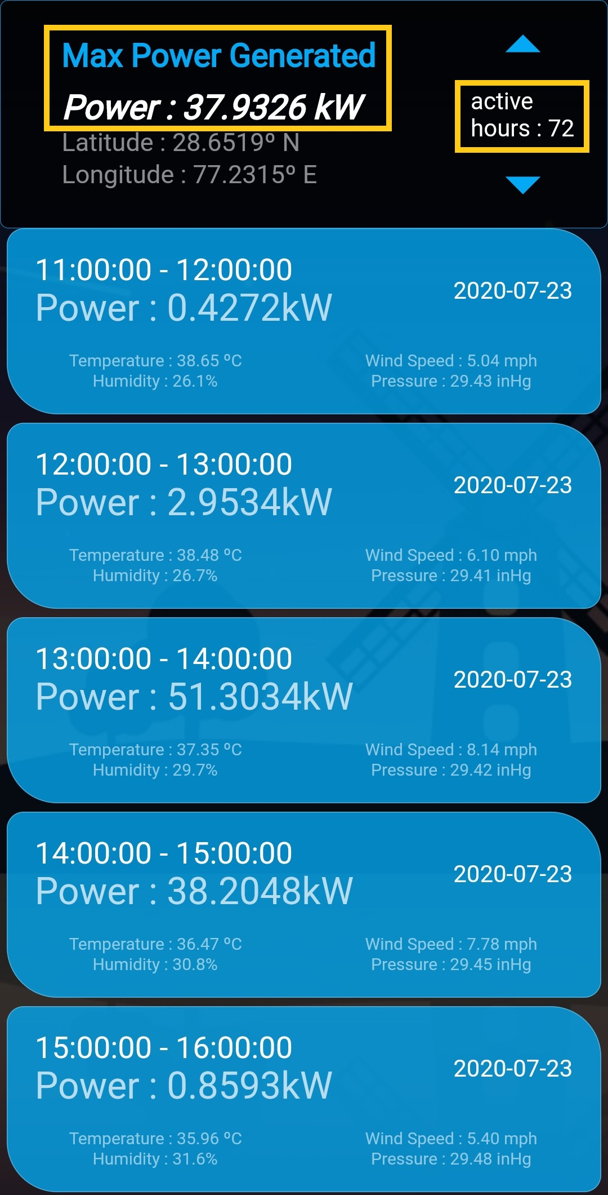
2.Provides wind power output prediction of upcoming 72 hours

Slide 15
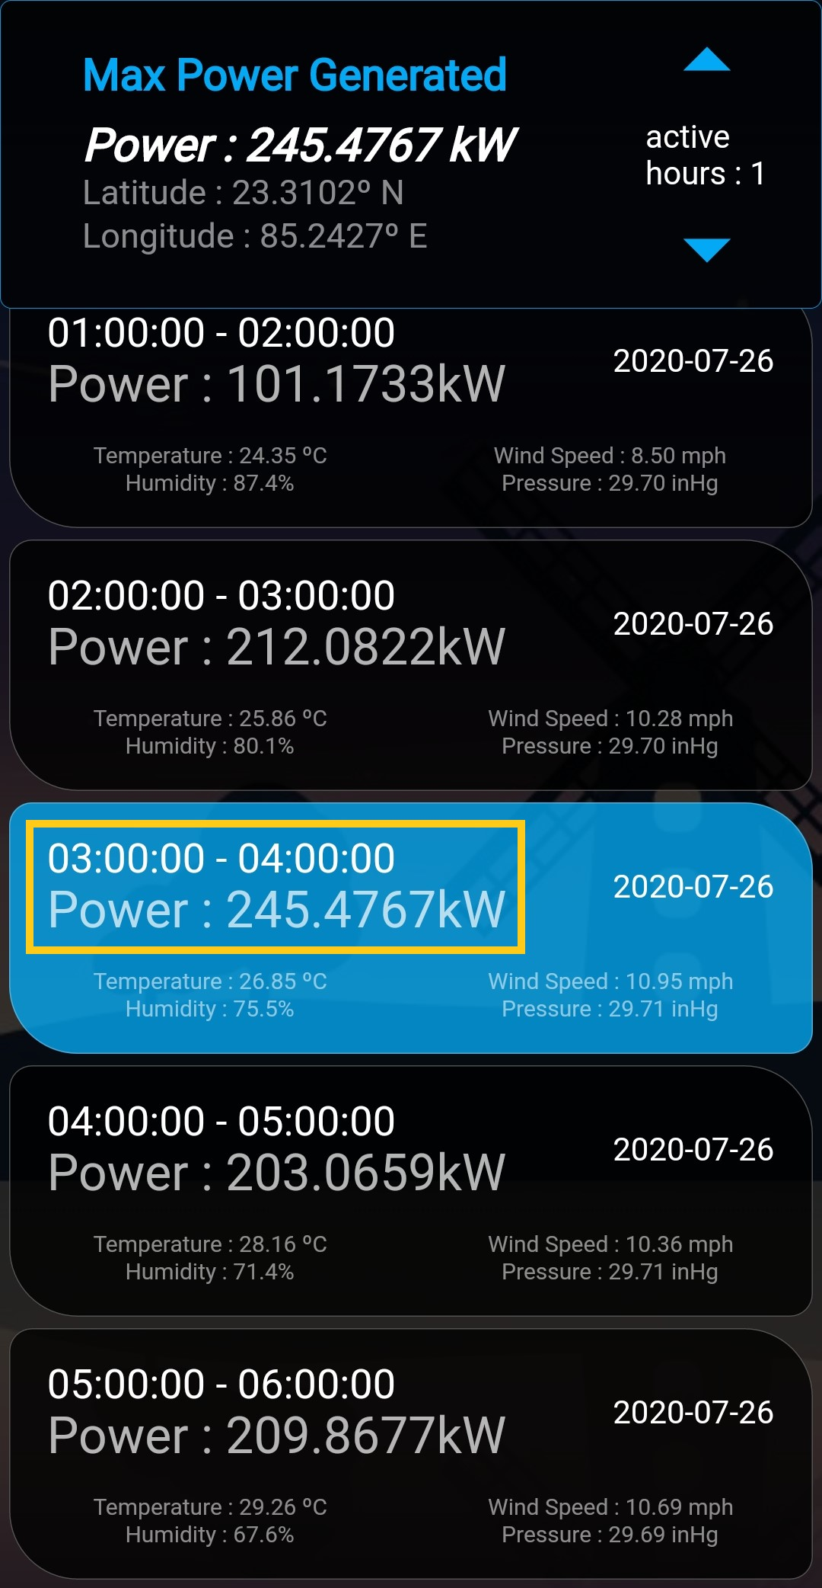
3.Display Best Utilisation Time and output power of wind turbine

Slide 16
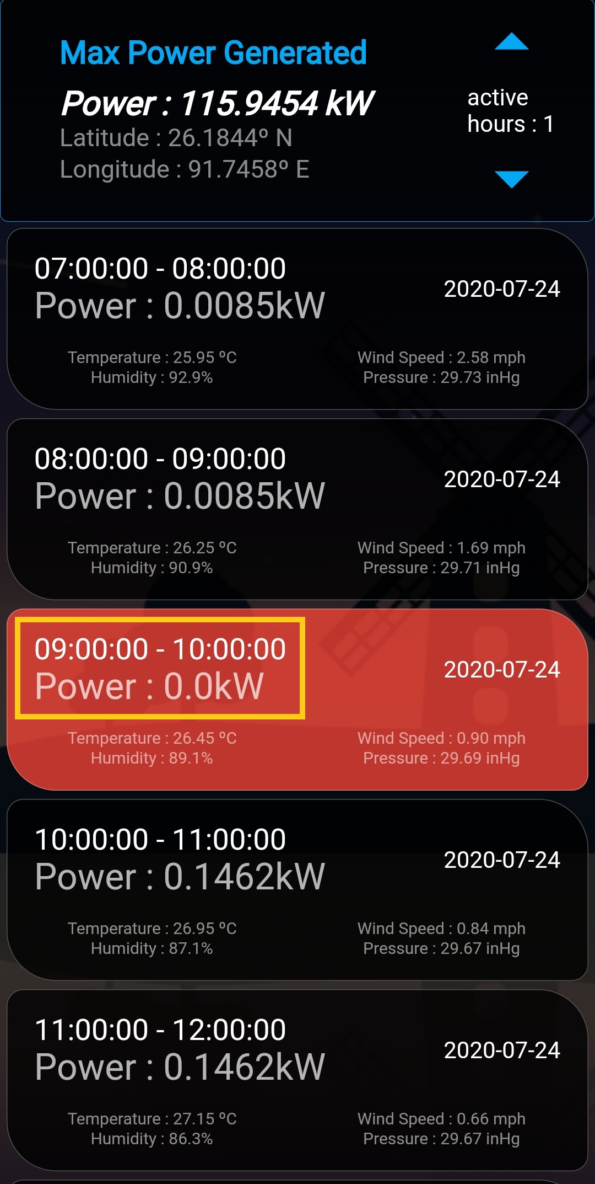
4.Display worst time for operating wind turbine

Slide 17
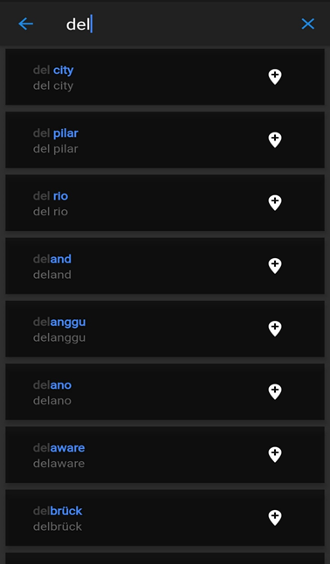
5.Provides accurate geo coordinates of 13,000 cities

Slide 18
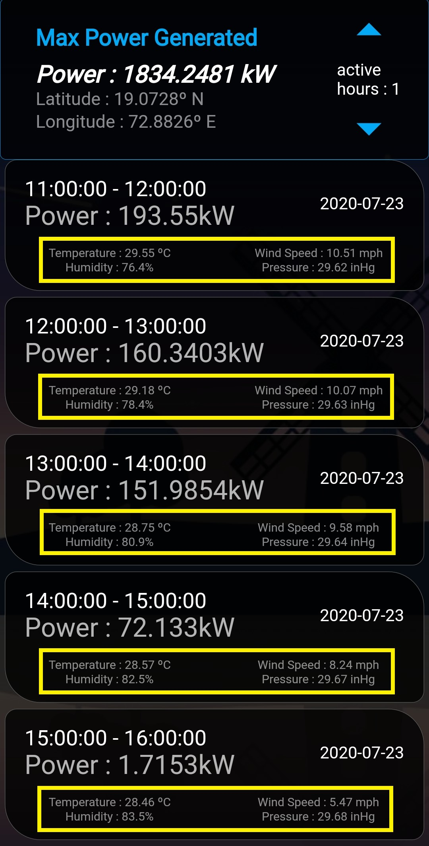
6.Provides accurate Weather data of any location for 72 hours

Slide 19
FUTURE SCOPE

Slide 20
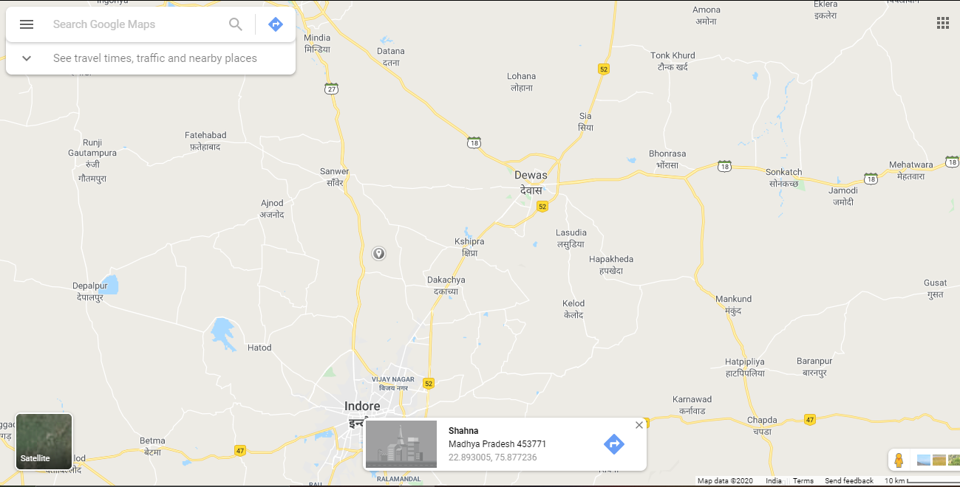
Use of Maps in the Application

Slide 21
Idea
Replace current geo-coordinate input methods entirely with the maps using google maps API.
Impact of Idea
No need for manually entering geo-coordinates value. Just click on location and you will get geo-coordinates of place
Cities not limited to 13k. Exploit search feature of maps and search for any location on globe and get accurate geo-coordinates
Why didn’t we Implement
Google Maps API is a paid service
No better free alternatives available

Slide 22
2. Predicting location for new Wind Farm from given options
Idea
From available location options of Wind Farm, choose the best option by using a new ML Model.
Model will carry out detailed Weather study of location from historical data and it will also consider features like proximity to city or sub-station before giving final predictions.
Why didn’t we implement
Out of scope of current project
Impact of Idea

Slide 23
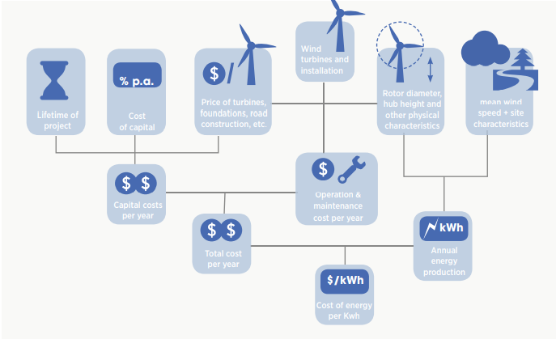
Economics of Wind System

Slide 24
THANK YOU

