Slide 1
Smart Security System for Homes
Internet of Things - BEGINNER

Slide 2
ABSTRACT:
Everything is getting automatic and smarter with the passing of days. It is time to make our homes smarter and automated. Our resource of pure water and power are limited and most of the time we use these resources unconsciously in our household chores which leads us to a crucial future. So this is the time to utilize our resources thriftily. This system includes doors automation with password protected lock, temperature fan - controlled , automated water pump, water tap and shower, light, anti-theft security and primary fire protection using various sensors like LDR, IR, pressure, smoke, heat & object sensors controlled by mainly microcontroller. Some features can be controlled by remote control system for more flexibility with the help of IBM Cloud Service. The goal of this system is to make our life more easy and safe as well as to save our resource and power.

Slide 3
INTRODUCTION:
Wireless Home security and Home automation are the dual aspects of this project. The currently built prototype of the system sends alerts to the owner over voice calls using the Internet if any sort of human movement is sensed near the entrance of his house and raises an alarm optionally upon the user’s discretion. The provision for sending alert messages to concerned security personnel in case of critical situation is also built into the system. On the other hand if the owner identiﬁes that the person may entering his house is not an intruder but an unexpected guest of his then instead of triggering the security alarm, the user/owner can make arrangements such as opening the door, switching on various appliances inside the house, which are also connected and controlled by the IBM Cloud/IBM IOT Platform in the system to welcome his guest. The same can be done when the user himself enters the room and by virtue of the system he can make arrangements from his doorstep such that as soon as he enters his house he can make himself at full comfort without manually having to switch on the electrical appliances or his favorite T.V. channel for an example. Thus using the same set of sensors the dual problems of home security and home automation can be solved on a complementary basis.
The alerts and the status of the IoT system can be accessed by the user from anywhere using Internet Connection connected with IBM Cloud, MIT App with your smart mobile phones.

Slide 4
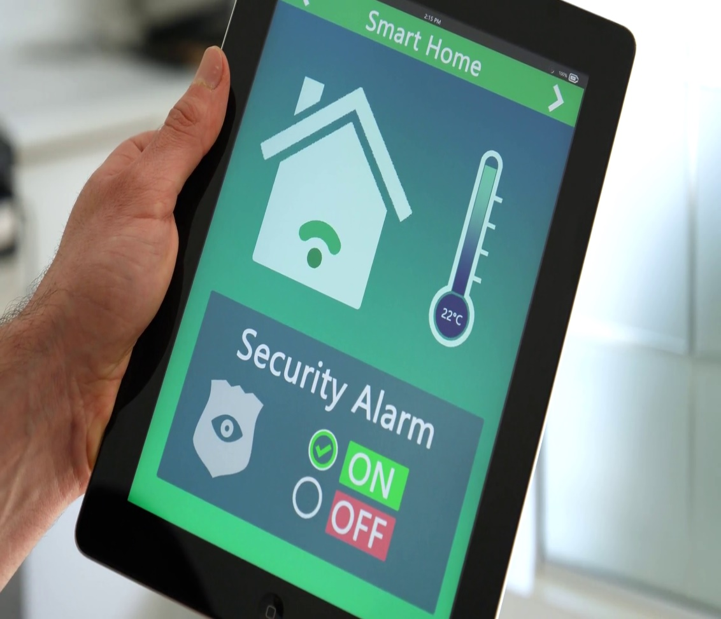
ADVANTAGES:
This low cost system with minimum requirements takes care of both home security as well as home automation.
This home security uses MIP App , so , providing better AI companionship features as private security.
IBM Cloud/ IOT Platform cares different services without any sensors/devices being triggered.
Since MIT App Inventor Account provides designing as well as companion with QR code/ six digit code, it can be accessible to admin.
Since it analyze with admin, there's no chance to get faulty with alarm service.

Slide 5
Implementation Setup

Slide 6
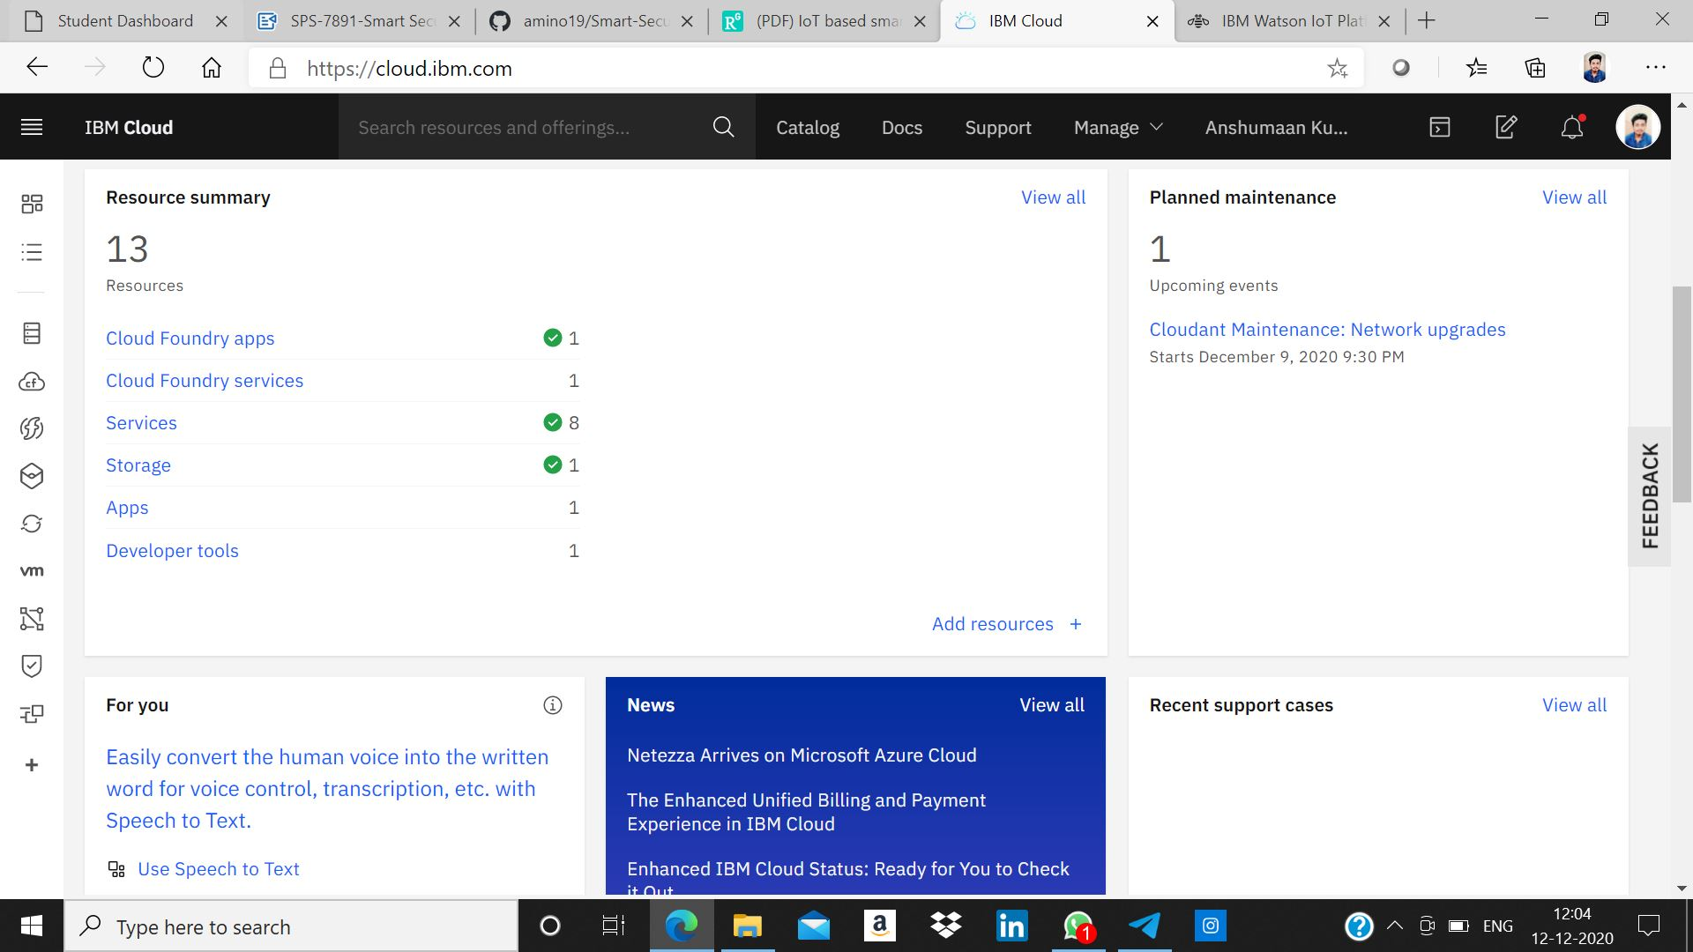
1. IBM Cloud Platform:
IBM Cloud® offers the most open and secure public cloud for business with a next-generation hybrid cloud platform, advanced data and AI capabilities, and deep enterprise expertise across 20 industries.

Slide 7
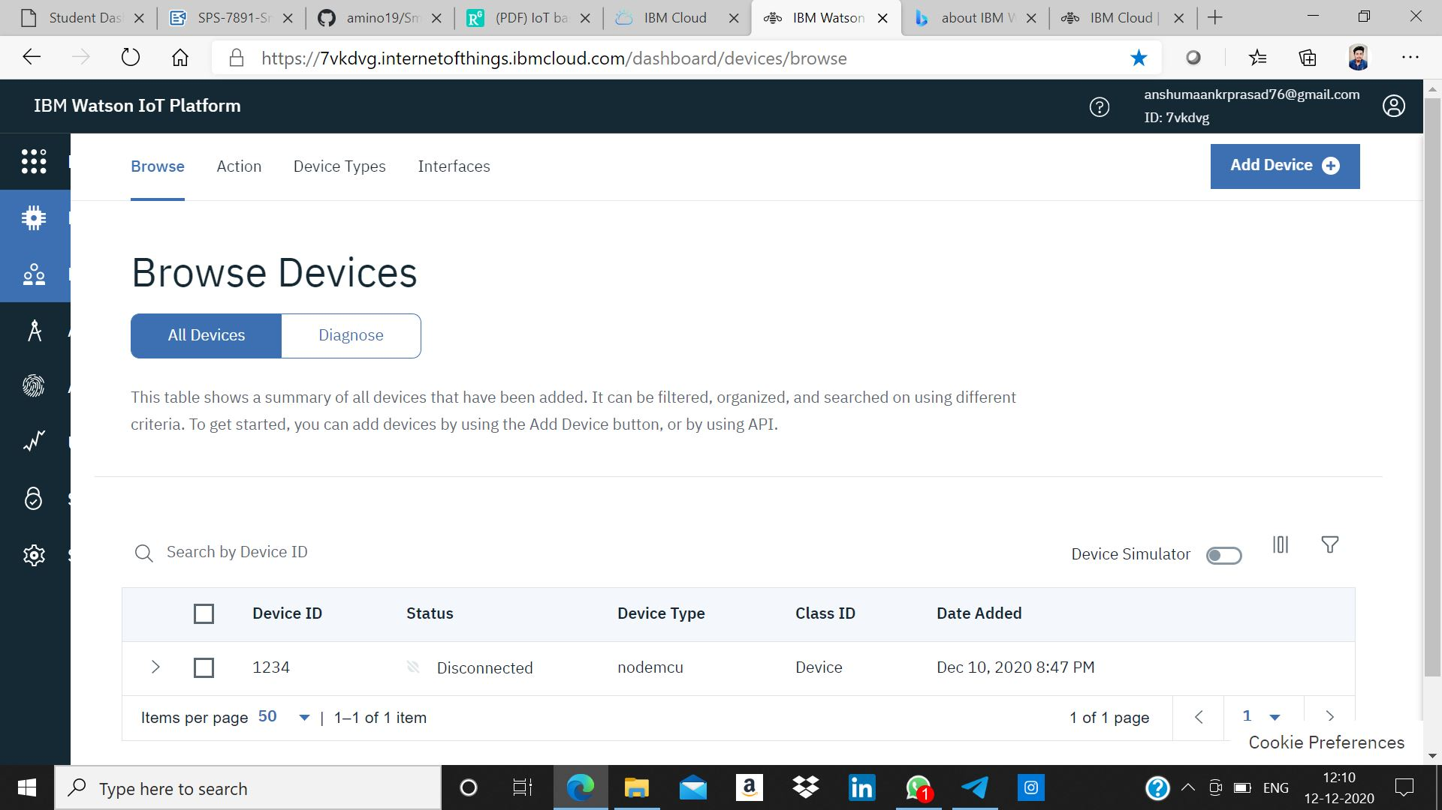
2. IBM Watson IoT Platform:
IBM Watson IoT Platform is a managed, cloud-hosted service designed to make it simple to derive value from your IoT devices. Watson IoT Platform and its additional add on services - Blockchain service and analytic service - enable organizations to capture and explore data for devices, equipment, and machines, and discover insights that can drive better decision-making.

Slide 8
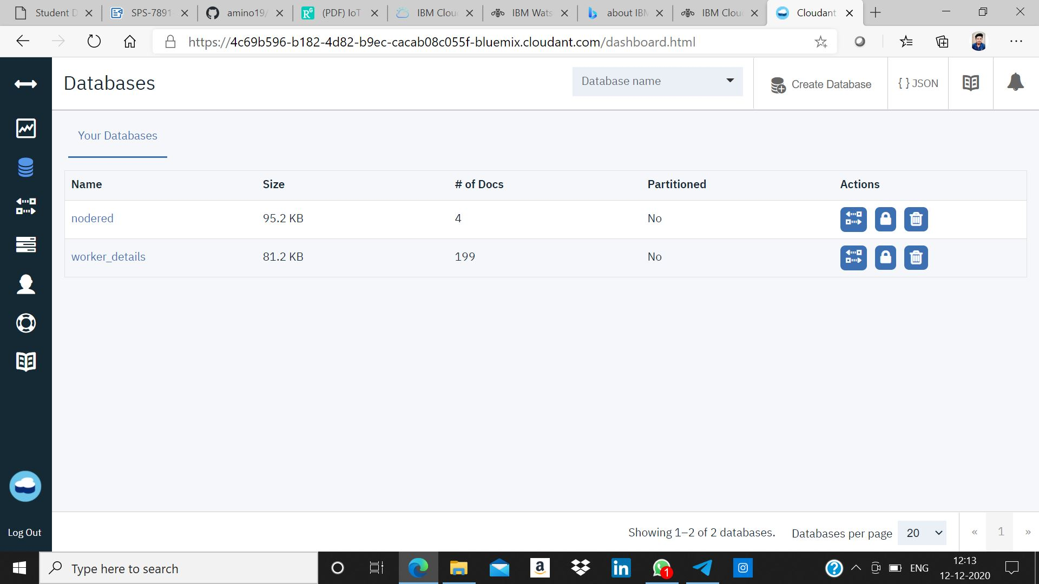
3. IBM Cloudant DB:
IBM Cloudant® is a distributed database that is optimized for handling heavy workloads that are typical of large, fast-growing web and mobile apps. Available as an SLA-backed, fully managed IBM Cloud™ service, Cloudant elastically scales throughput and storage independently.

Slide 9
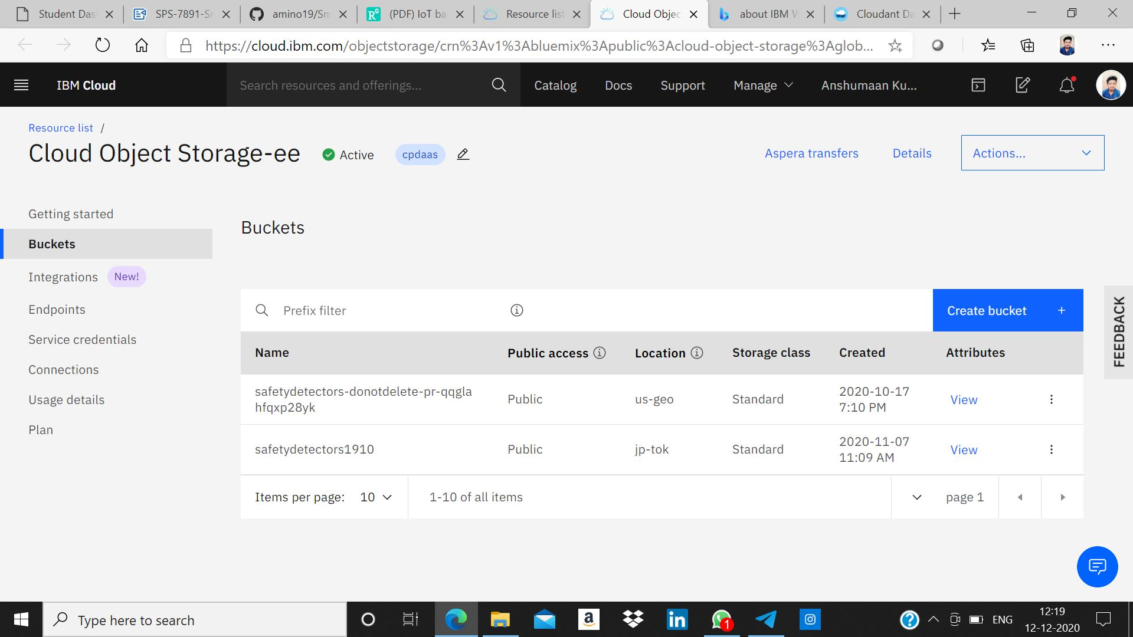
4. IBM Cloud Object Storage:
IBM Cloud Object Storage is integrated with IBM Watson Studio on IBM Cloud. When a machine learning project is created in IBM Watson Studio, an instance of IBM Cloud Object Storage is created automatically to accelerate the handling of the data required to train and deploy machine and deep learning models.

Slide 10
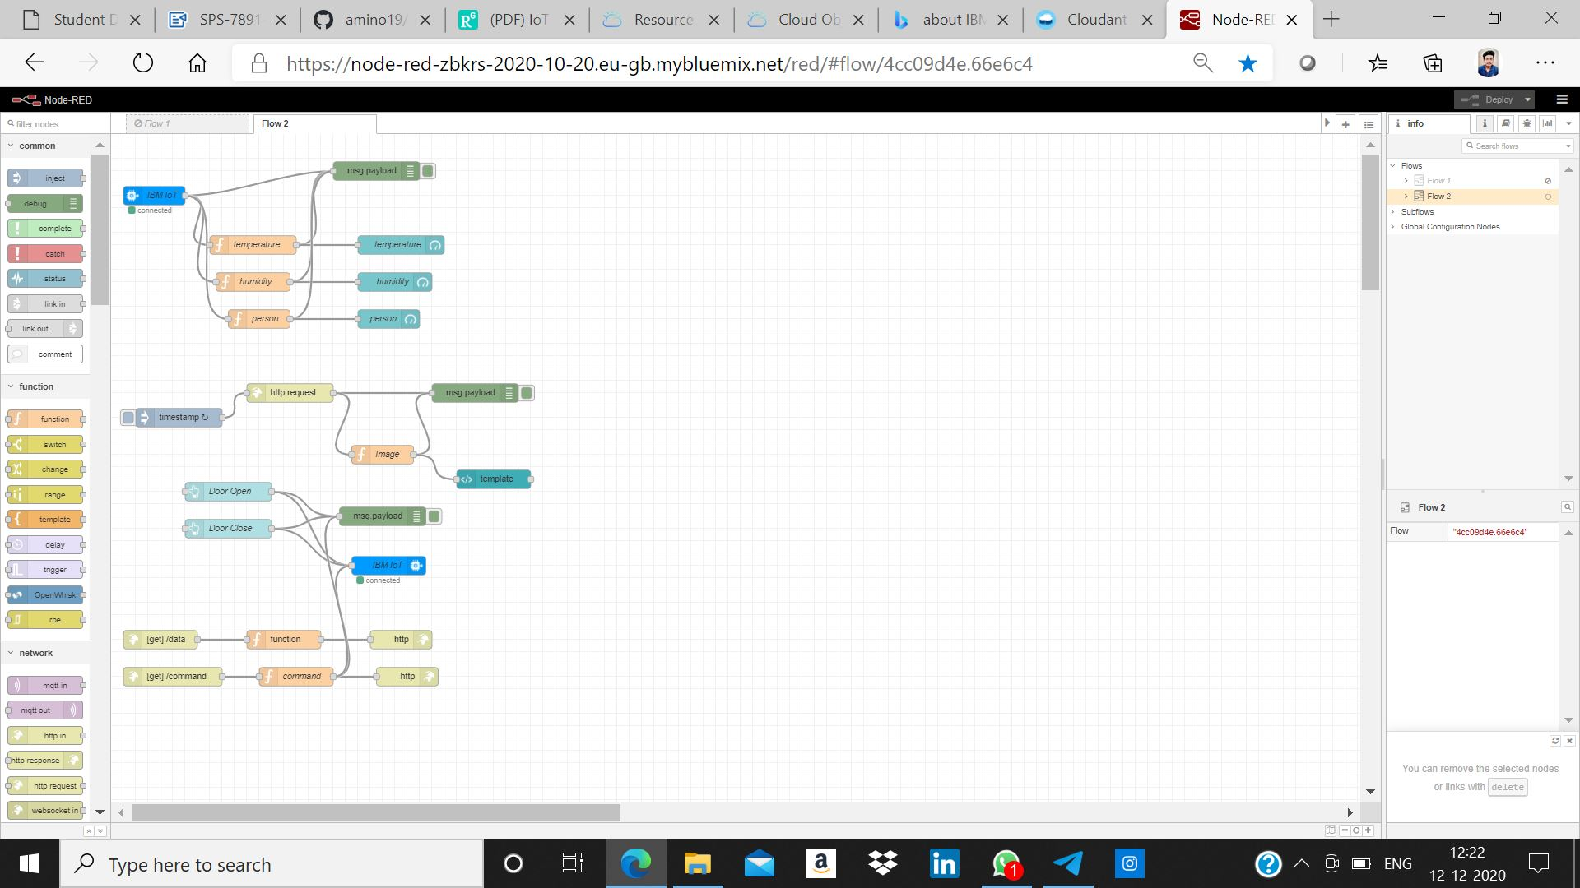
5.1 Node Red Service:
Node-RED is a programming tool for wiring together hardware devices, APIs and online services in new and interesting ways. It provides a browser-based editor that makes it easy to wire together flows using the wide range of nodes in the palette that can be deployed to its runtime in a single-click.

Slide 11
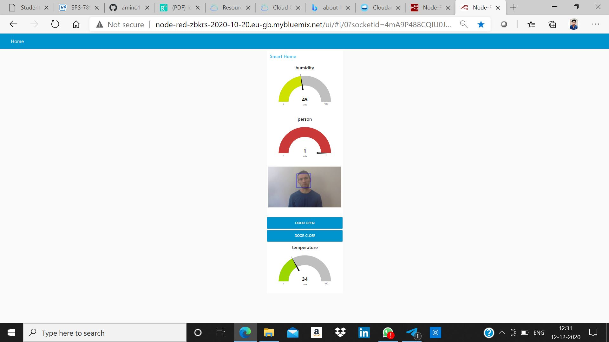
5.2 Node Red App:
The IBM App Connect UI on IBM Cloud includes a Dashboard to present all the integration flows for your App Connect instance together in one place. The Dashboard is a “one-stop shop” for creating and managing your integration flows and connectivity options, and from which to manage your App Connect account.

Slide 12
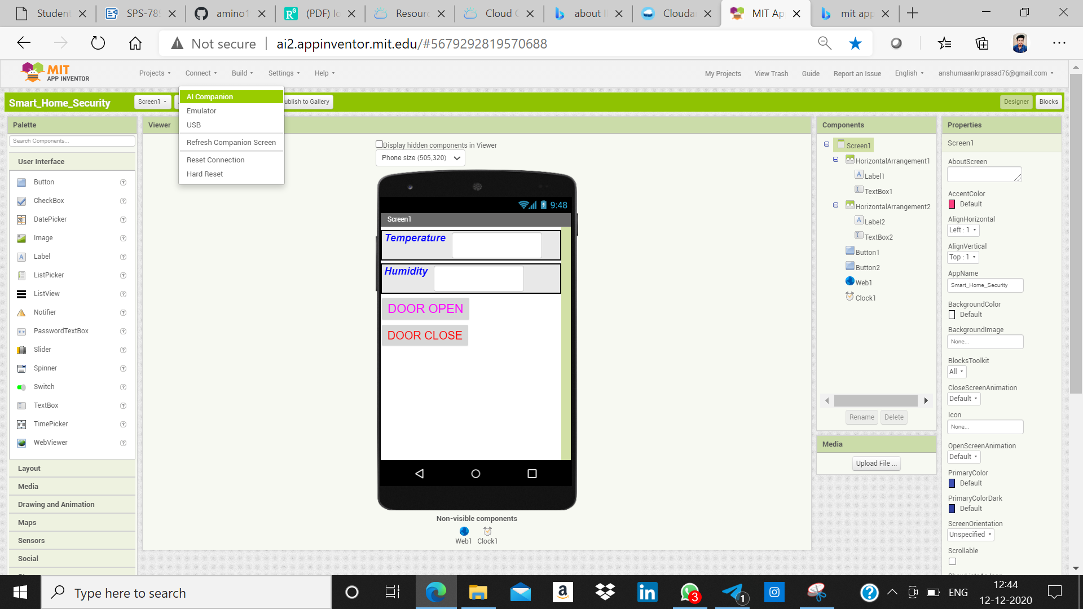
6. MIT App Inventor Account:
MIT App Inventor is a web application integrated development environment originally provided by Google, and now maintained by the Massachusetts Institute of Technology. It allows newcomers to computer programming to create application software(apps) for two operating systems: Android, and iOS, which, as of 8 July 2019, is in final beta testing. It is free and open-source software released under dual licensing: a Creative Commons Attribution ShareAlike 3.0 Unported license, and an Apache License 2.0 for the source code.

Slide 13
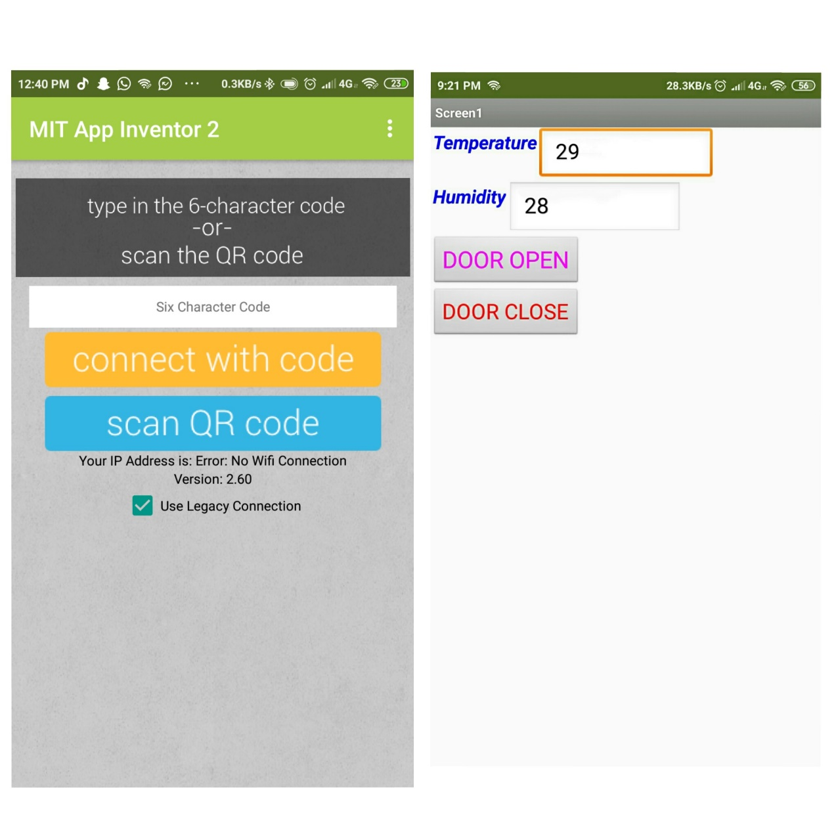
7. MIT AI2 Companion:
Here, we've to follow the steps by check "Use Legacy Connection" & type the code as seen in your laptop screen "AI Companion", it generates a code as well as QR to connect it with MIP App Inventor 2 Companion in your Smart phone.
The Values are visible as Temperature & Humidity. Note : We can make another row for person.
The description of MIT AI2 Companion
Note: The MIT AI2 Companion is not a stand-alone application. It is intended to be used with the MIT App Inventor system, a web based App Building tool which is free to use.
You can learn more about MIT App Inventor at :
http://appinventor.mit.edu

Slide 14
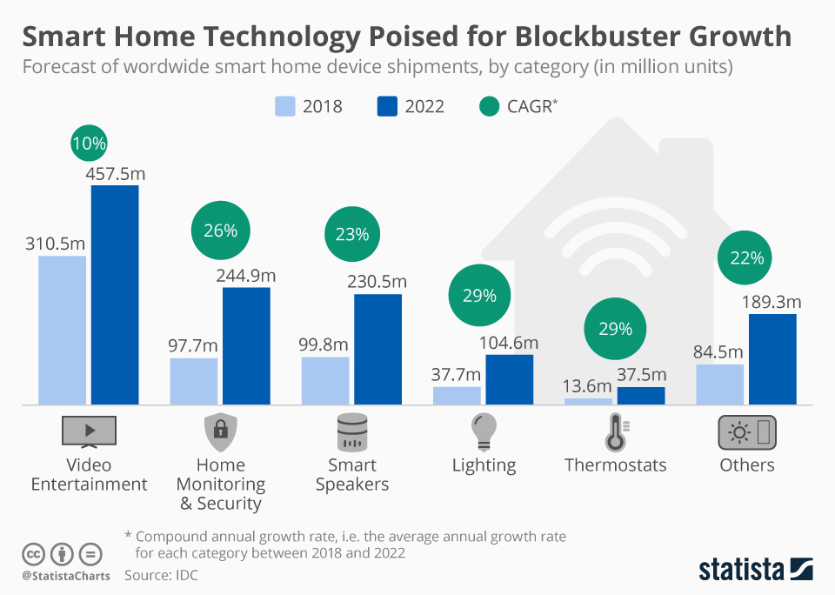
SECURITY STATS:

Slide 15
THANKYOU!
STAY SAFE. STAY SECURE.

