Slide 1
SMART AGRICULTURE SYSTEM BASED ON IOT
PROJECT ID- SPS_PRO_101
STUDENT ID- SB48015
NAME- T.Akanksha

Slide 2
TABLE OF CONTENT
INTRODUCTION
IBM IOT PLATFORM
WATSON IOT SIMULATOR
NODE-RED PLATFORM
WEATHER API
PYTHON IDLE
CONCLUSION

Slide 3

INTRODUCTION
SMART AGRICULTUE- Made farming easy

Slide 4
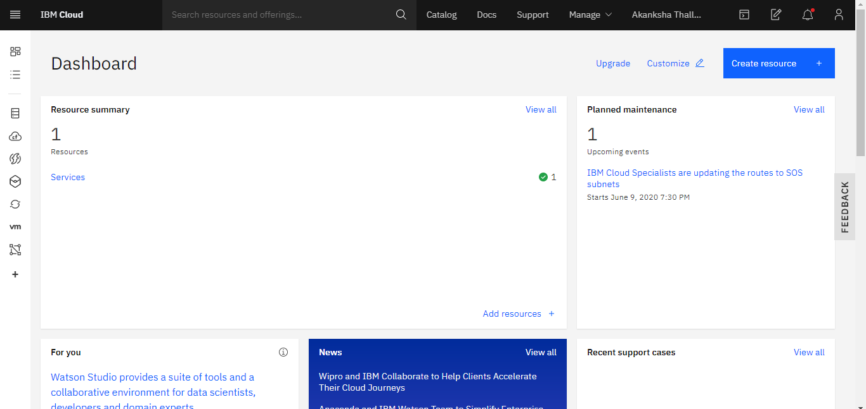
IBM IOT PLATFORM

Slide 5
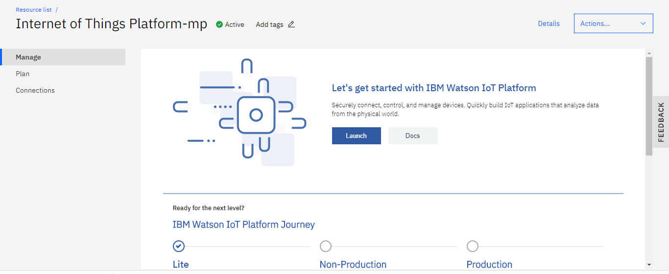
IBM IOT SERVICE

Slide 6
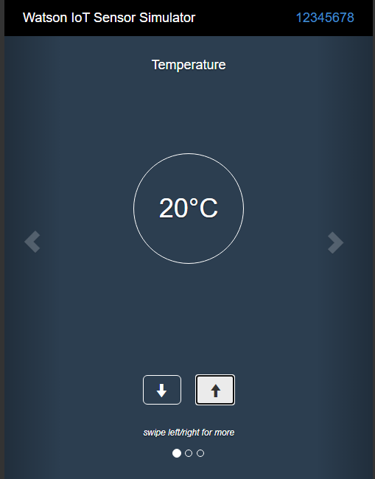
WATSON IOT SIMULATOR

Slide 7
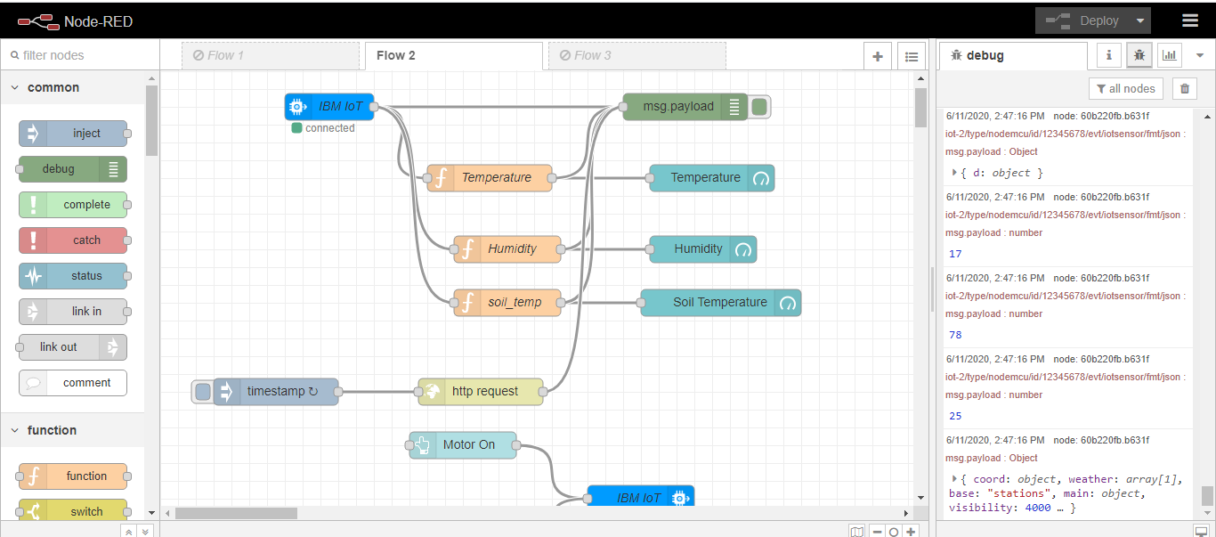
NODE-RED PLATFORM

Slide 8
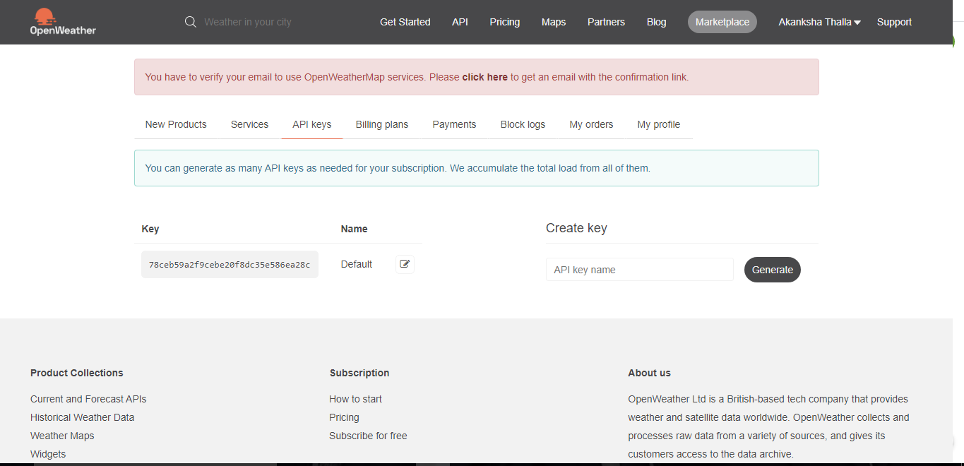
WEATHER API PLATFORM

Slide 9
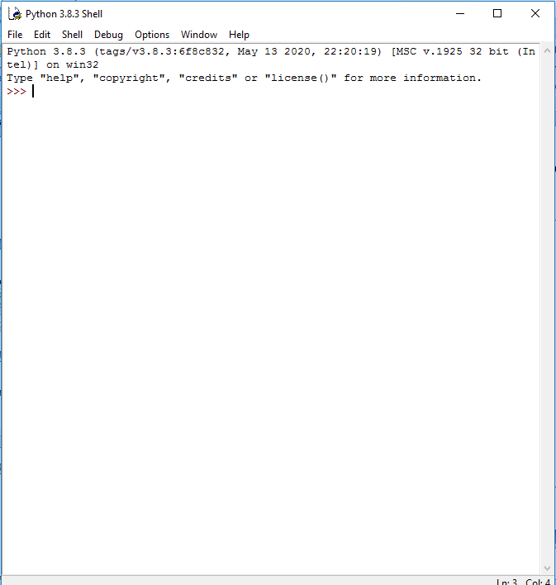
PYTHON IDLE

Slide 10
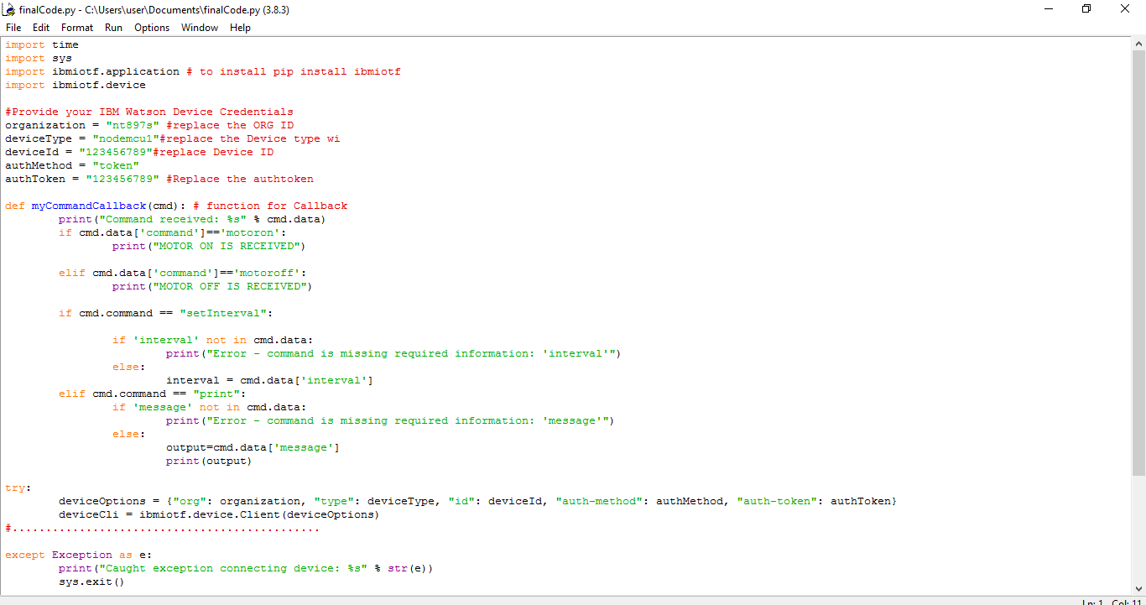
PYTHON CODE

Slide 11
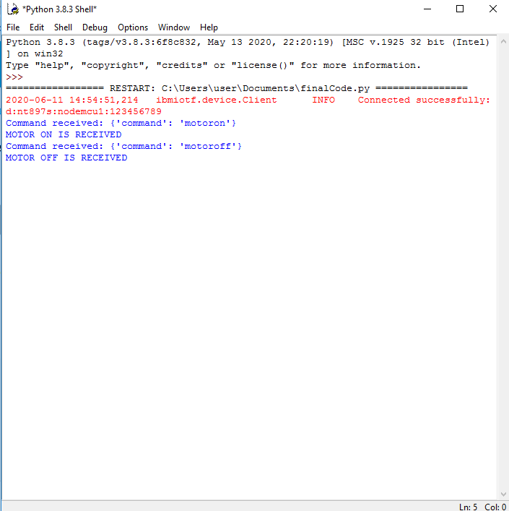
CONCLUSION

Slide 12


