Slide 1
HELLO GUYS!!!!!!!!!!!!!!!!!!!!
THIS IS
HARSHITHA.DIGAJARI

Slide 2
TODAY I’AM HERE TO EXPLAIN ABOUT MY INTERNSHIP UNDER SMARTINTERNZ .
MY PROJECT IS:
SMART AGRICULTURE SYSTEM BASED ON IOT

Slide 3
Project Description:
Smart Agriculture System based on IoT can monitor soil moisture and climatic conditions to grow and yield a good crop.
The farmer can also get the realtime weather forecasting data by using external platforms like Open Weather API.
Farmer is provided a mobile app using which he can monitor the temperature,humidity and soil moisture parameters along with weather forecasting details.
Based on all the parameters he can water his crop by controlling the motors using the mobile application.
Even if the farmer is not present near his crop he can water his crop by controlling the motors using the mobile application from anywhere.
Here we are using the Online IoT simulator for getting the Temperature,Humidity and Soil Moisture values.

Slide 4
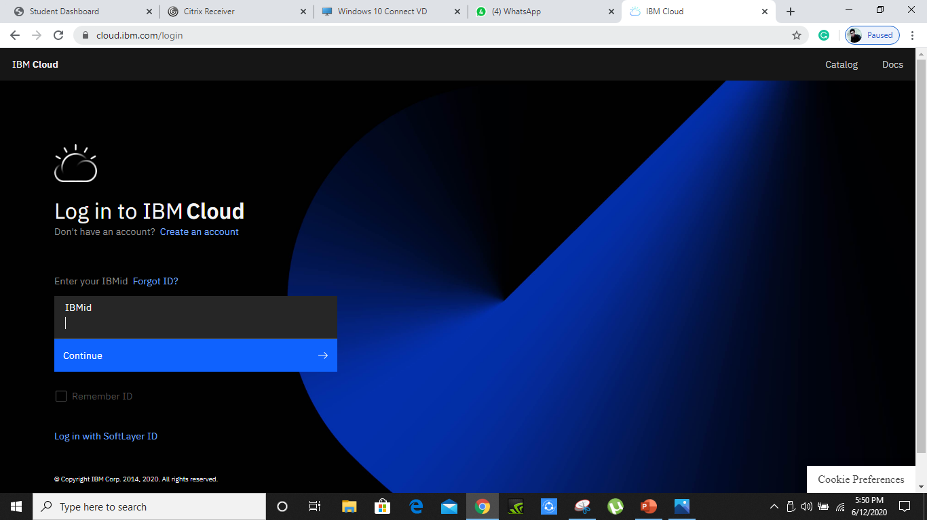
Firstly, we need to create an account in ibm cloud

Slide 5
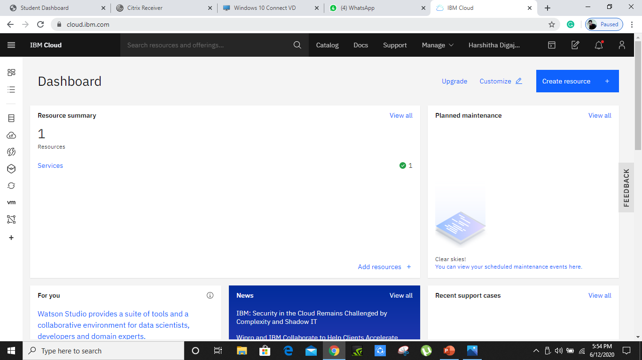
We should give the credentials of our account and get looged in to ibm cloud

Slide 6
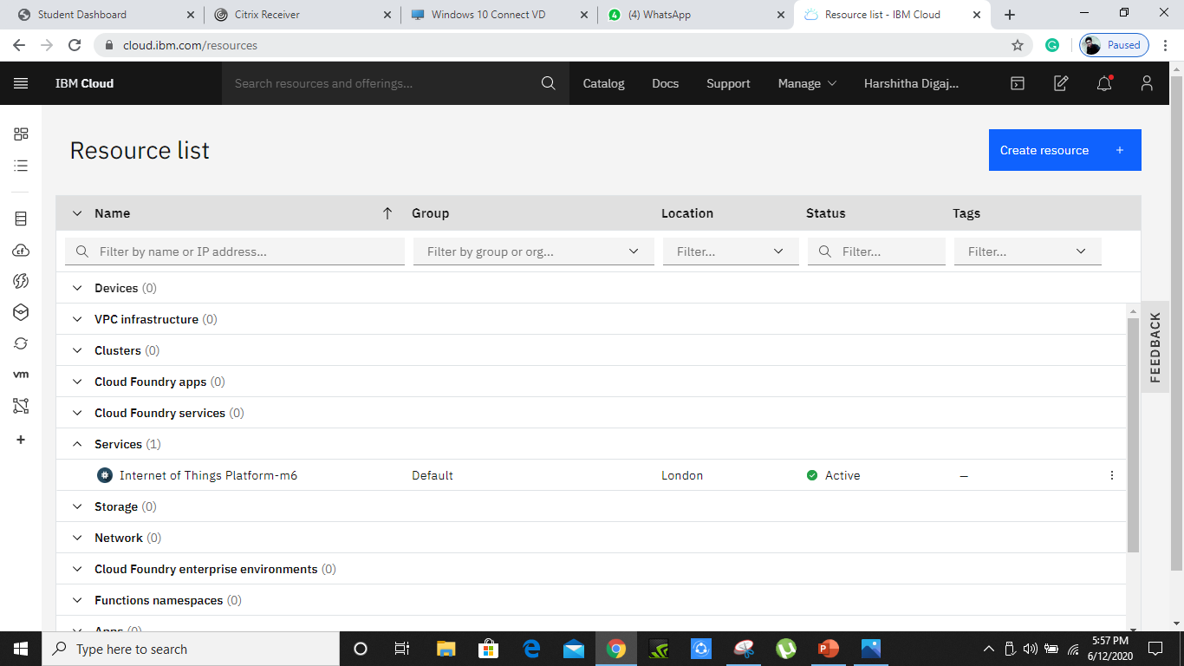
In ibm cloud we have to create a service named iot

Slide 7
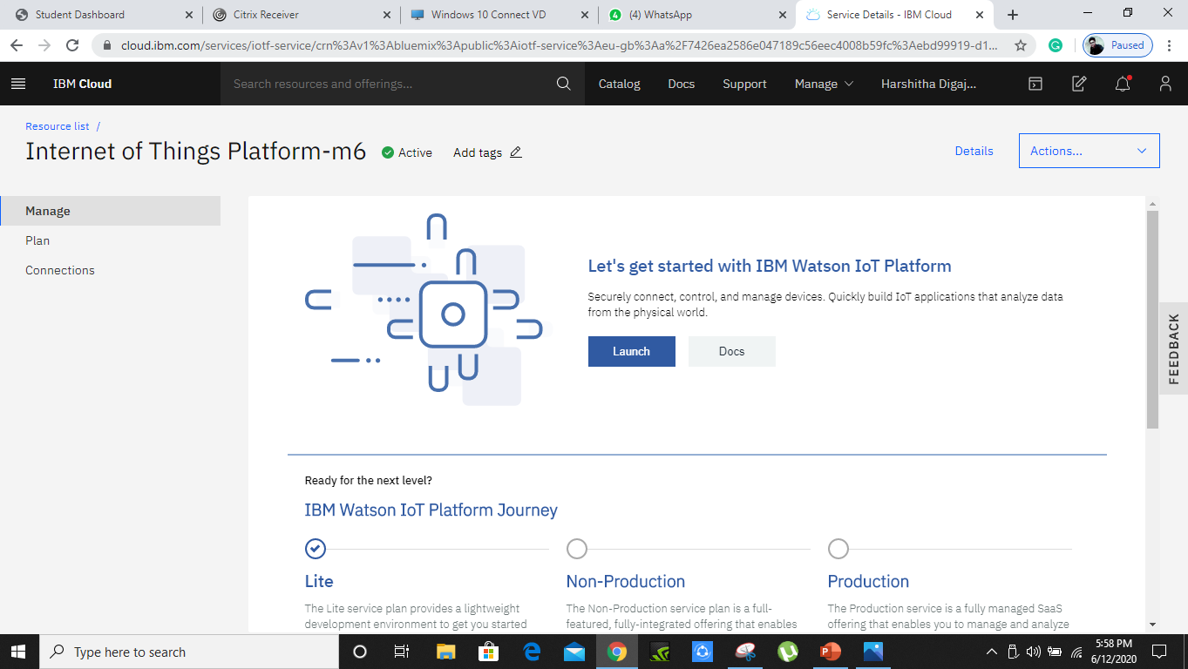
Click on the the services you are redirected to here.

Slide 8
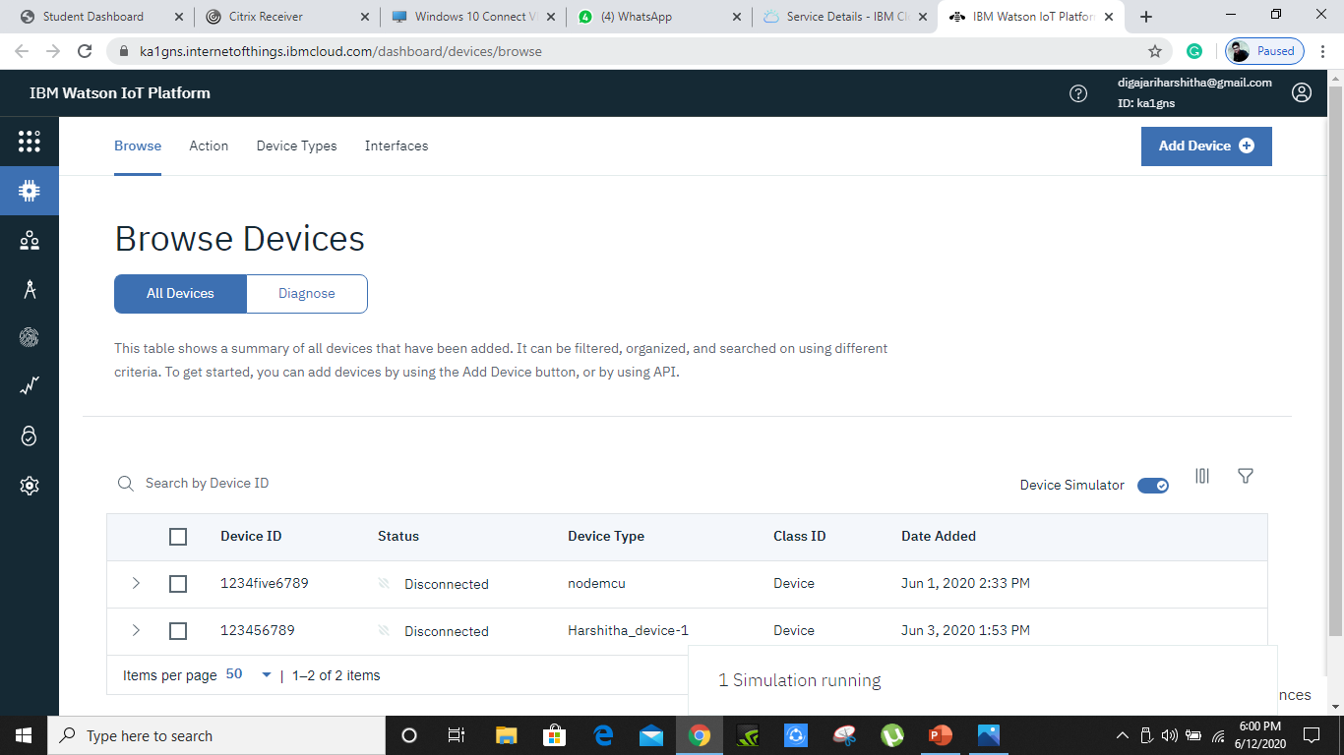
Click on the launch button and then we will be redirected to IBM IOT WATSON platform

Slide 9

Here ,we have to create devices by using add device button as shown below

Slide 10
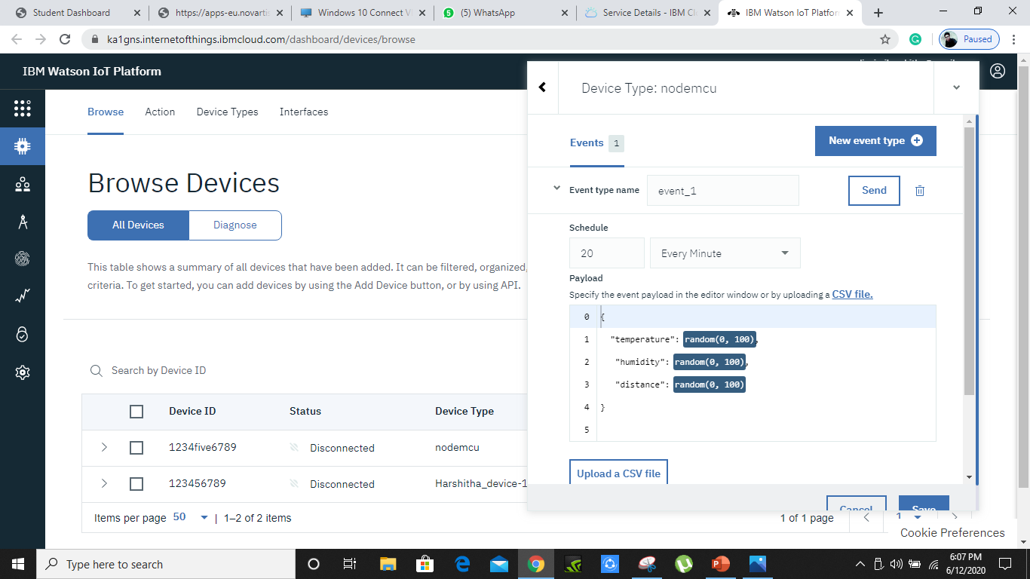
Herewe have 1 device running on the simulation as shown below

Slide 11
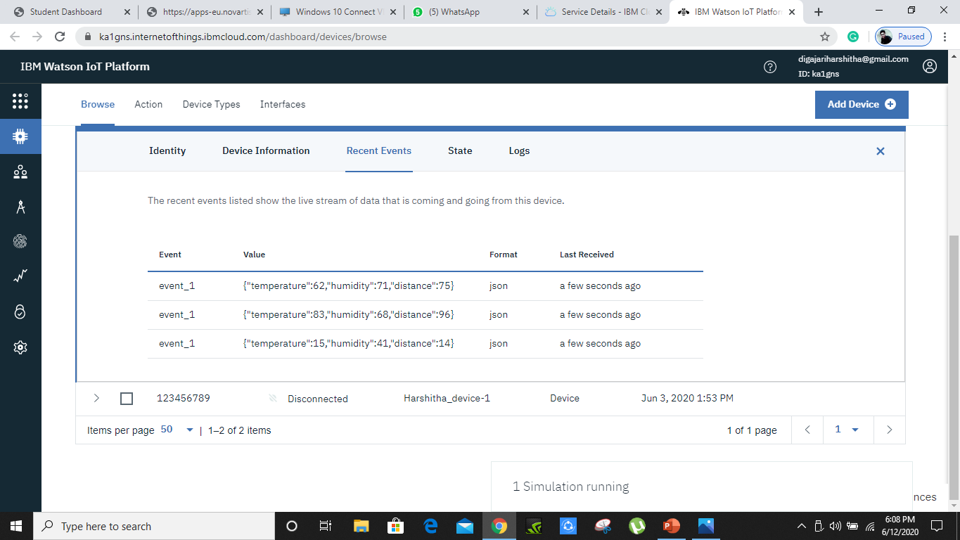
Minimize the simulation tab, and click on device 1 and checkout for the recent events over there sent by the simulation .It looks like this

Slide 12
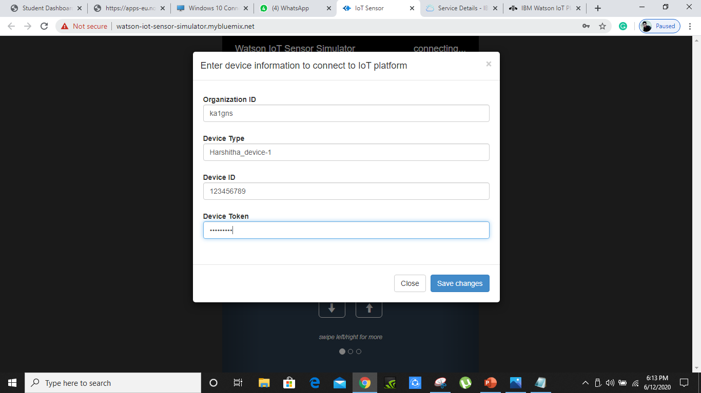
Using second device credentials we save changes to Watson iot sensor simulator

Slide 13
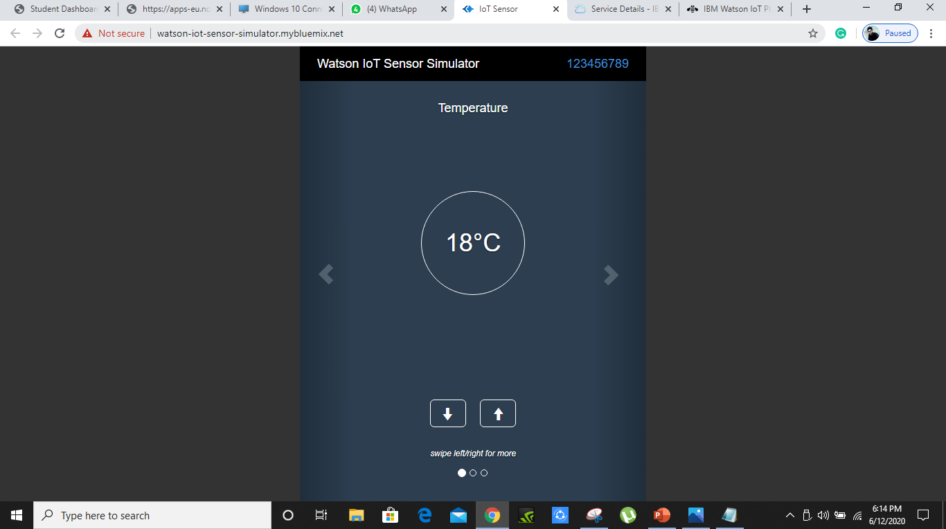
We will able to see like this

Slide 14
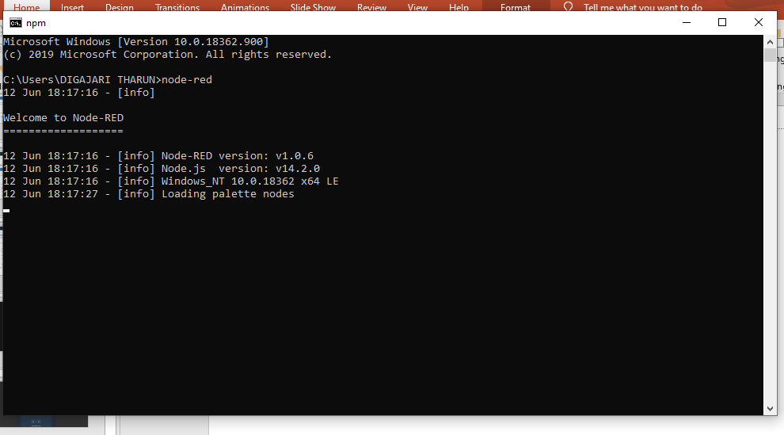
After that we have to install nodered and type node-red in terminal
Here we will get a server number 127.0.0.1:1880 an type it in chrome

Slide 15
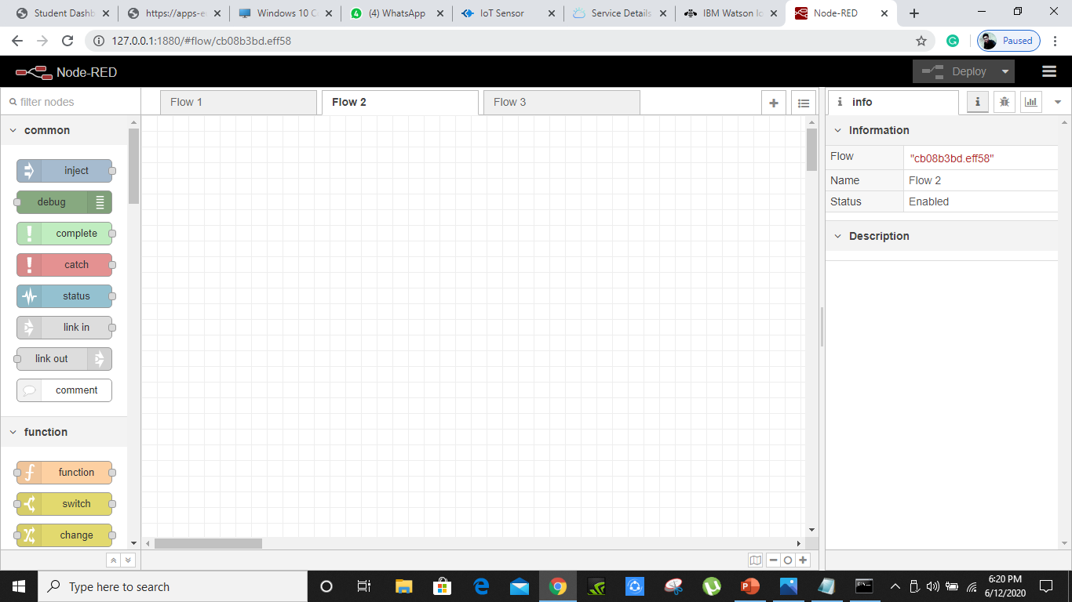

Slide 16
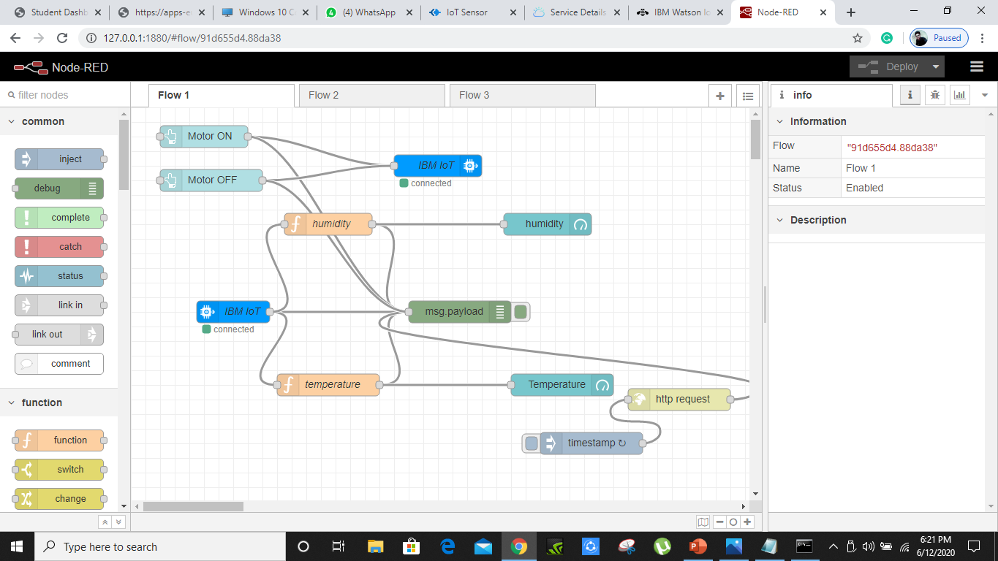
Now we have to create nodes

Slide 17
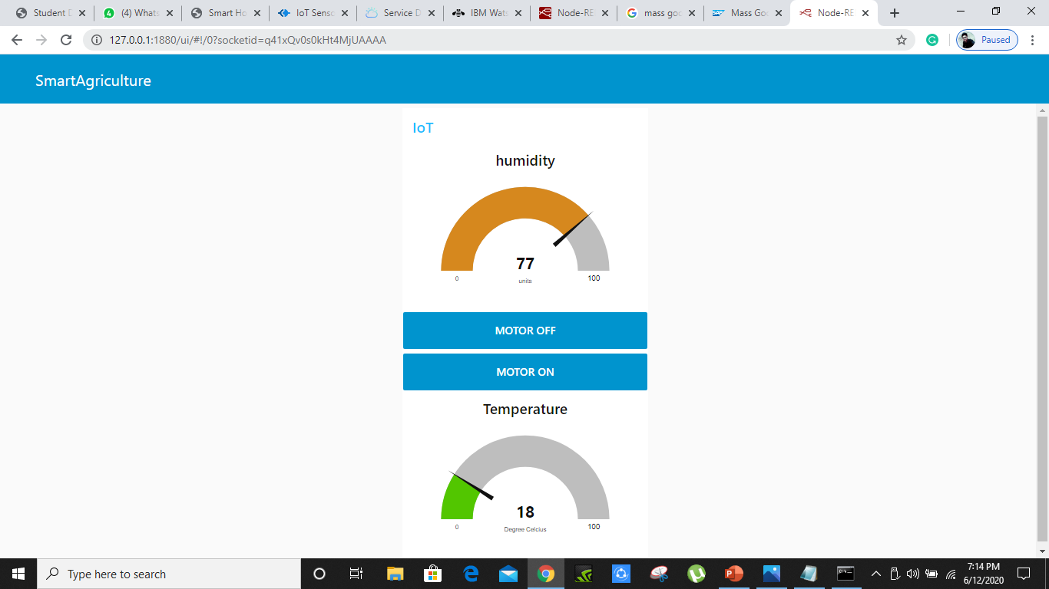
Create an open weather acoount api and paste the url in http request node
After all the cofigarations are done click on deploy
And the open browser and type 127.0.0.1:1880/ui
You will see like this

Slide 18
Now write the python code with the device 1 credentials as shown below
import time
import sys
import ibmiotf.application # to install pip install ibmiotf
import ibmiotf.device
#Provide your IBM Watson Device Credentials
organization = "ka1gns" #replace the ORG ID
deviceType = "Harshitha_device-1"#replace the Device type wi
deviceId = “******************"#replace Device ID
authMethod = "token"
authToken = “*****************" #Replace the authtoken
def myCommandCallback(cmd): # function for Callback
print("Command received: %s" % cmd.data)
if cmd.data['command']=='motoron':
print("MOTOR ON IS RECEIVED")
elif cmd.data['command']=='motoroff':
print("MOTOR OFF IS RECEIVED")
if cmd.command == "setInterval":
if 'interval' not in cmd.data:
print("Error - command is missing required information: 'interval'")
else:
interval = cmd.data['interval']
elif cmd.command == "print":
if 'message' not in cmd.data:
print("Error - command is missing required information: 'message'")
else:
output=cmd.data['message']
print(output)
try:
deviceOptions = {"org": organization, "type": deviceType, "id": deviceId, "auth-method": authMethod, "auth-token": authToken}
deviceCli = ibmiotf.device.Client(deviceOptions)
#..............................................
except Exception as e:
print("Caught exception connecting device: %s" % str(e))
sys.exit()
# Connect and send a datapoint "hello" with value "world" into the cloud as an event of type "greeting" 10 times
deviceCli.connect()
while True:
deviceCli.commandCallback = myCommandCallback
# Disconnect the device and application from the cloud
deviceCli.disconnect()

Slide 19
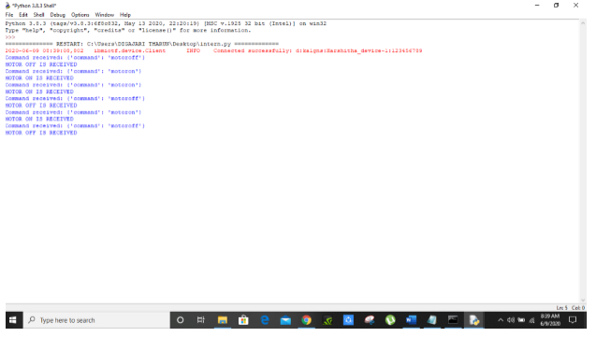
So,when you un this code and click on motor on and off bttons in ui output will be like this
This will be very helpful to farmers.

Slide 20
THANK YOU

