Slide 1
Smart Agriculture System Based on IOT
By- Juhi Wani
Project ID: SPS_PRO_101

Slide 2
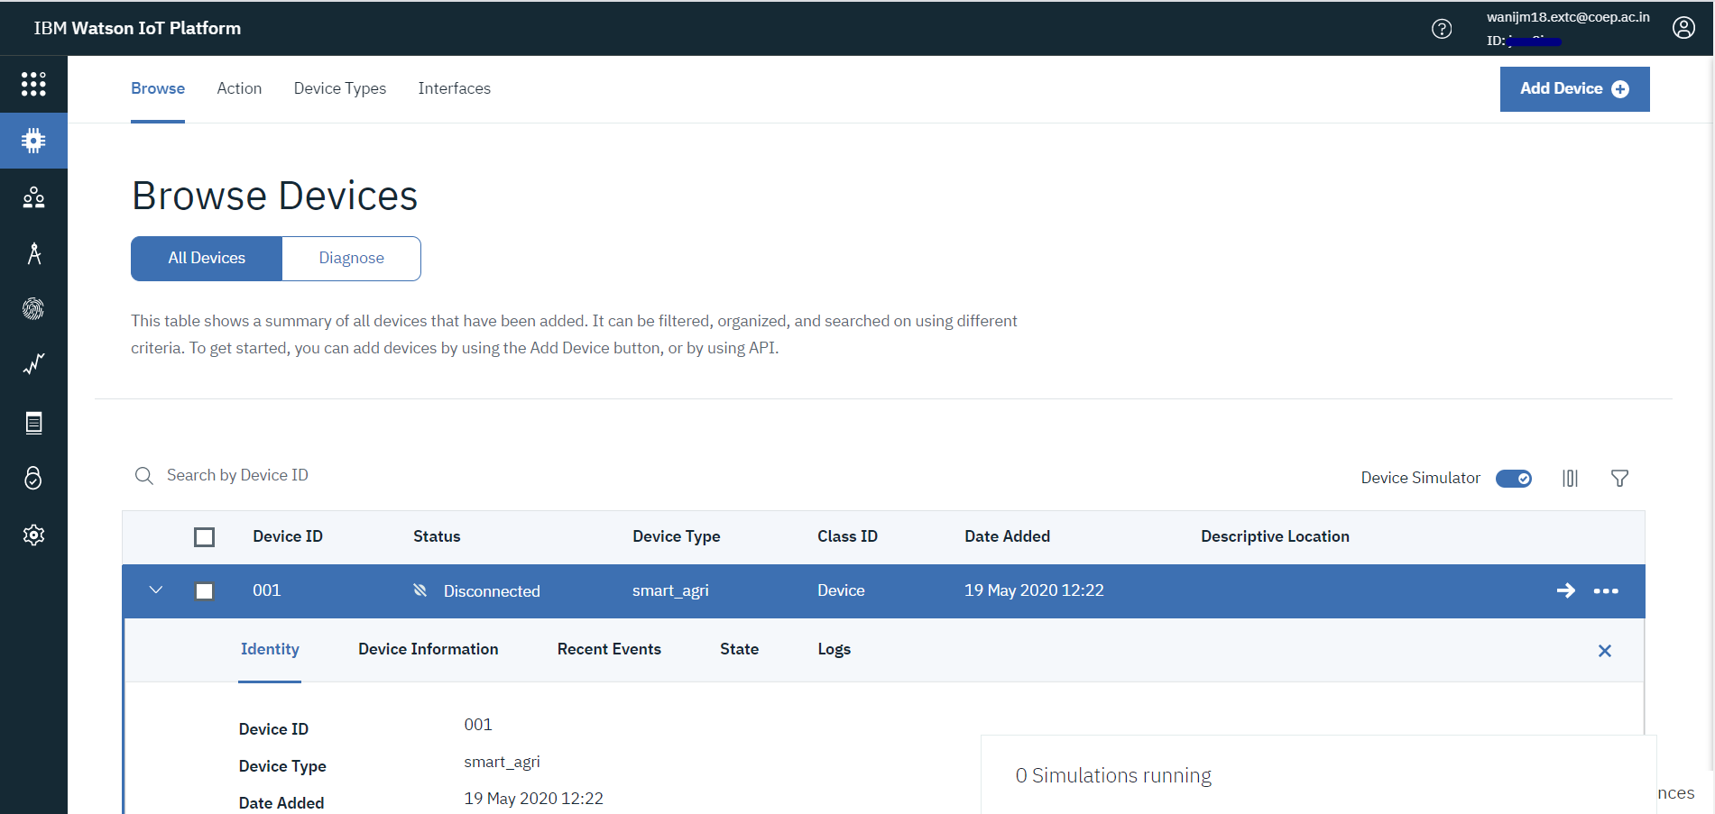
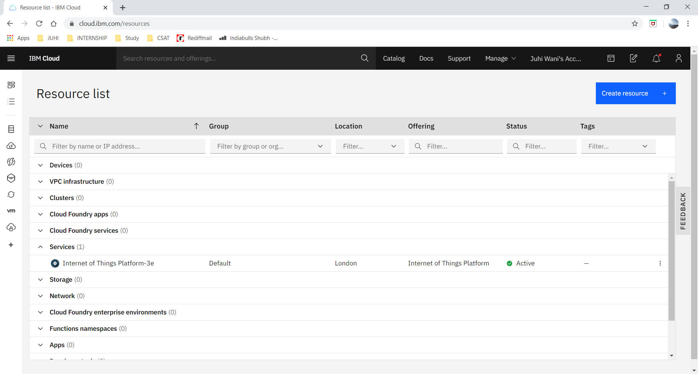
IBM CLOUD SERVICE CREATION AND DEVICE CREATION IBM WATSON

Slide 3
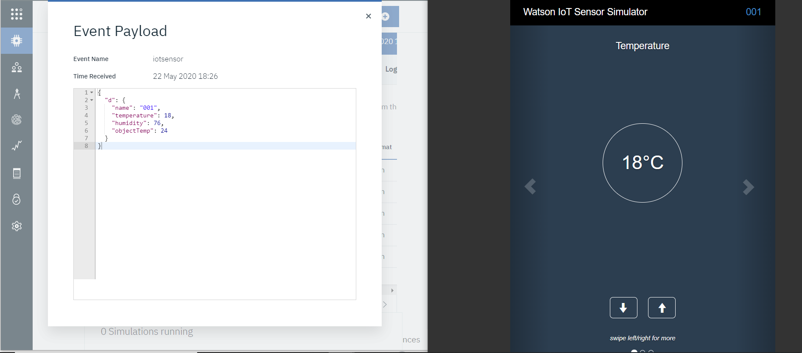
RECEIVING IOT SENSOR DATA ON THE IBM DEVICE

Slide 4
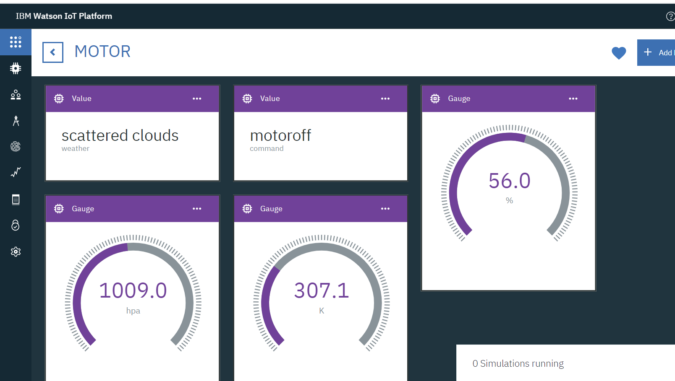
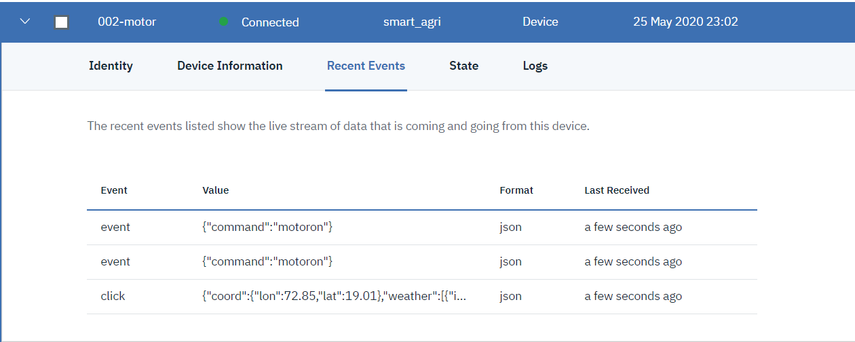
RECEIVING THE COMMANDS ON THE DEVICE AND DISPLAYING THEM ON CARDS

Slide 5
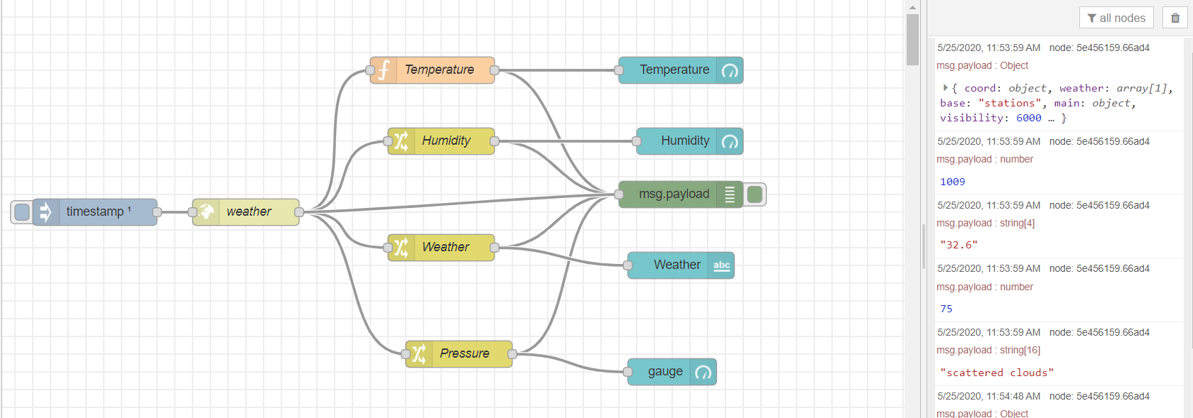
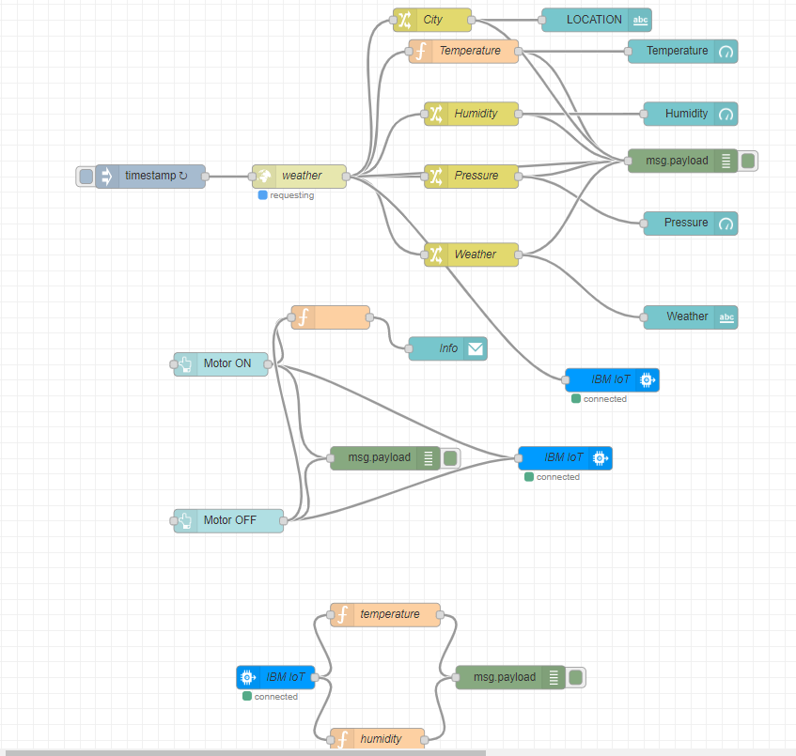
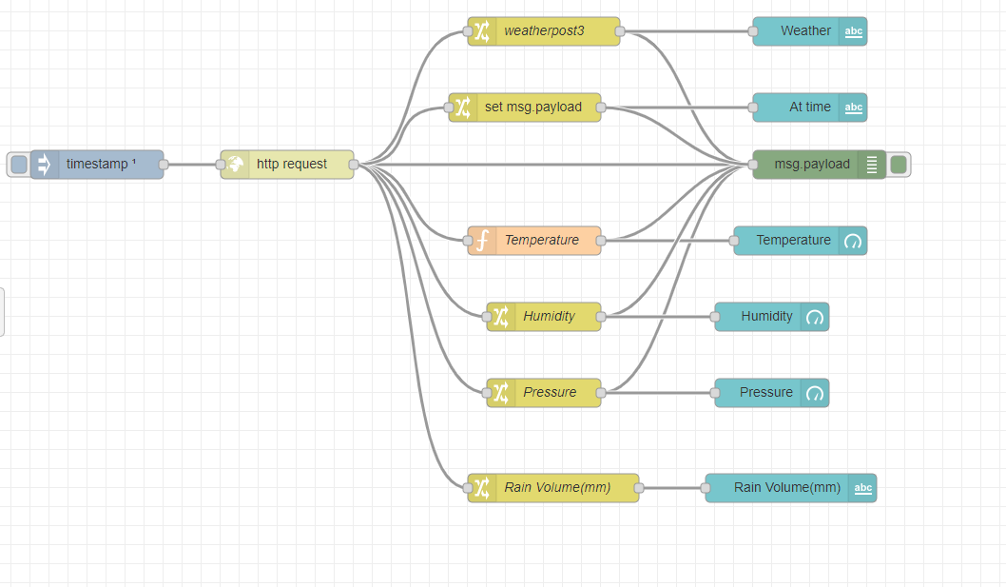
RECEIVING DATA FROM OPEN WEATHER API AND CONFIGURING BUTTONS

Slide 6
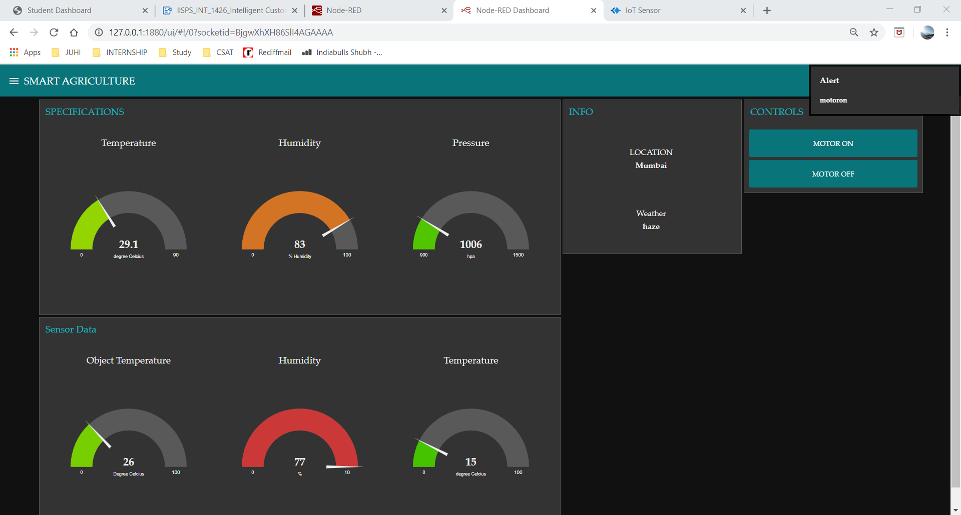
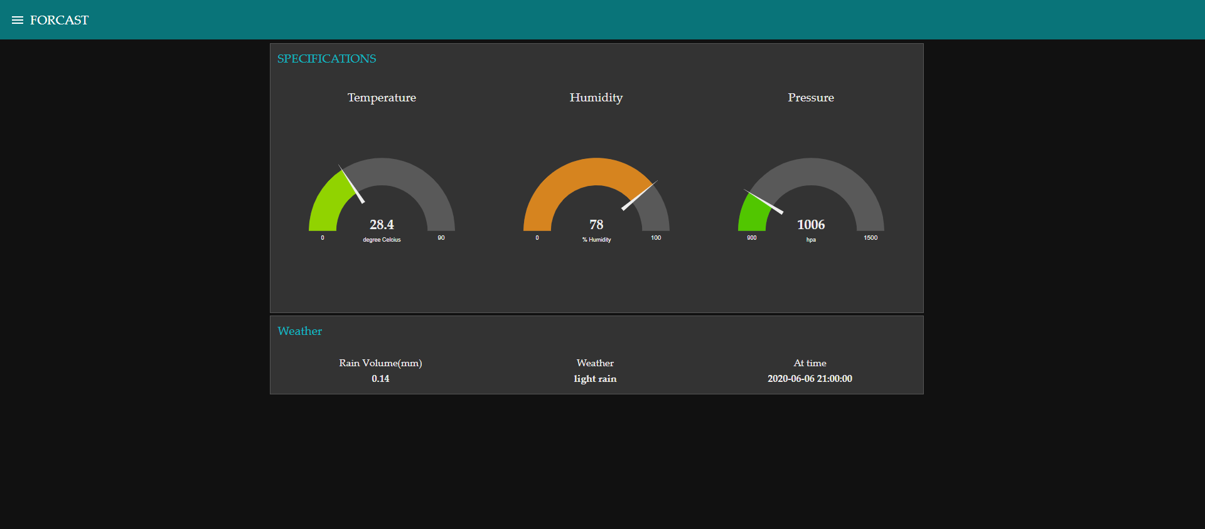
COMPLETED UI WITH MESSAGE FUNCTIONALITY

