Slide 1
Smart Agriculture System
Based on IoT

Slide 2
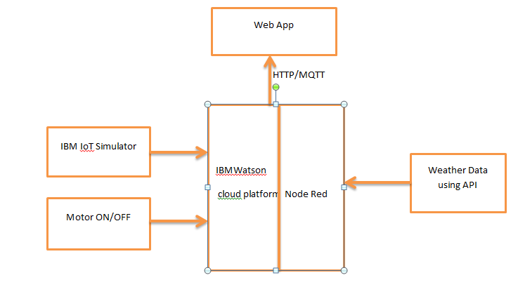

Slide 3
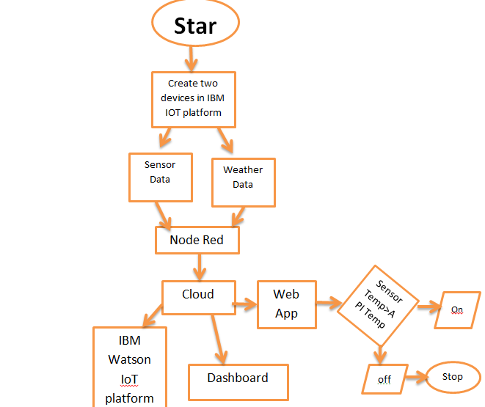
t

