Slide 1
Akhila maarka
College : Chaitanya Bharathi Institute Of Technology(Hyderabad).
Branch : Electronics and Communication Engineering.
Year of Study : 3rd Year.

Slide 2

Smart Agriculture System Based on IOT

Slide 3
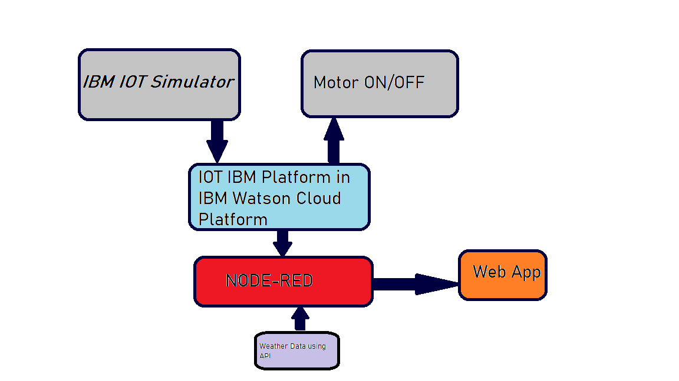
Block Diagram

Slide 4
Future Scope
This Project brings us the smart procedure to produce crops with reduced efforts.
Since, farming is very essential for us to survive , this IOT based application will help farmers to do complete their daily tasks easily and will be able to increase crop yield.

Slide 5


