Slide 1
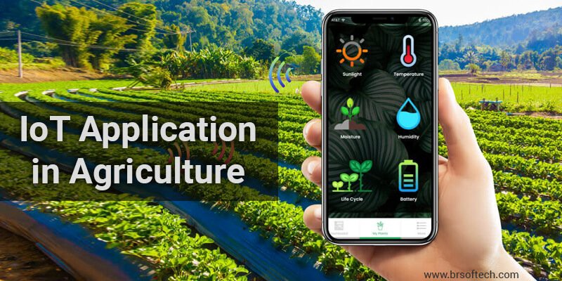
SMART AGRICULTURE SYSTEM
BASED ON
INTERNET OF THINGS
SUBMITTED TO: SUBMITTED BY:
SMARTINTERZ Mansi Kukreja
(THE SMART BRIDGE) B.Tech (Mechatronics) 3rd year
Intern under Smartinternz

Slide 2
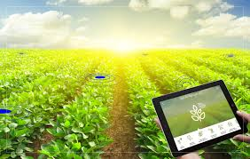
INTRODUCTION
Smart Agriculture System based on IOT is a project that focuses on the advancement of the agricultural process by providing the farmers a mobile application using which they can monitor the temperature, humidity and soil moisture of the their farm along with live update of the weather conditions of the area and depending on that they can control the irrigation system (motor) of their farm.

Slide 3

Block Diagram
Web Application
HPPT
IBM WATSON CLOUD PLATFORM
Node Red
IBM IOT SIMULATOR
Weather data using API
IOT IBM PLATFORM
Motor ON/OFF

Slide 4
FLOW CHART
Open the web App
Go on the IBM IOT sensor data tab then see and analyze the sensor data.
Go on the open weather API tab and see the live forecast of the weather condition of the area.
Depending upon the analysis and the need of the crop control the motor.

Slide 5
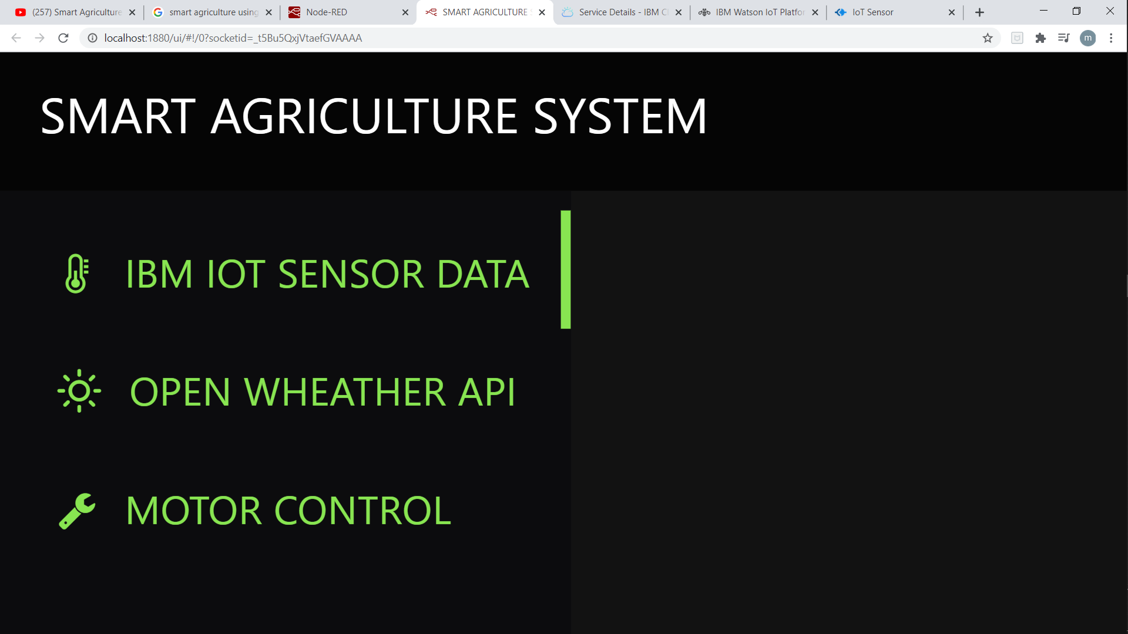
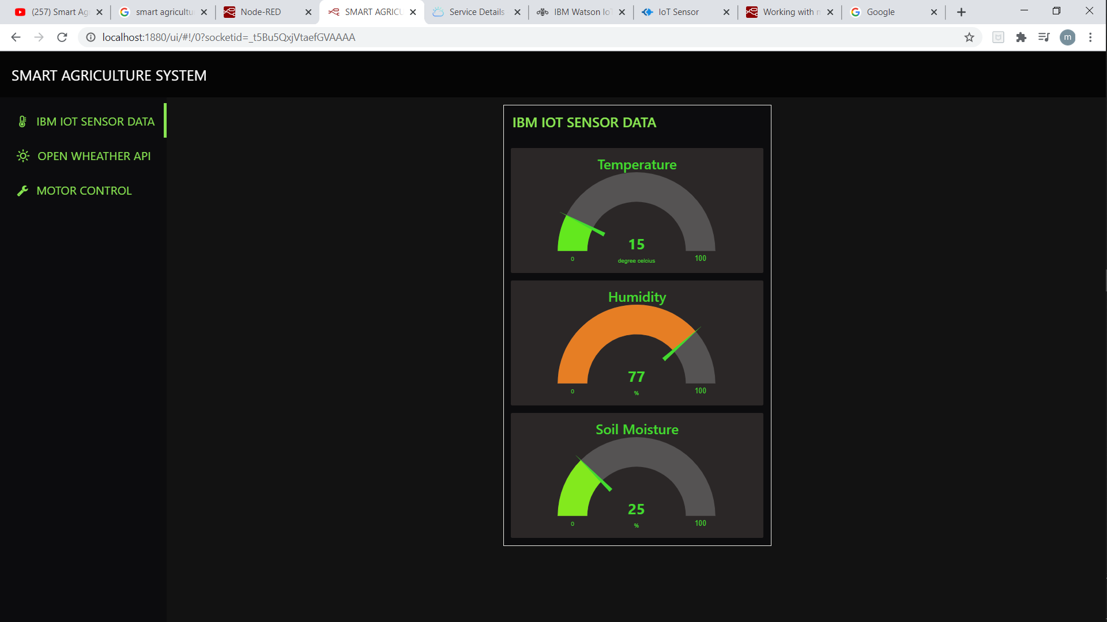
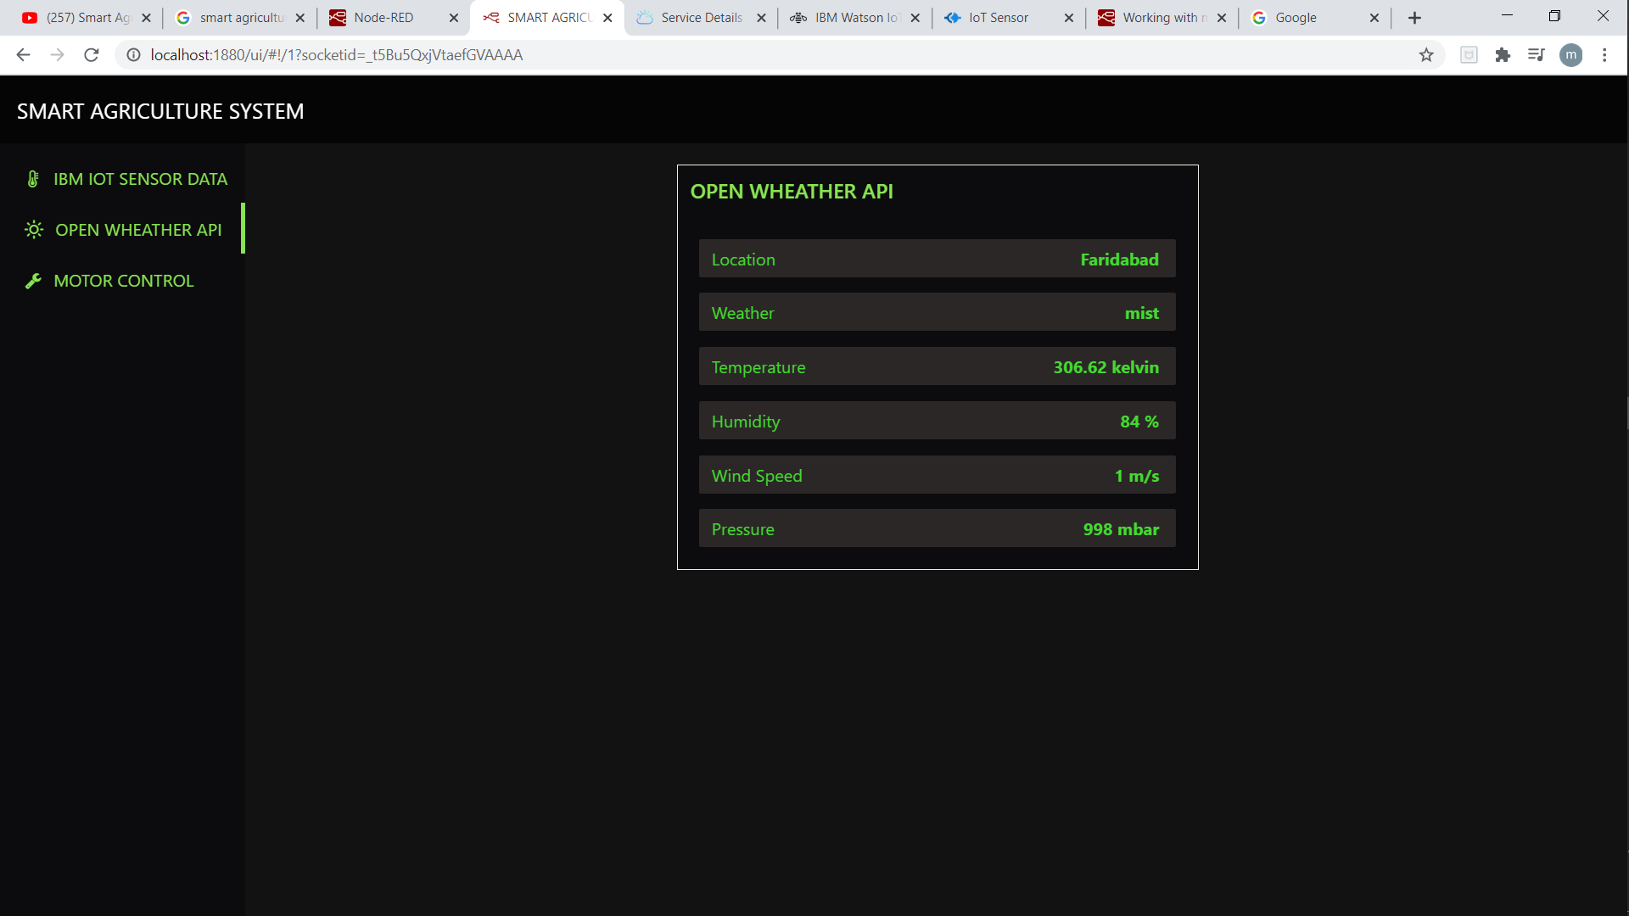
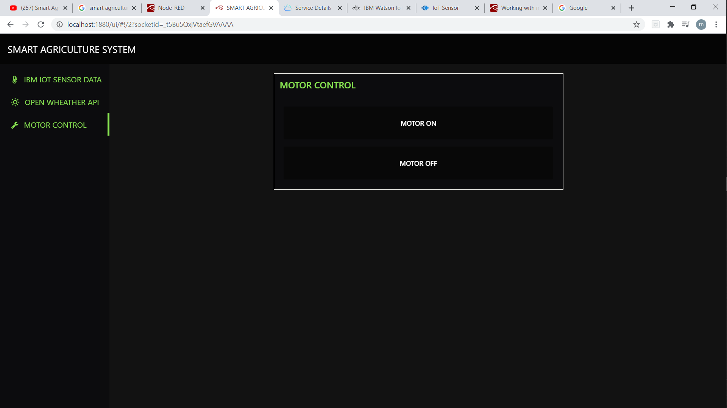
WEB APPLICATION

Slide 6
THANK YOU

