Slide 1
Smart Agriculture System
based on
IOT
By
Valishetty Priyanka

Slide 2
Project Details
Internship Title : Smart Agriculture system based on IoT - SB38197
Project ID : SPS_PRO_101
Project Title : Smart Agriculture system based on IoT
Name : Valishetty Priyanka
Team Size : 1

Slide 3
Project Summary
To create a smart agriculture system based on IOT, which will assist farmers in getting Temperature, soil moisture, and humidity for efficient environment monitoring which will enable smart farming and increase their overall yield and quality of products. A web app is also built that will control motor on and off from anywhere.

Slide 4
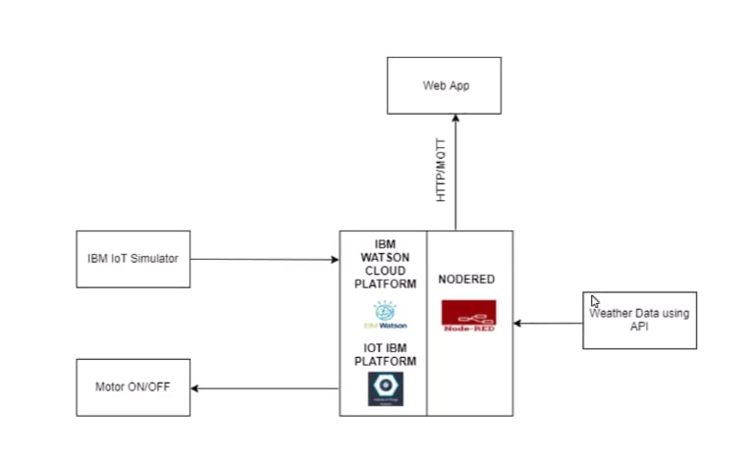
Block Diagram

Slide 5
Future Scope
With the growing population of the nation, the demand for food also increases and to satisfy all the needs, it is important that agriculture activities are carried out in most accurate and efficient manner. Bringing in IOT technology over here can assist us greatly with automated farming activities, maintaining the quality of the products and reducing the extravagant use resources like electricity and water.

