Slide 1
NAME:Chandrika Sagar (c807472@gmail.com) TITLE:Smart Agriculture System Based on IOT Category:Internet of Things Internship at smartinternz.com@2020

Slide 2
SMART AGRICULTURE BASED ON IOT
Aim and Scope: Smart Agriculture System based on Iot can monitor soil moisture and climatic c onditions to grow and yield a good crop. The farmer can also get the real-time w eather forecasting data by using external platforms like Open Weather API. F armer will be provided a mobile app using which he can monitor the t emperature, humidity and soil moisture parameters along with weather f orecasting details. Based on all the parameter, farmer can water his crop by c ontrolling the motor using the mobile application. Thus even if the farmer is not p resent near his crop he can water his crop by controlling the motors using the a pplication from anywhere.

Slide 3

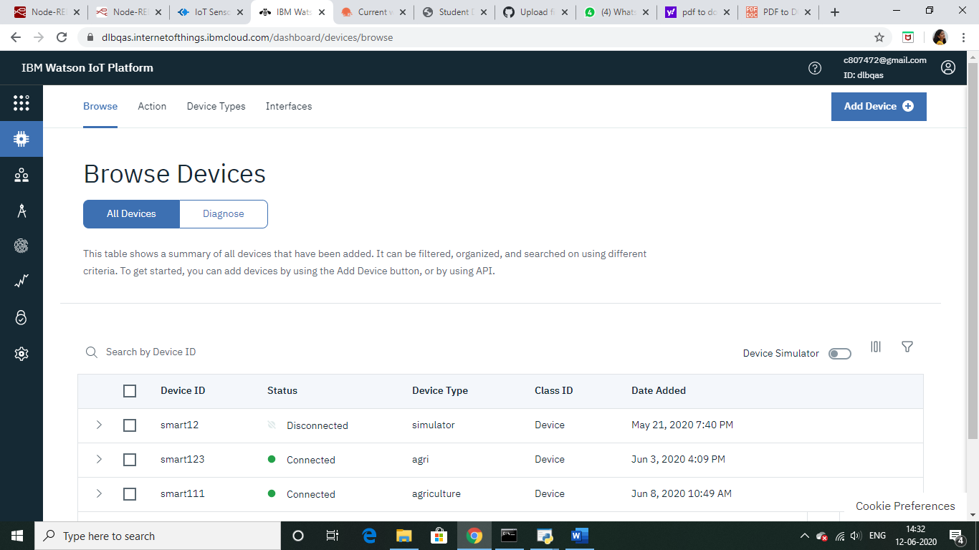
Getting Sensor Inputs into IBM Cloud :

Slide 4
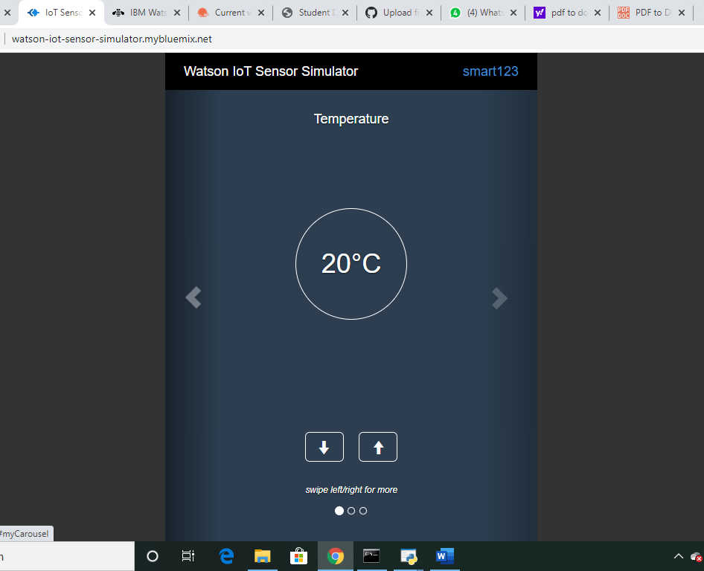
Watson IOT Sensor Simulator:

Slide 5
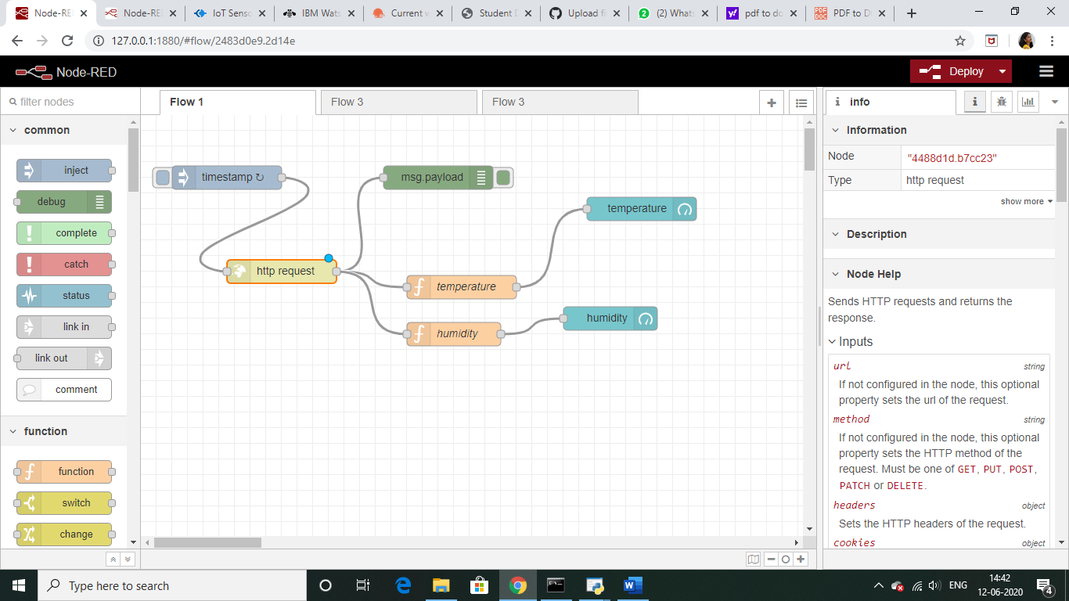
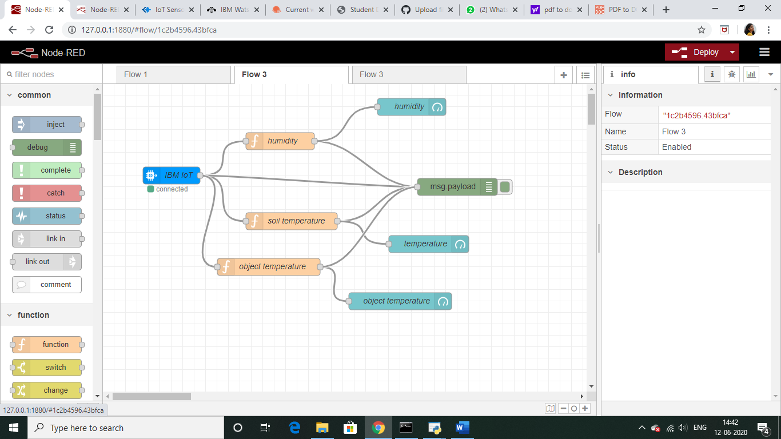
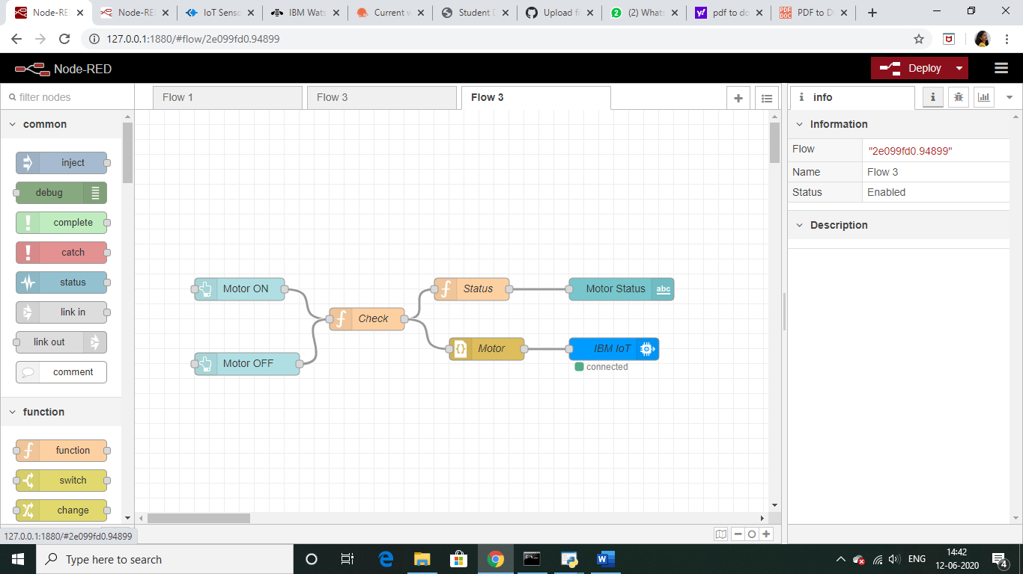
Node-Red
Flow-1
Flow-2
Flow-3

Slide 6
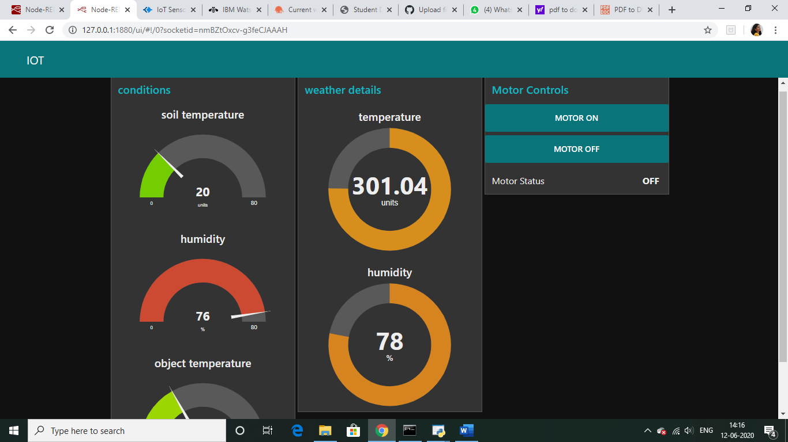
WEB APP

Slide 7
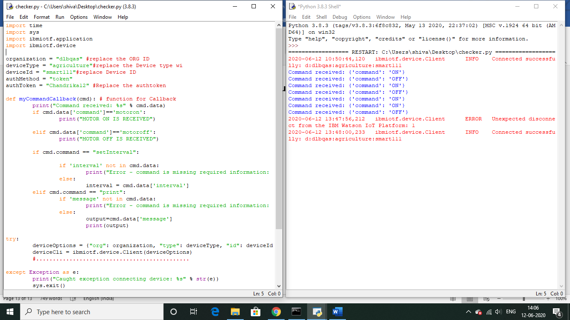
FINAL OUTPUT

