Slide 1
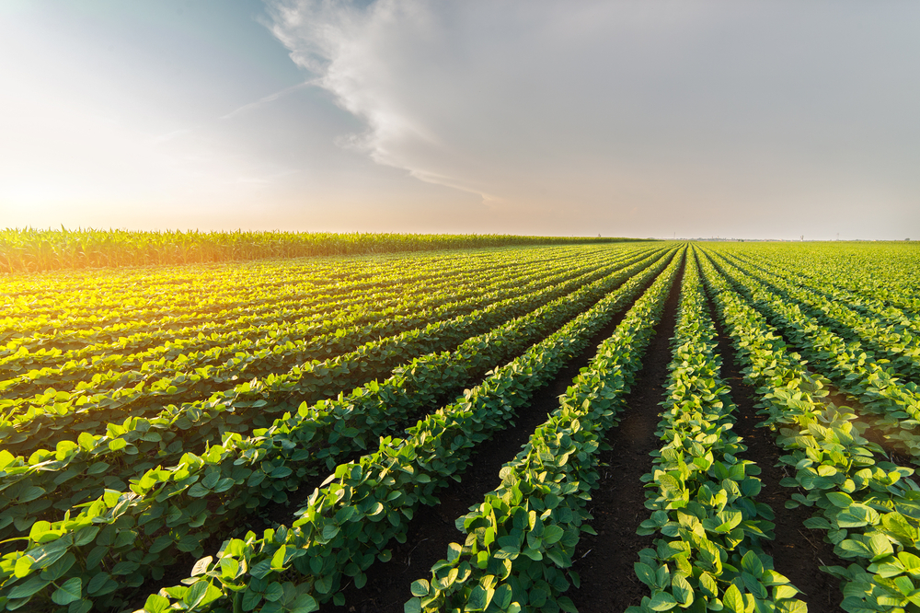
SMART AGRICULTURE SYSTEM
BASED ON IoT
-By
Gedda Prathyusha
Information Technology

Slide 2
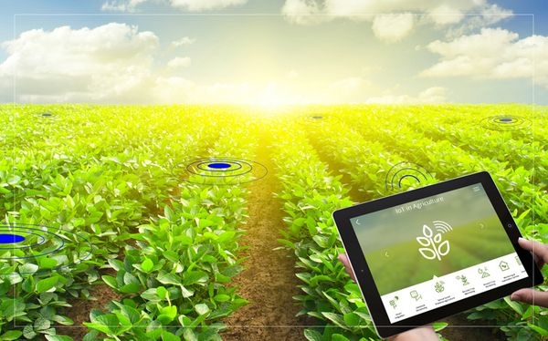
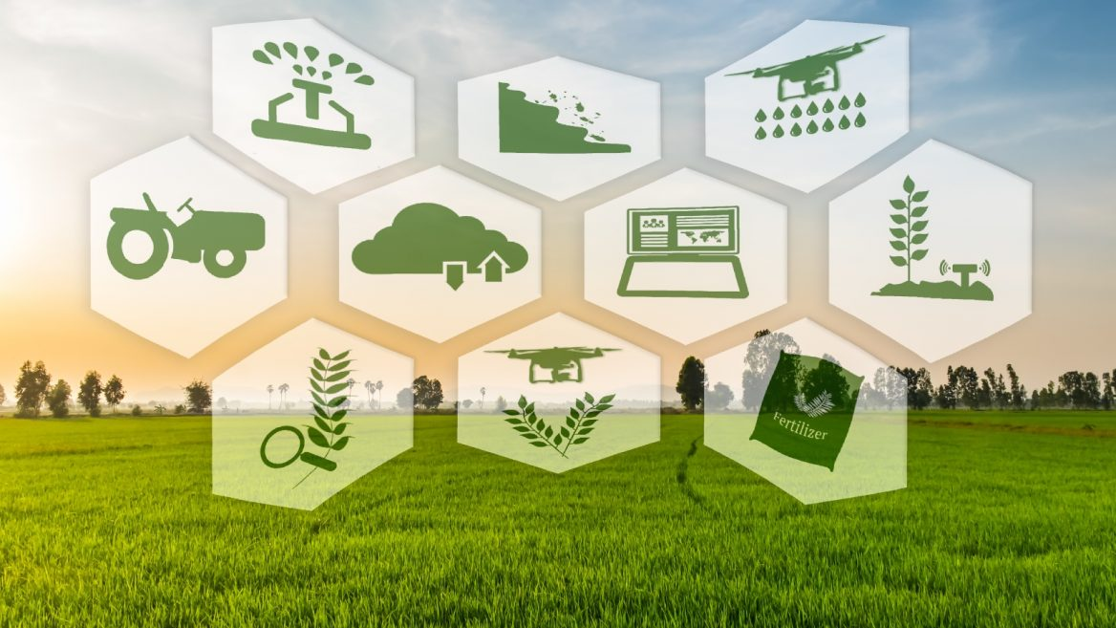
What is Smart Agriculture System?
Smart Agriculture or Smart Farming is a farming management concept using modern technology to increase the quantity and quality of agricultural products.

Slide 3
ADVANTAGES OF SMART AGRICULTURE SYSTEM
Real-Time Data and Production Insight.
Increases the quantity of production.
Increases the quality of production.
Improved Livestock Farming.
To reduce human efforts.
Efficient and saves time.
Remote Monitoring.

Slide 4
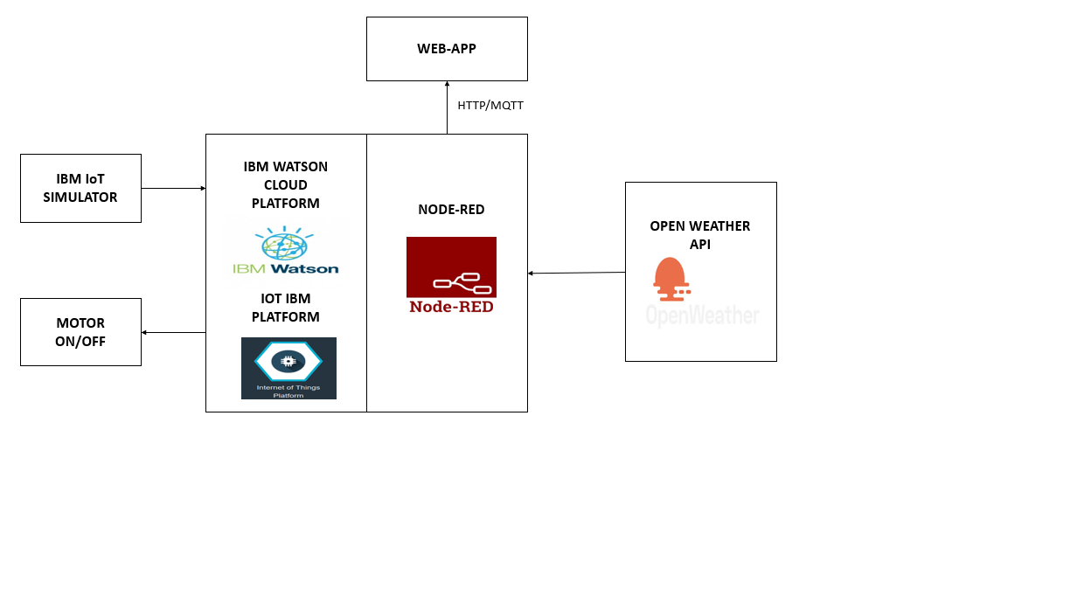
BLOCK DIAGRAM

Slide 5
CONCLUSION
Smart agriculture System helps farmers to predict the upcoming weather forecast and prevent a lot of crop damage and loses, helps in increasing the quality and quantity of crop production and also helps in reducing few human efforts.

Slide 6
THANK YOU..!!

