Slide 1
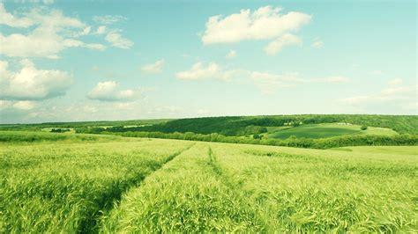
SMART AGRICULTURE SYSTEM
BASED ON
IoT
By
PAYAL SHINDE

Slide 2
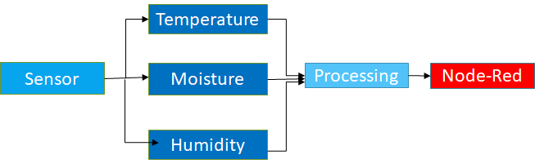
PLAN

Slide 3
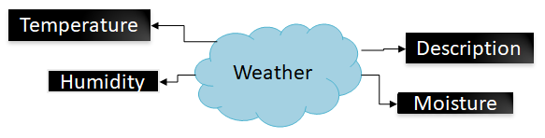

Slide 4
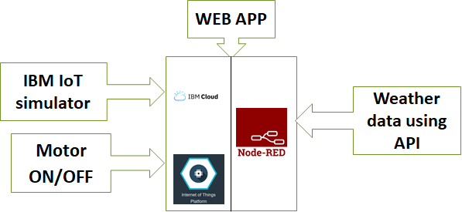
BLOCK DIAGRAM

Slide 5
CONCLUSION
The IoT system based smart Agriculture has high efficiency and accuracy in fetching the live data of temperature and soil moisture IoT enabled agriculture has helped TO implement modern technological solutions to time tested knowledge. This has helped bridge the gap between production and quality and quantity yield. Using IoT in agriculture has a big promising future as a driving force of efficiency, sustainability, and scalability in this industry. Sytem proposed via this will assist farmers in Soil moisture , temperature , humidity monitoring and inturn controlling motor .

Slide 6
THANK YOU!!!

