Slide 1
JAYAPRIYA S
3rd YEAR- B.E. PRODUCTION ENGINEERING
PSG COLLEGE OF TECHNOLOGY

Slide 2
SMART AGRICULTURE SYSTEM USING IOT

Slide 3
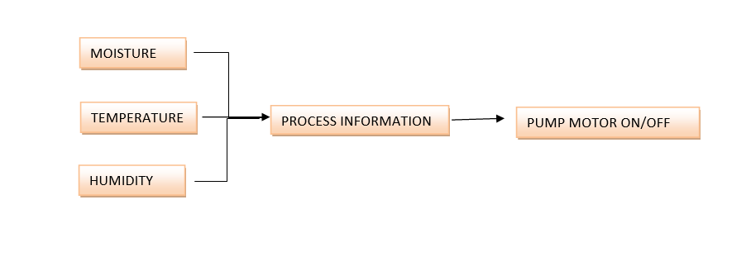
WORKFLOW
CONTROL
MOTOR
LIGHTS

Slide 4
SOFTWARE AND HARDWARE
IOT SIMULATOR
WEATHER API
IBM WATSON
IOT PLATFORM
WEB APPLICATION
NODE-RED
DEVICE (MOTOR)

