Slide 1
Internet Of Things
SMART AGRICULTURE BASED ON IOT

Slide 2
WHAT IS IOT?
The internet of things, or IoT, is a system of interrelated computing devices, mechanical and digital machines, objects, animals or people that are provided with unique identifiers (UIDs) and the ability to transfer data over a network without requiring human-to-human or human-to-computer interaction.

Slide 3
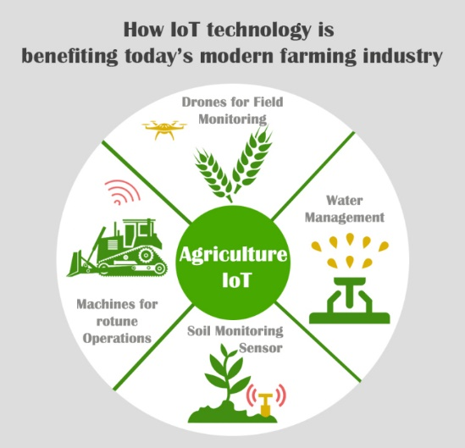
BENEFITS Of Iot On Smart Agriculture>>>

Slide 4
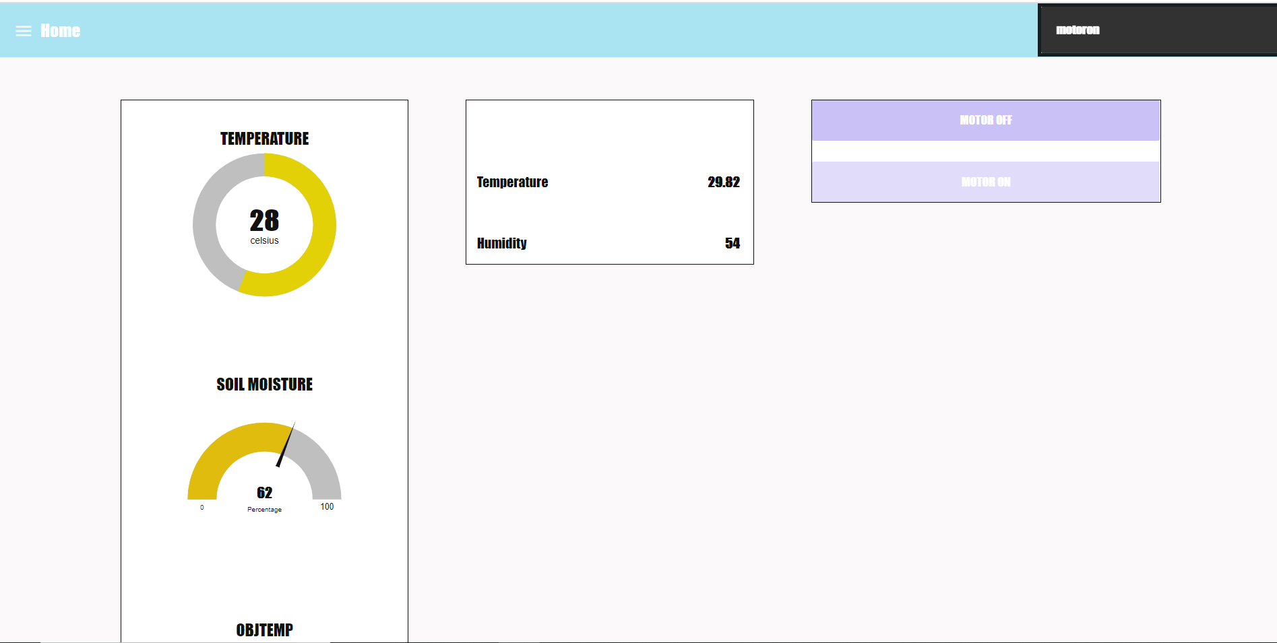
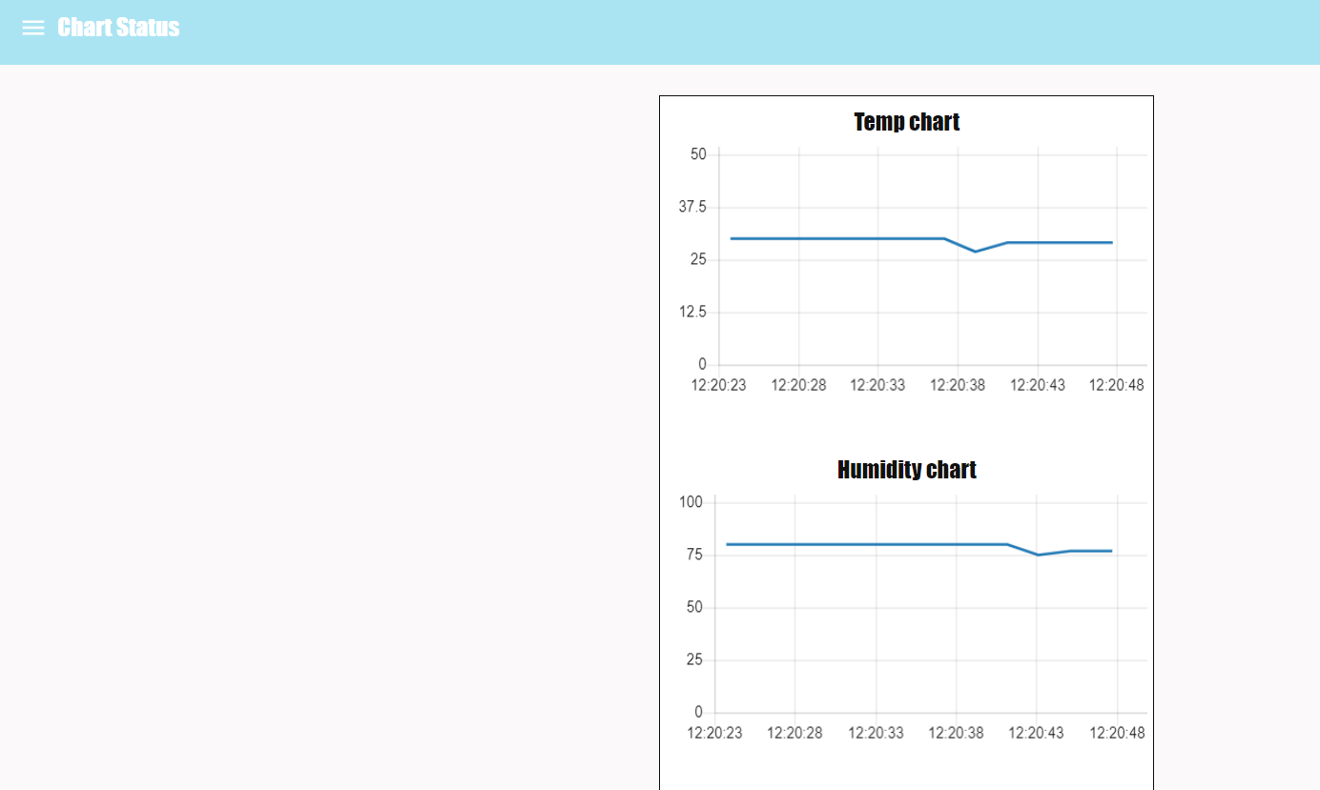
Smart Agri -Dashboard
MOTO ON/OFF
STATUS
GRAPH
API

Slide 5
Cloud
Cloud computing is a type of computing that relies on shared computing resources rather than having local servers or personal devices to handle applications. ... The services are delivered and used over the Internet and are paid for by the cloud customer on an as-needed or pay-per-use business model.
So to get services virtually IBM cloud platform will be utilized.

Slide 6
Thank You

