Slide 1
M.Sai pradeep
college: v r Siddhartha engineering college
Branch: eee
Roll no:178w1ao236

Slide 2
Smart agriculture system based on iot

Slide 3
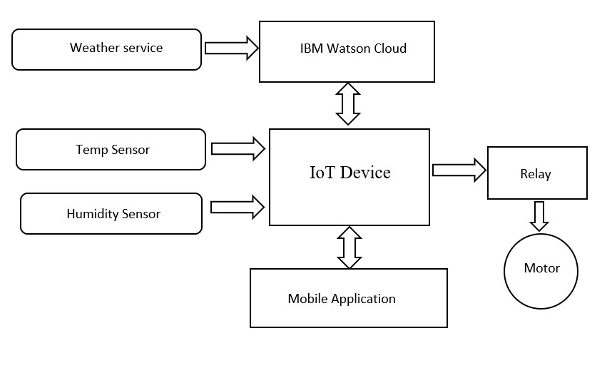
Block diagram

Slide 4
Project Scope
● Project Summary
➤ Smart Agriculture System based on IoT can monitor soil moisture and climatic conditions to grow and yield a good crop.
➤ A Farmer is provided a mobile app using which he can monitor the temperature, humidity and soil moisture parameters along with weather forecasting details.
➤ Based on all the parameters he can water his crop by controlling the motors using the mobile application
● Project Requirements
➤ IOT Application Development
➤ IOT Cloud Platform
● Software Requirements
➤ GIT tool and Node-red
➤ Python IDE

Slide 5
● Project Deliverables
➤ Explore IBM Cloud Platform
➤ Connect The IOT Simulator To Watson IOT Platform
➤ Configure The Node-red To Get The Data From IBM IOT Platform And Open Weather API
➤ Building A Web App
➤ Configure Device To Receive The Data From The Web Application And Control motors

Slide 6
Thank you

