Slide 1
Smart Agriculture
Submitted by:
Naman rastogi
student of HMRITM(GGSIPU)
Intern at Smart bridge

Slide 2
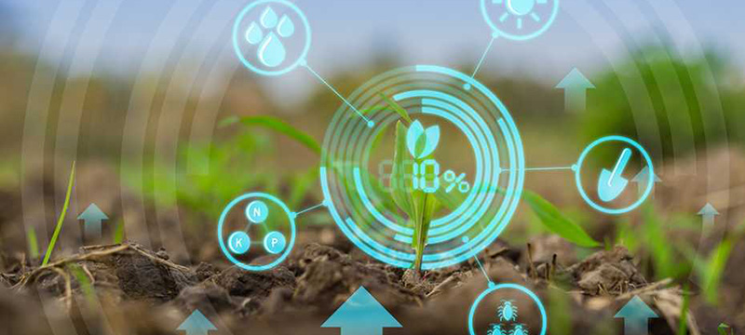
OBJECTIVE
the objective of this project is to bring together the traditional methods and the modern technology together for the good yield and improve the farming conditions in the system.
I propose to bring together technologies like Internet of things and traditional farming methodologies to help farmers.
in this project the sole focus will be upon the weather changes and how to reduce its impact on the crops . we will be providing farmer the facility of looking and observing different parameters like soil moisture, temperature and the weather conditions of the area and then decide functions like irrigation in his/her Farm , all this at the ease of a touch by providing a web app which will be easy to use

Slide 3
CHALLENGES
PROPOSED SOLUTION
Using smart irrigation system with IOT & associative technology requirement to make the field cultivation process more efficiently with less cost & human interface. The following points will be covered: o Rain Water Harvesting & Solar Power Utilization. o Checking About the weather conditions with corrective measures. o Effect Irrigation from remote location.
• Engineering application in agricultural land can provide efficient production, remote monitoring, optimum utilization of resources like water, power with minimum manpower.
• Our project intends to use IOT , IBM Cloud Services , Open Weather API and variety of sensors to record agricultural and irrigation process and store it in a database, rain water harvesting and utilization, use of clean energy sources along with conventional energy resources which will not only maximize the agricultural production with minimum cost and better efficiency, remote monitoring with eco-friendly environment.
Uncertain, unreliable & erratic rainfall leads to water wastage due to lack of modern equipment's.
Insufficient agricultural methods due to absence of technological interface leads to large manpower & high cost.
Absence of proper crop monitoring process doesn’t lead to enhancement in crop output efficiency.
in many area’s there is shortage of manpower and due this unavailability of manpower the output is not as much as it can be
human errors: sometimes due to negligence like no timely irrigation, over irrigating the crops or some other reason the crops get destroyed

Slide 4
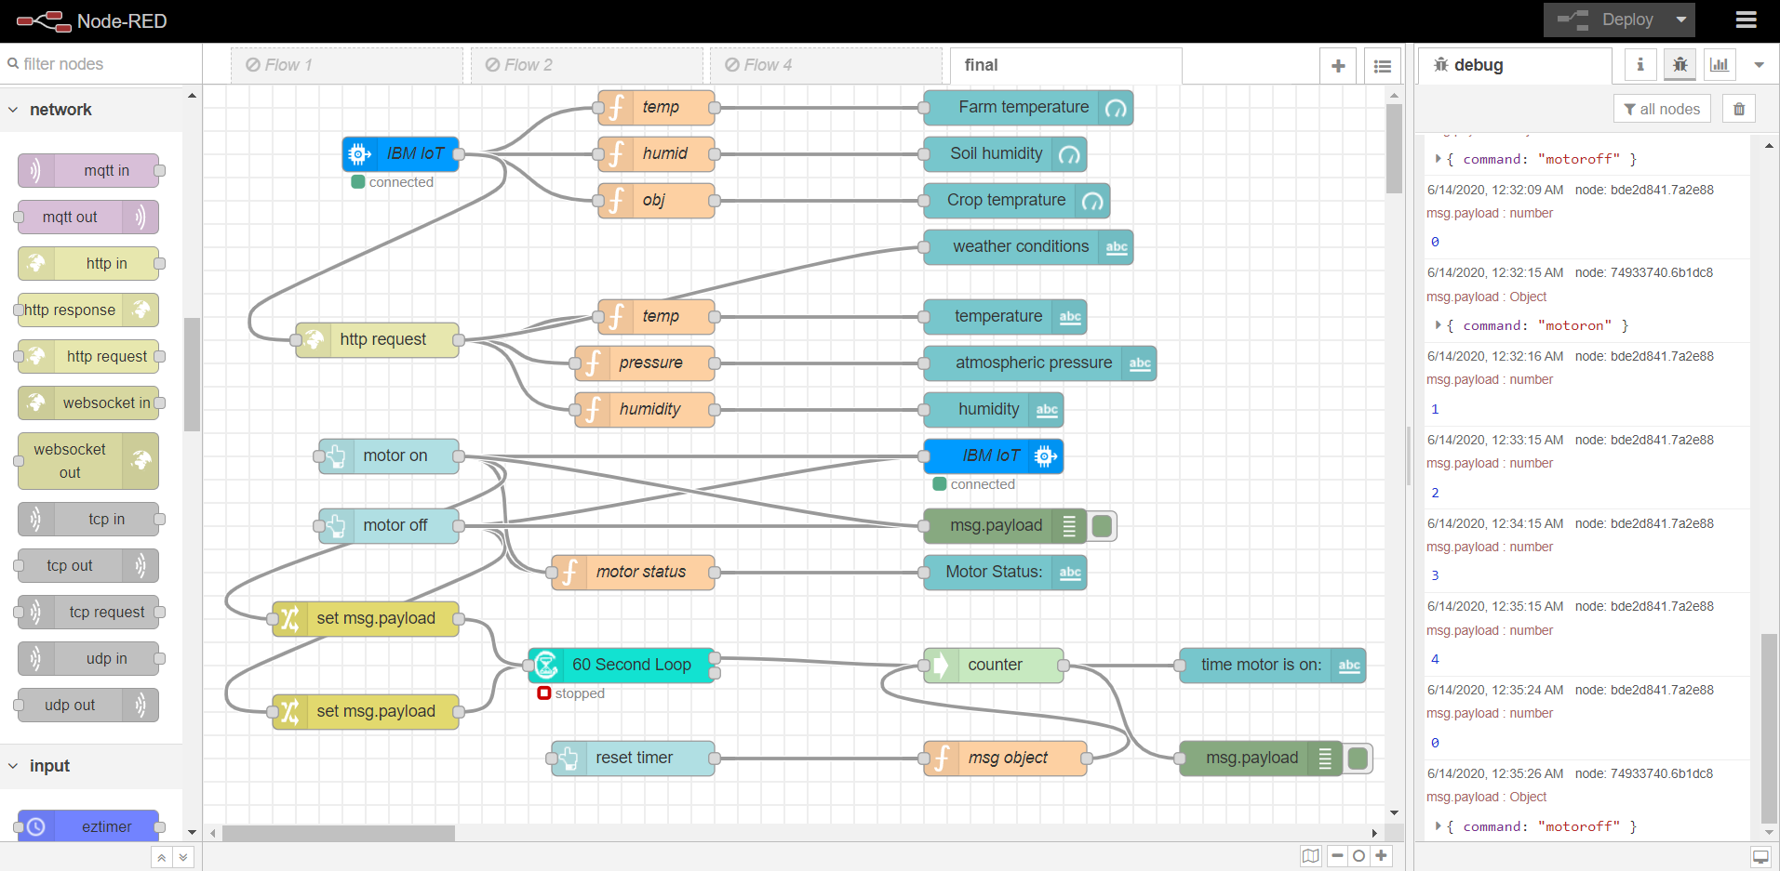
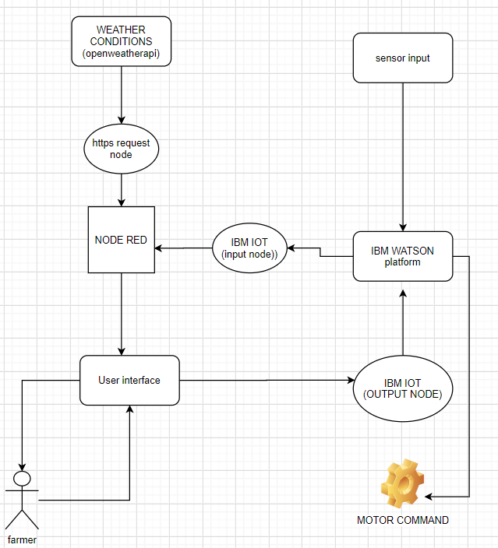
FLOW CHART
Weather information is received using open weather API
Sensor data is obtained through IBM WATSON SERVICE and delivered to node red using IBMIOT node
Both the information are delivered to the user using A WEB APP created using NODE-RED service
User gives input on the basis of data displayed on the UI and the command is sent to the IBM Watson using IBMIOT Output node.
The command is sent to the motor driver to control the motor

Slide 5
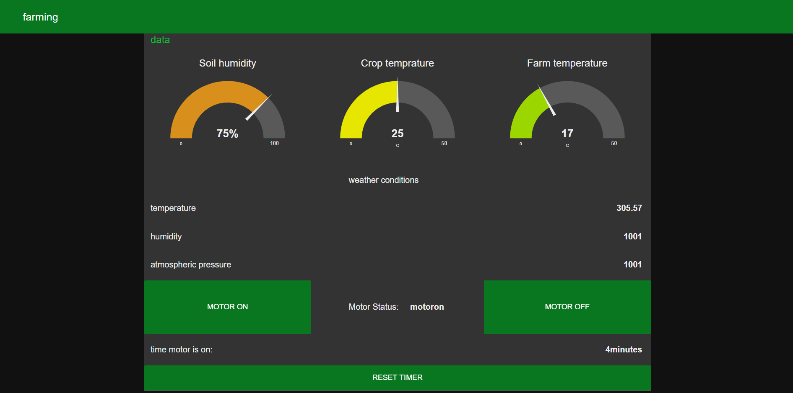
FUTURE SCOPE
The Future of Smart Agriculture Technology:
According to a new market intelligence report by BIS Research, the global smart farming market is expected to reach $23.14 billion by 2022, rising at a compound annual growth rate (CAGR) of 19.3% from 2017 to 2022.
A recent Beecham's report entitled Towards Smart Farming: Agriculture Embracing the IoT Vision predicts that food production must increase by 70 percent in the year 2050 in order to meet our estimated world population of 9.6 billion people. It also describes growing concerns about farming in the future: climate change, limited arable land, and costs/availability of fossil fuels. So, what's the solution? Smart farming.
USER INTERFACE

