Slide 1

Sentiment Classification and Opinion Mining on Airline Reviews

Slide 2
AN overview
Every piece of information shared on Social Media carries an emotion, sentiment or feeling. These emotions can be positive, negative and neutral. All these emotions may come from a travel trip, restaurant trip, exhibitions, movies, elections, hospital visits etc. These emotions carry some hidden information related to comfort/discomfort in related areas. Hence, there is a good scope of analyzing this information to detect the patterns of the emotions. This analysis can help us to understand the emotions of the people in respective domain and the reasons behind it.
It is very important to understand the needs and comfort level of customers i.e. customer satisfaction during the flight. Therefore, customer feedback is very important for any airline industry.

Slide 3
MAIN PURPOSE:
Sentiment analysis is an important approach to extract emotions from any textual information i.e. online articles, product review, movie reviews, Twitter data etc. Twitter data is usually contains information about a person’s opinion on any miscellaneous topic. Air travel is also one of these hot topics that are widely spread on Twitter. Air passengers usually share their travel experience on Twitter. This information can be useful if analyzed using machine learning techniques and can provide insights that helps to understand the comfort level of the passenger in the flight.

Slide 4
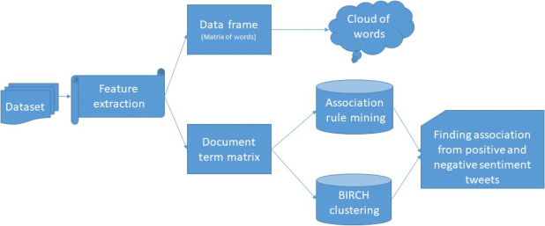
BLOCK DIAGRAM:

Slide 5
USES:
Consumers can use sentiment analysis to research products or services before booking a flight.
Using sentiment analysis Airlines companies attract the customers by knowing the requirements of the customers.
To analyze customer satisfaction.
Airlines companies can also use this to gather critical feedback about problems in their services.

Slide 6
Conclusion
We explored learning techniques and successfully applied them on our learning problem. NLP and CNN performs best and yields 99.1% accuracy in sentiment task. We also implemented this NLP and CNN model with our html page to get a more accurate information, which gives promising results and would be useful if we have a larger labeled dataset for training.

