Slide 1
U Talin sai V S S R Rajavarma Ganapathiraju Ananda Mouli C Wasim Syed
AI Enabled Weed Recognition System

Slide 2
Introduction
Weeds are considered to be one of the biggest problems in agronomy. Their adverse effect is widely known—they reduce crop yields, serve as hosts for crop diseases and also produce toxic substances. Manual removal of weeds is labour-intensive, while the use of chemicals has long-term environmental consequences. Reducing this quantity of chemicals would potentially lead to reduced herbicide residues in water, food crops and the environment. One possible method of achieving this is to improve the selectivity with which herbicidal agents are applied to fields, by automated visual discrimination between crops and weeds for spot application of herbicide

Slide 3
PROBLEm
Weed picking is one of the laborious job in fields. Weeds are the plants growing in a wrong place which compete with crop for water, light, nutrients and space, causing reduction in yield and effective use of machinery and can cause a disturbance in agriculture. Weeds can also host pests and diseases that can spread to cultivated crops.In olden days weed detection was done by employing some people, especially for that purpose. They will detect the weed by checking each and every place of the field. Then they will pluck them out manually using their hands.

Slide 4
Our solution
We are Proposing a device which is integrated with camera and there will be a live video streaming in that it will detect the weed in the crop by using image processing. This system will distinguish the crop and weed. Our system will use a Convolution neural network algorithm to extract the features from image and train them by using neural network.

Slide 5
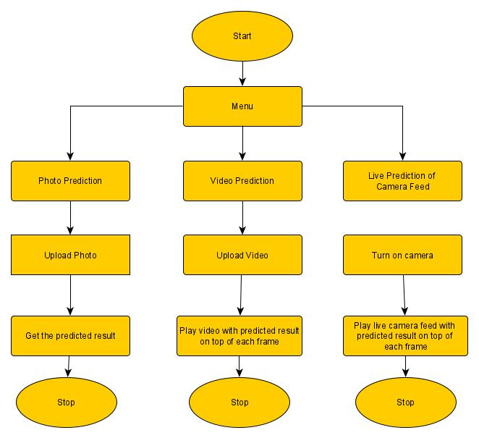
SOFTWARE architecture

Slide 6
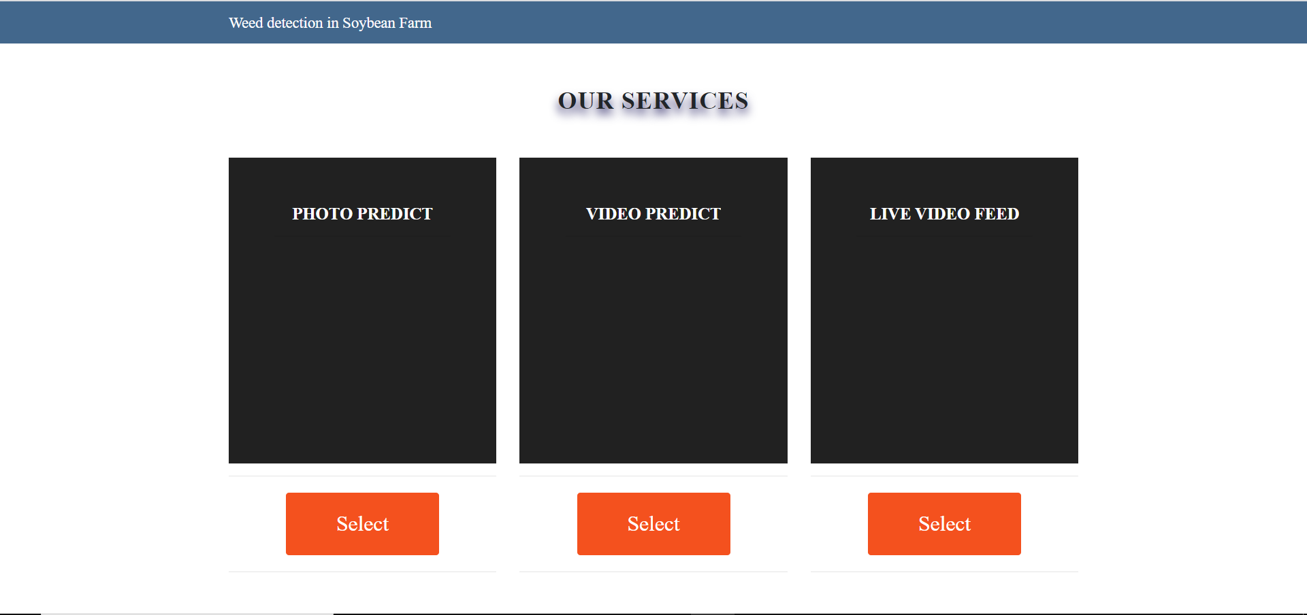
product

Slide 7
Conclusions
The AI enabled weed recognition system using Convolution neural networks is currently being practiced at many agriculutal sectors.
This application of CNN in weed recognition system helps many farmers as it is time saving, and decreases the spray of chemicals

