Slide 1
EMISSION OF CO2 FROM CARS
Team members:
Akkaldevi Prathyusha
Pogalla saisri
Navuluri Navya

Slide 2


Slide 3
INTRODUCTION
Ever wondered How much co2 is emitted by cars or other electric vehicles Really are a clearly alternative?
Transport is responsible for nearly 30% of the Total co2 emissions,of which 72% comes from road transportation.
As part of Efforts to reduce Co2 emissions from transport will not be easy as the rate of emission reductions has slowed.
Passenger’s cars are a major polluter ,accounting for 60.7% of total emissions from road transport.
From nowonwards it is considered that fuel economy of engines will be further improved by boosting engines efficiency and by hybridization (electrification) of cars.

Slide 4
Project description
Nowadays automobiles are ofently used all over the world which results in emission of more CO2 which effects the economic growth Using dynamic panel threshold framework.
Ther is evidence of significant causal relationship between CO2 emission,economic growth,energy consumption and standards are getting tough all over the world.
Auto manufacturers are potentially take measurers to decrease such high conentration levels by electrification of cars.

Slide 5
Aim of the project
We are going to predict the amount of CO2 emission from a particular vehicles.
If the amount of CO2 emission of that particular car is more than the threshold Value then that car details are sent to the RTA department.
It reduces the levels of CO2 emissions from the transport sector.

Slide 6
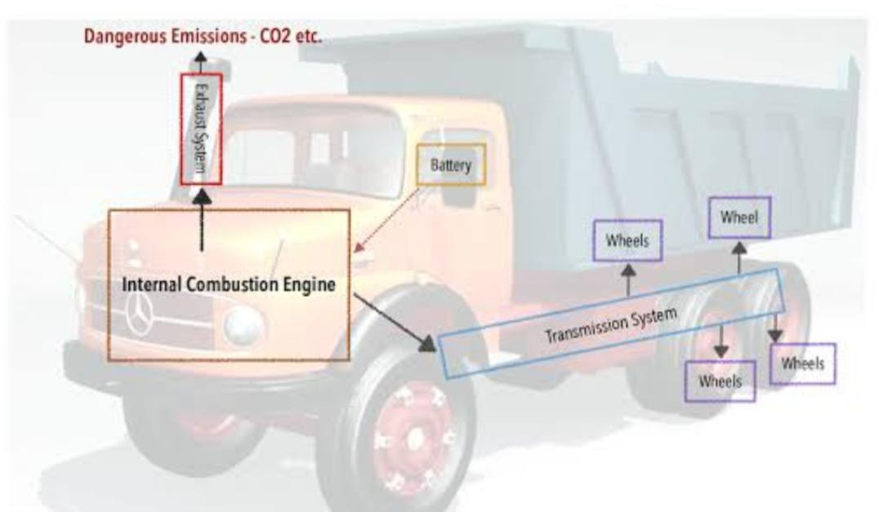
Our model should predict the vehicle which emits more amount of co2 greater than the threshold value.

Slide 7
Project building
Coleection of data,Data division into Train and Test sets,Load required Libraries, LoadImageDataGenerayor,Building the model,Load the model and Prediction is performed.
Flask application:
Python code,HTML code,CSS,javascript
All the above codes are integrated internally.
Once you execute the code you can view the output in any browser.
After all the above steps we will be done developing our project.

Slide 8
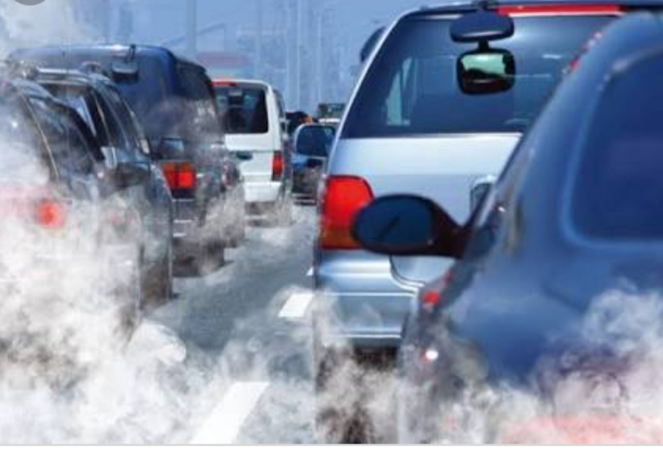

Slide 9
Conclusion
The machine learning model built upon the results of the original statistical analysis showed a correlation between Co2 emission and GDP of countries, showing the Kuznets curve hypothesis to be reasonable.
Seeing the promise in using the Kuznets curve hypothesis,I built a machine learning model using the Random forest Regression algorithm.
The accuracy of the models can be improved by inculding data from more years or including other datasets which relate to CO2 emissions.
Adding more years of data gives the model more training data,which will improve accuracy.

Slide 10
Thank. You.

