Slide 1


Financial RiSk Management
Presented by Team 44: 1.Aayesha Qureshi 2.Syeda Khadijah Kaleem
01

Slide 2

Introduction
Financial Risk Management is the way toward
comprehension and dealing with the budgetary dangers
that your business may be confronting either now or later
on.

Slide 3

EXISTING PROBLEM
Learning to manage your money is like overcoming a big hurdle in your life.
People don’t realize and don’t come to a conclusion about their financial status and hence fall into the risk.
03

Slide 4
SOLUTION STATEMENT
By applying Machine Learning algorithms to the financial risk management dataset, the risk is calculated and hence concluded whether the risk is good or bad for that particular details of a person.
This is done by using various algorithms such as Decision Tree Classifier, Naïve Bayes, Logistic Regression, Support Vector Machine etc.
04

Slide 5
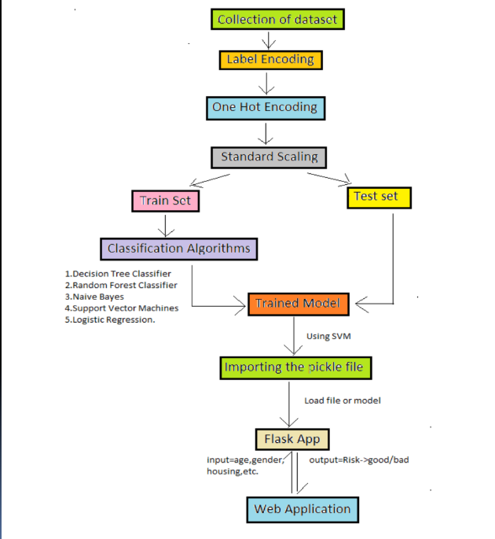

Slide 6




WORKING OF THE MODEL
Let’s get a little into the Jupyter code we used to build our model.
The model was built using SVM algorithm.
06

Slide 7
AFTER MODEL BUILDING, WE TAKE THE SAVED PICKLE FILE AND USE IT TO INTEGRATE AND RUN OUR PYTHON CODE IN SPYDER.
Spyder has the python code for our application
along with the HTML (with embedded CSS).
07

Slide 8
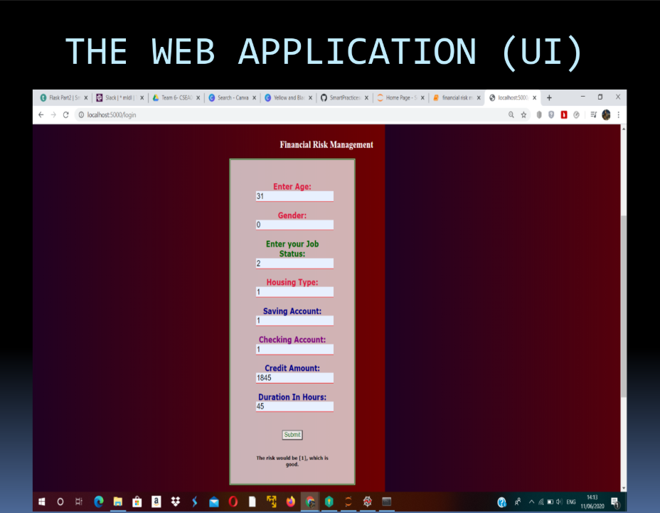

Slide 9


The designed Web Page
CONCLUSION
predicts the risk when taking inputs from the user
This UI works when
connected with the model
that works best when SVM
Algorithm is applied.
09

Slide 10
THANK YOU !!
This was the project built using the Machine learning algorithms taught.

