Slide 1
Name: YASH SANTOSH MAJALKAR
College: Thakur College of Engineering & Technology
Branch/Semester: Electronics/6th

Slide 2
Smart Agriculture System Based On IOT

Slide 3
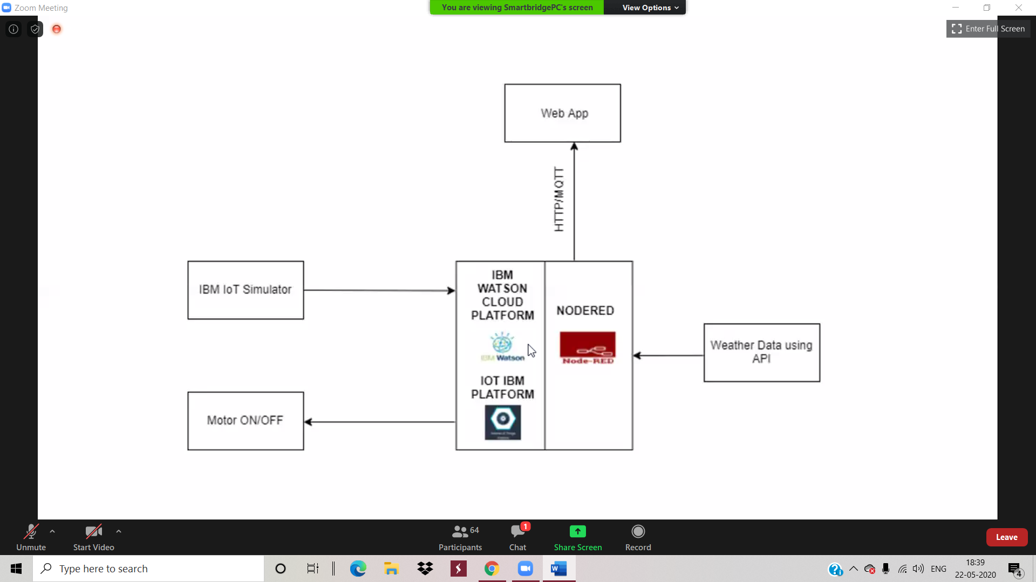
Block Diagram:

Slide 4
Future Scope:
Weeding and pest control are both critical aspects of plant maintenance and tasks that are perfect for autonomous robots.
We can also implement machines for weeding and pest control purpose.
Seeding can be improved with seeding machines, which can cover more ground much faster than a human.
Even the movement of animals can be monitored which may destroy the crops in agricultural field and in case of any discrepancy send a SMS notification as well.

