Slide 1
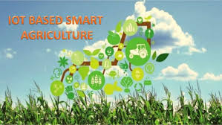
Done By: Dhaval Mehta

Slide 2
Contents Of Video
Introduction
Overview of the project
Resources Required And Cloud Introduction
User Interface And Code

Slide 3
Overview Of The Project
Agriculture is the main backbone of India. Agriculture required the dedication of various normal resource counting land, water, and natural condition. The quality what's more, measure of trademark resource has spoiled all through the a long time in view of fiscal issues related with extended expense of data and lessening farm compensation continually declining land, work, assets, and ecological issue, for instance, soil .What's more, water tainting putting the reasonableness without limits agriculture activity at possibility.
The project aims at making agriculture smart using cloud and IOT technologies. The highlighting features of this project include smart agriculture with smart control based on real time field data. Secondly temperature maintenance, humidity maintenance and other environmental parameters. And finally the recommendation to farmer for smart agriculture

Slide 4
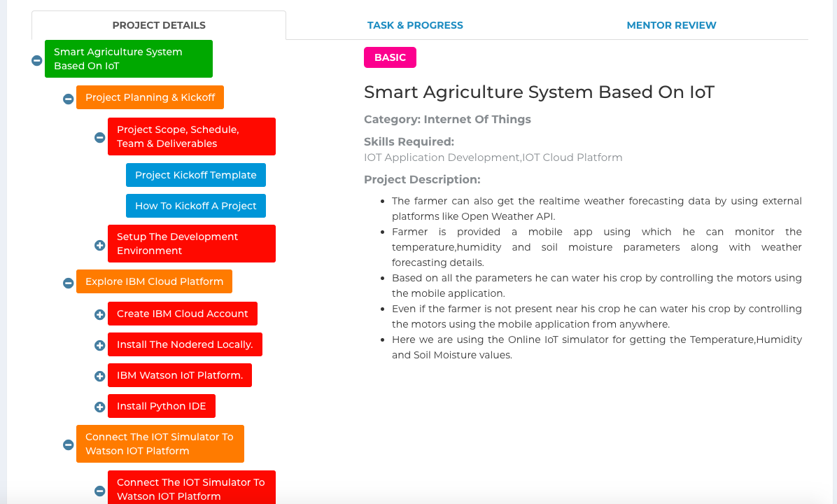
Resources Required(SmartInternz Dashboard)

Slide 5
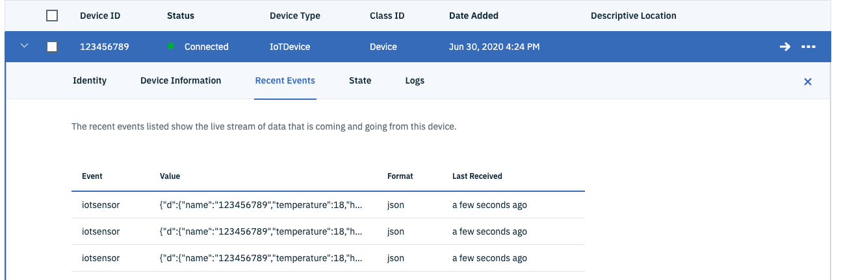
Cloud Introduction
Device Creation

Slide 6
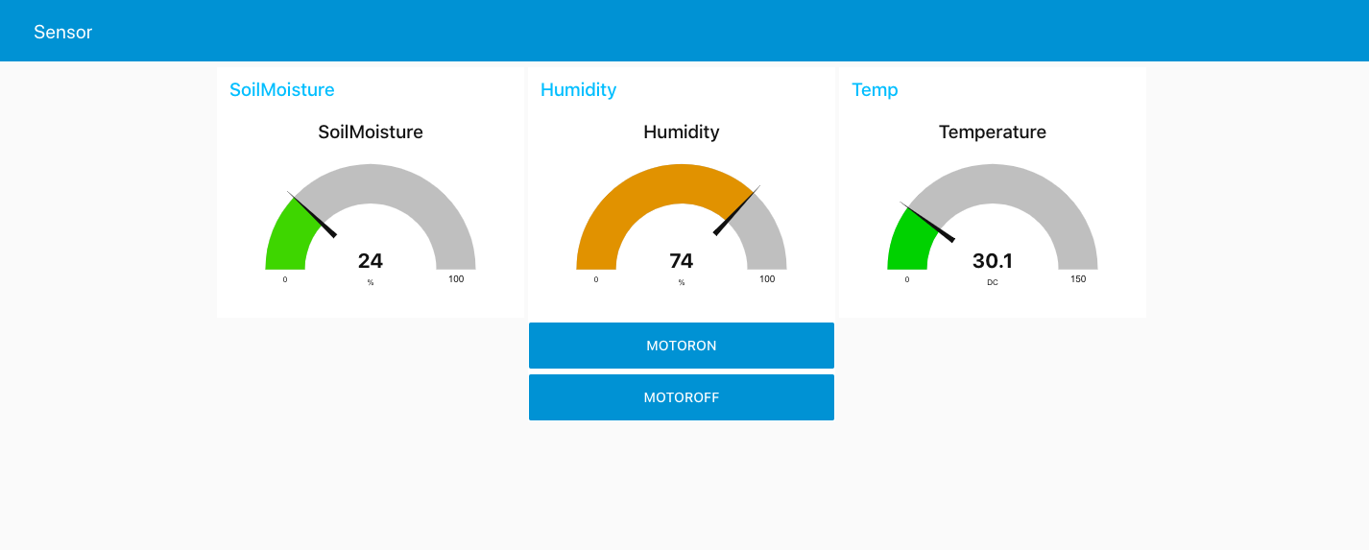
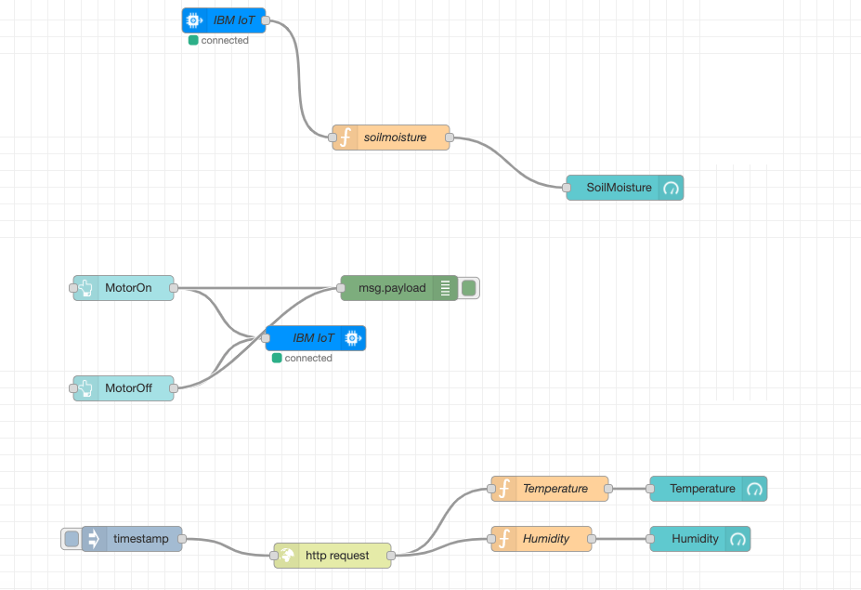
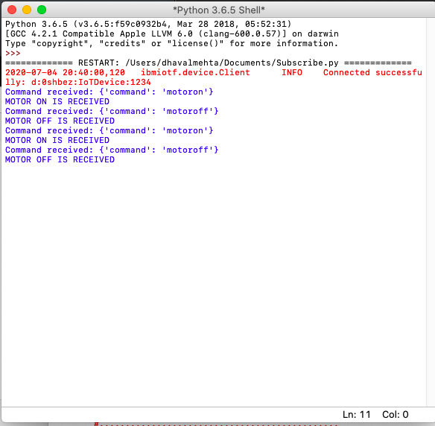
User Interface And Code

