Slide 1

CONSUMER PURCHASE BEHAVIOUR ANALYSIS
Team-21

Slide 2

Contents
Introduction
Available Data
Assumptions
Categorize
Workflow
Model Building

Slide 3
Introduction
Machine Learning is the science of getting computers to learn and act like humans do, and improve their learning over time in autonomous fashion, by feeding them data and information in the form of observations and real-world interactions.
Data analysis is a method in which data is collected and organized so that one can derive helpful information from it.

Slide 4
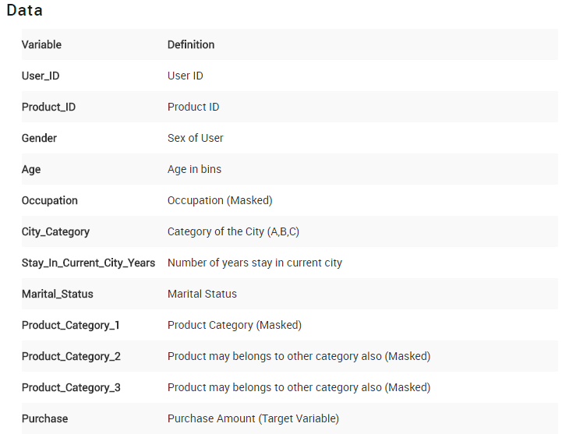

Slide 5
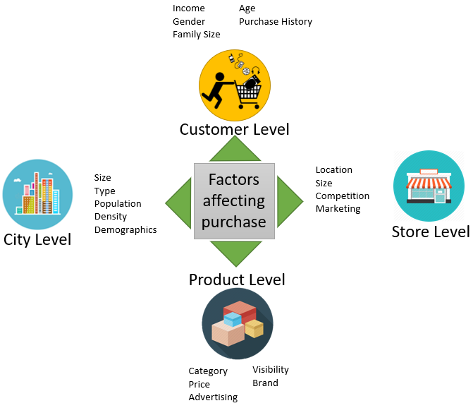
Make Assumptions
Therefore, let’s start to think about possible parameters that might influence the amount a client spends on Black Friday.

Slide 6
City Level Hypotheses:
City Type and Size : Urban or Tier 1 cities should have higher sales because of the higher income levels of people there.
Population Density: Cities with densely populated areas should have higher sales because of more demand.
Younger Population : Cities with younger populations might have higher tendency to spend more on Black Friday

Slide 7
Customer Level Hypotheses:
Income: People with higher income should spend more on products.
Age and Gender: Men with ages ranging from 25 to 40 should spend more on techlogical products.
Family Size: Families should be more contained on spendings, just buying the best offers and only needed products.
Purchase History: Customer with a purchase history should be more willing to purchase more products on this day.

Slide 8
Store Level Hypotheses:
Location: Stores with a location in well moved streets should have better sales.
Size: Bigger stores with higher stores and variety of products should have better sales.
Competition: Stores with no competitors near by must have the highest sales.
Marketing: Do stores which spend more on marketing should have the best sales results

Slide 9
Product Level Hypotheses:
Category: Most clients should be looking to buy technological products;
Price: Customer will spend more on products with higher discounts
Advertising: More advertised products should sell more
Visibility: More visible products should sell more
Brand: Clients will invest more on already known brands

Slide 10
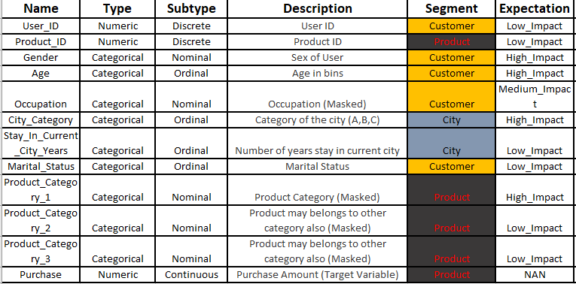
Categorize

Slide 11
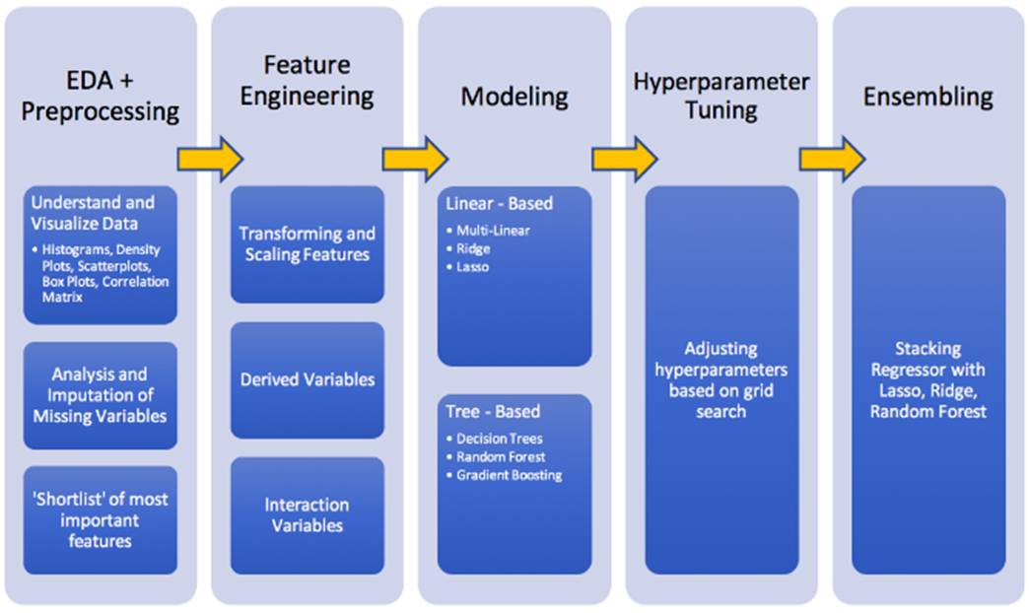
Work Flow
Our goal as a Data Scientist is to identify the most important variables and to define the best regression model for predicting out target variable. Hence, this analysis will be divided into five stages:

Slide 12


