Slide 1
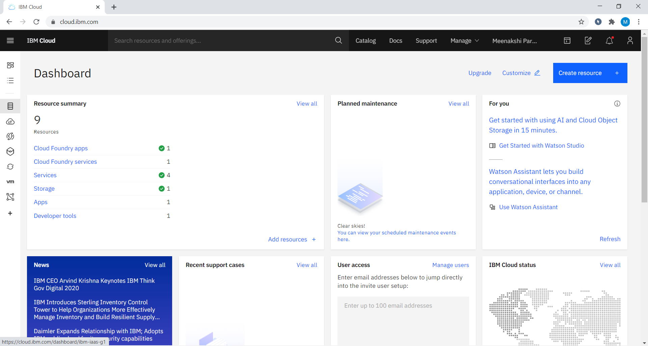
PLACE MOUSE POINTER ON IT
Notes:
First we need to create a account in IBM cloud.And now we were in IBM Cloud dashboard.We already created some resources.So comming into project we need to create a WATSON STUDIO account.I already created it,so we directly entered into WATSON STUDIO by clicking in services

Slide 2
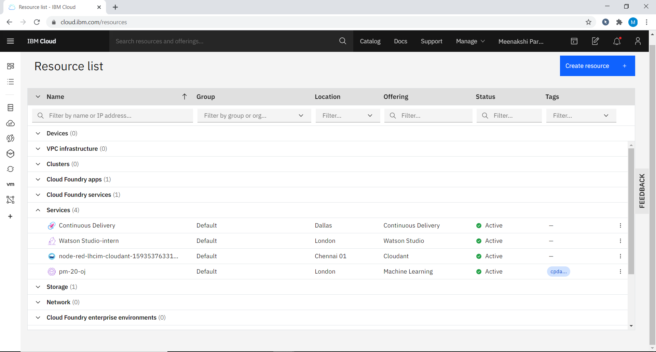
Notes:
After clicking on the services we can see WATSON STUDIO-intern in the services list.Click on it,we were redirected into the WATSON STUDIO account

Slide 3
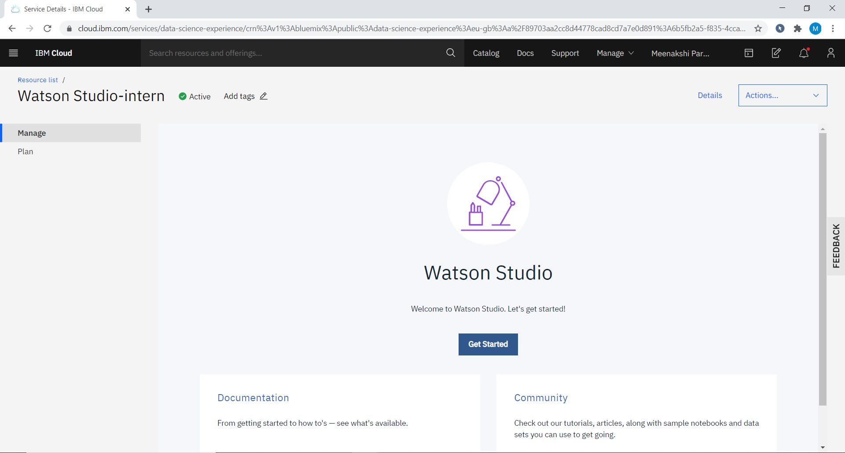
Notes:
Now we were in WATSON STUDIO-intern.Now click on Get Started

Slide 4
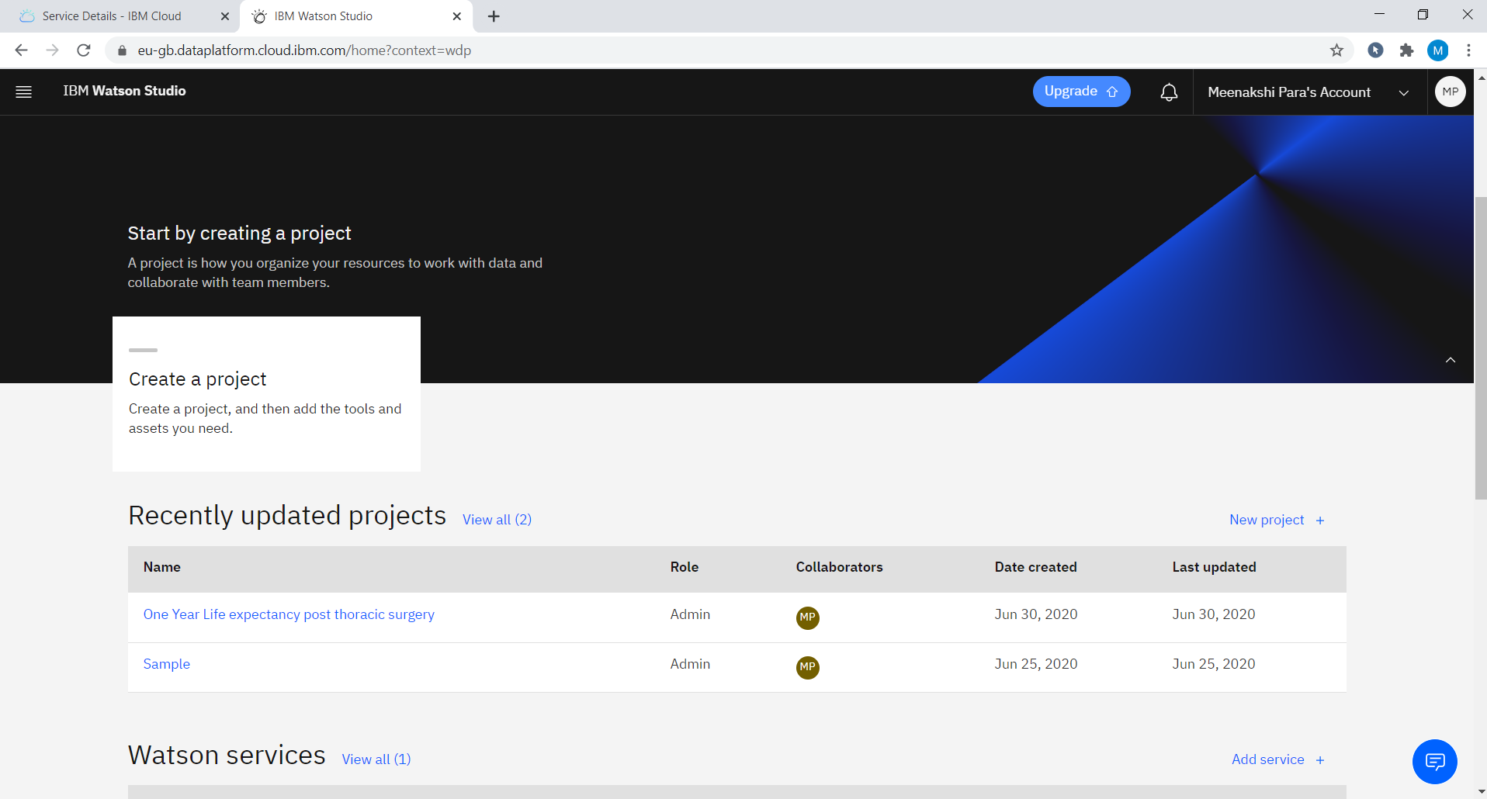
Notes:
Here are some projects we already created.Simply clcik on One Year Life expectancy post thoracic surgery project

Slide 5
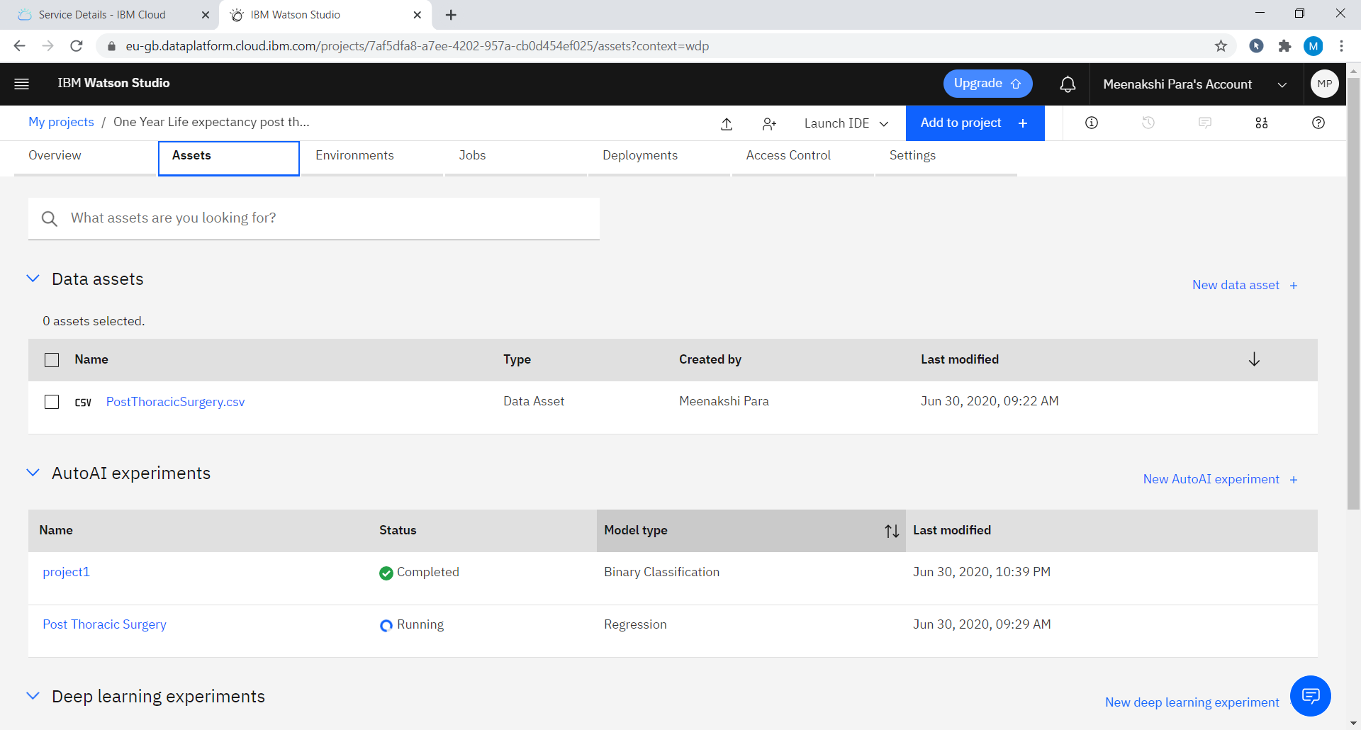
Notes:
Upon clicking that project we are redirected into this page.So I imported a dataset to predict.

Slide 6
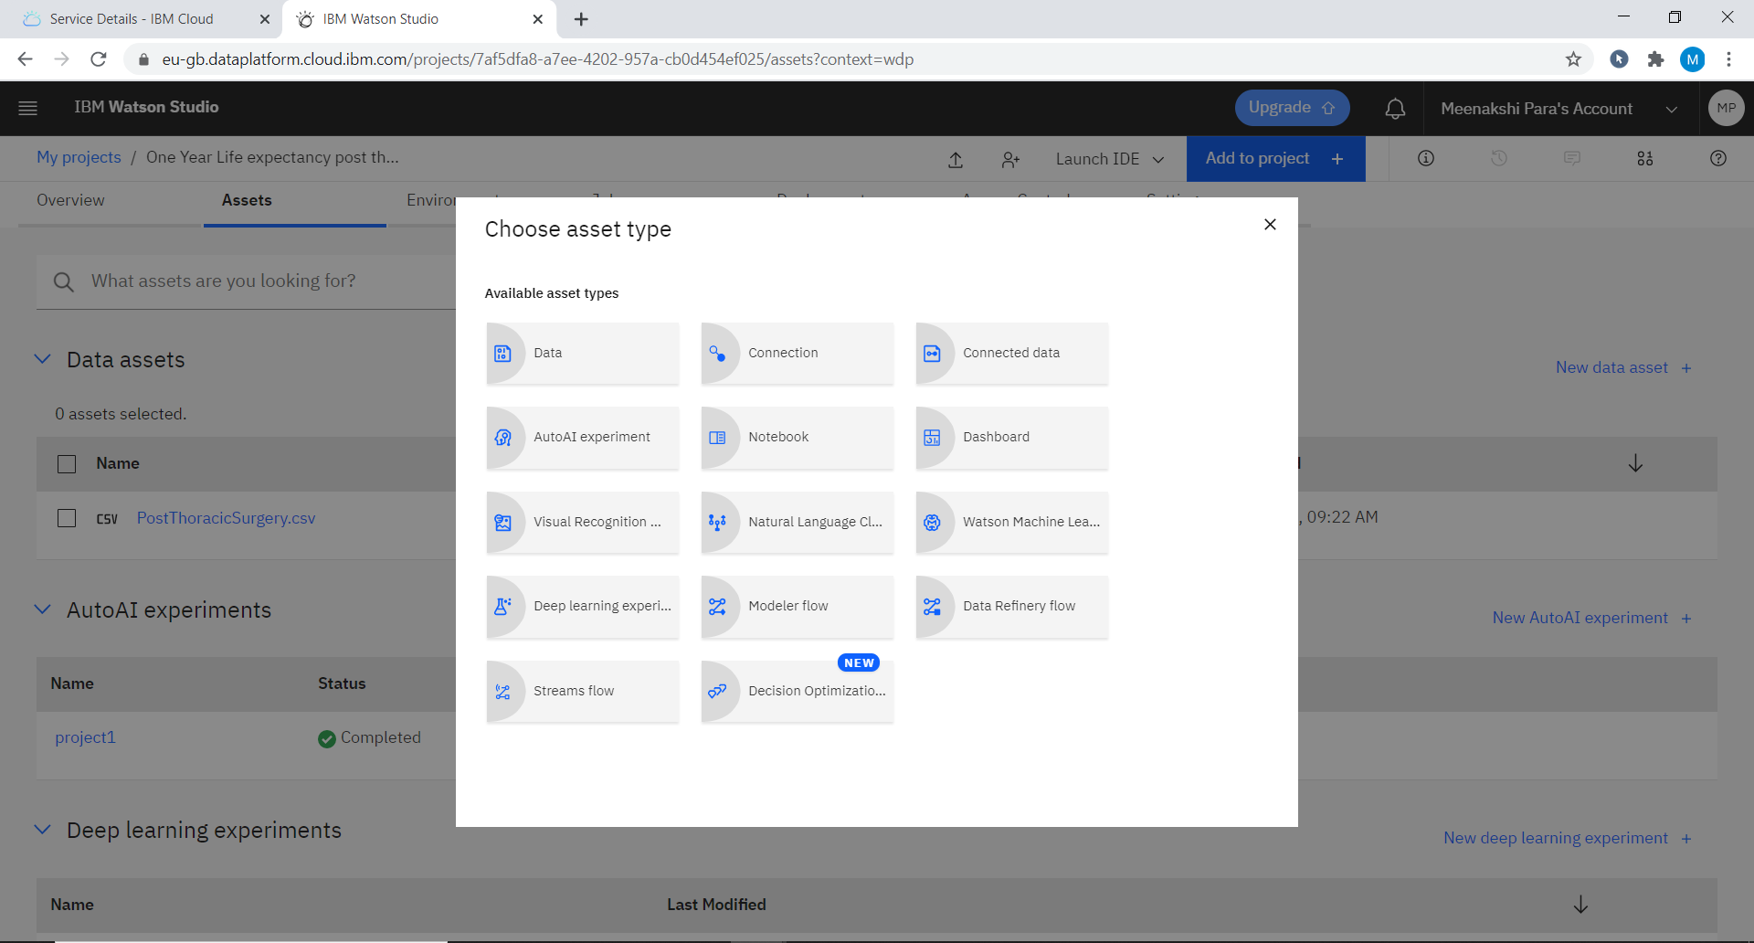
Notes:
To predict our output we need to create a asset type which was AUTO AI experiment

Slide 7
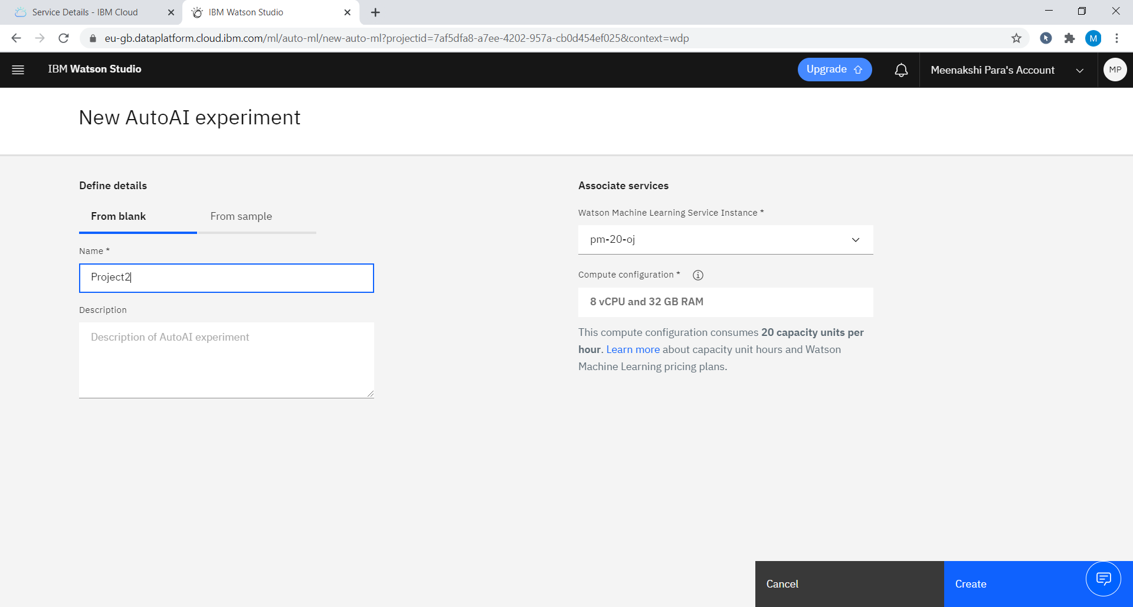
Notes:
Now we create a new AUTO AI experiment

Slide 8
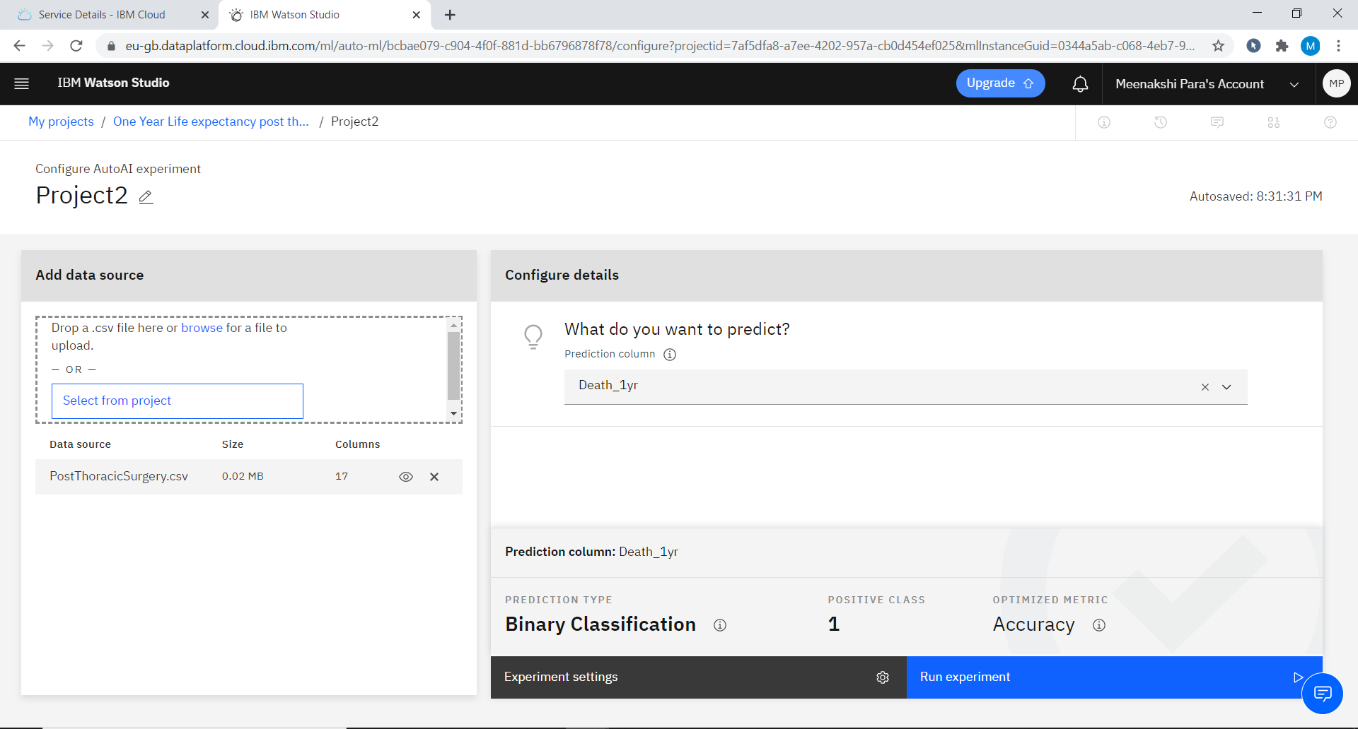
Notes:
We choose the predicted column here after creation and click on Run Experminet

Slide 9
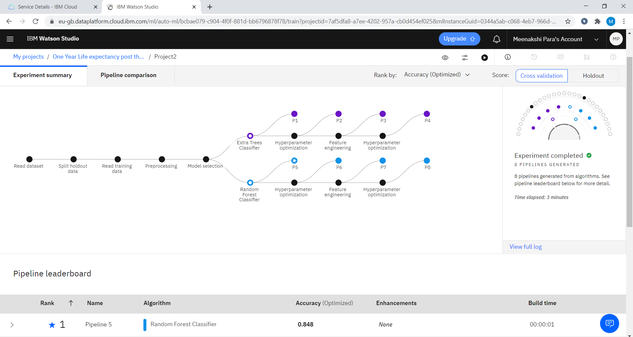
Notes:
Then this pipeline comparision takes place and best pipeline with highest accuracy was kept on top

Slide 10
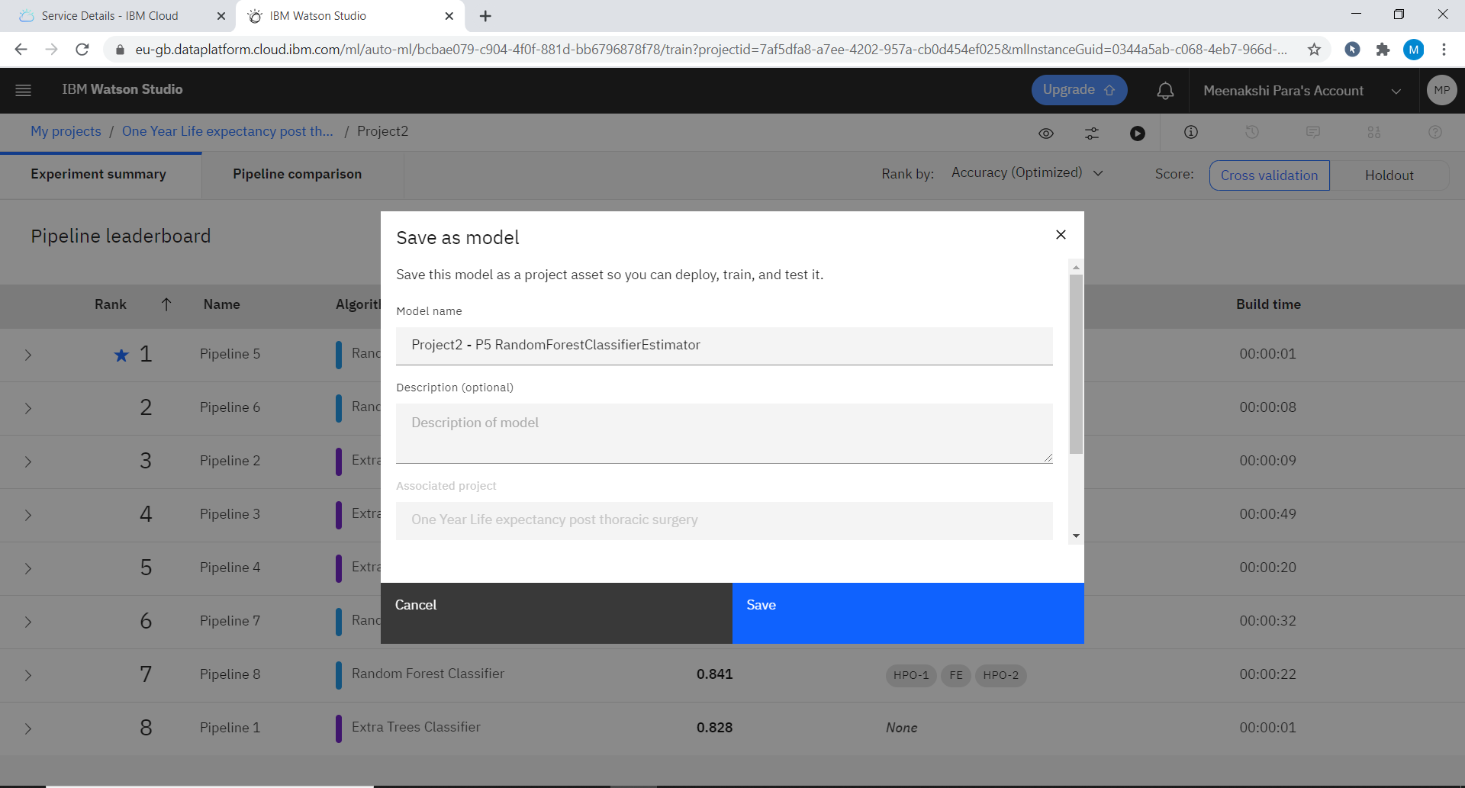
Notes:
We need to save this pipeline as model

Slide 11
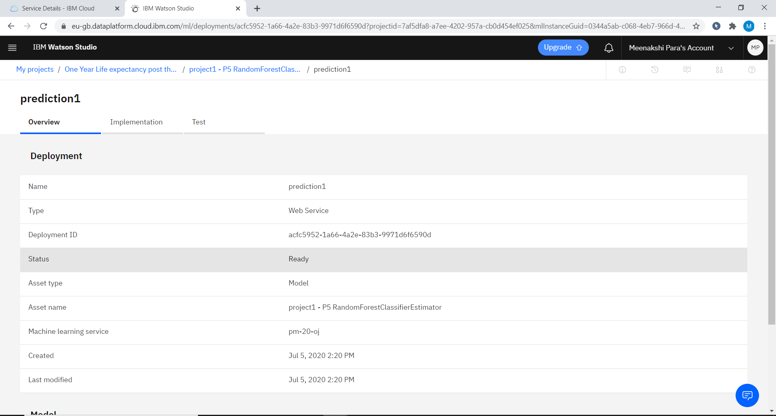
Notes:
Now a web service is created in deployments and we can test the model

Slide 12
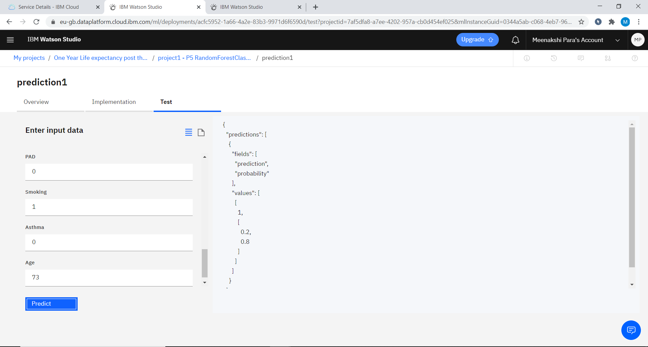
Notes:
Here we given some inputs and this model will predict the output

Slide 13
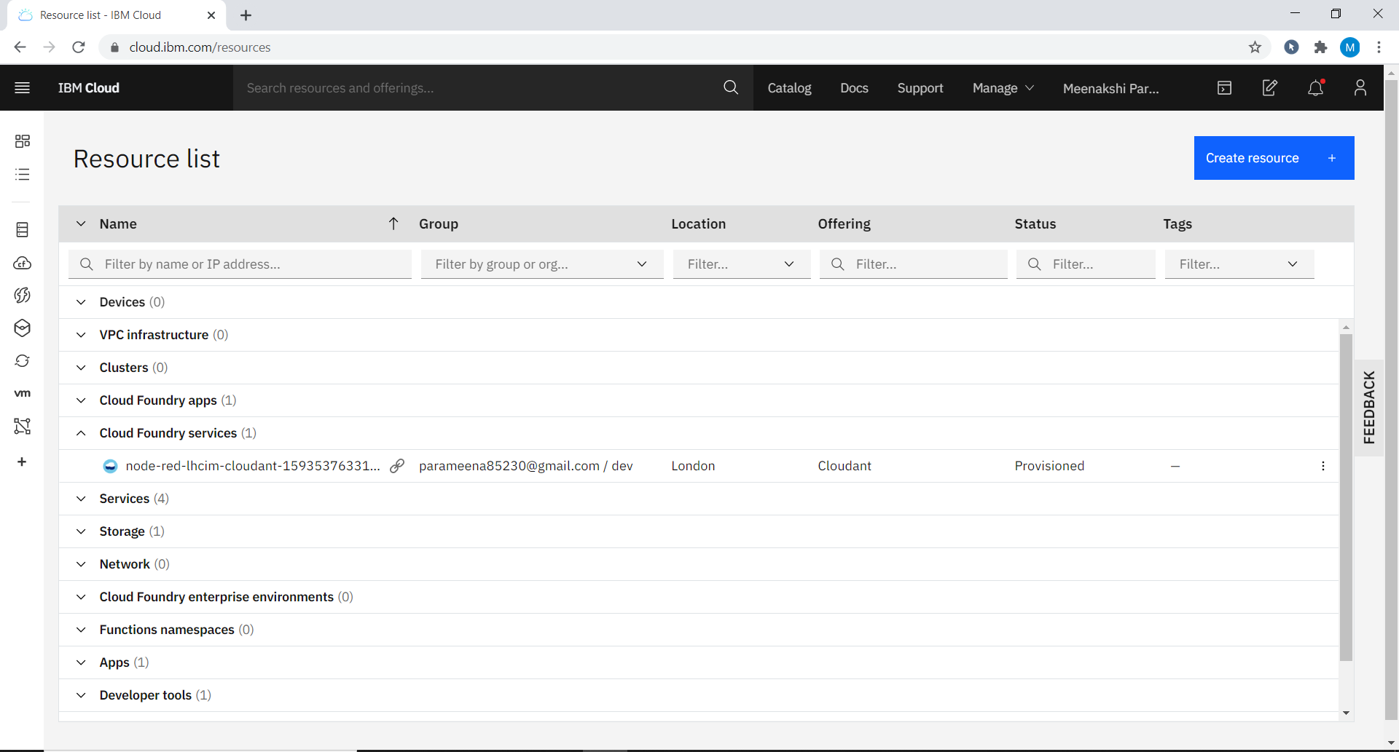
Notes:
Now we need to create NoderED application for given model .Upon clicking cloud foundary services in dashboard we were redirected to that page

Slide 14
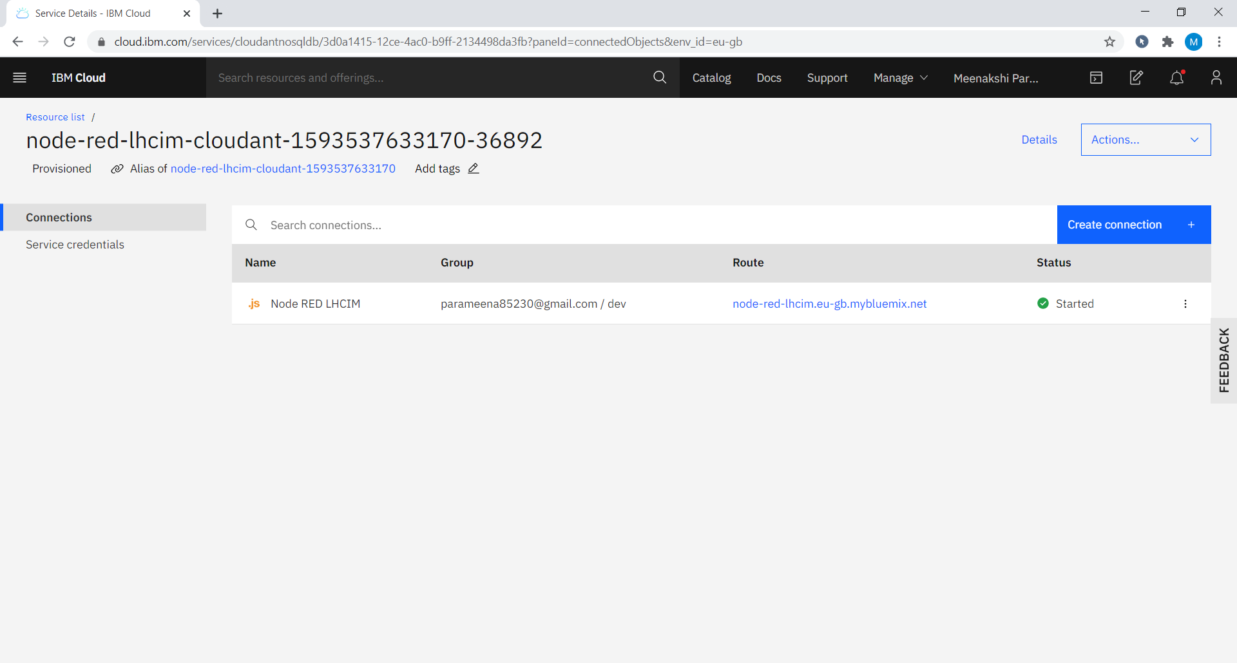
Notes:
Here is our NodeRED aaplication route and clcik on it

Slide 15
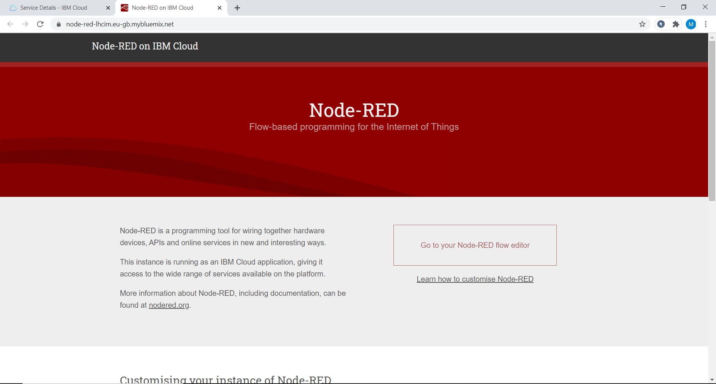
Notes:
Now click on Go to your NodeRED flow editor

Slide 16
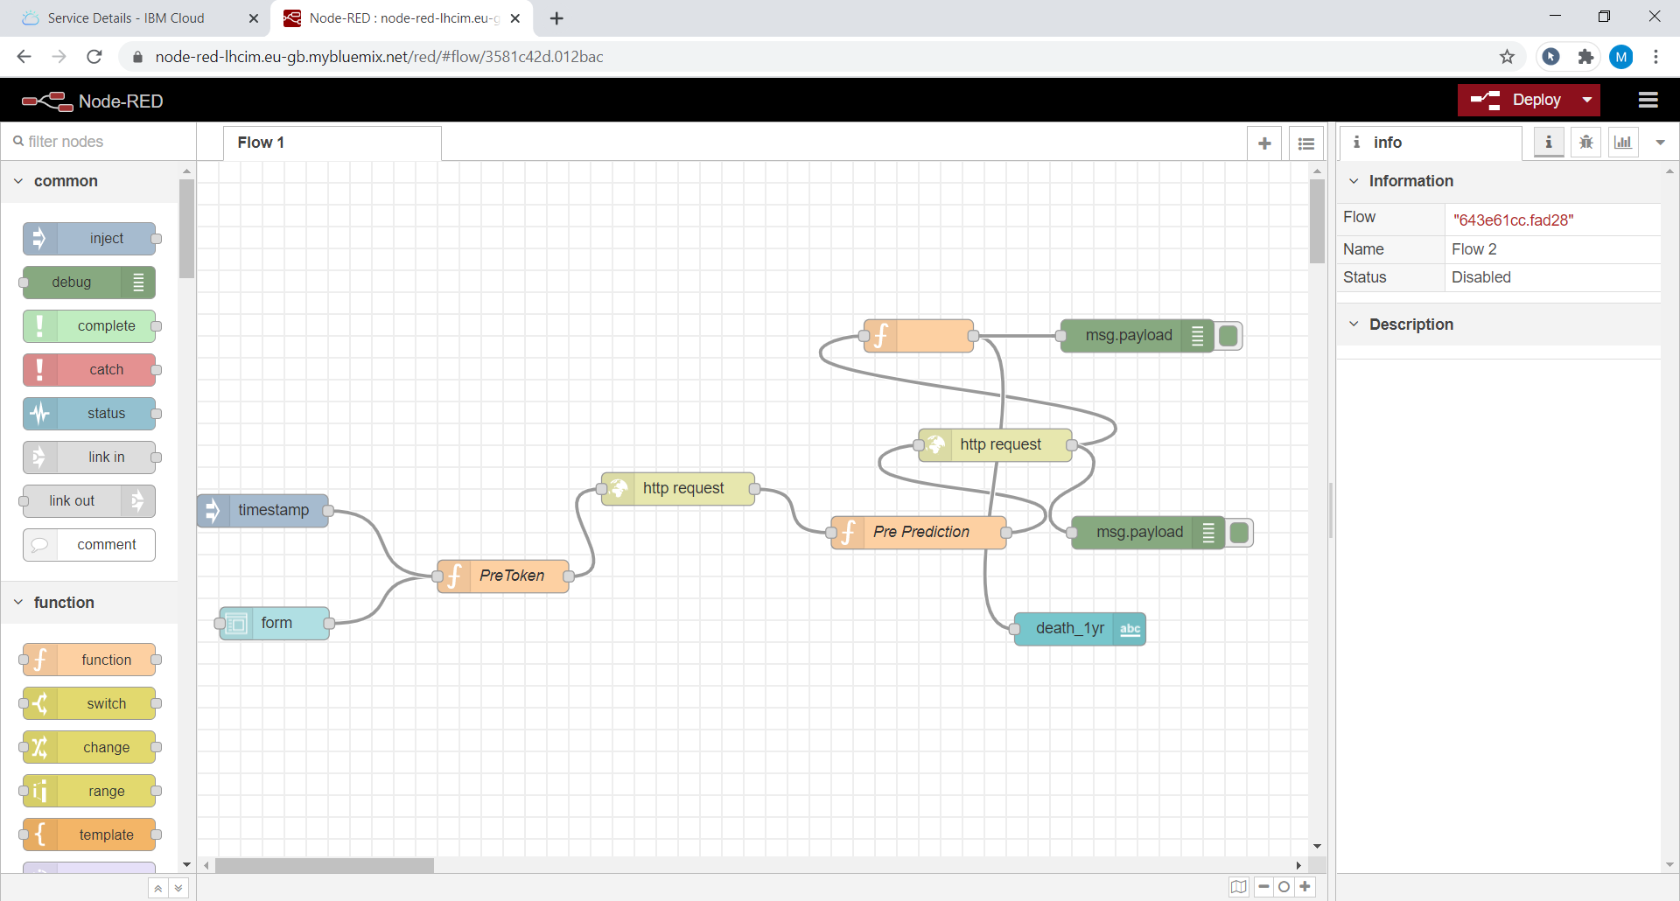
Notes:
Here is our nodered flow created to interface our output.Deploy it and copy link upto .net

Slide 17
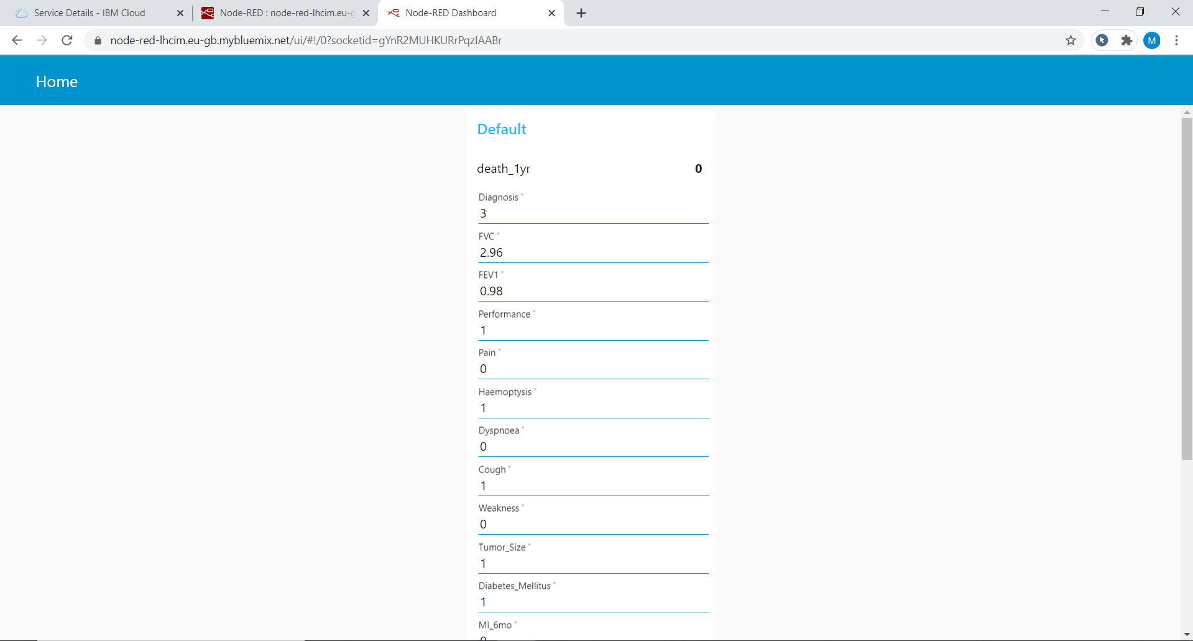
Notes:
Paste that copied link into new tab with extension of /ui.This is our NodeRED UI.Here we given some inputs and it predicted the output

