Slide 1
Telecom Customer Churn Prediction Using Watson Auto AI
Presented by:
Ananya M K
Archana Shenoy
Prajna A

Slide 2
INTRODUCTION:
Churn prediction is one of the most popular Big Data use cases in business. It consists of detecting customers who are likely to cancel a subscription to a service.
Churn is a problem for telecom companies because it is more expensive to acquire a new customer than to keep your existing one from leaving.
Python is one of the most frequently used programming languages for financial data analysis with plenty of useful libraries and built-in functionality.
Python’s machine learning libraries can be used for churn prediction.

Slide 3
DATASET:
Python comes with a variety of data science and machine learning libraries that can be used to make predictions based on python’s scikit-learn library for customer churn prediction.
After importing libraries such as numpy and pandas we have to load the dataset
We have to load the dataset from the local SV file into our Python program
We used read_csv method of the pandas library.
Eg:customer_data=pd.read_csv(r’E:/Datasets/Churn_Modelling.csv’)

Slide 4
Overview of the steps we followed:
Importing the libraries
Loading the dataset
Selecting relevant features
Converting categorical coloumns to numeric ones
Preprocessing the data
Training a machine leaning algorithm
Evaluating the dataset features.

Slide 5
ADVANTAGES:
The importance of this type of research in the telecom market is to help companies make more profit.
It has become known that predicting churn is one of the most important sources of income to Telecom companies.
Hence, this research aimed to build a system that predicts the churn of customers i telecom company.
These prediction models need to achieve high AUC values. To test and train the model, the sample data is divided into 70% for training and 30% for testing.

Slide 6
Problem Statement:
Using the data provided,we analyse the data to determine what variable are correalated with customer churn
Additionally, a prediction model, to identify the people that might churn, will also be built.
To build a prediction model,we will make different models using techniques such as logistic regression,KNN etc.
It splits the data and also remove the unnecessary data.
It also helps to check missing data.

Slide 7
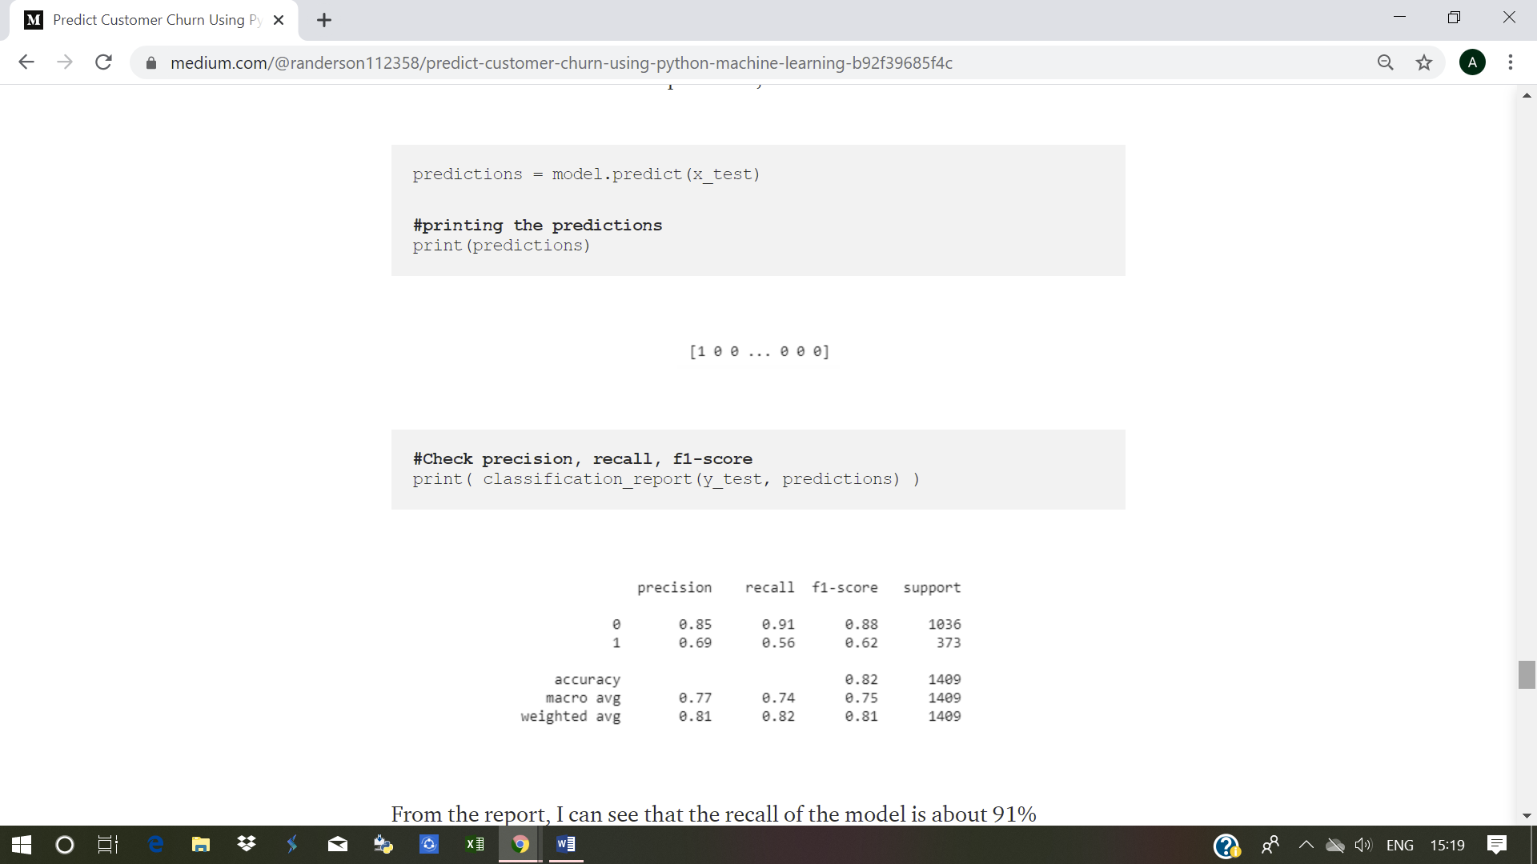
OUTPUT:

Slide 8
CONCLUSION:
From the report, I can see that the recall of the model is about 91% meaning the model correctly identified about 91% of the customers that were retained and missed about 9%.

