Slide 1

Rishitha Gajula Pramod Padidala Sindhu Ette Rakesh Nallateegala
ANALYSIS OF AMAZON CELL
PHONE REVIEWS
Devoleped by:

Slide 2
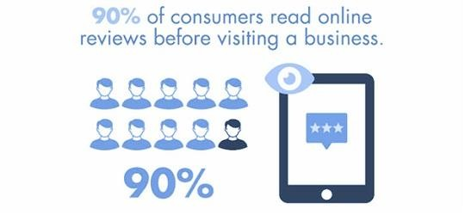
INTRODUCTION:
Overview:
90 percent of online reviews before they decide to purchase any Mobile phone from any e-commerce website.
Online mobile applications has revolutionaised the way consumers purchase mobile phones online as these apps have all the inf ormation
regarding any mobile phone at users finger tips.
Amazon is one of the best mobile applications which is considered as a treasure trove of all mobile reviews,and their review system is accessible accross all the channels presenting reviews in an easy-to-use format
So there should be a system which analysis thousands of reviews of unlocked mobile phones sold on Amazon.com to find insights with respect to reviews.

Slide 3
Purpose:
Amazon reviews serve a few different purposes
Reviews can:
Push on the dense buyers into a purchase.
Convince consumers to buy your product over alternatives.
Assure consumers of quality.
Serves as word of mouth recommendations.
Amazon customer reviews about the products are one of the main reasons to attract consumers on Amazon.It
basically helps them understand almost every detail of the product.

Slide 4
LITERATURE SURVEY:
EXISTING PROBLEM:
Amazon’s problem with fake reviews shows no sign of abating,with an investigation by the
which?consumer group releasing a flood of fake five star reviews for tech products.
Unknown brands of headphones,dash cams,fitness trackers and smart watches are receiving thousands of reviews;as they are unverified,there is no evidence that the reviewer has even bought or used the product.
Ex: ITSHINY, Vogek and Aitalk.
Of the 1.8 million unverified Reviews posted , 99.6% were 5-star.
By comparision , the no of unverified reviews averaged fewer than 3Lakhs per month,only 75%of which were 5-star.

Slide 5
PROPOSED SOLUTION: NLP Algorithm
NLP refers to AI method of communicating with an intelligent systems using a natural language such as English.
Processing of Natural language is required when you want an intelligent system likerobot to perform as per your
instructions,when you want to hear decision from a dialogue based clinical expert system.
The field of NLP involves making computers to perform useful tasks with the natural language humans use.
Thee input & output of an NLP system can be :
1.Speech 2.Written Text
We will be using the Natural Language Processing to analyse the sentiment (positive or a negative) of the given review.
A sample web application is integrated dynamically.

Slide 6
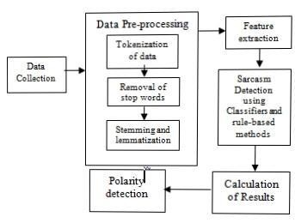
THEORITICAL ANALYSIS:
BLOCK DIAGRAM:

Slide 7
H/W designing:
S/W designing
1.Operating system - OS Windows 10 2.Coding languages - Python
Processor-dual core
RAM - 8GB
Hard disk -1TB Keyboard | Front-end Back-end | HTML,CSS Python , Flask Web Frame Works
Mouse Monitor

Slide 8
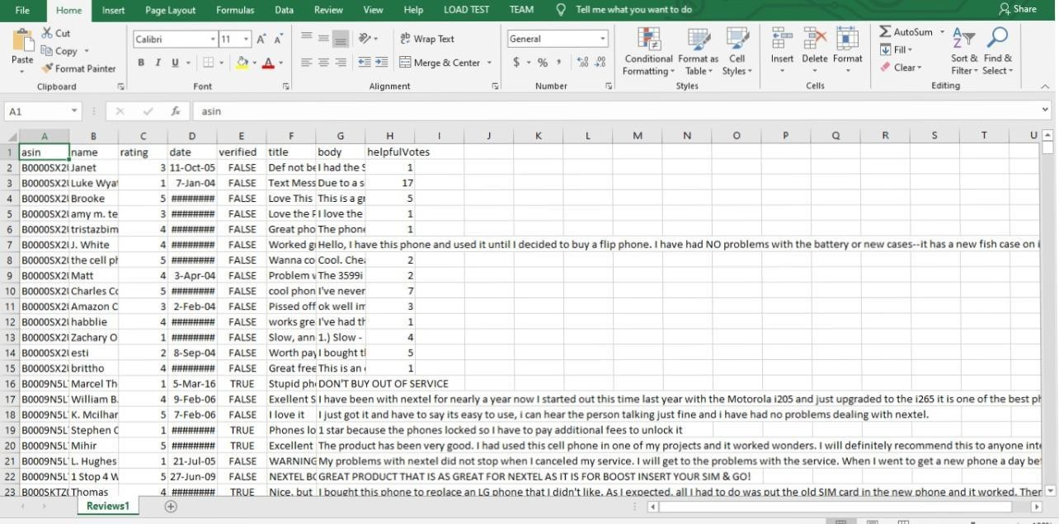
EXPERIMENTAL INVESTIGATION:
In this paper, the dataset we used is derived from www.kaggle.com/grikomsn/amazon-cell-phones- reviews
It contains more than 200 data of users with a lot of Reviews.
After that the missing values are filled in by means of mode interpolation, and the duplicate or S- attributes are deleted, finally we have retained to 13 attributes.
Those attributes were shown below in the
screenshot of the data set we used.

Slide 9
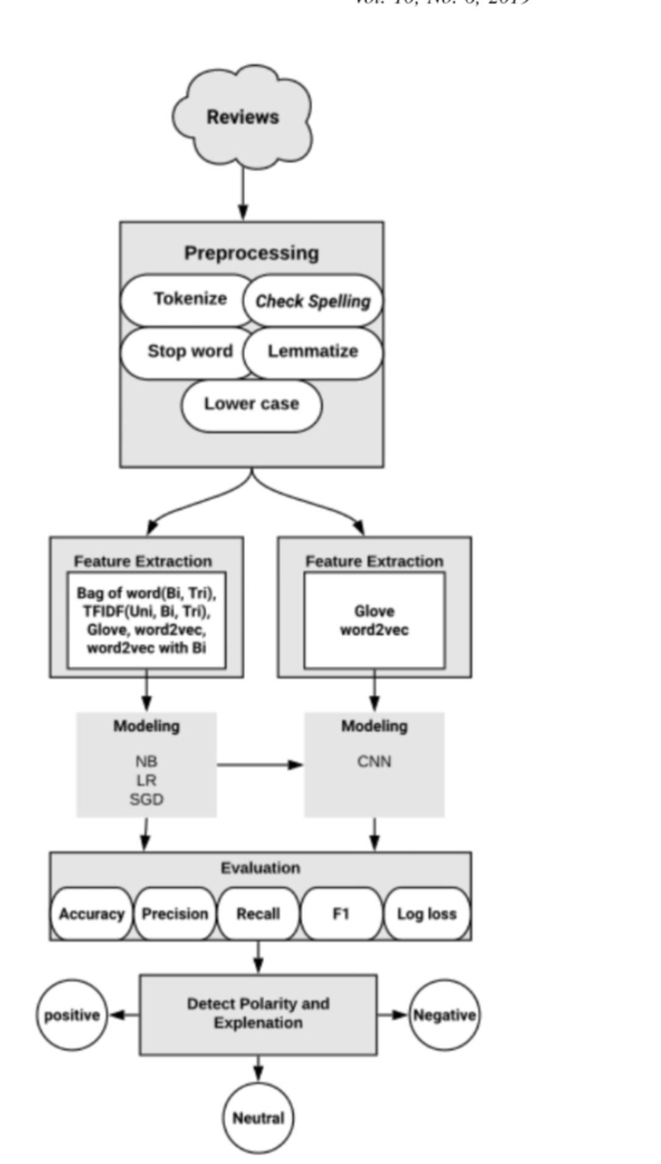
FLOW CHART:

Slide 10
RESULT:
The development of Amazon reviews explains us a lot of benefits.
It helps the user to estimate the quality of the product.
It estimates that it is liable according to the customer.
Through this product,we can assure that reviews play a key role in estimating the product.

Slide 11
ADVANTAGES &DIS-ADVANTAGES:
ADVANTAGES:
Many potential buyers are looking for products on Amazon based on reviews given by customers.
Well-established Amazon partner program for affiliates of Amazon reviews.
By using reviews we don’t need any own shop software for better understanding of the products.
We will not have to pay extra charges for renewing of Reviews.
According to a report, reviews might impact the purchasing decisions even more.Power reviews also found that positive reviews increase the sale by 20%.
DIS-ADVANTAGES:
There are only possible limited oppurtunities to directly influence the display of product.
Several service providers on same product can result a price battle due to reviews given by customers.
Due to reviews given by a customer whole product may gets bad review.

Slide 12
CONCLUSION:
Amazon’s product review platform shows that most of the reviewers have given 4-star and 3-star ratings to unlocked mobile phones.
The average length of the reviews comes close to 230 characters. We also uncovered that lengthier reviews tend to be more helpful and there is a positive correlation between price & rating.
Sentiment analysis shows that positive sentiment is prevalent among the reviews and in terms of emotions, ‘trust’, ‘anticipation’ and ‘joy’ have highest scores.It’d be interesting to perform further analysis based on the brand (example: Samsung vs. Apple).
We can also look at building a model to predict the helpfulness of the review and the rating based on the review text.
Corpus-based and knowledge-based methods can be used to determine the semantic similarity of review text. There are many more insights to be unveiled from the Amazon reviews.

Slide 13
FUTURE SCOPE:
In this NLP is used further to understand the reviews in a simple language.
It is used to analyse the reviews in a realistic way.
In future, reviews are made identical to the product.
In future reviews are made such that it is made according to beneficiary of a customer &any such fake reviews will be eliminated or discarded.
A software is used to understand & demolish the fake reviews.

Slide 14
THANK YOU

