Slide 1


LIVER PATIENT
ANALYSIS
Developed by
-Manasa Akinepelly
-Yashaswi Neela
-Achyutha Bodapatla
-Rakesh Basa

Slide 2
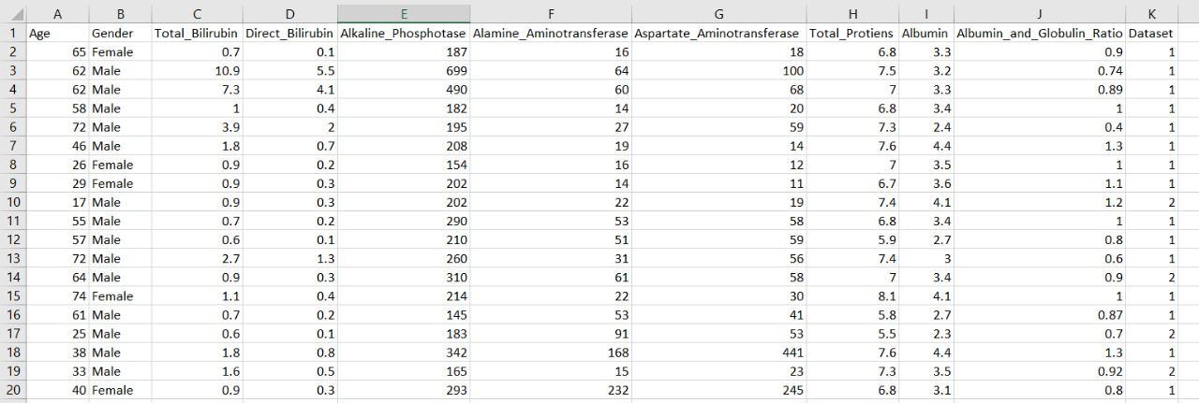
Dataset For Liver Patient Analysis

Slide 3


INTRODUCTION
PYTHON LANGUAGE
AI MACHINE LANGUAGE
Python is a very powerful programming language used for many different applications. Over time, the huge community around this open source language has created quite a few tools to efficiently work with Python.
AI Machine learning is the scientific study of algorithms and
Statistical models that computer systems use in order to perform a specific task effectively without using explicit instructions, relying on patterns and inference instead. It is seen as a subset of artificial intelligence
PYTHON
AI MACHINE LANGUAGE

Slide 4
DESIGN MODEL
DESIGN MODEL
TYPES OF MODEL USED
LOGISTIC
REGRESSION
DECISION TREE CLASSIFIER
RANDOM FOREST CLASSIFIER

Slide 5
Random Forest Regression
A Random Forest is an ensemble technique capable of performing both regression and classification tasks with the use of multiple decision trees and a technique called Bootstrap Aggregation, commonly known as bagging.
Decision tree classifier
The decision tree classifier creates the classification model by building a decision tree. Each node in the tree specifies a test on an attribute, each branch descending from that node corresponds to one of the possible values for that attribute.
Logistic Regression
Since the outcome is binary and we have a reasonable number of examples at our disposal compared to number of features, this approach seems suitable. At the core of this method is a logistic or sigmoid function that quantifies the difference between each prediction and its corresponding true value.

Slide 6
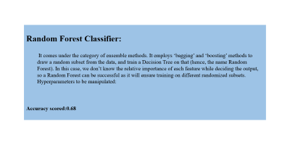
Random Forest Classifier:
It comes under the category of ensemble methods. It employs ‘bagging’ and ‘boosting’ methods to draw a random subset from the data, and train a Decision Tree on that (hence, the name Random Forest). In this case, we don’t know the relative importance of each feature while deciding the output, so a Random Forest can be successful as it will ensure training on different randomized subsets. Hyperparameters to be manipulated:
Accuracy scored:0.68

Slide 7
Decision Tree Classifier
Using the decision algorithm, we start at the tree root and split the data on the feature that results in the largest information gain (IG) (reduction in uncertainty towards the final decision).
In an iterative process, we can then repeat this splitting procedure at each child node until the leaves are pure. This means that the samples at each leaf node all belong to the same class.
Accuracy scored:0.64

Slide 8
Logistic Regression:
Since the outcome is binary and we have a reasonable number of examples at our disposal compared to number of features, this approach seems suitable. At the core of this method is a logistic or sigmoid function that quantifies the difference between each prediction and its corresponding true value.
When presented with a number of inputs , it assigns different weights to features(based on their relative importance).Since for this data it already knows the output beforehand, it continuously adjusts the weights such that when these weights summed up with their features are introduced in the logistic function, the results are as near as possible to the actual ones.
Once presented with a test value, it again inserts the value into our logistic function and returns the output as a number between 0 and 1, which represents the probability of that test value being in a particular class.
Accuracy scored:0.77

Slide 9
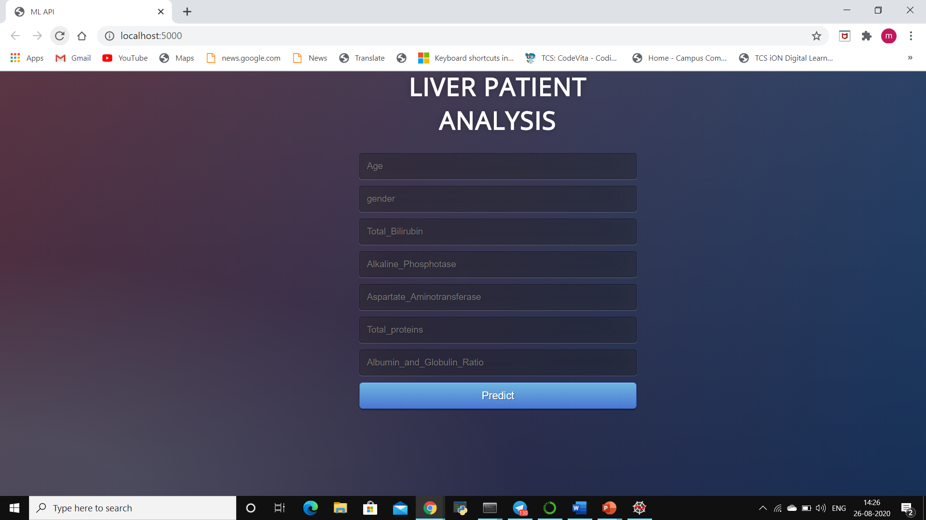
USER INTERFACE USING FLASK

Slide 10
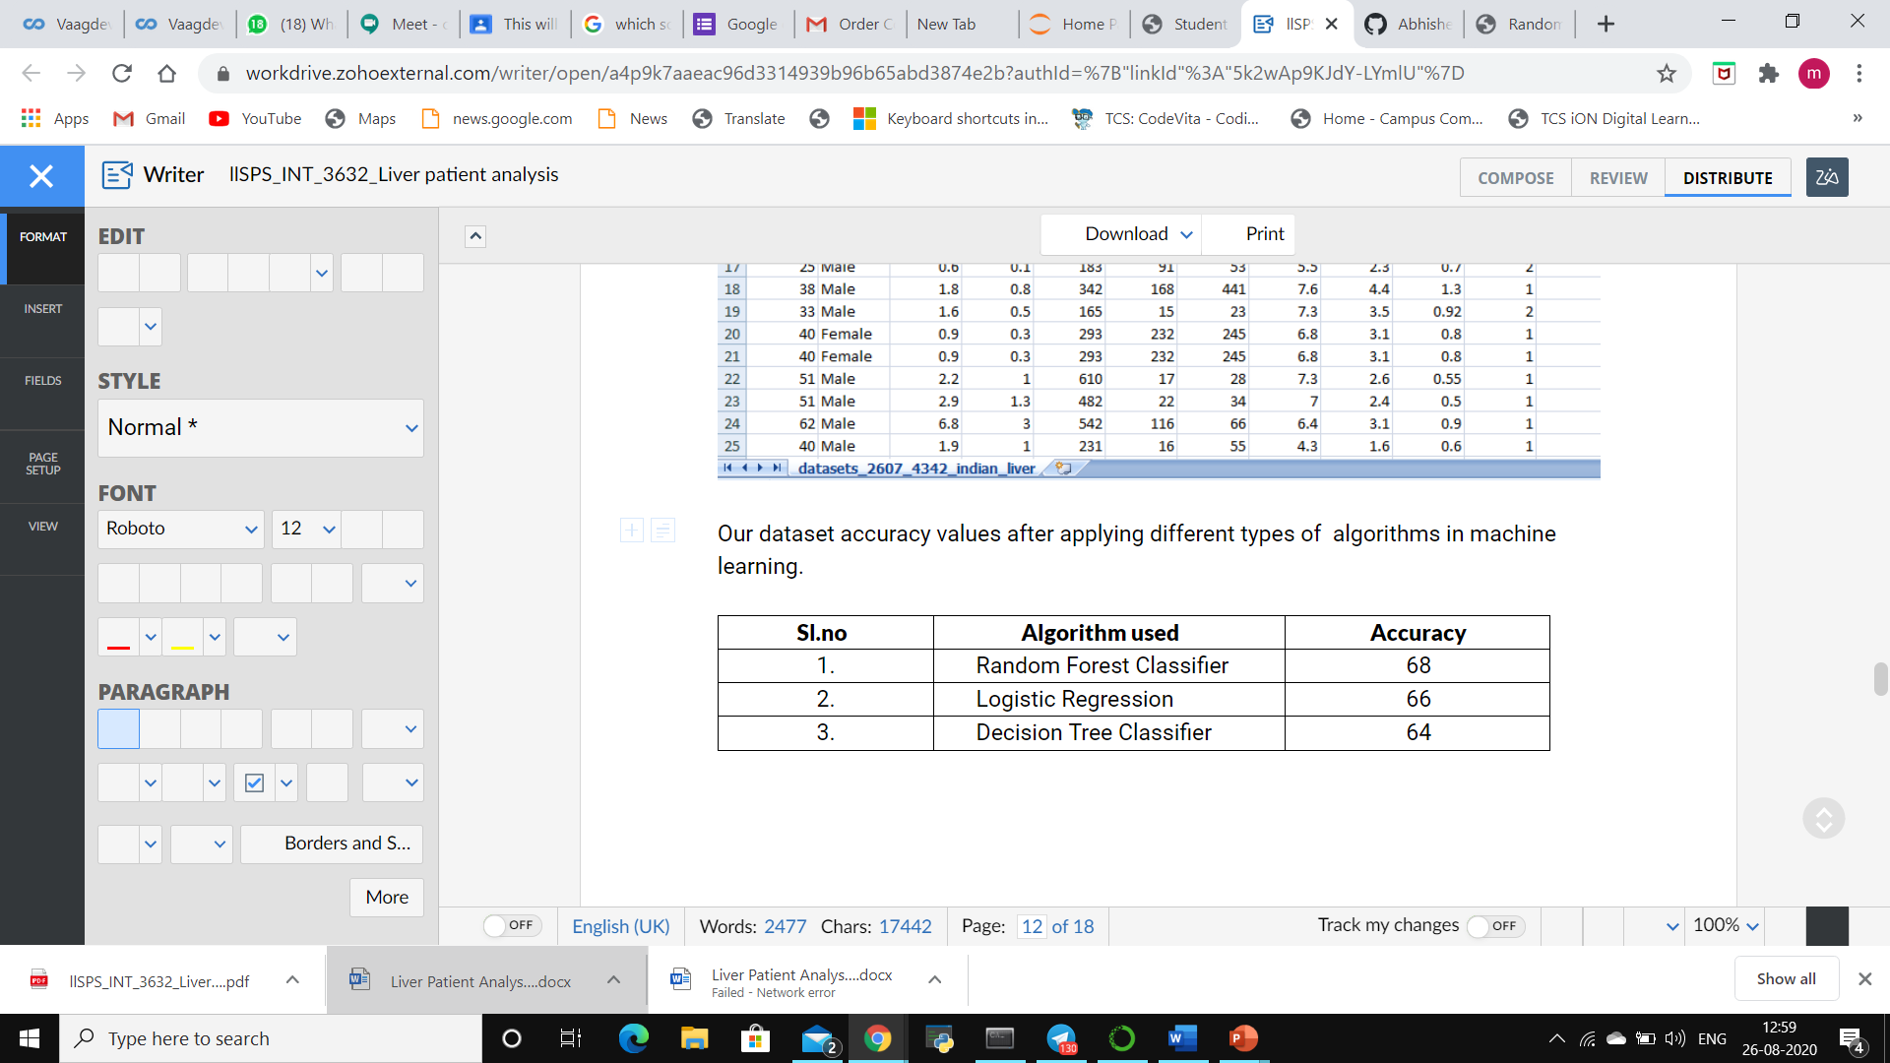
CONCLUSION
Initially, the dataset was explored and made ready to be fed into the classifiers. This was achieved by removing some rows containing null values, transforming some columns which were showing skewness and using appropriate methods (Label encoding) to convert . So that they can be useful for classification purposes.

Slide 11
Thank You

