Slide 1

UNIVERSITY ADMISSION
PREDICTION
TEAM MEMBERS: APEKSHA. B
CHINMAYA.G.R
KRUTHIKA.C.S
MADHUMATI.B
VEENA.M.R

Slide 2
INTRODUCTION AND OVERVIEW:
Machine learning is an application of artificial intelligence(AI) that provides systems the ability to automatically learn and improve from experience without being explicitly programmed.
A persons education plays a vital role in their life. While planning for education students often have several questions regarding the courses, universities, job opportunities, expenses involved, etc. Securing admission in their dream university is one of their main concerns. It is seen that often students prefer to pursue their education from universities which have global recognition.

Slide 3
A Machine Learning approach is developed to automatically predict the possibility of postgraduate admission to help graduates recognizing and targeting the universities which are best suitable for their profile
The aim of our project is to develop a system using machine learning algorithms. It will help the students to identify the chances of their application to an university being accepted.
Linear regression algorithm is used to predict the likelihood of success of the application, and multiple classification algorithms like Decision Tree, Random Forest, were compared and evaluated based on their accuracy to select the best candidates for the college.

Slide 4
PROJECT DESCRIPTION:
Students are often worried about their chances of admission in University. The aim of this blog is to help students in shortlisting universities with their profiles. The predicted output gives them a fair idea about their admission chances in a particular university. This analysis should also help students who are currently preparing or will be preparing to get a better idea.
PROPOSED SOLUTION:
In this Project, we discuss the results obtained from applying our selected classifiers on the pre-processsed admissions dataset.. All supervised machine learning algorithms applied in this study have been developed using the open-source, object-oriented programming language Python 3.0 and its many packages such as scikit-learn. The cross-validated accuracy score and cross-validated AUC scores for all the binary classification algorithms we used on the Occidental College admissions data. when class imbalance is present, the accuracy score can cause misleading interpretations of the model’s performance.

Slide 5
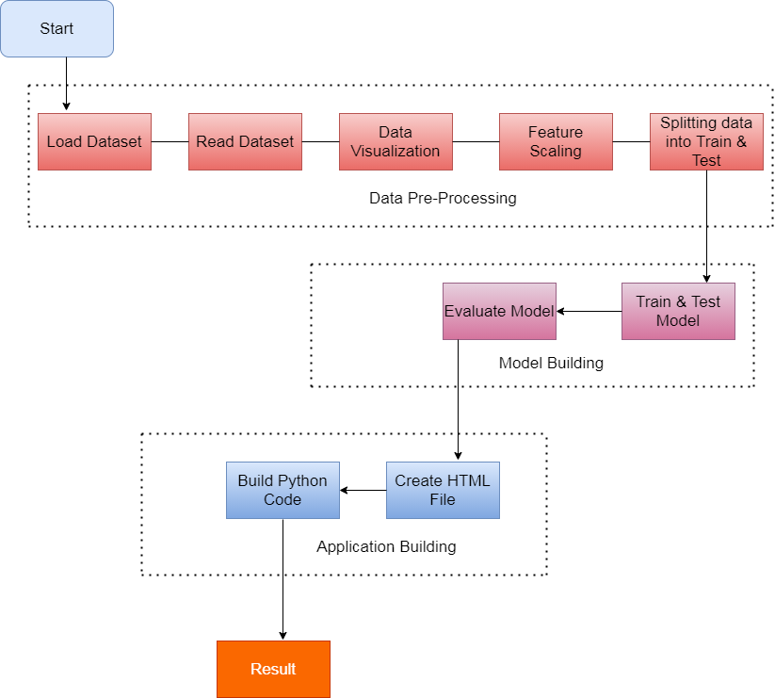
F
L
O
W
C
H
A
R
T

Slide 6
Jupyter Notebook Environment
Spyder Ide
Machine learning algorithms.
Python (pandas, numpy, matplotlib,seaborn,sklearn)
HTML
Flask
SOFTWARE
DESIGN:

Slide 7
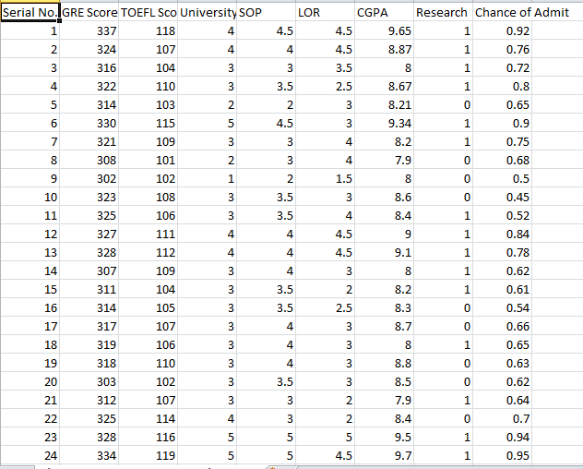
A VIEW OF THE EXPERIMENT:
Dataset used for the software design:

Slide 8
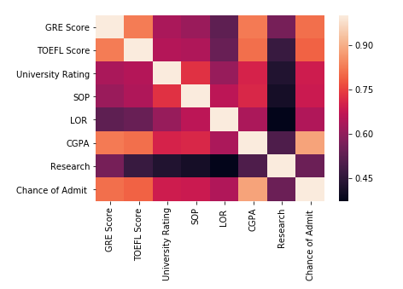
HEAT MAP:
Here linear regression is used to predict the chance of admit..

Slide 9
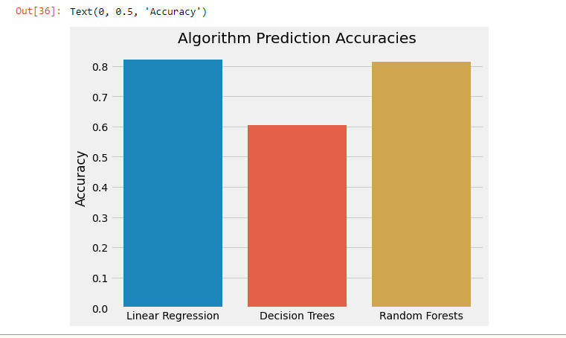
Comparision of accuracies between linear, decision tree and random forest regression:
algorithm | accuracy
Linear regression | 82.12%
Decision tree | 60.37%
Random forest | 81.31%

Slide 10
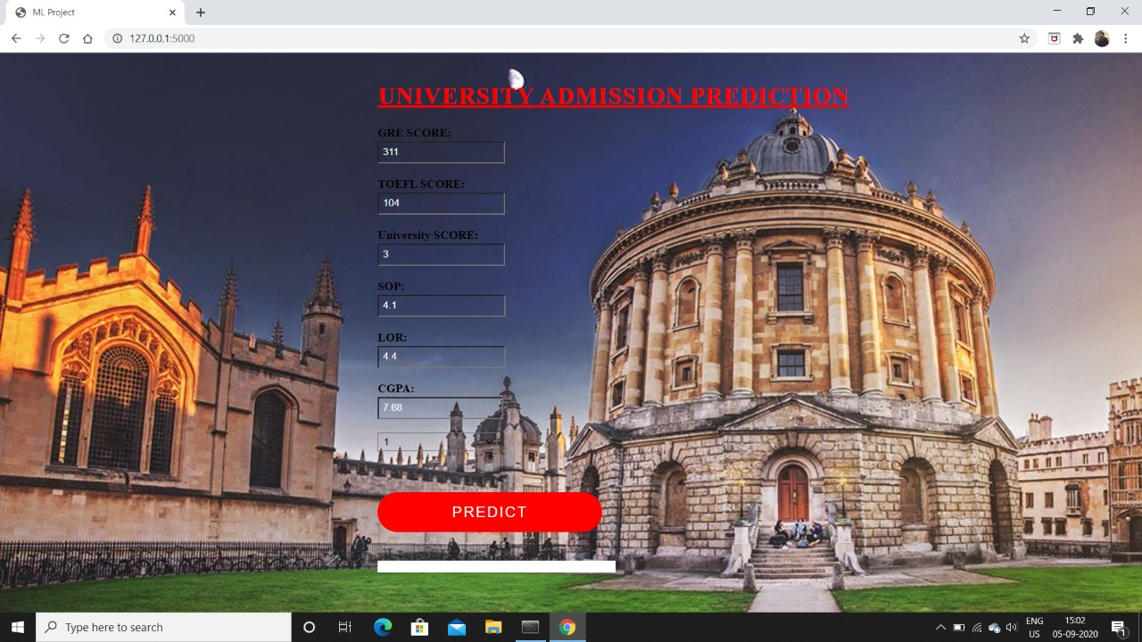
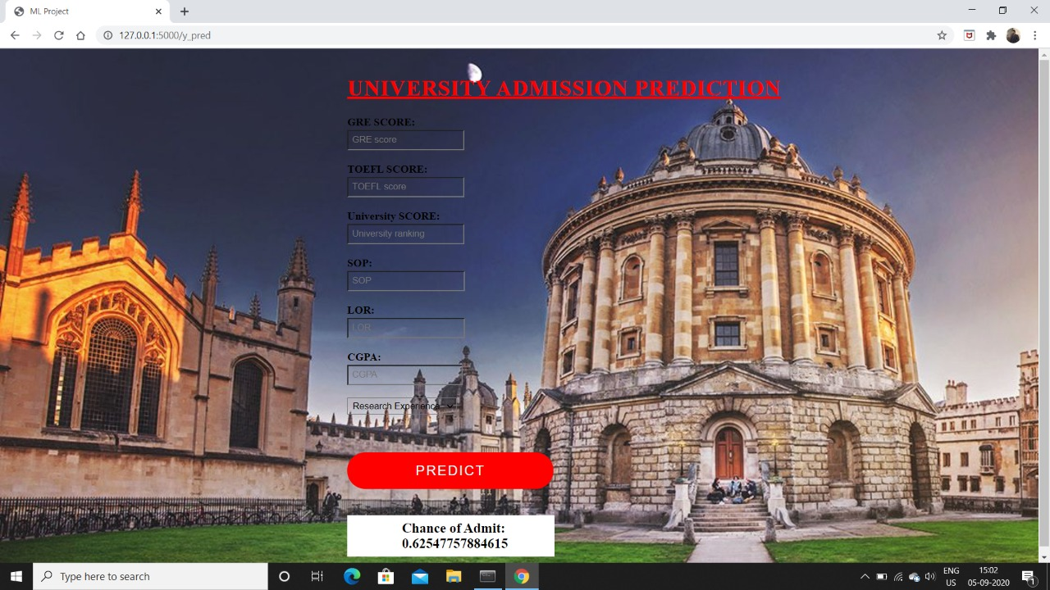
Front end page:

Slide 11
CONCLUSION:
The main objective of this research was to develop a prototype of the system that can be used by the students to shortlist their universities with their profiles.
Multiple machine learning algorithms were developed and used for this research. Linear regression proved to best-fit for development of the system when compared by giving highest accuracy.

Slide 12

THANK YOU

