Slide 1
Enhancing Performance Through Smart Scheduling
Project Implementation by Saitej Yavvari , Pavani Ronanki

Slide 2
Introduction
Process scheduling is an essential part of operating systems managing the execution of processes.
Modern operating systems handle a diverse range of applications and tasks simultaneously selecting the appropriate scheduling algorithm becomes a critical decision
Here we are introducing a novel approach, the Smart Round Robin, where the time quantum
dynamically adjusts based on the remaining time of processes.

Slide 3
Problem Statement
Traditional scheduling algorithms like FCFS, SJF, and RR each come with their own set of limitations.
FCFS may lead to long waiting times, SJF might neglect longer processes, and RR may not be
the most effective for varying task durations.
Recognizing these challenges, we seek to explore and propose an enhancement to the round robin algorithm, termed Effective Round Robin.
The goal is to address existing inefficiencies, particularly in reducing Average Waiting time (AWT) and Average Turnaround Time (TAT), providing a more dynamic and responsive scheduling approach.

Slide 4
Methodology
1) Process Initialization
Initialization of processes with predefined burst times.
Placement of processes in the ready queue.
2) Cycle Initialization
Ordering processes based on increasing remaining burst time.
Setting the initial remaining burst time.
3) Dynamic Time Quantum Computation
Calculation of Smart Time Quantum (STQ) as the average of adjacent remaining
burst time (rounded off).

Slide 5
Methodology (contd)
4) Delta Computation
Computation of Delta as half of STQ (floor rounded).
5) Execution Cycle
For each process:
If remaining burst time ≤ (STQ + Delta), execute for remaining burst time.
Else, execute for STQ milliseconds.
6) Repeat Cycle
Repeating the cycle until all processes finish execution.

Slide 6
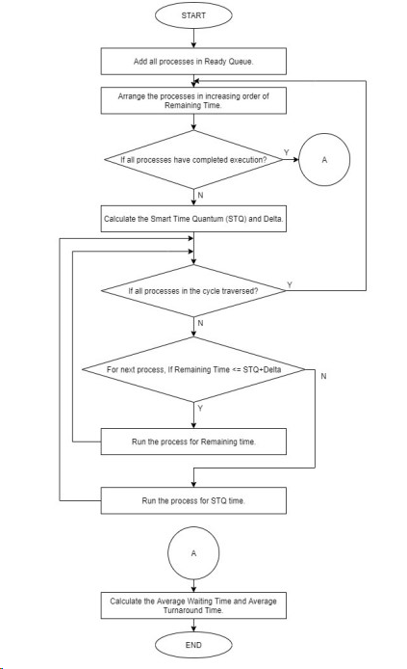
Algorithm
1) Start.
2) Empty The ready Queue.
3) Change the status of all the processes to ready state.
4) Arrange the processes in ready queue in increasing order of their remaining burst time (RBT).
5) Calculate the difference between adjacent RBT. Smart Time Quantum (STQ) is the average of those differences. Round off the value to the nearest integer.
STQ = Avg. of the differences of adjacent RBT TABLE I

Slide 7
Algorithm (contd)
6) Delta value is computed to be half of the Smart Time Quantum (STQ) rounded off to lower integer value
Delta = STQ/2
7) For each process in the cycle:
IF RBT <= (STQ + Delta)) then
Assign RBT ms on the CPU
Else Assign STQ ms on CPU
8) Repeat steps 4) to 7) until all processes finish execution.
9) Calculate the Turnaround Time (TAT), Waiting Time (WT), Average Turnaround Time (ATAT) and Average
Waiting Time
10) Stop.

Slide 8
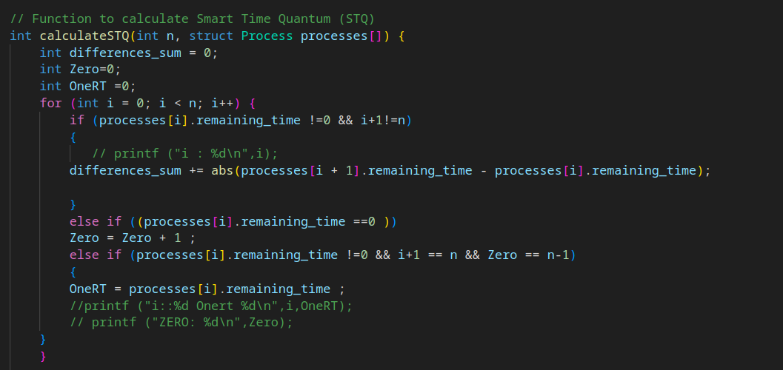
Implementation

Slide 9
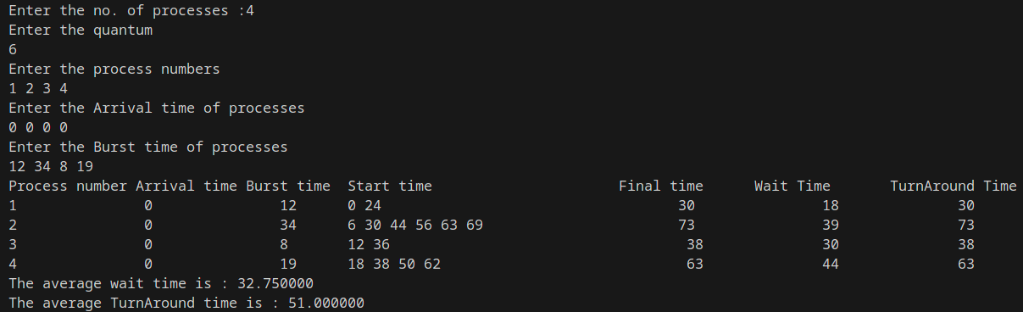
Results

Slide 10
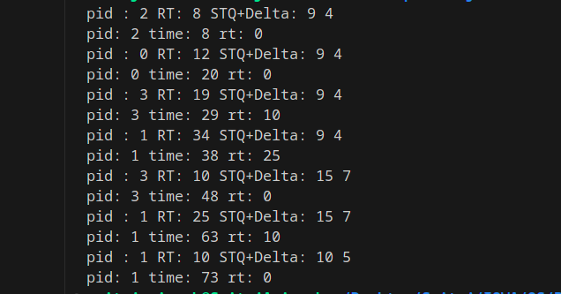
Enhanced Round Robin :

Slide 11
Conclusion
The Smart Round Robin algorithm significantly improves system efficiency, surpassing Traditional Round Robin and other algorithms with reduced Average Waiting Time (AWT) and Average Turnaround Time (ATAT). Its strength lies in the dynamic time quantum for each cycle, particularly advantageous for tasks with short burst times. The groundwork is laid for future enhancements, considering adaptations for multiprocessor systems, real-time constraints, and the potential inclusion of task priority. Beyond CPU scheduling, the algorithm's adaptability hints at broader applications, showcasing efficiency gains in diverse computing scenarios.

Slide 12

Thank you

