Slide 1

IOT Based Smart lights And Vehicle Crossing Alert with Indication Systems In Hill Station
DEPARTMENT OF INFORMATION TECHNOLOGY
TEAMMATES:
SAKTHI DHASN.K (130720205305)
DHILIP KUMAR.D (130720205303)
PROJECTGUIDE:
MS.CHRISTY GRACE
BATCH NO:18
.

Slide 2
.
DOMAIN: ELECTRONICS IOT BASED
USING SENSORS: IR (Infrared) & PIR SENSOR (Passive Infrared )
.

Slide 3
ABSTRACT:
The project is IoT Based Smart lights And Vechile Crossing Alert with Indication Systems In Hill Station With the help of an PIR Sensor, we will control the smart light and alert the crossing vechiles.
When if any vehicle is crossing the sensor above the lights blow automatically because of the sensor triggered.
This project presents an advance lighting system to minimize the wastage of electrical power and save electricity. For this purpose we are using Arduino, Light Dependent Resistor(LDR) and Passive Infrared (PIR) motion sensor. Light will be switched on when LDR detects moment.
We are using LDR to reduce unnecessary wastage of power during daytime and increase the efficiency of system. This project can also work as a security system. This project can also be used in smart light system.

Slide 4
Problem definition:
Drivers face the risk of accidents when driving on hairpin bends due to lack of communication and zero visibility over the hairpin curves.
Alerting the driver about the vehicles coming from the opposite side in Ghats sections by keeping an ultrasonic sensor on one side of the road before the curve and keeping a LED light after the curve.
Averting collisions between vehicles mainly occurring in hairpin bends, short corners, blind curves, etc. using Arduino microcontroller.

Slide 5
EXsiting system:
The existing systems detect only the incoming vehicles and not the type of vehicle.
As a result, there is traffic congestion and delay in travel.
The proposed system is used to detect the vehicles on one side of the hairpin and assist the vehicle coming opposite to it.
Exsiting system use ultrasonic sensor use to detect vehicle crossing and transmission use to detection the hairpin bend vehicle crossing.

Slide 6
Proposed system:
This project presents an advance lighting system to minimize the wastage of electrical power and save electricity.
For this purpose we are using Arduino, Light Dependent Resistor(LDR) and Passive Infrared (PIR) motion sensor.
Light will be switched on when LDR detects moment. We are using LDR to reduce unnecessary wastage of power during daytime and increase the efficiency of system.
This project can also work as a security system. This project can also be used in smart light system.

Slide 7
System Components:
Arduino uno and smd
IR sensor
LED Lamp
SSR(5v, solid state relay)
Push switch button
PIR sensors
Transistor (BC547)
Voltage Adapter(5v)

Slide 8
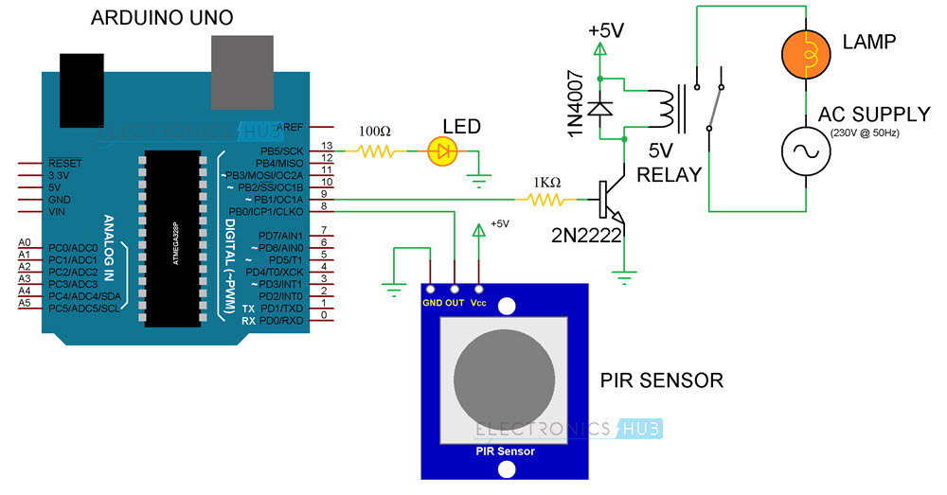
System overview:

Slide 9
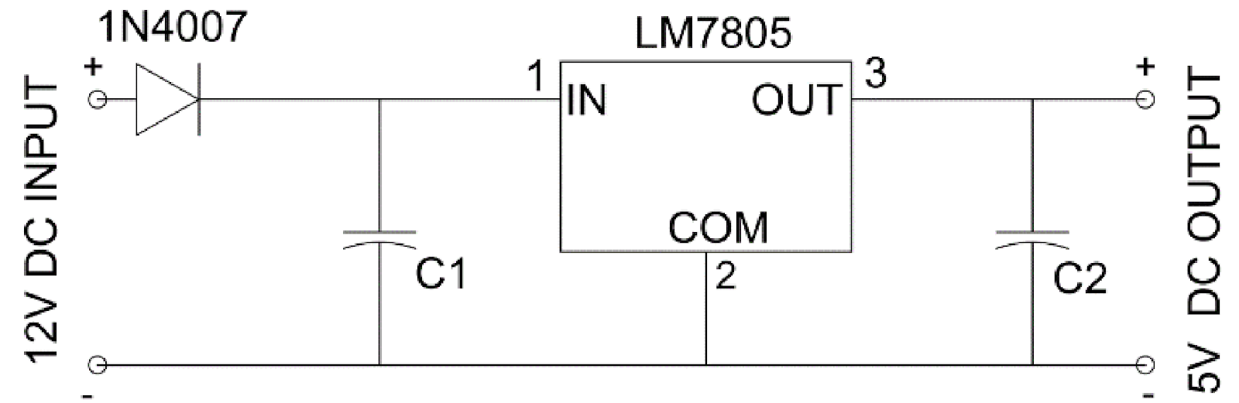
Power supply module:

Slide 10
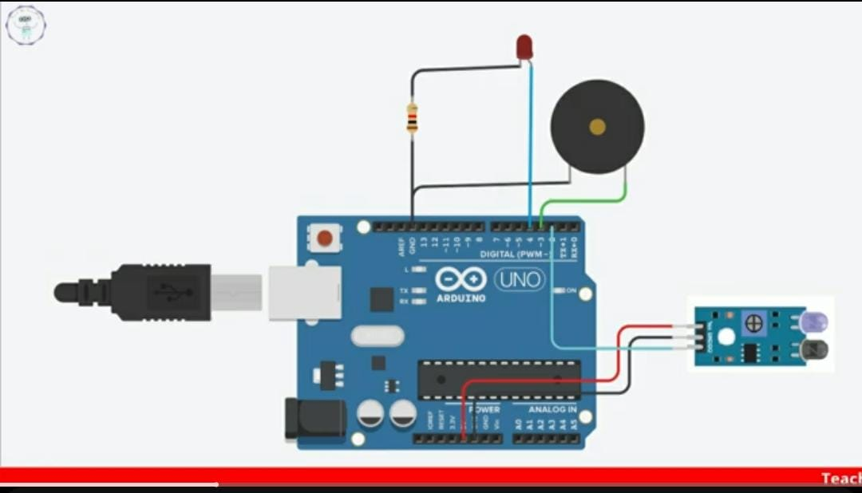
Alert with indicate Circuit diagram :
.

Slide 11
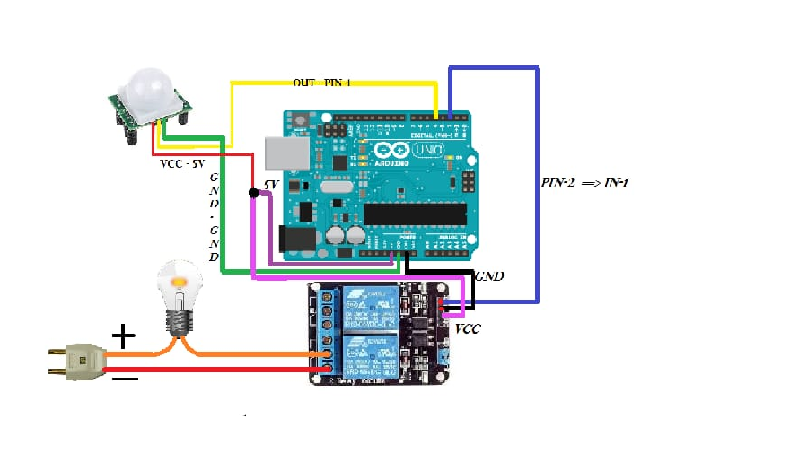
Smart Lights Circuit diagram :

Slide 12
ADVANTAGES:
The project is designed to prevent accidents in hill station hairpin bends.
It utilizes an alert and indication system for vehicles crossing hairpin bends.
Tourist Safety: Vehicle crossing alert systems can offer real-time alerts to drivers, pedestrians, and cyclists, decreasing the chances of accidents in tourist-popular areas.
It facilitates easy vehicle crossing in areas with hairpin bends where visibility is limited for drivers.
The system is economically reliable and cost-effective.

Slide 13
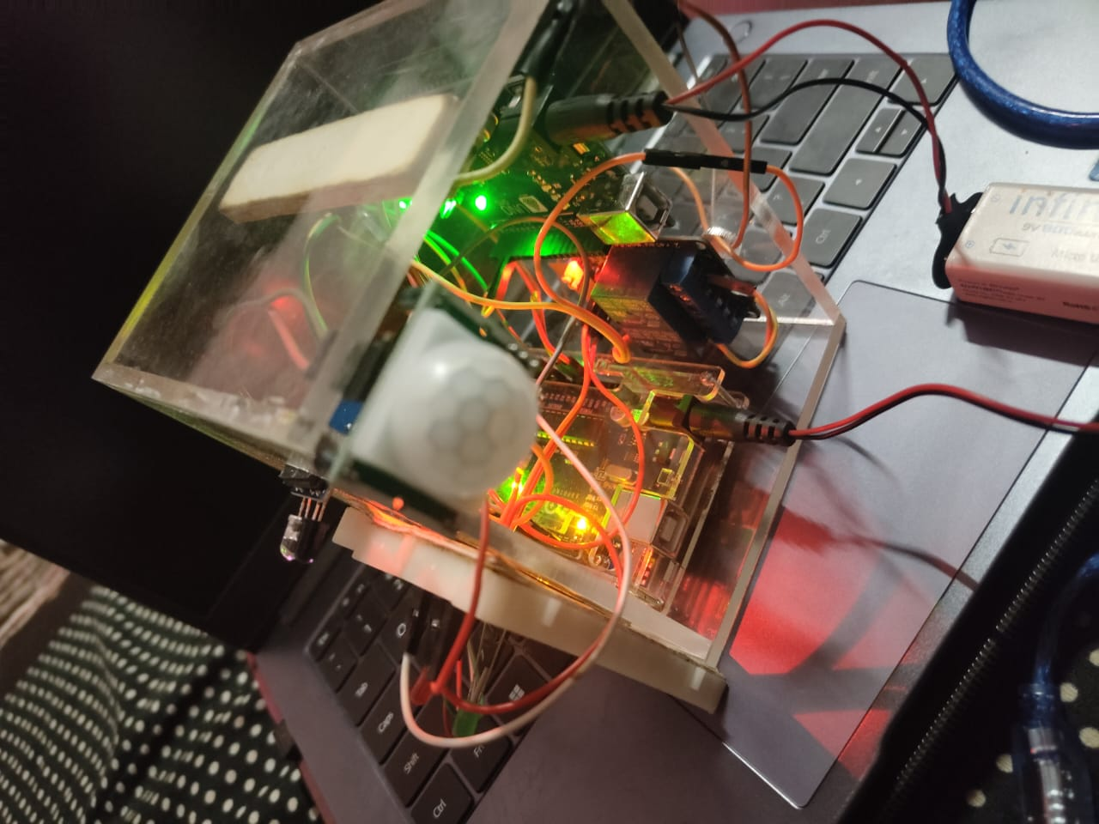
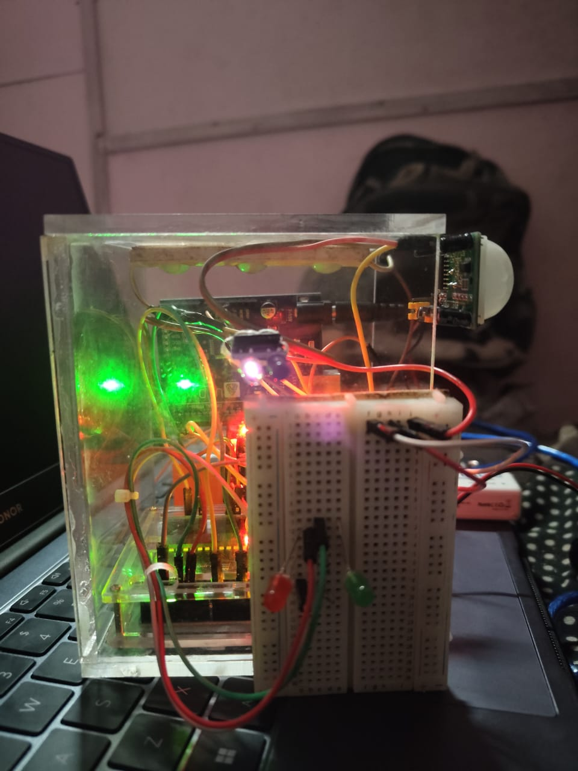
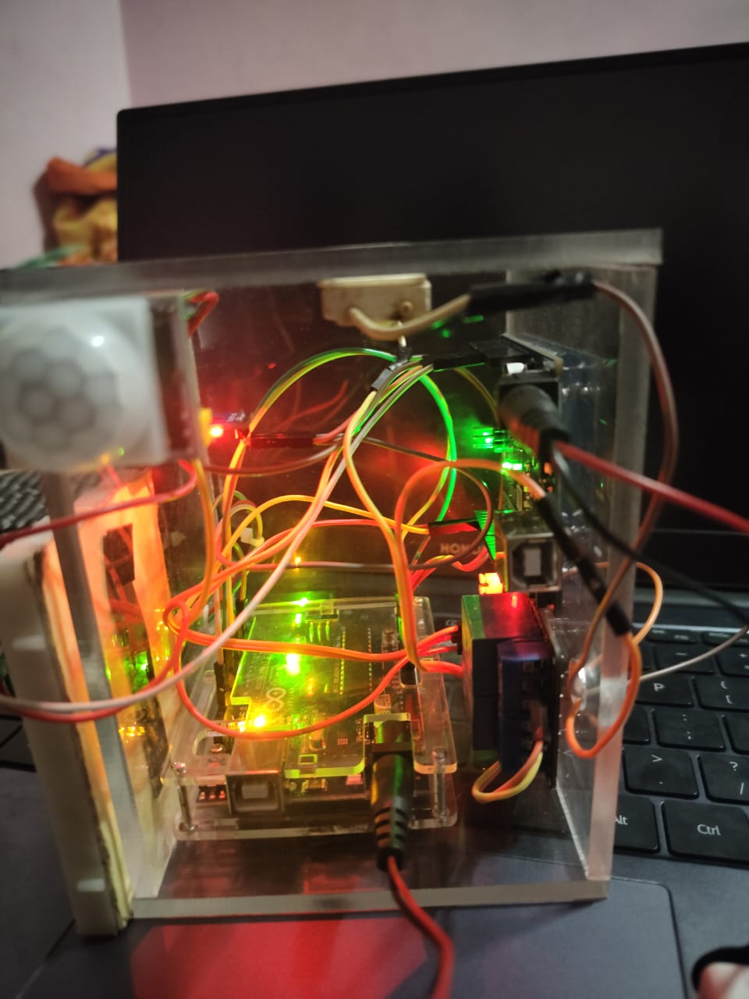
OUT COME OF THE SYSTEM

Slide 14
REFERENCES:
[1]. L. Goswami, M. K. Kaushik, R. Sikka, V. Anand, K. Prasad Sharma and M. Singh Solanki, "IOT Based vehicle Detection of hill station through Node MCU Module," 2020 International Conference on Computer Science, Engineering and Applications (ICCSEA), Gunupur, India, 2020, pp. 1-6, doi: 10.1109/ICCSEA49143.2020.9132893.
[2]. Goswami and P. Agrawal, "IOT based smart lights in Power Line Transmission through GOOGLE Firebase database," 2020 4th International Conference on Trends in Electronics and Informatics (ICOEI)(48184), Tirunelveli, India, 2020, pp. 415-420, doi: 10.1109/ICOEI48184.2020.9143007.
[3]. Baoan Lia, Jianjun Yub “Research and application on the smart home based onComponent technologies and Internet of Things”.
[4]. Suk Lee, Kyoung Nam Ha, Kyung Chang Lee, “A Pyroelectric Infrared Sensor-based Indoor Location-Aware System for the Smart Home”.

Slide 15


