Slide 1
TensorFlow Lite

Slide 2
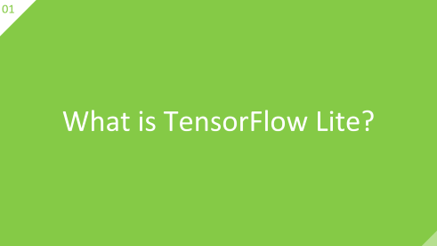
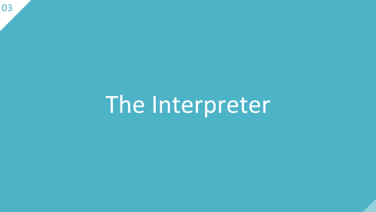
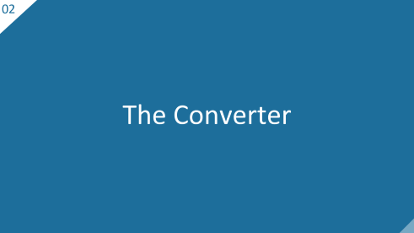

Slide 3
What is TensorFlow Lite?
01

Slide 4
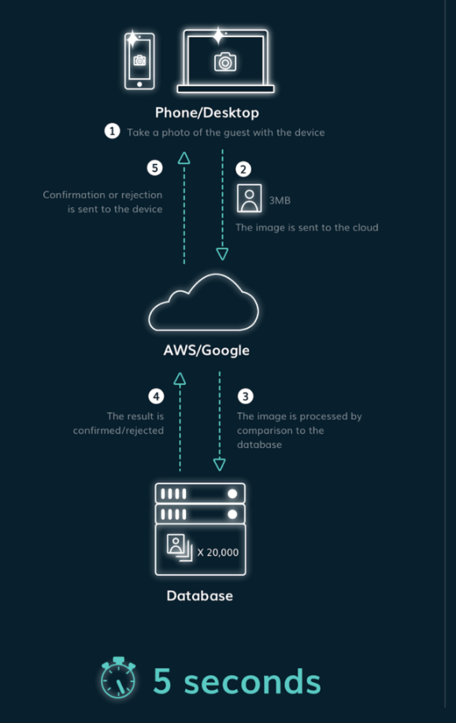
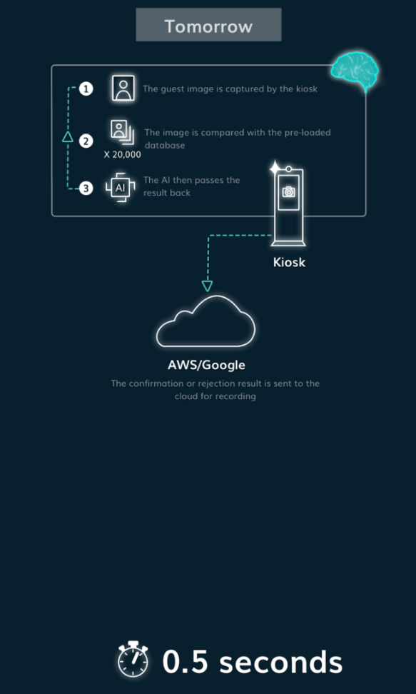
Tensorflow vs Tflite
01
4 / 18

Slide 5
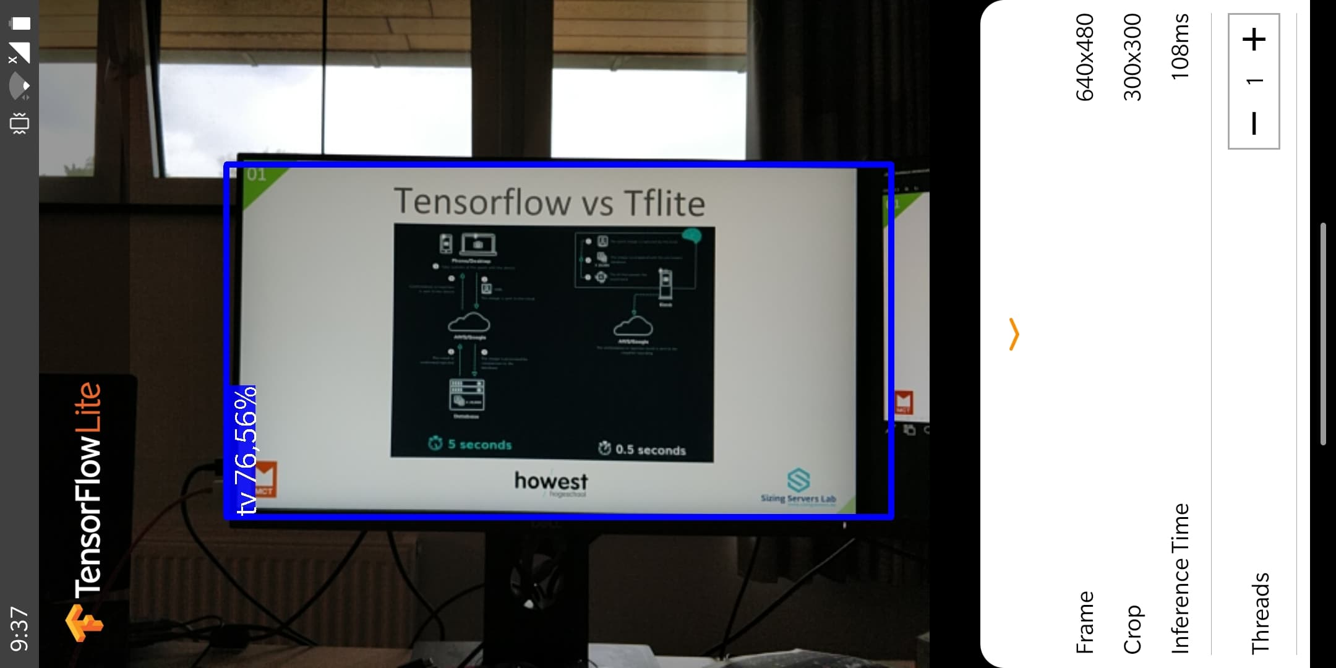
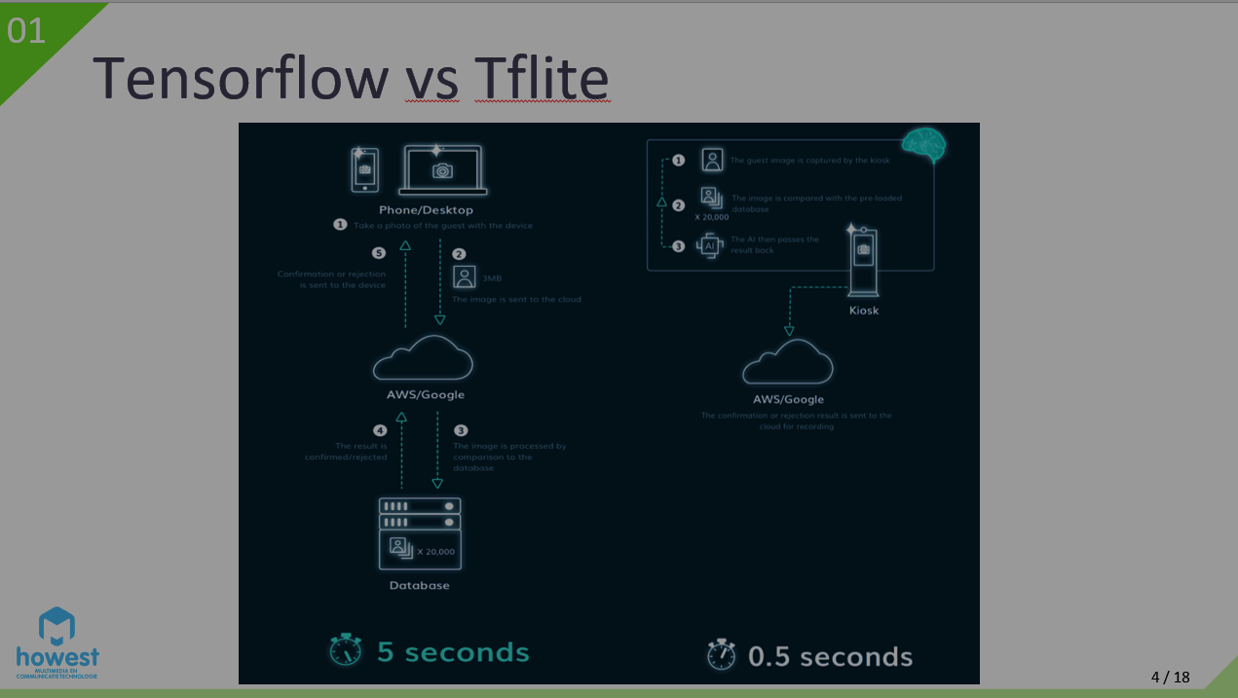


Example application
01
5 / 18

Slide 6
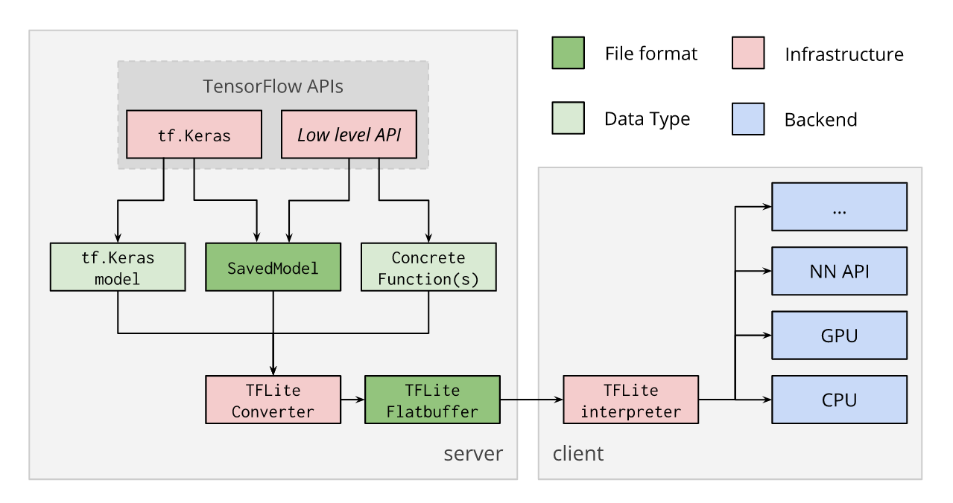
TensorFlow lite workflow
01
6 / 18

Slide 7
The Converter
02

Slide 8
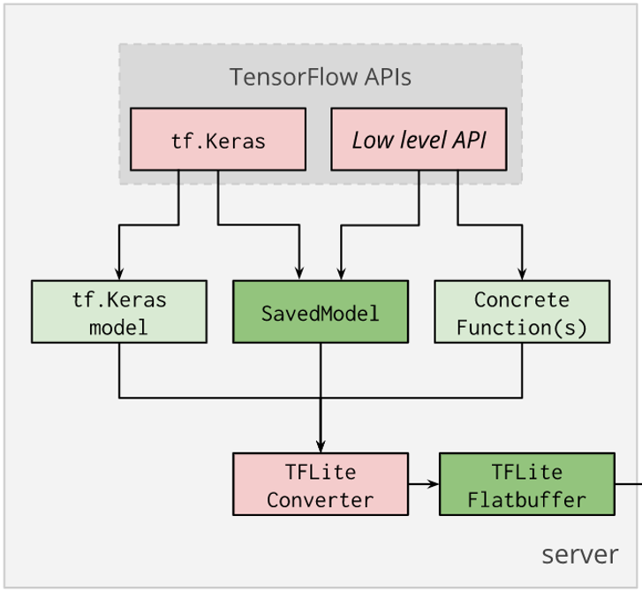
What is the converter?
02
8 / 18

Slide 9
Tflite optimization
02
Size
Compatability to run on EdgeTPU
Latency
Accelerator compatibility
Smaller storage size
Smaller download size
Less memory usage
Less time waiting for interference
Extreem speedup
9 / 18

Slide 10
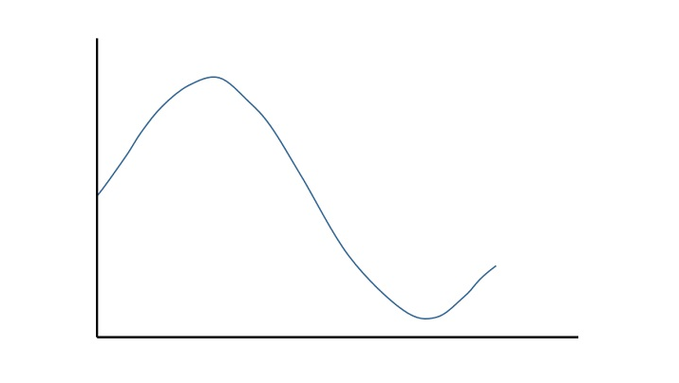
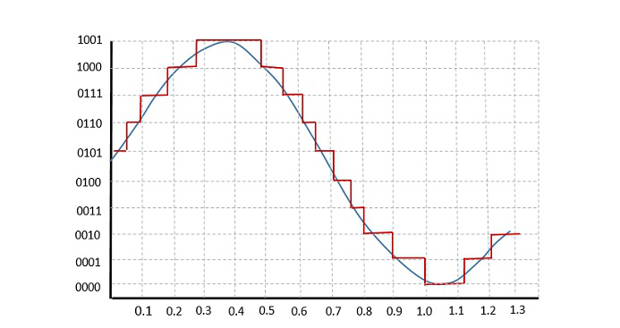
Quantization?
02
Pre quantization
Post quantization
10 / 18

Slide 11
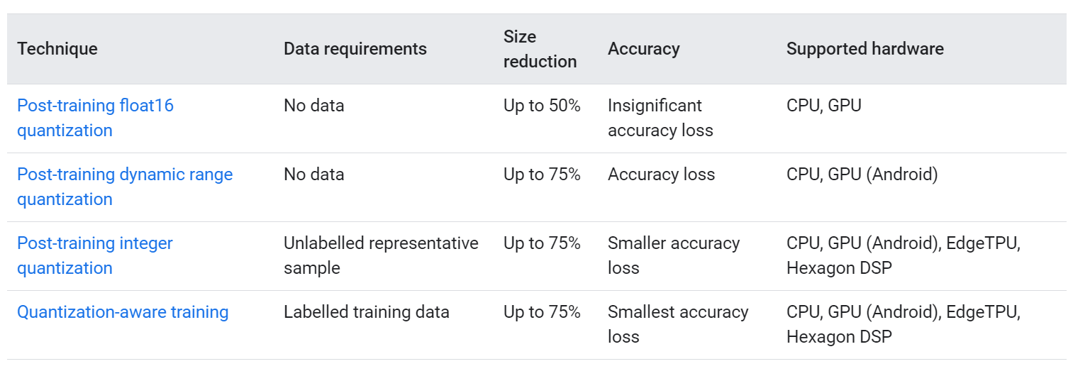
Quantization techniques
02
Post training
While training
11 / 18

Slide 12
The Interpreter
03

Slide 13
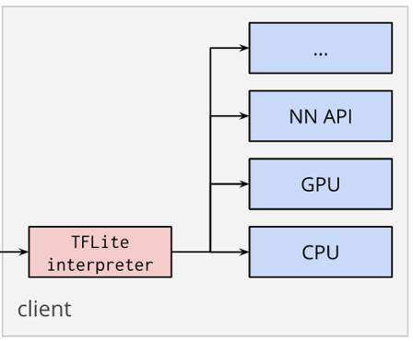
What is an interpreter?
03
15 / 18

Slide 14

Operations
03
16 / 18

Slide 15
Workflow
03
Load model
Import dependencies
Create namespace
Add operations
Allocate in- and output
Invoke the Interpreter
Handle output data
provide data
17 / 18

Slide 16
TensorFlow Lite

