Slide 1
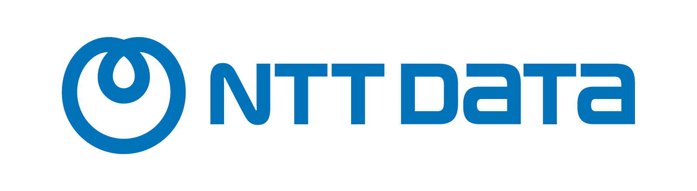



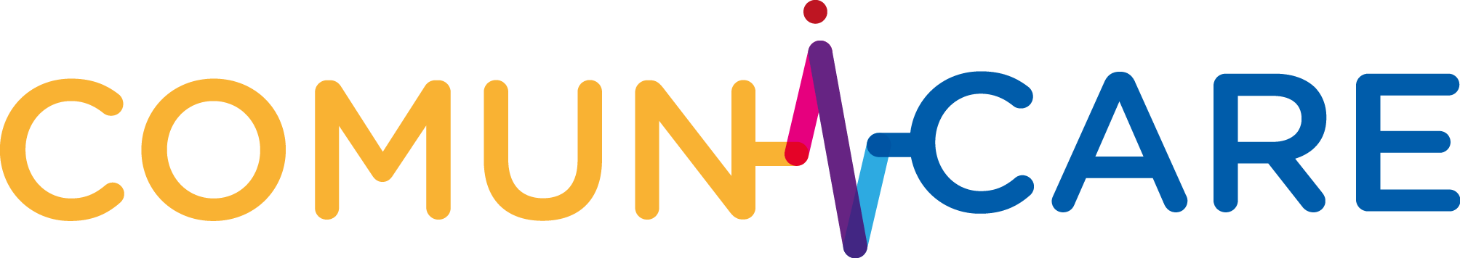
SmartNation AI Hackathon (EASEMED – Enhanced AI Service for Medical Data)

Slide 2




Importance of data in health
Any data related to individual or collective health, including medical records, test results, disease tracking data, health app information, and more.
They add value to different areas:
Clinical Care
Improvement in personalized diagnoses and treatments
Investigation
Understanding diseases and development of new therapies
Public health
Disease surveillance and outbreak management
Public Decision
Data-driven information for health policy formulation

Slide 3
SmartNation Challenge
Unstructured content in Electronic Patient Records (EPR).
Patient data privacy
No easy access and interpretation by healthcare professionals.
Lack of structured visibility into medical history.
Interoperability issue.
Limited reusability of medical data.
Variations in data formats, standards, and accessibility.
Lack of standardizing medical record formats, terminology, and protocols.
Efficiency loss due to missing patient medical information.
Incomplete medical information can lead to inefficiencies in diagnosis, treatment, and care coordination.
Manual aggregation and centralization of medical records are challenging and resource-intensive tasks.
Manual tasks often prone to errors and inconsistencies.

Slide 4
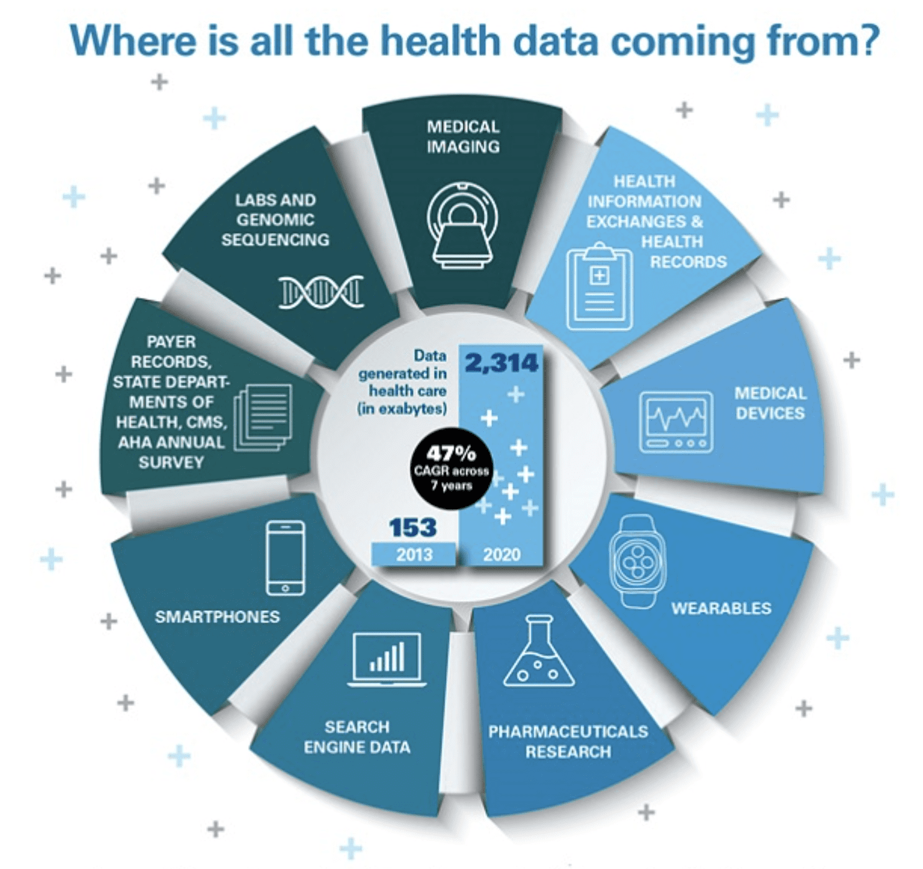
Health data sources
Electronic Health Records (EHR): Digital patient health information, including diagnoses, prescriptions, test results.
Medical imaging: Use of x-rays, MRIs, and CT scans for diagnosis and follow-up.
Omic data: Molecular data for personalized medicine and research.
Sensor data (IoT): Real-time health monitoring with devices such as smart watches.
Epidemiological data: Disease statistics for public health planning.
Clinical trial registries: Safety and efficacy of treatments for approvals.
PREMs, PROMs: Patient evaluations of the care received to improve care, and of their health and treatment to evaluate effectiveness
Internet search data: Health-related search trends and patterns to identify outbreaks and public health concerns.

Slide 5
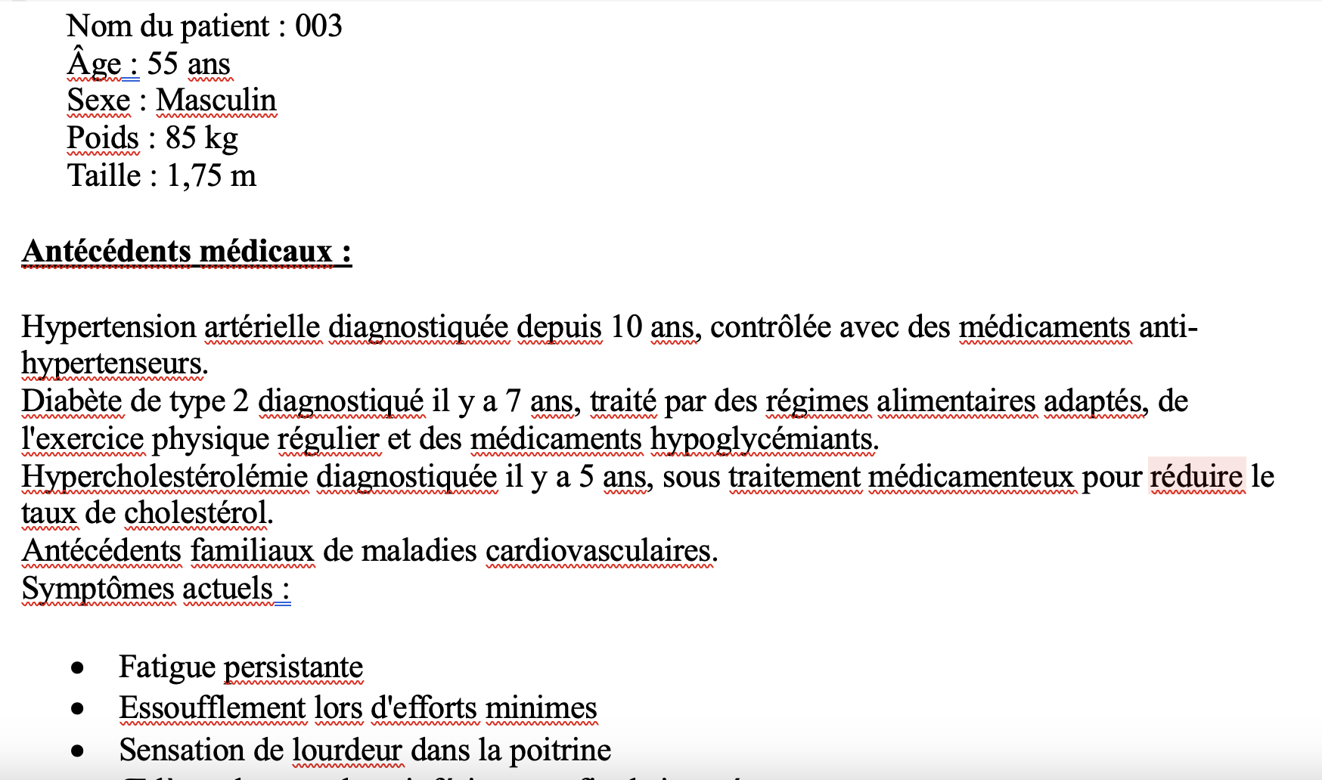
Health data source - Example

Slide 6
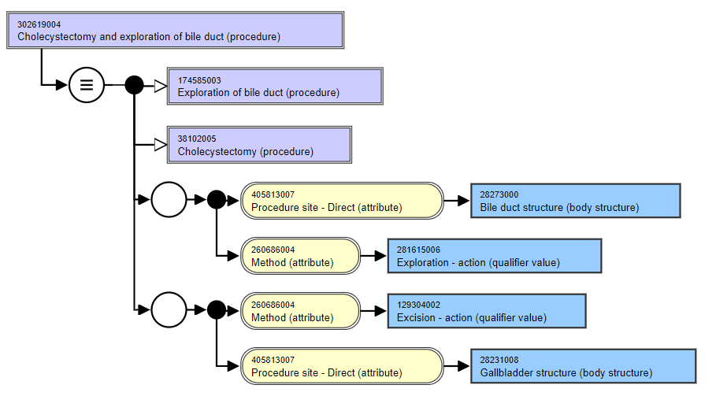
Standards in health informatics
Vocabulary
Coding and classification systems used to describe diseases, findings, procedures, medications, among others.
Examples:
ICD-10
SNOMED-CT
RxNorm
LOINC
ATC

Slide 7
Proposed AI Solution
Capabilities powered by Large Language Models (LLMs) in processing and understanding medical data.
French language AI models.
French language-based web interfaces to upload documents and enabling conversational bot.
RAG (Retrieval Augmented Generation) solution (to maintain data privacy and security)
Use of on-premises deployment solution for data security
Anonymised data and database for data privacy
Semantic similarity for evaluation metrics.
Standardized format for efficient retrieval and analysis of medical records.
Use of natural language to interact with the patient data.
Standardizing structured medical information from SNOMED (French version) to ensure consistency
Platform to support and facilitate clinical decisions, medical record management and monitoring.
Centralized and secured medical data repositories for healthcare institutions and researchers.

Slide 8
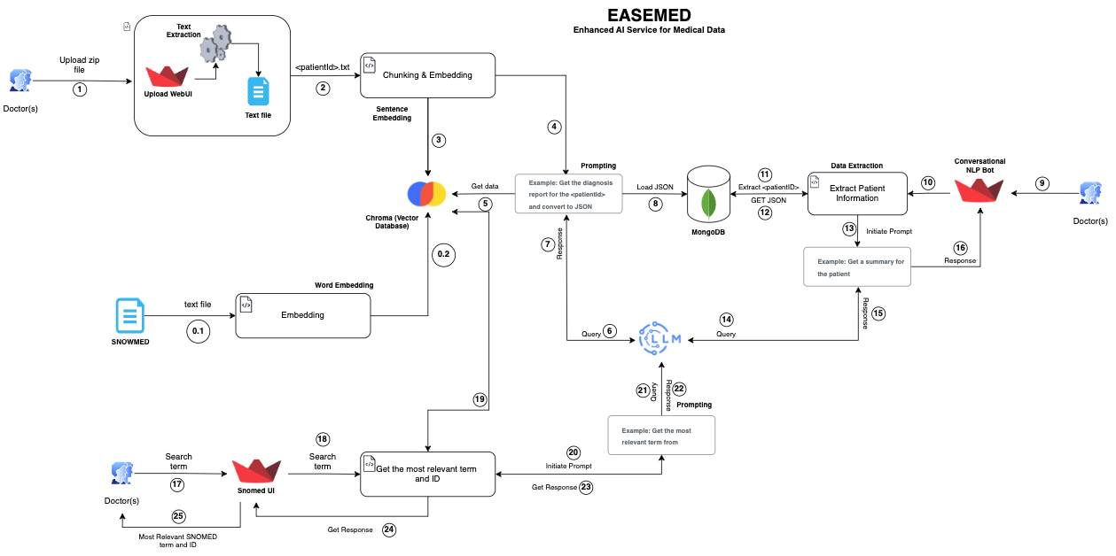
Technical Solution – Architecture (EASEMED)
Open and local deployment
Model: Mistral 7B (LangChain Framework)
Vector Database: ChromaDB
NoSQL Database: MongoDB
Embedding Model: sentence-camembert-large
Web Interface: Streamlit

Slide 9

What does the solution bring?
Below are some of the benefits that healthcare industry could see with this AI powered solution.
Quality of Care
Necessary to ensure continuity of care between centers.
Efficiency and Cost Reduction
Reduce redundancy of tests and procedures
Investigation and development
Facilitates data researchers, thus enabling research and development in health technologies

Slide 10
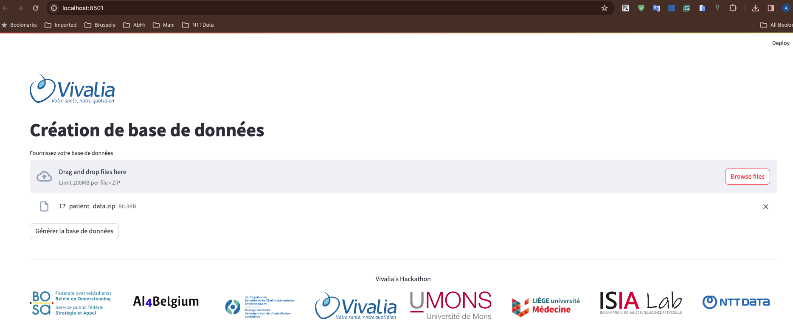
Web Interface 1 – Upload document

Slide 11
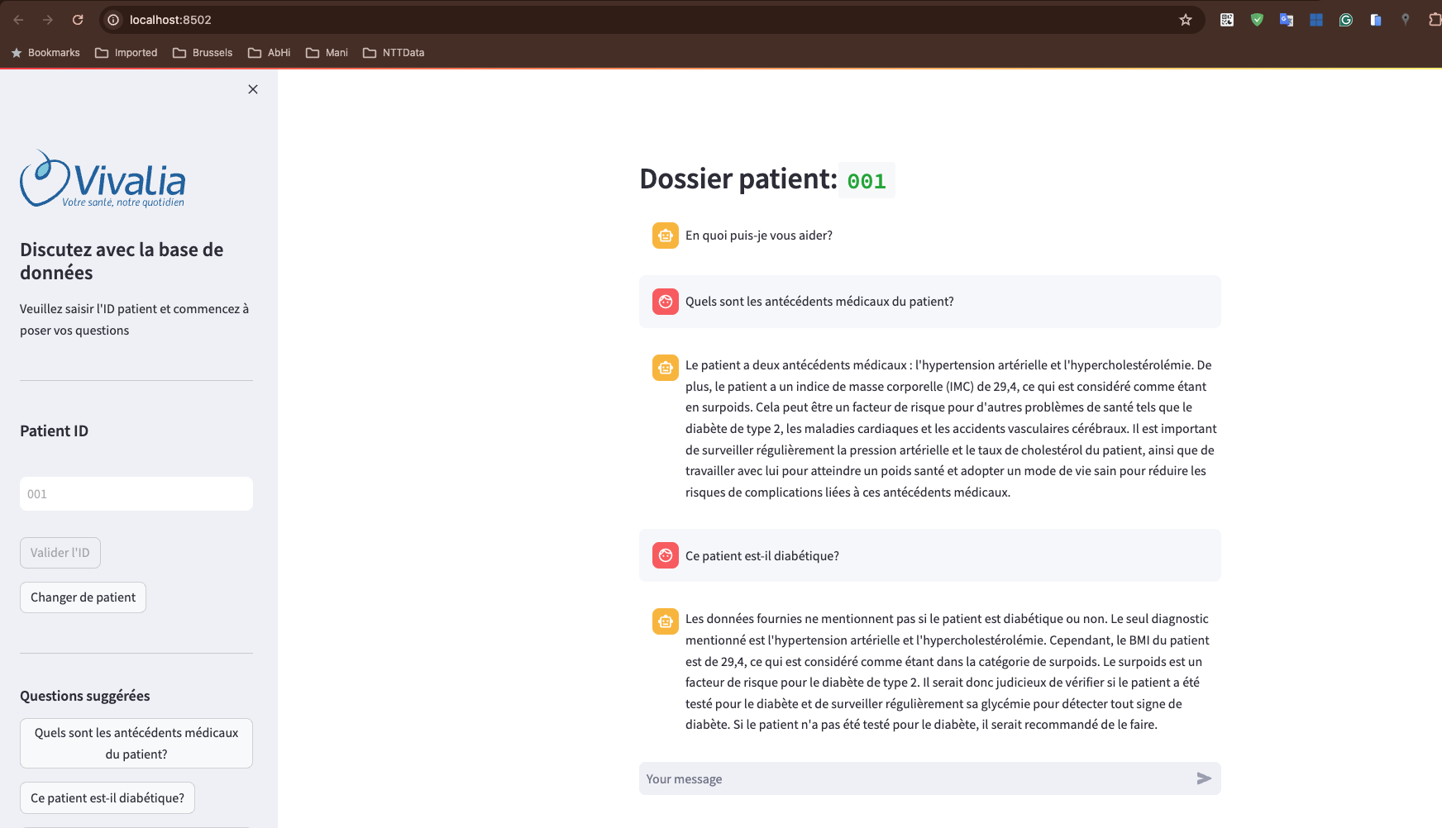
Web Interface 2 – Chatbot

Slide 12
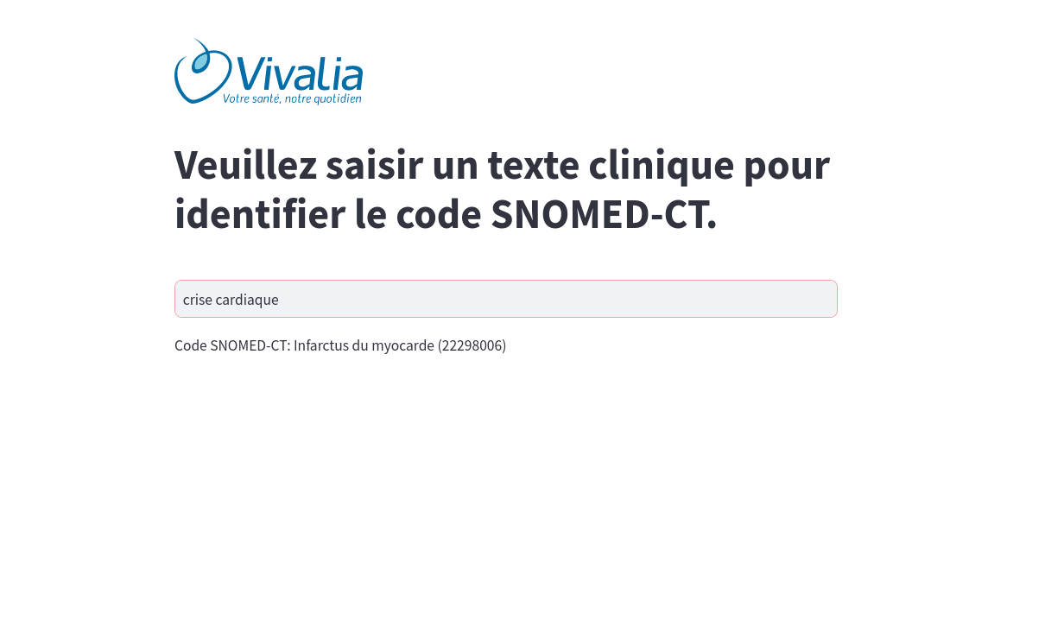
Web Interface 3 – AI Assistant SNOMED

Slide 13
DEMO TIME

Slide 14
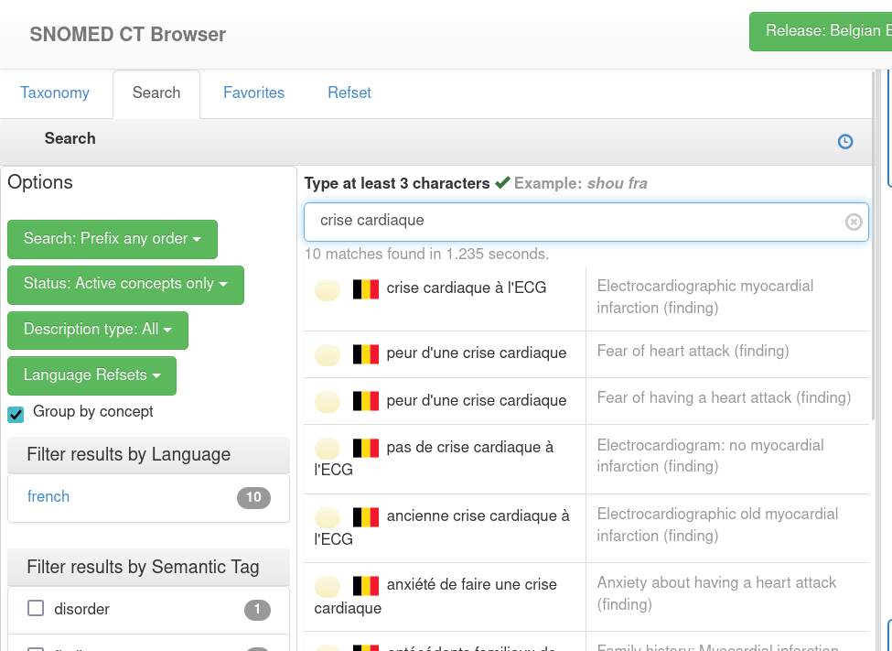
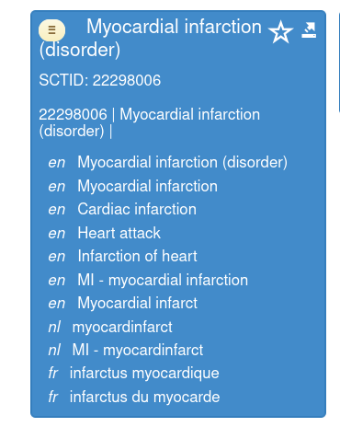
Why additional SNOMED UI?

Slide 15
Next Phase
Scalable platform for on-premises or cloud (if required) solutions.
Building entire solutions using open-source technologies.
Focus on data privacy and security (accessibility for internal healthcare professionals)
High focus on GDPR and AI Act Regulation
Complete integration with the full SNOMED knowledge base and other medical standards.
Expand the scope to cover other medical conditions such as treatments, medications, etc.
Centralized medical data repositories for healthcare institutions and researchers.
Fine-tune models with validation and metrics to remove any hallucination or bias
Possibility of extending use across different languages, enabling multilingual support.
Building large centralized platforms at the hospital-level or nationwide-level.
Conversational memory-based chatbots.

Slide 16
THANK YOU
https://github.com/giovannibriganti/smartnation-health

