Slide 1
SmartNation AI Hackathon

Slide 2
The Challenge
Unstructured content in Electronic Patient Record (EPR)
Limited reusability
Encoding repetition
Loss of patient information and efficiency
Lots of un-structured documents still to be added
Facing the same complexity

Slide 3
Our Translated Objective
Automated tools based on LLMs
Structure given documents
Standardize the structured information according to SNOMED CT terminology
Use case: natural language query patient information
Potential applications of the tool
Extended tools to build large databases for EPR at hospital-level or nationwide-level
Cross-language application
Database for research purposes

Slide 4
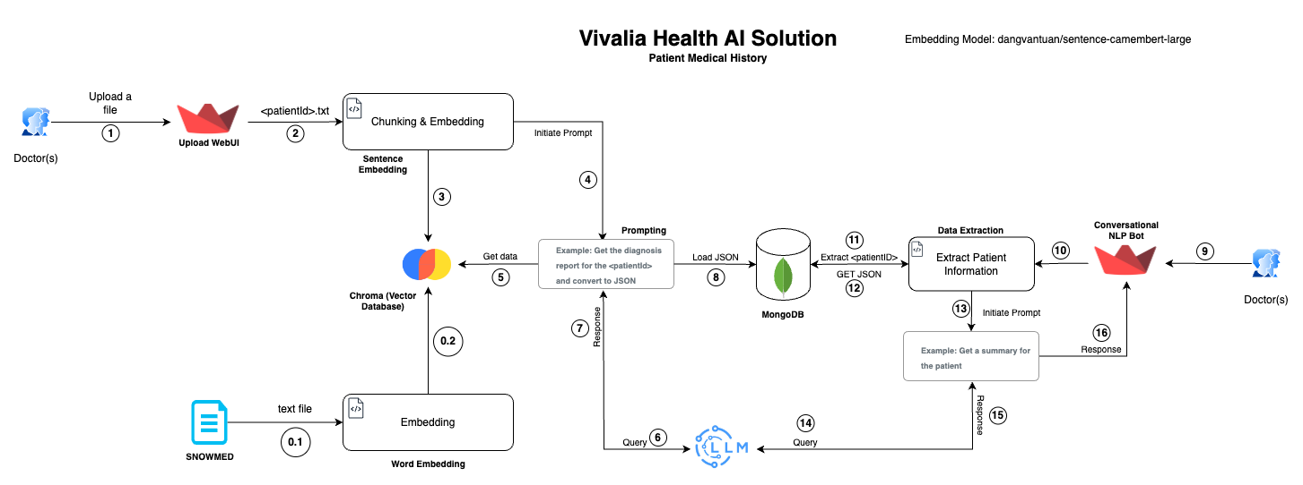

Slide 5
Technical Background
Open-source solution
Chunking and embedding for text preparation (LangChain)
Vector database (Chroma)
Local patient record storage (MongoDB Community Server)
LLMs for querying (Mistral and Llama 2 – 7B parameters)
Inherent risks
Built and tested only with sample data in French
Accuracy linked to chosen LLM and pre-trained parameters
--> More comprehensive testing in the future

Slide 6
Deployment Perspective
Close and secure production environment for privacy purposes
Anonymized database
To be linked identifier database for medical consultancy
Ready to be used for research purposes
Potential applications of the tool
Extended tools to build large databases for EPR at hospital-level or nationwide-level
Cross-language application
Database for research purposes
Cost effective thanks to open-source
Light development and maintenance

Slide 7
Proof of Concept Demo
[INSERT VIDEO IF ANY]

