Slide 1
Data Scientist
Transform raw data into actionable insights that drive strategic decisions and gain a competitive edge
Prepared by Cheryl Smart

Slide 2
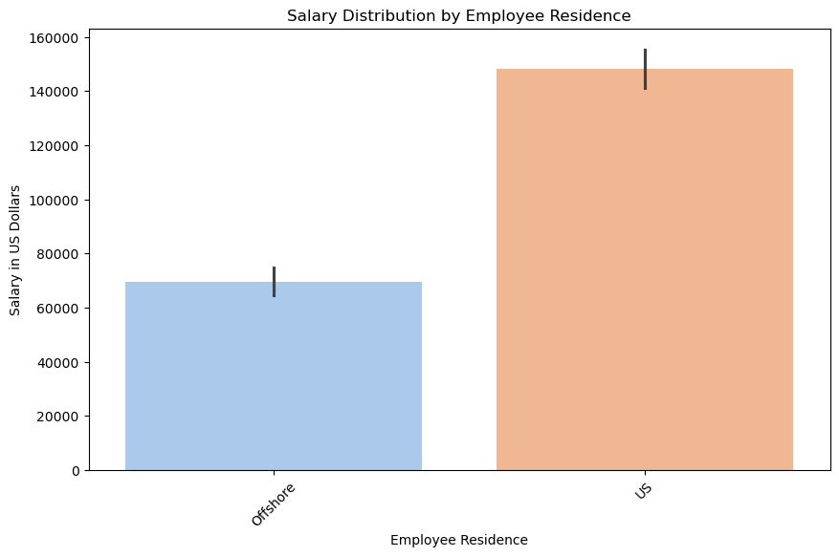
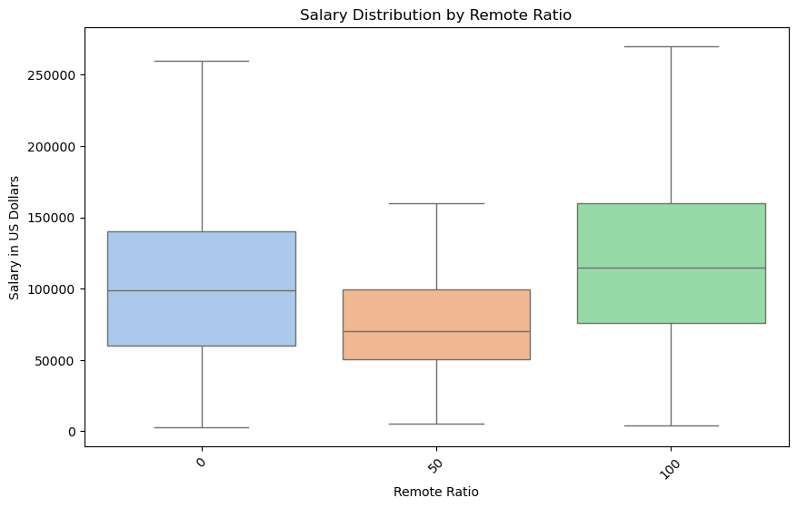

Slide 3
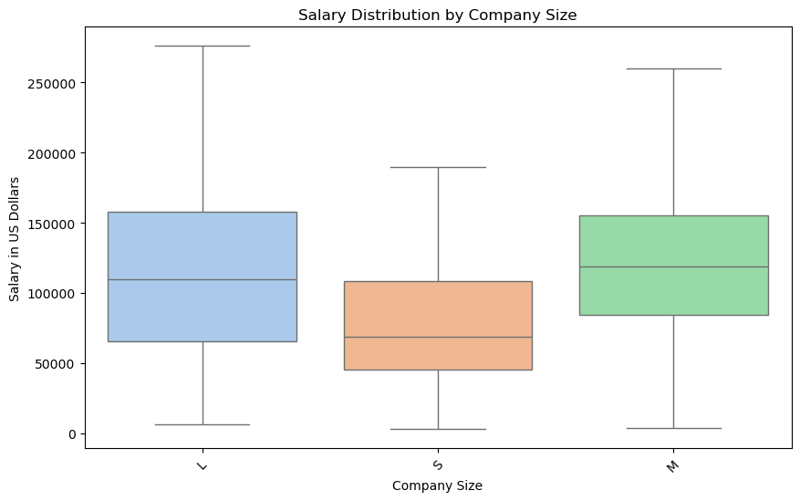
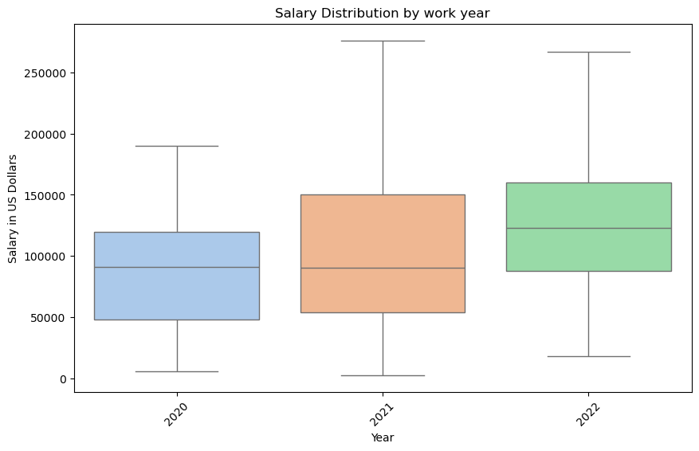

Slide 4
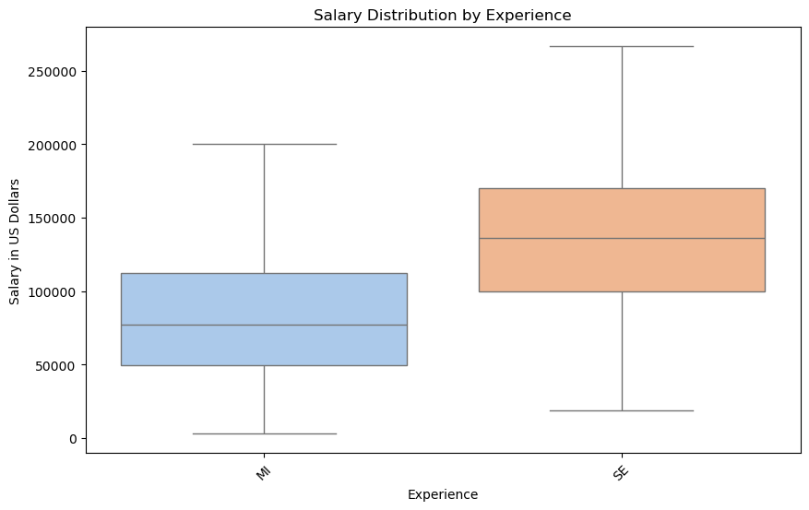
Range for Mid-level
$50,000-112,500
Range for Senior-level
$100,000-$170,000

