Slide 1





Gallery Walk/ Chat Stations
Deepening Understanding and Use
of the
Formative Assessment Process

Slide 2
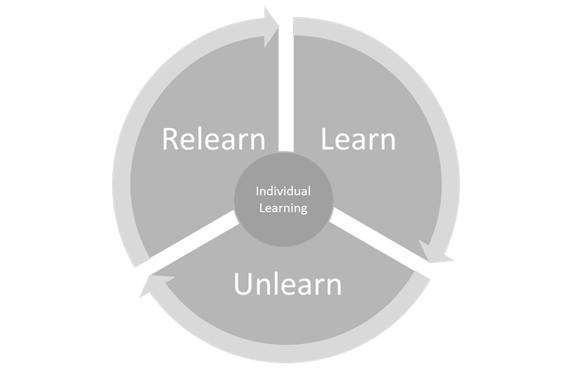
Notes:
Article from Forbes about Learn, Unlearn, Relearn Concept.
https://www.forbes.com/sites/margiewarrell/2014/02/03/learn-unlearn-and-relearn/#6b5e2c90676f
Learning is up to the individual. For this activity, ask educators to think about their learning needs and ask them to be aware of what they already know and open to new understandings. Some information will be new, some will challenge what we already believe, and some will adapt and deeping our understanding.

Slide 3
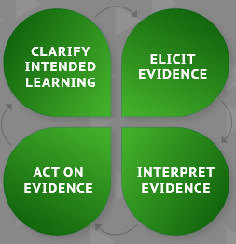
Clarify Intended Learning
Learning Goal: Participants will deepen understanding of the formative process
Success Criteria: (looks like, sounds like, feels like)
establish together
Notes:
Prior to getting started, share the graphic organizer and establish the success criteria together. Depending on the levels of previous understanding for participants, the Success Criteria may be difference for those who are new to this topic and those who already have a deep understanding. By establishing the success criteria for this activity together, participants are able to take charge of their learning.

Slide 4
Using Data to Inform Instruction
Guiding Questions:
How does this data apply to instructional practices?
How will you apply this data as you create resources?
How will you apply this data in your current role?
What will you share about this data with others?
Review Data Charts (2 minutes)
Discuss (5 minutes)
Reflect/Jot Notes (1 minute)

Slide 5
“Those given feedback as marks are likely to see it as a way to compare themselves with others (ego-involvement), those given only comments see it as helping them to improve (task-involvement): the latter group out-perform the former.”
“Feedback given as rewards or grades enhances ego rather than task involvement.”
Data and Quotes from: Butler, R. (1987). Task-involving and ego-involving properties of evaluation: Effects of different feedback conditions on motivational perceptions, interest, and performance. Journal of educational psychology, 79(4), 474.

Slide 6
“When teachers were required to employ data-utilization rules, effect sizes were higher than when data were evaluated by teacher judgement. Data-evaluation rules required practitioners to analyze student performance at regular intervals and, if the data suggested certain patterns, to introduce instructional changes into a student’s educational program.”
Data and Quote from: Fuchs, L. S., & Fuchs, D. (1986). Effects of systematic formative evaluation: A meta-analysis. Exceptional children, 53(3), 199-208.

Slide 7
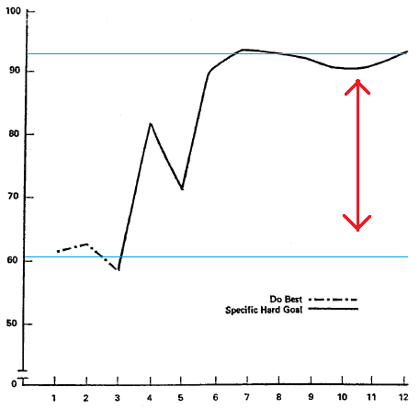
Effect of Goal Setting on Performance
Specific and challenging goals are more effective than vague and easy ones.
Effective goals are SMART
Specific
Measureable
Attainable
Relevant
Time-Bound
Performance
Told, “Just do your best”
Given a specific & challenging goal
Time (weeks)
From Latham, G. P., & Kinne, S. B. (1974). Improving job performance through training in goal setting. Journal of Applied Psychology, 59(2), 187.

Slide 8
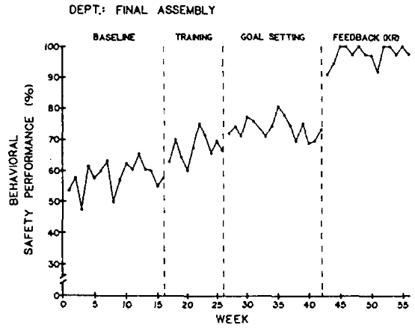
Relationship Between Goal-Setting and Feedback
For goals to be effective, people need feedback that reveals their performance relative to the goal. If they do not know how they are doing, it is difficult or impossible for them to adjust their performance.
Locke, E. A., Shaw, K. N., Saari, L. M., & Latham, G. P. (1981). Goal setting and task performance: 1969–1980. Psychological bulletin, 90(1), 125.
Reber, R. A., Wallin, J. A., & Chhokar, J. S. (1990). Improving safety performance with goal setting and feedback. Human Performance, 3(1), 51-61.

Slide 9

Formative Assessment Process Updated Flier
Practices Tasks (your choice):
Create a 30-60 second elevator speech describing the formative assessment process.
Restate the definition of the formative assessment process in your own words (new SNEs).
Restate AND dive deeper into the four attributes of the formative assessment process and explain how it can improve student learning outcomes (experienced SNEs).
Review Flier (2 minutes)
Practice Tasks (5 minutes)
Share with a partner (1 minute)

Slide 10
Success Criteria and Student Self-Evaluation—Video
Purpose: Close Viewing Questions
What does the teacher do to support student self-evaluation in the classroom?
What is success criteria and how is it explicitly connected to high quality student learning?
How do these two videos complement each other as a professional learning resource?
Review Purpose (30 seconds)
Watch Videos & Jot Notes (6 minutes)
Discuss (1.5 minutes)

Slide 11
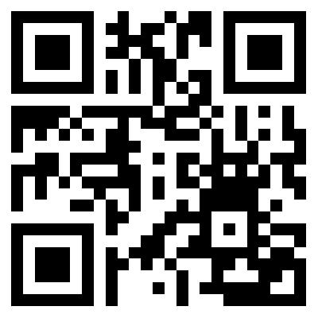
Success Criteria and Student Self-Evaluation—Video
Video #1: Student Self-Evaluation Classroom Video

Slide 12
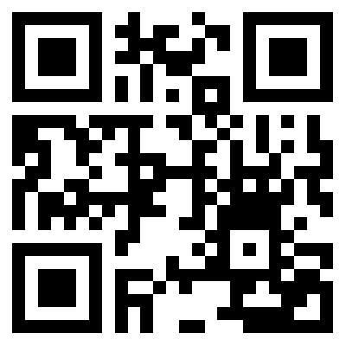
Success Criteria and Student Self-Evaluation—Video
Video #2: What on Earth are Success Criteria

Slide 13
Using Technology as a Tool to enhance the Formative Assessment Process
Process for Sharing:
Start with Silent Sharing or Review:
Add to the list of tech resources that you use in your classroom on the poster (if already there, add a tally).
or
Search and review one of the listed options.
Share/Discuss Tech Options:
Benefits
Options
Uses
Silent Share/Review (2 minutes)
Discuss Tech Options (5 minutes)
Jot a resource to try (1 minute)

Slide 14

Text as Expert—Quote Jigsaw
Jigsaw Protocol:
Identify 1-2 quotes to share out and discuss from your excerpt.
Share quote and reason for selecting.
Discuss how you will apply information to your current role and with colleagues.
Record any quotes that resonate with you.
Read Excerpt (3 minutes)
Share Quotes & Discuss (4 minutes)
Jot Down Quotes (1 minute)

