Slide 1
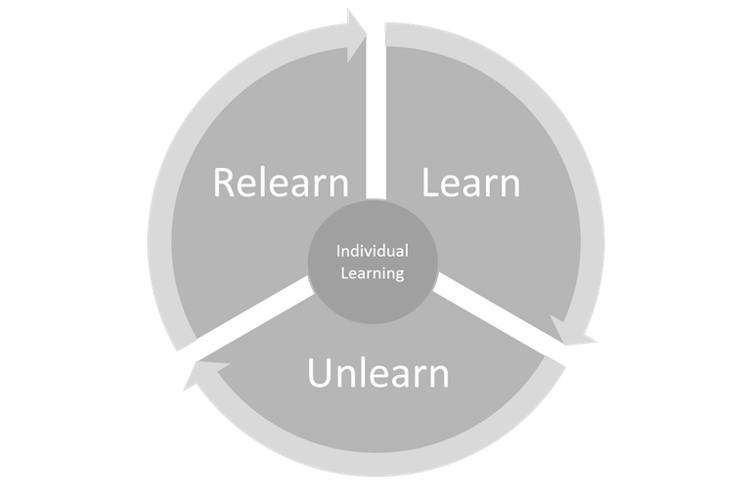
Focus on Feedback
Professional
Learning
Providing Feedback to Students and to Each Other
Notes:
Reminder: All professional learning is personal. The individual learner is at the center of the experience and will get of this opportunity what he or she puts into it. We all come to the table with different experiences, past learning, etc. Thus, it is important to remember and be attentive to what is “new learning,” what is “re-learning,” and what is something that we may need to “un-learn” (possibly a past misconception or a new shift in thinking).

Slide 2
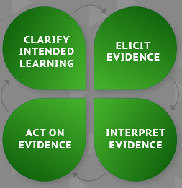
Clarify Intended Learning
Learning Goal:
Participants will develop and/or deepen their understanding of the types of feedback we give and receive as educators.
Success Criteria:
Explain the types of different types of feedback, (e.g. evaluative, task, process, self-regulation, ego-based, and descriptive feedback).
Apply understanding of the different types of feedback into teacher practice with students and colleagues.
Notes:
Clarify intended learning with learners. Review the learning goals and the success criteria.

Slide 3
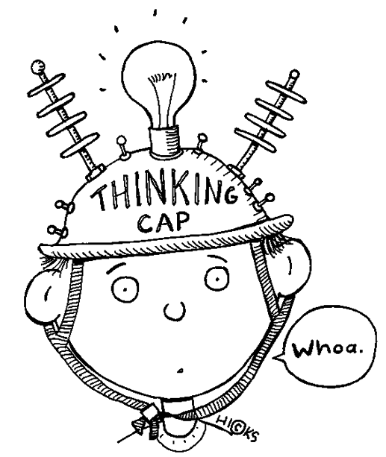

Activating Prior Knowledge Think about a time…
Example: a time when feedback impacted your attainment of a goal.
Non-example: a time when you did not receive feedback and you needed it to improve your performance toward a goal.
1 Minute Timer
Notes:
Activate prior knowledge. Think about a time when feedback impacted you. It could be feedback that helped you attain a goal. Or, a non-example when feedback was given, but it wasn’t helpful, meaning that it did not impact future performance/practice.

Slide 4
Focus on Feedback Training Overview
4 Videos
Guided Viewing Qs
Discuss & Reflect
Notes:
Provide an overview of the learning activity. We will view 4 videos with a purpose using guiding questions and we will have a brief opportunity to discuss and reflect on the content in the video after each one with a partner.

Slide 5


Options for Viewing
See
Hear
View with whole group
Use your handheld device and scan the QR code (earphones needed)
Use the word doc to access video on computer (earphones needed)
Notes:
Provide viewing options as needed for learners and the environment for viewing.
Using the viewing guide, participants can view each video individually using the QR code. This can be used during the initial viewing activity or post viewing as educators review the videos to deepen their learning. Each viewing will prompt new layers for understanding and use.

Slide 6

Feedback on Learning with Dylan Wiliam 3:17 minutes
Notes:
Set up each video with a brief look at the viewing questions. These are look-fors while viewing. Learners may want to jot down some notes during viewing. View the short clip, then provide 3 minutes of discussion time with a partner.
Video Embedded
Feedback on Learning with Dylan Wiliam
https://www.youtube.com/watch?v=MzDuiqaGqAY
3:17 minutes
Read Question
3 minutes to Discuss
Attention Grabber

Slide 7
The Power of Feedback 3.26 minutes
Notes:
Set up each video with a brief look at the viewing questions. These are look-fors while viewing. Learners may want to jot down some notes during viewing. View the short clip, then provide 3 minutes of discussion time with a partner.
Video Embedded
The Power of Feedback (based on research by John Hattie and Helen Timperley)
https://www.youtube.com/watch?v=S770g-LULFY
3:26 minutes
Read Question
3 minutes to Discuss
Attention Grabber

Slide 8
Types of Feedback for Students 2:45 Minutes
Notes:
Set up each video with a brief look at the viewing questions. These are look-fors while viewing. Learners may want to jot down some notes during viewing. View the short clip, then provide 3 minutes of discussion time with a partner.
Video Embedded
Types of Feedback for Students (Teacher Solutions)
https://www.youtube.com/watch?v=m-_ZyUSq3Lg
2:45 minutes

Slide 9

The Classroom Experience 7:14 minutes
Notes:
This is a longer video. Learners may want to view the clip in its entirety on their own later. This video is a bit longer than the other three. Review the questions, view, and provide 3 minutes to discuss.
Video not embedded. Link will start at 43.20
The Classroom Experiment (Dylan Wiliam, Ep.1)
https://youtu.be/J25d9aC1GZA?t=2601
59 minutes—start clip at 43:20 End clip at 50:06
Read Question
3 minutes to Discuss
Attention Grabber
https://youtu.be/J25d9aC1GZA?t=2603

Slide 10
Review Success Criteria
Explain the different types of feedback (e.g. evaluative, task, process, self-regulation, ego-based, and descriptive feedback).
Apply understanding of the different types of feedback into teacher practice with students and colleagues.
Notes:
Review success criteria. Ask learners to self-identify where they are on success criteria.
Question 1 (Explain)
Option 1: Thumbs up, down, sideways—can they explain at least two different types of feedback?
Option 2: Fist to five—ask learners to identify how many different types of feedback they can now explain. Fist is zero. Five is five different types. Use this information to determine next steps in professional learning on feedback.
Question 2 (Application)
Option 1: Ask how likely learners are to use one of the different types of feedback with students or colleagues today/tomorrow.
Option 2: Observe over the next few days and collect examples of educators using the different types of feedback. This could be done in peer observations, self-identification, etc.

Slide 11
Focus on Feedback
Professional
Learning
1 minutes 2 minutes
Notes:
Wrap up learning by reflection on the professional learning experience. As individuals, learners should reflect on the following: What did the learner learn, un-learn, and/or relearn?

