Slide 1

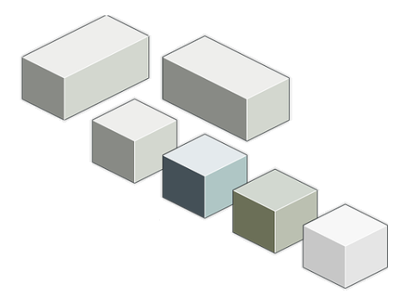
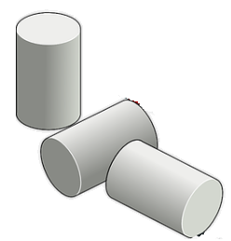
Any Way You Slice It
Slicing a Solid and Finding a Two-Dimensional Shape

Slide 2
Common Core State Standard
7.G.A.3 Describe the two-dimensional figures that result from slicing three-dimensional figures, as in plane sections of right-rectangular prisms and right-rectangular pyramids.

Slide 3
Learning Goal
Students will describe two-dimensional figures that result from slicing prisms and pyramids by planes.
Notes:
Teacher Notes: Before beginning the assignment, have students identify/predict what two dimensional shapes could be found from slicing three dimensional geometric solids. Have some three-dimensional geometric shapes available for students to see before starting the lesson.

Slide 4
Success Criteria
I can identify two-dimensional shapes from slicing rectangular prisms and pyramids.
I can explain how I arrived at those shapes.

Slide 5
Warm-Up Activity for Whole Class
The teacher will slice an apple to show different cross sections. If there is time, paint can also be used to make a stamp of the cross section.
Notes:
Teacher Notes: During this activity, the teacher could be asking questions in a whole-group setting to check for understanding.

Slide 6



Cross Section Images
Notes:
Teacher Notes: Slide to show an example of a cross section.

Slide 7
Introduce the Lesson
In this activity, students are given clay/playdough and a piece of wire/dental floss for cutting prisms and pyramids. Students are asked to draw cross sections freehand, but this is not a skill that is required in order for students to be able to describe two-dimensional shapes.
Students describe how the cross section changes as the plane moves.

Slide 8
Directions:
1. Work in pairs and first construct a rectangular prism out of clay.
2. Use a wire/dental floss and make a continuous slice through the rectangular prism.
3. Pull apart the slice and identify the two-dimensional geometric shape that is made by the slice and record results on the worksheet.
Notes:
Teacher Notes: Pair students up using the List of Polygons and Sides resource in the Student Materials and Additional Resources Links section of the resource. Students will need to match their shape with someone else in class that has the correct number of sides for that shape.
Distribute the worksheets (At Level, Below Level, Above Level) to student groups based on skill. Give students 3–5 minutes of quiet work time followed by time to discuss shapes of cross sections with a partner. Follow with a whole-class discussion.Teacher can circulate around the room checking in with each group for understanding and misconceptions.

Slide 9
Directions:
4. Repeat the process to find at least three two-dimensional geometric shapes from the clay rectangular prism.
5. Construct a rectangular pyramid out of clay and repeat the process that was used for slicing the rectangular prism.

Slide 10
Exit Ticket
What did you notice when you sliced a rectangular prism?
What did you notice when you sliced a rectangular pyramid?
What is a cross section?
Notes:
Teacher Notes: Exit Ticket slide can be printed and handed out to students to check for understanding and any misconceptions.

Slide 11
Teacher Next Steps
The following resources can be used for students who need additional support or for an extension:
Complete a practice worksheet using prisms or pyramids.
Complete a practice worksheet using cylinder, cones, and spheres.
Edulastic Formative Assessment
Notes:
Teacher Notes: These worksheets can be found in “Student Materials and Additional Resources Links.”

