Slide 1
Software Testing and Quality Assurance Theory and Practice Chapter 4 Control Flow Testing
Notes:
------------------------------------------------------------------
------------------------------------------------------------------
-------------------------------------------------------------------
--------------------------------------------------------------------
1

Slide 2
Outline of the Chapter
Basic Idea
Outline of Control Flow Testing
Control Flow Graph
Paths in a Control Flow Graph
Path Selection Criteria
Generating Test Input
Containing Infeasible Paths
Summary

Slide 3
Basic Idea
Two kinds of basic program statements:
Assignment statements (Ex. x = 2*y; )
Conditional statements (Ex. if(), for(), while(), …)
Control flow
Successive execution of program statements is viewed as flow of control.
Conditional statements alter the default flow.
Program path
A program path is a sequence of statements from entry to exit.
There can be a large number of paths in a program.
There is an (input, expected output) pair for each path.
Executing a path requires invoking the program unit with the right test input.
Paths are chosen by using the concepts of path selection criteria.
Tools: Automatically generate test inputs from program paths.
Notes:
Tools are being developed to support control flow testing [9]. Such tools identify paths from a program unit based on a user-defined criterion, generate the corresponding input
to execute a selected path, and generate program stubs and drivers to execute the test. Control flow testing is a kind of structural testing, which is performed by programmers to test code written by them. The concept is applied to small units of code, such as a function. Test cases for control flow testing are derived from the source code, such as a program unit (e.g., a function or method), rather than from the entire program.

Slide 4
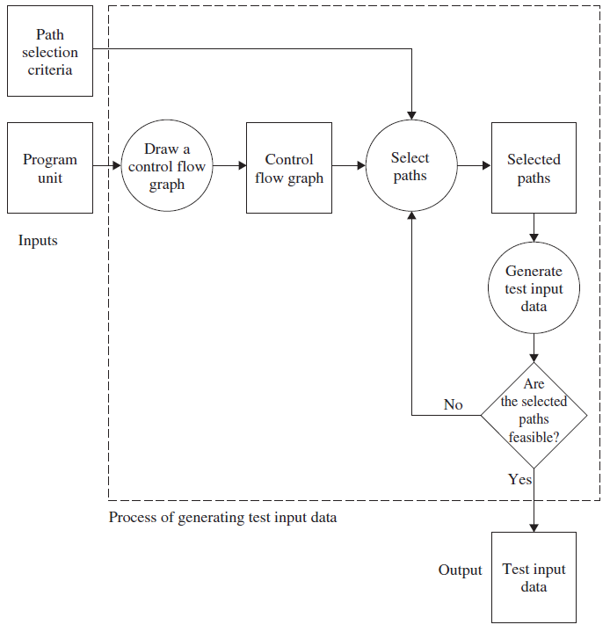
Outline of Control Flow Testing
Figure 4.1: The process of generating test input data for control flow testing.

Slide 5
Outline of Control Flow Testing
Inputs to the Generation Test Input Data process
Source code
Path selection criteria: statement, branch, … e.g., Select paths such that every statement is executed at least once
Generation of control flow graph (CFG)
A CFG is a graphical representation of a program unit. Used to visualize all the paths in a program unit
Several tools exist to draw CFGs. (You can draw one by hand.)
Selection of paths
Paths are selected from the CFG to satisfy the path selection criteria
Feasibility Test of a Path: check if selected path meets the path selection criteria
Two kinds of paths
Executable path: There exists input so that the path is executed.
Infeasible path: There is no input to execute the path.
Generation of test input data
Solve the path conditions to produce test input for each path.

Slide 6
Control Flow Graph
if (i) ;
if (i) ; else ;
if (i && j) ;
if (i || j) ;
do ; while (i);
while (i) ;
switch(i) { case 0: break; ... }

Slide 7
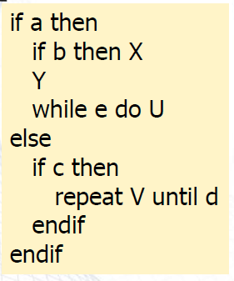
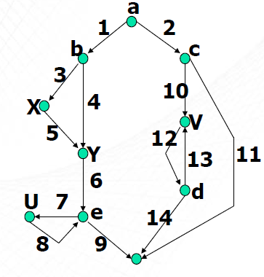
Control Flow Graph .. Example 1

Slide 8
Control Flow Graph … .. Example 1
Example code: openfiles()
FILE *fptr1, *fptr2, *fptr3; /* These are global variables. */
int openfiles(){
/*
This function tries to open files "file1", "file2", and "file3"
for read access, and returns the number of files successfully
opened. The file pointers of the opened files are put in the
global variables.
*/
int i = 0;
if(
((( fptr1 = fopen("file1", "r")) != NULL) && (i++) && (0)) ||
((( fptr2 = fopen("file2", "r")) != NULL) && (i++) && (0)) ||
((( fptr3 = fopen("file3", "r")) != NULL) && (i++))
);
return(i);
}
Figure 4.3: A function to open three files.

Slide 9
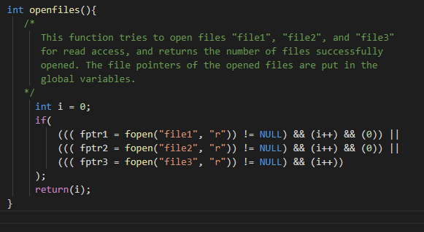
Control Flow Graph
Figure 4.4: A high-level CFG representation of openfiles().

Slide 10
Control Flow Graph
A closer examination of the condition part of the if() statement reveals that there are not only Boolean and relational operators in the condition part, but also assignment statements. Some of their examples are given below:
Assignment statements: fptr1 = fopen(“file1”, “r”) and i++
Relational operator: fptr1! = NULL
Boolean operators: && and ||

Slide 11
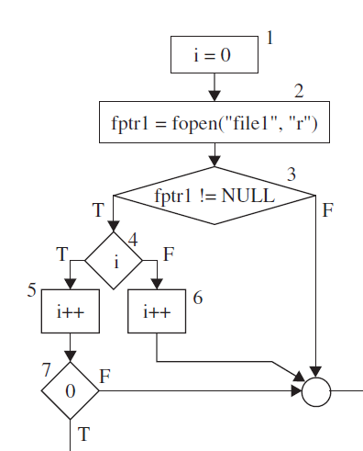
((( fptr1 = fopen("file1", "r")) != NULL) && (i++) && (0))
The above condition is executed as follows:
Execute the assignment statement fptr1 = fopen(“file1”, “r”).
Execute the relational operation fptr1! = NULL.
If FALSE , skip the evaluation of the subsequent condition components
If TRUE, then first i is evaluated to true or false. Irrespective of the outcome of this evaluation, the next statement executed is (i++).
If i has evaluated to true, then the condition (0) is evaluated. Otherwise, evaluation of (0) is skipped.

Slide 12
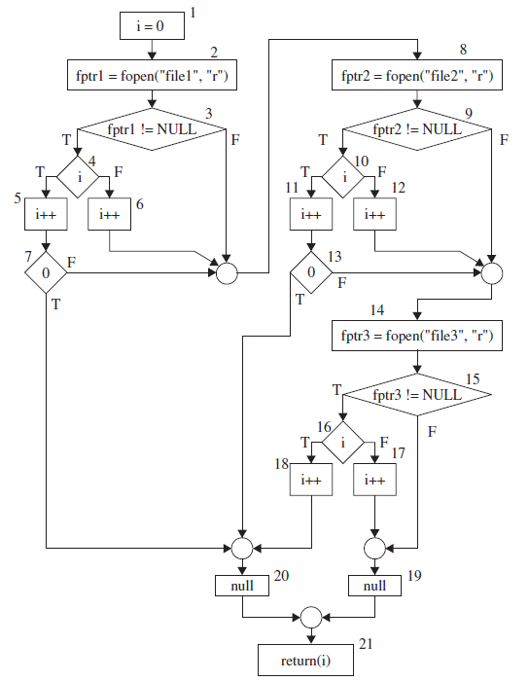
Control Flow Graph
Figure 4.5: A detailed CFG representation of openfiles().

Slide 13
Control Flow Graph- Example code: ReturnAverage()
public static double ReturnAverage(int value[], int AS, int MIN, int MAX){
/* Function: ReturnAverage Computes the average of all those numbers in the input array in the positive range [MIN, MAX]. The maximum size of the array is AS. But, the array size could be smaller than AS in which case the end of input is represented by -999. */
int i, ti, tv, sum;
double av;
i = 0; ti = 0; tv = 0; sum = 0;
while (ti < AS && value[i] != -999) {
ti++;
if (value[i] >= MIN && value[i] <= MAX) {
tv++;
sum = sum + value[i];
}
i++;
}
if (tv > 0)
av = (double)sum/tv;
else
av = (double) -999;
return (av);
}
Figure 4.6: A function to compute the average of selected integers in an array.

Slide 14
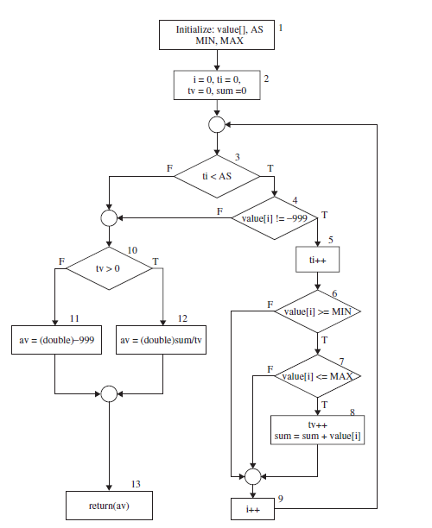
Control Flow Graph
Figure 4.7: A CFG representation of ReturnAverage().

Slide 15
Paths in a Control Flow Graph
A few paths in Figure 4.7. (Table 4.1)
Path 1: 1-2-3(F)-10(T)-12-13
Path 2: 1-2-3(F)-10(F)-11-13
Path 3: 1-2-3(T)-4(T)-5-6(T)-7(T)-8-9-3(F)-10(T)-12-13
Path 4: 1-2-3(T)-4(T)-5-6-7(T)-8-9-3(T)-4(T)-5-6(T)-7(T)-8-9-3(F)-10(T)-12- 13

Slide 16
Path Selection Criteria
Program paths are selectively executed.
Question: What paths do I select for testing?
The concept of path selection criteria is used to answer the question.
Advantages of selecting paths based on defined criteria:
Ensure that all program constructs are executed at least once.
Repeated selection of the same path is avoided.
One can easily identify what features have been tested and what not.
Path selection criteria
Select all paths.
Select paths to achieve complete statement coverage.
Select paths to achieve complete branch coverage.
Select paths to achieve predicate coverage.

Slide 17
Path Selection Criteria
If all the paths in a CFG are selected, then one can detect all faults, except those due to missing path errors
However, a program may contain a large number of paths, or even an infinite number of paths
E.g., openfiles() function contains more then 25 Paths.
One does not know whether or not a path is feasible at the time of selecting paths, though only eight of all those paths are feasible.
If one selects all possible paths in a program, then we say that the all-path selection criterion has been satisfied.
Let us consider the example of the openfiles() function for feasible path selection.
This function tries to open the three files file1, file2, and file3.
The function returns an integer representing the number of files it has successfully opened.
A file is said to be successfully opened with “read” access if the file exists.
The existence of a file is either “yes” or “no.”
Thus, the input domain of the function consists of eight combinations of the existence of the three files,

Slide 18
Path Selection Criteria
input domain of the function consists of eight combinations of the existence of the three files
We can trace a path in the CFG of Figure 4.5 for each input, i.e., each row of Table 4.2..
Existence of “file1” | Existence of “file2” | Existence of “file3”
No | No | No
No | No | Yes
No | Yes | No
No | Yes | Yes
Yes | No | No
Yes | No | Yes
Yes | Yes | No
Yes | Yes | Yes

Slide 19
Path Selection Criteria
In this manner, we can identify eight possible paths in Figure 4.5.
The all-paths selection criterion is desirable since it can detect faults; however, it is difficult to achieve in practice.
Input | Path
<No, No, No> | 1-2-3(F)-8-9(F)-14-15(F)-19-21
<Yes, No, No> | 1-2-3(T)-4(F)-6-8-9(F)-14-15(F)-19-21
<Yes, Yes, Yes> | 1-2-3(T)-4(F)-6-8-9(T)-10(T)-11-13(F)-14- 15(T) -16(T)-18-20-21

Slide 20
Statement Coverage Criterion
Statement coverage criterion
100% statement coverage means all the statements have been executed at least once.
Cover all assignment statements.
Cover all conditional statements.
Less than 100% statement coverage is unacceptable.
We follow these rules while selecting paths:
Select short paths.
Select paths of increasingly longer length. Unfold a loop several times if there is a need.
Select arbitrarily long, “complex” paths.
One can select the two paths shown in ReturnAverage(). to achieve complete statement coverage.
Table 4.4: Paths for statement coverage of the CFG of Figure 4.7.
SCath1 | 1-2-3(F)-10(F)-11-13
SCPath2 | 1-2-3(T)-4(T)-5-6(T)-7(T)-8-9-3(F)-10(T)-12-13

Slide 21
Branch Coverage Criterion
Branch coverage criterion
A branch is an outgoing edge from a node in a CFG.
A condition node has two outgoing branches – corresponding to the True and False values of the condition.
Covering a branch means executing a path that contains the branch.
100% branch coverage means selecting a set of paths such that each branch is included on some path.

Slide 22
Path Selection Criteria
SCath1 | 1-2-3(F)-10(F)-11-13
SCPath2 | 1-2-3(T)-4(T)-5-6(T)-7(T)-8-9-3(F)-10(T)-12-13
Table 4.4: Paths for statement coverage
BCPath 1 | 1-2-3(F)-10(F)-11-13
BCPath 2 | 1-2-3(T)-4(T)-5-6(T)-7(T)-8-9-3(F)-10(T)-12-13
BCPath 3 | 1-2-3(T)-4(F)-10(F)-11-13
BCPath 4 | 1-2-3(T)-4(T)-5-6(F)-9-3(F)-10(F)-11-13
BCPath 5 | 1-2-3(T)-4(T)-5-6(T)-7(F)-9-3(F)-10(F)-11-13
Table 4.5: Paths for branch coverage of the flow graph of Figure 4.7

Slide 23
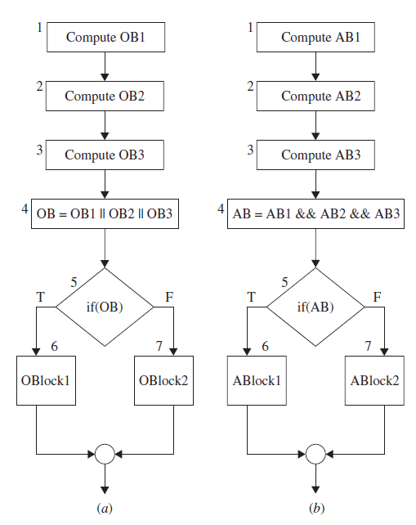
Predicate coverage
Predicate coverage criterion
If all possible combinations of truth values of the conditions affecting a path have been explored under some tests, then we say that predicate coverage has been achieved.
Figure 4.9: Partial control flow graph with (a) OR operation and (b) AND operation.
Notes:
Predicate nodes are decision points – Logical, return TRUE or FALSE.

Slide 24
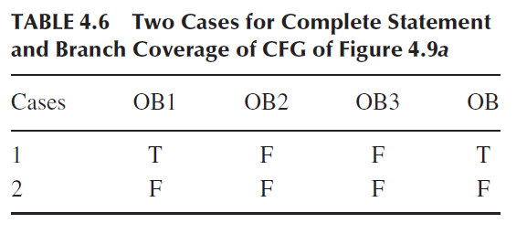
Predicate coverage
Assume OB/1/2/3 and Boolean
Node 5, evaluates to T or F under the conditions below
Only these two test cases are sufficient for branch coverage
The FALSE branch of node 5 is executed under exactly one condition, namely, when OB1/ OB2 and OB3 = F
whereas the TRUE branch executes under seven conditions
If all possible combinations of truth values of the conditions affecting a selected path have been explored under some tests, then we say that predicate coverage has been achieved

Slide 25
Generating Test Input
Having identified a path, a key question is how to make the path execute, if possible.
we need to identify inputs to force the executions of the paths.
Key concepts in generating test input data
Input vector
Predicate
Path Predicate
Predicate interpretation
Path predicate expression
Generating test input from path predicate expression

Slide 26
Generating Test Input
Input vector
collection of all data entities read by the routine whose values must be fixed prior to entering the routine.
Members of an input vector can be as follows.
Input arguments to the routine
Global variables and constants
Files
Contents of registers (in Assembly language programming)
Network connections
Timers
Example: An input vector for openfiles() consists of individual presence or absence of the files “files1,” “file2,” and “file3.”
Example: The input vector of ReturnAverega() shown in Figure 4.6 is {value[], AS, MIN, MAX}

Slide 27
Generating Test Input
Predicate
A predicate is a logical function evaluated at a decision point.
Example: ti < AS is a predicate in node 3 of Figure 4.7.
Example: The construct OB is a predicate in node 5 in Figure 4.9.
Path predicate
A path predicate is the set of predicates associated with a path.
Figure 4.10: An example path from Fig. 4.7:
1-2-3(T)-4(T)-5-6(T)-7(T)-8-9-3(F)-10(T)-12-13.
Figure 4.11: The path predicate for the path shown in Figure 4.10.
ti < AS ≡ True
value[i] != -999 ≡ True
value[i] >= MIN ≡ True
value[i] <= MAX ≡ True
ti < AS ≡ False
tv > 0 ≡ True

Slide 28
Generating Test Input
Predicate interpretation
A path predicate may contain local variables.
Example: <i, ti, tv> in Figure 4.11 are local variables.
Local variables play no role in selecting inputs that force a path to execute.
Local variables can be eliminated by a process called symbolic execution
For example, replace local variables with predicate elements of the input vector
symbolically substituting operations along a path in order to express the predicate solely in terms of the input vector and a constant vector.
Notes:
symbolic execution (also symbolic evaluation) is a means of analyzing a program to determine what inputs cause each part of a program to execute
The local variables are not visible outside a function but are used to
• hold intermediate results,
• point to array elements, and
• control loop iterations.

Slide 29
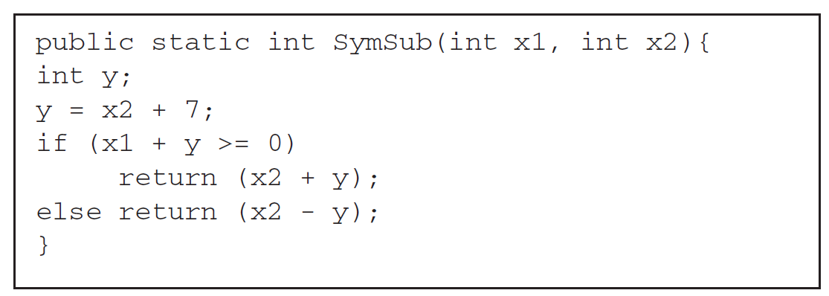
Generating Test Input – symbolic substitution
Predicate interpretation
Example of symbolic substitution
The input vector for the method is given by <x1, x2>. The method defines a local variable y and also uses the constants 7 and 0.
The predicate x1 + y >= 0 can be rewritten as x1 + x2 + 7 >= 0 |
by symbolically substituting y with x2 +7. The rewritten predicate x1 + x2 + 7 >= 0 has been expressed solely in terms of the input vector<x1,x2>and the constant vector<0,7>.
Notes:
Thus, predicate interpretation is defined as the process of symbolically substituting operations along a path in order to express the predicates solely
in terms of the input vector and a constant vector

Slide 30
Generating Test Input
Path predicate expression
An interpreted path predicate is called a path predicate expression.
A path predicate expression has the following attributes.
It is void of local variables.
It is a set of constraints in terms of the input vector, and [maybe] constants.
Path forcing inputs can be generated by solving the constraints.
If the set of constraints cannot be solved, there exist no input which can cause the selected path to execute. In other words, the selected path is said to be infeasible.
Figure 4.13: Path predicate expression for the path shown in Figure 4.10.
0 < AS ≡ True …… (1)
value[0] != -999 ≡ True …… (2)
value[0] >= MIN ≡ True …… (3)
value[0] <= MAX ≡ True …… (4)
1 < AS ≡ False …… (5)
1 > 0 ≡ True …… (6)
Notes:
The local variables are not visible outside a function but are used to
• hold intermediate results,
• point to array elements, and
• control loop iterations.

Slide 31
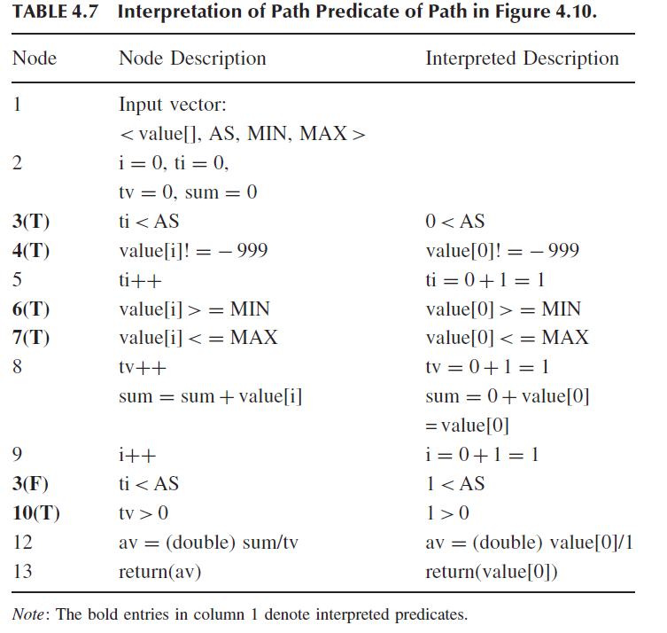

Slide 32
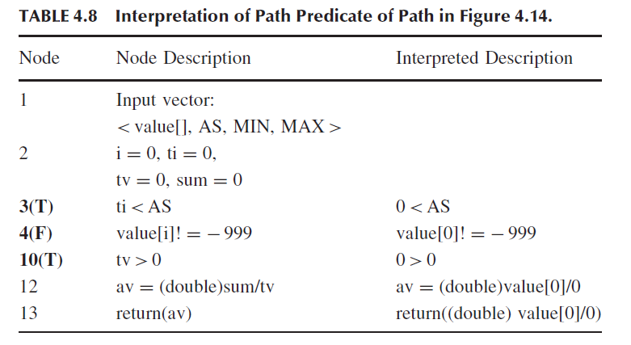
Generating Test Input
Path predicate expression
An example of infeasible path
Figure 4.14: Another example of path from Figure 4.7.
1-2-3(T)-4(F)-10(T)-12-13
Figure 4.15: Path predicate expression for the path shown in Figure 4.14.
0 < AS ≡ True …… (1)
value[0] != -999 ≡ True …… (2)
0 > 0 ≡ True …… (3)

Slide 33
Generating Test Input
Generating input data from a path predicate expression
Consider the path predicate expression of Figure 4.13 (reproduced below.)
0 < AS ≡ True …… (1)
value[0] != -999 ≡ True …… (2)
value[0] >= MIN ≡ True …… (3)
value[0] <= MAX ≡ True …… (4)
1 < AS ≡ False …… (5)
1 > 0 ≡ True …… (6)
One can solve the above equations to obtain the following test input data
AS = 1
MIN = 25
MAX = 35
Value[0] = 30
Note: The above set is not unique.

Slide 34
Containing Infeasible Paths
A program unit may contain a large number of paths.
Path selection becomes a problem. Some selected paths may be infeasible.
Apply a path selection strategy:
Select as many short paths as possible.
Choose longer paths.
There are efforts to write code with fewer/no infeasible paths.

Slide 35
Summary
Control flow is a fundamental concept in program execution.
A program path is an instance of execution of a program unit.
Select a set of paths by considering path selection criteria.
Statement coverage
Branch coverage
Predicate coverage
All paths
From source code, derive a CFG (compilers are modified for this.)
Select paths from a CFG based on path selection criteria.
Extract path predicates from each path.
Solve the path predicate expression to generate test input data.
There are two kinds of paths.
feasible
infeasible

